Slide 1
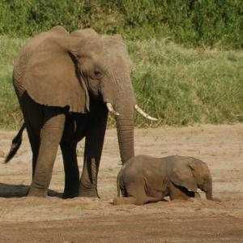
Lesson 1: Mass Tourism in Kenya.

Slide 2
Starter
What is mass tourism?
When and where did mass tourism begin?
Why does mass tourism occur?
www.gatm.org.uk/geographyatthemovies/tourism.html
http://www.bbc.co.uk/learningzone/clips/4507.nb.wmv
http://www.bbc.co.uk/learningzone/clips/4506.flv

Slide 6
Impact of mass tourism
In pairs discuss what is meant by the statements thereby checking your understanding of key terms such as service occupations, infrastructure, habitats, conservation.
Then divide up statements into economic gain, economic loss, environmental gain, environmental loss to create a tourism matrix.
Read the casestudy sheet and highlight ten key facts. Compare with one another the ten facts they have highlighted.
Then using the information from both the casestudy and the tourism matrix answer the exam question:
With reference to a tourist area in the tropics, describe the positive and negative effects of tourism. (6 marks)

Slide 7
Greater earner of foreign exchange | New opportunities from the great increase in number and variety of service occupations; tourism is labour intensive. | Specific local issues, e.g. divers damaging coral reefs in the tropics, pressure on frequently visited landscapes (e.g, footpath erosion) disturbance of wildlife in natural environments.
Greater awareness of the need for an interest in conservation of landscape features, vegetation and wildlife and the preservation of monuments. | Pollution problems from litter and untreated waste going into rivers and seas. | Low income jobs can be converted to provide a better living (e.g. fishing boat used for coastal tours, tourist fishing or snorkelling and diving trips).
Complete destruction of environments, and resulting habitat losses, in order to build hotels, roads and airports. | Visitor numbers go up and down and the area’s popularity may wane. | Holiday companies are often run by multinational businesses therefore profits don’t stay in the country.
Some local people, notably farmers and fishermen, may lose their livelihoods. | The country/tourist region might gain only a small percentage of total tourist spend. | Increased understanding of a countries culture and environment.
Loss of rural peace and quiet which is replaced by urban activity and noise. | New infrastructure (airports, roads, water and electricity supplies) can benefit other industries. | Tourists don’t want local cuisine, expect western cuisine therefore produce is flown in.
Income from tourism/entrance fees may pay for management, conservation and repairs. | Many jobs in tourism are seasonal, poorly paid, low status and unskilled; high earning jobs, such as those of guides with language skills, often go to outsiders. | Rent/cost of housing goes up forcing some local people to move away.

Slide 8
Review of exam answers
Self assess answers awarding marks out of 6.
Compare answers. How can you improve?
What are the key points that the answer to the question requires?

Slide 9
With reference to a tourist area in the tropics, describe the positive and negative effects of tourism. (6 marks)
Mass tourism in Kenya has had many advantages. The increase in tourists going on Safari in the Masi Mara National reserve has meant that there are many more jobs available for local people e.g. as bartenders, tour guides. From more people gaining employment a multiplier effect has occurred as these people have more money to spend within their local economy thereby offering opportunities for others. An increase in tourists has also meant that there is no a greater awareness of the fragile savannah grassland ecosystem with an appreciation that species like the White Rhino are under threat from extinction. As Kenya earns foreign exchange from visitors this enables the country to invest in improving infrastructure and community services such as schools and health. Some of the income can also be diverted to protect threatened species and landscape.
However the increase in tourists has also disrupted the breeding and migratory patterns of animals. It has put an increased pressure on the landscape with as many as 15 minibuses all following lion tracks, this has increased soil erosion. Although new jobs are often created many of them are seasonal which means that a families income is not throughout the year. Income earnt by the government is too often spent in providing services for the tourists instead of the local population. The concept of a trickle down effect of wealth is not occurring as tourism is generally operated by large multinationals and the funds leave the host nation. The increase in visitor numbers has meant an increase in pollution such as noise and has put a strain on already depleted water supplies.

Slide 10
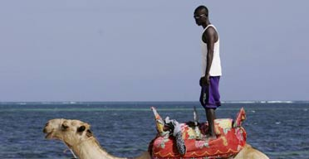
Lesson 2: Kenya’s decline?
Camel keepers and camels wait for tourists at a beach resort near Mombasa, Kenya, January 6, 2008.

Slide 11
The white sands were deserted. Palm trees swayed in the evening breeze, as a dhow and several pleasure boats bobbed on the warm Indian Ocean waters. It was a snapshot of paradise, but to the hundreds of thousands of Kenyans involved in tourism - and to their millions of dependants - the empty beaches brought to mind another word: disaster.

Slide 12
Question
Why do empty beaches bring another word to mind: disaster?

Slide 13
Disputed election - civil unrest.
The unrest that followed the disputed election of President Mwai Kibaki on December 27 has decimated Kenya's tourist industry, which is the mainstay of the economy and normally accounts for 15% of GDP. More than 100,000 holidaymakers, a fifth of them British, were expected to visit the coastal resorts and safari lodges this month. But following travel warnings and graphic scenes of violence on television, just 9,000 tourists are now expected.
All UK charter flights have been cancelled until the summer, as have most from continental Europe, leaving hotels empty, thousands of waiters, cleaners and bar staff on compulsory leave, and taxi drivers, curio sellers and tourist guides with no income.

Slide 14
Massive job losses in tourism
"Even after al-Qaida bombed the US embassy here in 1998 it was not as bad as this," said Jake Grieves-Cook, of the Kenya Tourist Board, who said that at least 20,000 hotel workers had already lost their jobs. "This is the worst crisis the industry has ever faced."
Kenya's government has been slow to acknowledge the scale of the problem, leaving tour operators frustrated and angry. Yesterday the information minister, Samuel Poghisio, admitted that the last month had been a "dark period in history", but said the violence was fading and urged tourists not be put off, as the situation was "not what you hear and what you see".

Slide 15
Hard Facts
The hard facts - more than 1,000 people dead and more than 300,000 displaced - tell their own story, but it is true that tourist areas have been largely unaffected by the unrest. Most of the clashes between ethnic groups, and between police and protesters, have happened in the west, off the safari circuit, or in low-income areas of Nairobi.
The exceptions were the lakeside towns of Naivasha and Nakuru, which erupted into violence last week, but local travel agents say it is now safe to travel there. All are desperate to stress that throughout the crisis not a single foreign holidaymaker has been harmed.

Slide 16
Safari lodges shut
The few intrepid tourists on safari trips in recent weeks have sometimes had an entire resort to themselves. In the Masai Mara and Samburu game reserves, as well as the lush foothills around Mount Kenya, some lodges have shut for the season rather than open for only one or two guests.
But it is along the picturesque coastal region, which generates around two-thirds of all tourist revenue, that the effects are most keenly felt. Nearly all the hotels, from all-inclusive package destinations to the plush five-star resorts, were overbooked for January and February. But as soon Kibaki was controversially sworn in on December 30, sparking the violence, the cancellations started to pour in. Flights from Europe arrived empty and departed full.

Slide 17
Entire tourism industry to collapse?
Statistics compiled at a recent crisis meeting of coastal hoteliers show just how dire the situation is. Of the 28 resorts surveyed, occupancy rates ranged from zero to 36%. Only one of the hotels had yet to lay off staff.
A few miles north of Mombasa the Sarova Whitesands resort, the second largest hotel in East Africa, was eerily quiet. Only 60 of the 338 rooms were occupied. All the casual and contract staff have been sent home, and half the employees are on compulsory leave. A sign leading to one section of the five-star hotel saying "You are now entering a quiet zone" was redundant: the entire wing was vacant.
A £2.5m refurbishment programme has been put on hold, said Mohammed Hersi, the general manager, as he read yet another email from a British client cancelling a holiday. "We are trying to cut costs everywhere just to stay afloat."
Hersi said that if the effort by the former UN secretary general Kofi Annan to broker a deal between the government and opposition failed, the entire tourism industry, which employs 250,000 workers directly, and is responsible for an equal number of indirect jobs, "would face a tragedy" that would take years to get over.

Slide 18
In figures....
· Tourism is Kenya's biggest foreign exchange earner, with revenue topping £500m last year. The industry has grown at 10% to 20% a year for the last four years
· More than a million tourists visited in 2007, the highest figure ever. Some 203,000 were British
· Between January and March 315,000 tourists were expected. The Kenya Tourist Board says the likely figure is now 27,000, resulting in lost revenue of about £126m
· There are 250,000 people working in tourism, with a further 250,000 indirectly employed. Each employee typically supports seven to 12 people
· For every eight tourists who visit, one more job is created.
Reported in the Guardian Fri 8th Feb 2008.

Slide 19
Has there been any unrest in Kenya since 2008? Is this likely to impact tourism?
Kenya issued July, 2013:
Political unrest has all but vanished, but the US State Department still retains a travel warning for visitors to Kenya in the light of the high incidence of violent crime and possible threat from terrorists. For the most up to date information see the US Embassy web site based in Nairobi. Travelers should avoid the Kenya/Somali border, pirate activity is no longer an issue, as cruise ships have now returned to Lamu and pirate activity has been curtailed enormously.
Task:
Using information and figures from the US embassy in Nairobi and any other credible sources you can find describe the current situation for tourism in Kenya.

Slide 20
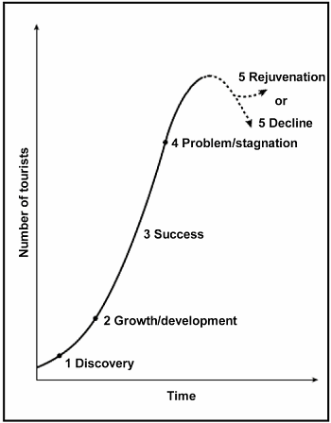
Task:
Option 1:
Give the reason why tourism has declined in Kenya? (2 marks)
Describe the impact of fewer tourists visiting Kenya on both the local people and the Kenyan Government. (6 marks)
Option 2:
Using the information from the Guardian report and your own knowledge create a detailed model of a downward spiral due to the decline in tourism in Kenya. (8 marks)

Slide 21
Plenary:
www.gatm.org.uk/geographyatthemovies/tourism.html
Safari Holiday

