Slide 1
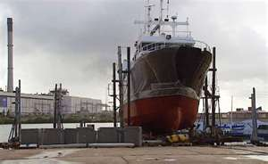
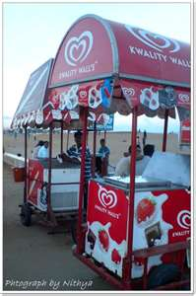
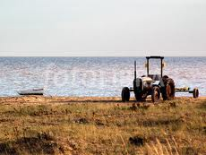
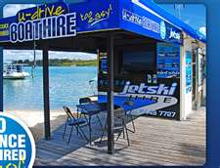
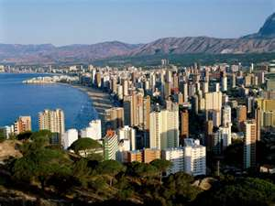
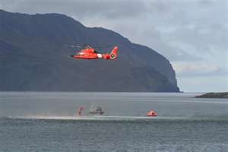
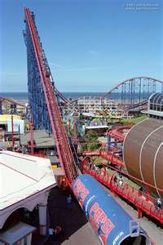
Jobs on the coast line
Brainstorm ALL the jobs you can think of that people do on the coastline.
If you finish…Try the challenge: Can you name any coastal towns? What do you think the main jobs are there?

Slide 2

Jobs on the coastline today…..
The jobs you have got listed……
1. If it is to do with LEISURE you need to put a star next to do it.
2. If it is to do with WORK you need to put a circle next to it.
3. How many jobs are to do with LEISURE and how many jobs are to do with WORK? Total the number of stars and the number of circles.
Challenge yourself: What jobs would you NOT be able to do 50 years ago? Make a list beneath your brainstorm.

Slide 3
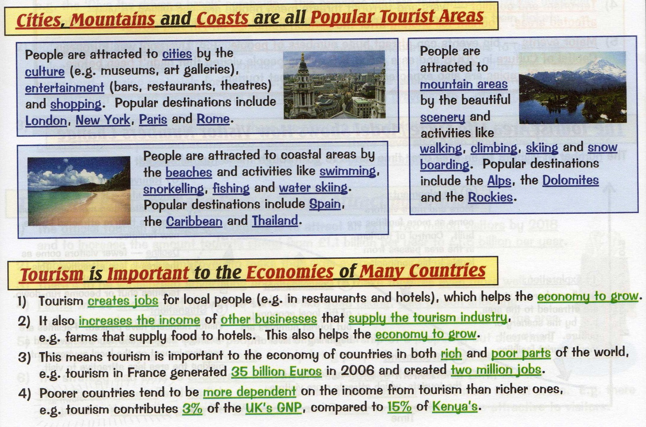

Slide 4
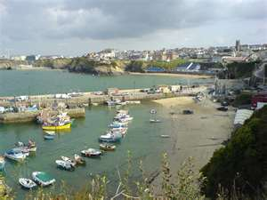
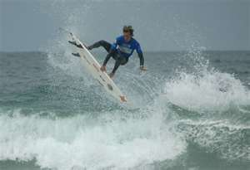
What we will be learning today…..
You will be able to describe the effects that jobs in the tourist industry have on a coastal resort.

Slide 5
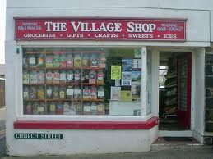



If you were a fisherman around a long time, living in a village on the coast, and had seen more and more jobs in the tourist industry, what thoughts would you have about this?
What positives and negatives are there to there being more jobs in the leisure industry than there were 50 years ago?
Task:
1. Think of one positive and negative
2. Pair – share your thoughts with your partner
3. Share – be prepared to feedback!

Slide 6
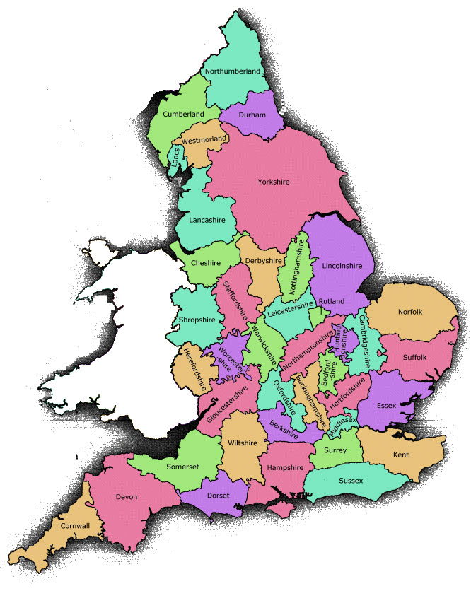
We are looking at Newquay. Where is it?
As Geography detectives, we need to look at the evidence jobs in the tourist industry have had on the people who live on the coastline and the environment itself.

Slide 7
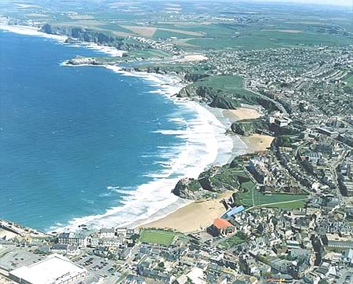
Task:
Organise your card sort into positive effects and negative effects.
CHALLENGE: come up with 2 additional examples of how you think tourism has impacted on Newquay and explain these.

Slide 8
POINT: what do you think?
The development of jobs in the tourist industry on the coastline has been mostly…………..
EVIDENCE: select some examples from your card sort
The evidence for my decision is that having more jobs means…...
EXPLAIN: Say why this is bad/good for the people living on the coastline and the environment.
Is the development of jobs in the tourist industry good or bad for the coastline?
Level 4 | You will describe the effects on the coastline.
Level 5 | You explain how jobs in the leisure industry have affected the coastline.
Level 6 | You will offer a balanced argument (so both positive and negative points) and make a conclusion.

Slide 9
The money made from the tourist jobs mean the resort makes a lot of money, running into several million pounds, the money can be spent on improving public transport. | Some people worry too many non-local people are coming to live and work in Newquay. They are not experiencing the ‘real’ Cornwall and are only seeing part of it which caters for the young party goer. | If jobs weren’t provided in tourism, the local people would have to move away because there aren’t enough jobs in the more traditional fishing and farming industries.
Some parts of the coastline have been ruined by hotels and holiday apartments destroying numerous habitats. | There are more opportunities for young people, more jobs and chances to socialise because there are more pubs and clubs. | Locals have seen prices rise as local businesses try to make more money out of the tourists.
The renting out of jet skis is noisy, pollutes and harms the peaceful atmosphere of the place. | Newquay has lost some of its character because of building ugly hotels built. | Tourists who come drop litter and don’t look after the beautiful beaches.
The development of jobs in the nightclub industry which cater for tourists encourage e.g. binge drinking and noise pollution. | Newquay depends so heavily on jobs in the tourist industry that if tourists stop coming because they can’t afford it, because of the recession, then Newquay has no lifeline. This is a worry given the current economic crisis. | The money generated from having so many more jobs means that there are more beach lifeguards on the beach for a longer proportion of the year.

Slide 10
Line of truth
Completely agree
Completely disagree
Good and bad
“Tourism has been mostly positive for Newquay

