Slide 1
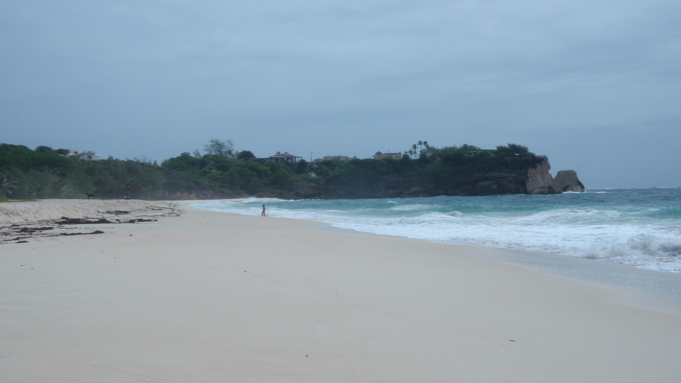
Internal Assessment IB Geography
Higher Level – 20% of total final marks
Standar level – 25% of total final marks

Slide 2
What does it involve
Classwork and fieldwork
This means 5 hours in the field and then every Monday double period and homework writing up until end of term.
The final product will be 2500 word write up (max).
It has to be based on the collection of primary data which can be backed up by some secondary.
It must have a spatial element (but over a small area)
It must relate to an area of the syllabus – needs stressing in write up.

Slide 3
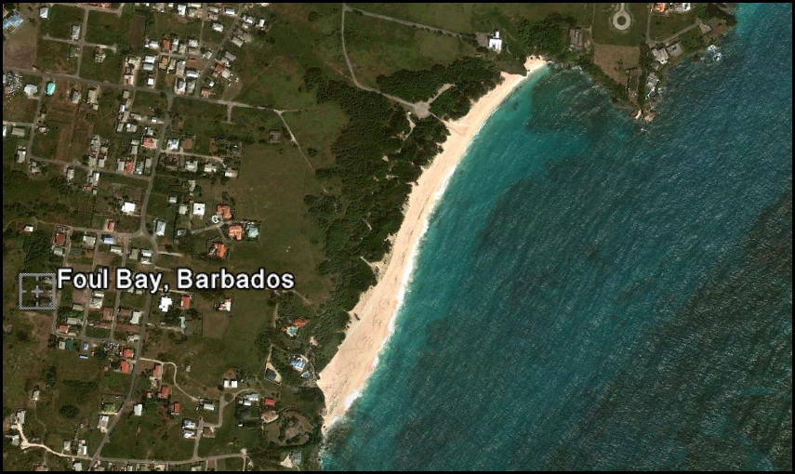
Step 1 – Choose location and justify it

Slide 4
Step 2 – Devise a Fieldwork question
This is one overall question you will be aiming to answer by collecting primary data
The question must be :
Focused
Unambigious
Answerable
Allow for investigative and not descriptive approach.

Slide 5
Once you have a Question
Plan some hypotheses that you will test to help answer the overall question.
In statistics it is best to first have a NULL hypothesis followed by an ALTERNATIVE hypothesis.
E.g.NULL- There will be no differences in waves along the beach.
ALTERNATIVE - There will be differences in waves along a beach

Slide 6
All the Hypotheses
Waves and longshore drift
Beach Profile
Vegetation and soil
Effect of Humans

Slide 7
Here are some I thought of. You may have more
There will be no differences in beach profile along the beach
There will be no differences in wave patterns along the beach
There will be no differences in direction and strength of longshore drift along a beach.
There will be changes in vegetation type, height or diversity with distance from the beach.
There will no differences in soil organic matter, moisture content, conductivity, pH, with distance from the sea.
The effect of humans on the beach area will not be affected by distance from the car park entrance. (e.g. litter, trampling of vegetation, management)
There is no pattern in dispersion of palm trees on the beach
There will be no differences in beach and cliff profiles over time (will you be able to do this with primary data collected on a field trip? How then)

Slide 8
How will we Collect the Data
Where do we collect the information from.
Can we collect information from all areas of the beach?

Slide 9
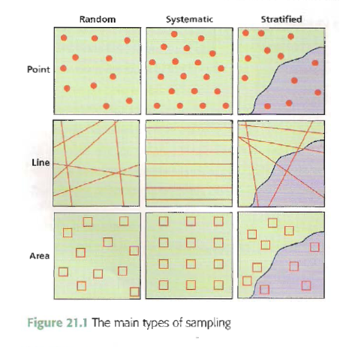
Sampling
We cannot collect data on all of the beach as this would be impractical. Therefore we have to sample.
The three main methods are Random, systematic and Stratified.
What is the difference between them and what are the benefits and disadvantages of each?

Slide 10
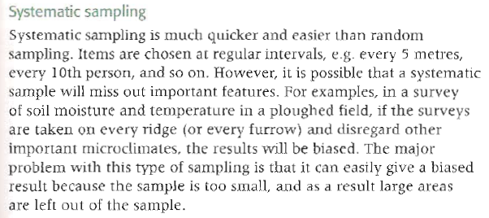
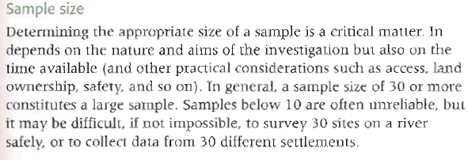

Slide 11
What type of sampling would be best here?
How many sample sites should we use?
Use Google Earth to find out exactly how long the beach is. Then decide upon the number of sample sites and mark them on to a copy of this photo. What method did you use?

Slide 12
Collecting Primary Data
You will need to collect information individually and in small groups. Each location will require a number of tasks to be performed.
Individual Tasks:
You need to draw annotated field sketches. Preferably 2 – one from either end of the beach.
Take photos which you can annotate later.
Observe!!!
Group Tasks:
This is the area that can create the most friction – If one groups messes around and does not get the information, then all groups work is ruined.
The following page will list some of the group work tasks.

Slide 13
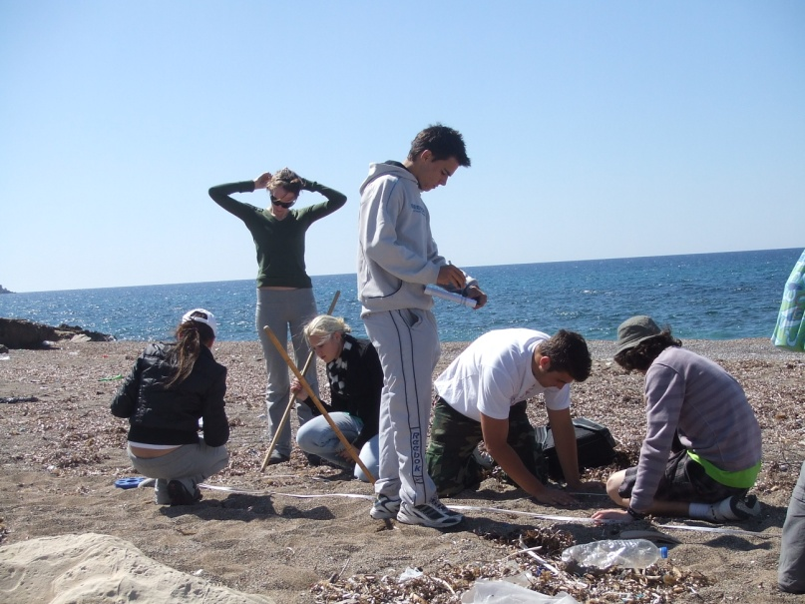
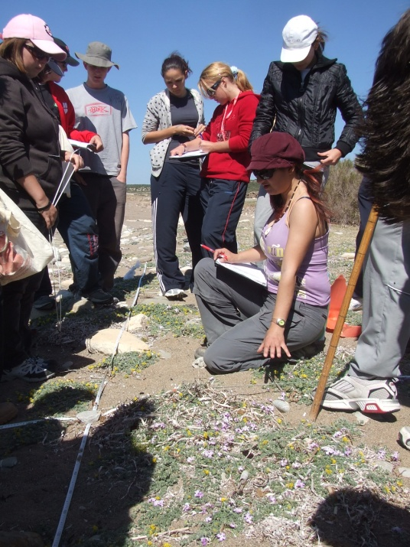
At each data collection point
Longshore drift
Beach profile
Wave frequency – number per minute
Wave period – average time between wave crests – time 11 and divide by 10 period and swash time
Swash time (between breaking of wave and swash reaching maximum height up beach)
Vegetation - check vegetation changes (height, diversity, species, % ground cover) every 2 metres
Get samples of soil every 5 metres.
Count and collect litter in a 5m strip either side of your transect.
Which of the two pictures best show how to work in groups?

