Slide 1
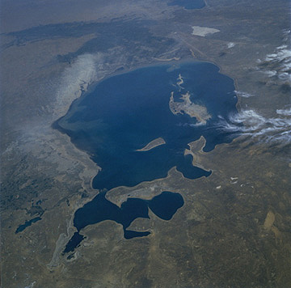
Interference with the water cycle
To know how people alter the hydrological cycle
To be able to explain how people are changing the Aral Sea
To understand how these alterations could be controlled

Slide 2
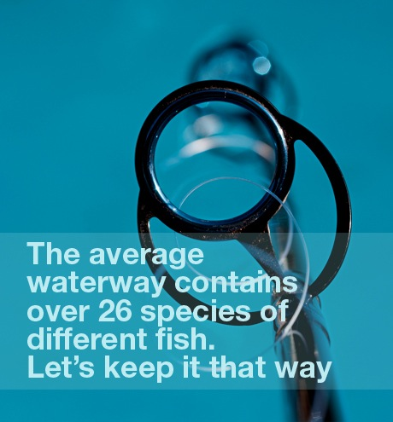
Interference with the water cycle
Make notes from Page 66 – 67 in the textbook on the following ways humans can alter the hydrological cycle…
Human interference
Overabstraction
Reservoir building
Deforestation
Task 2: Draw a flow diagram for the above 4 ways of interference to show the knock on effects.

Slide 3
The 5 W’s.
TASK
Read the article about the Aral Sea diversion in groups – highlight key words and complete a 5W’s case study.
“How might the Aral Sea diversion be managed or controlled?”
CASE STUDY
Who
What
Where
When
How

