Slide 1
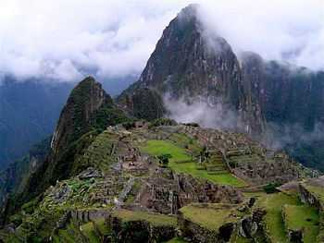
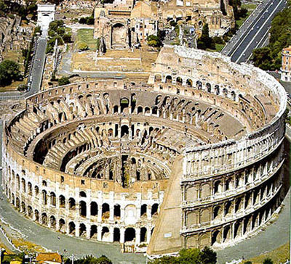
Starter: Famous attractions
Name these places:
Solve these anagrams: A) Angelical of wrath B) Halt a jam C) Heed merriest retch
D
E

Slide 2
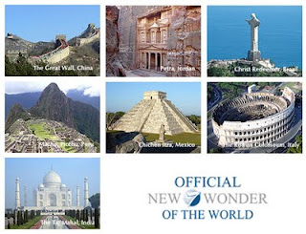
How wonderful are the seven wonders?
09/03/2014
Learning: Students will identify and describe the features of one of the seven wonders

Slide 4
Creating a double page information guide
Things you must include: 1) Why is the wonder so important? 2) What is interesting about it? 3) Information about its location, city or country 4) Why would it appeal to tourists?
Things you might include: 1) Drawings 2) Comments from tourists 3) Your thoughts on the site

Slide 5
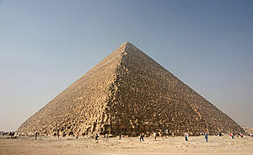
What other sites could be a wonder of the world?
Decide on an attraction - provide your reasons which explain why it would be a good choice

Slide 6
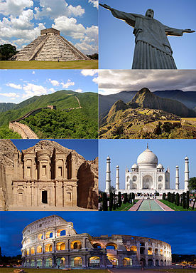
Starter: What other locations or attractions could be a wonder of the world? List them in your book and explain why.

Slide 7
What is group work?

Slide 8
Copy into books
Group
Score out of 10
Comments

Slide 9
Chichen Itza

Slide 10
Christ the Redeemer

Slide 11
Machu Picu

Slide 12
Great Wall of China

Slide 13
Taj Mahal

Slide 14
The Coliseum

Slide 15
