Slide 1
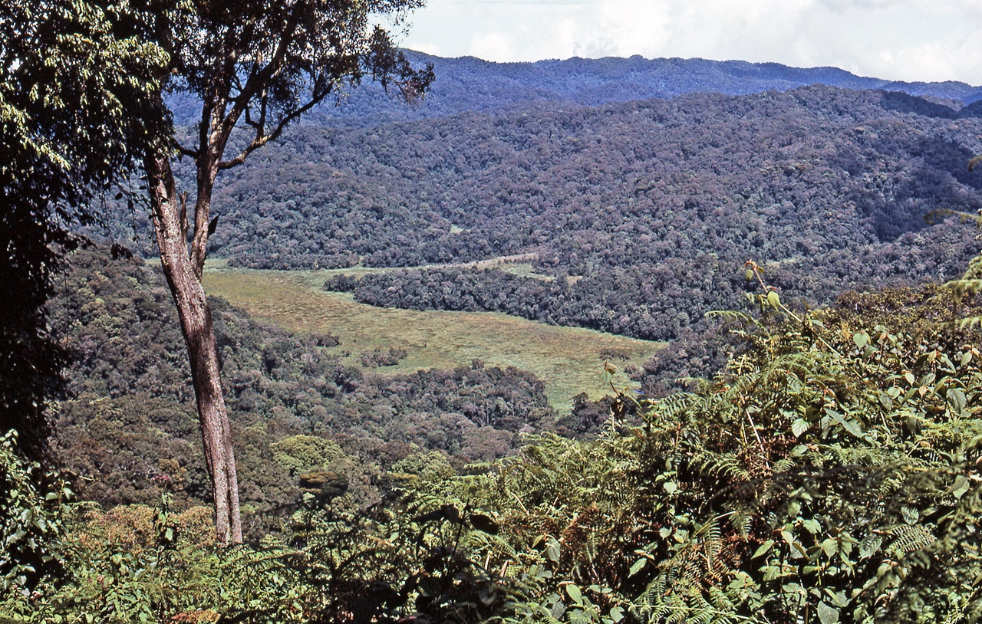

Slide 2
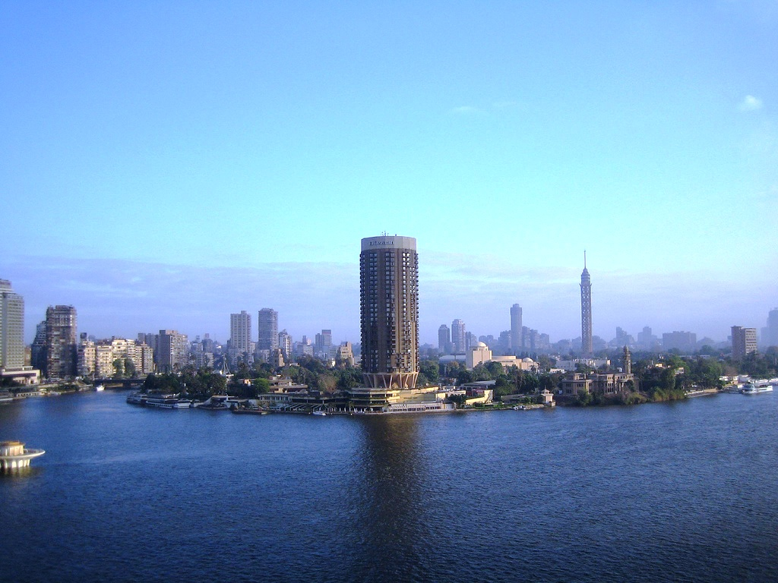

Slide 3
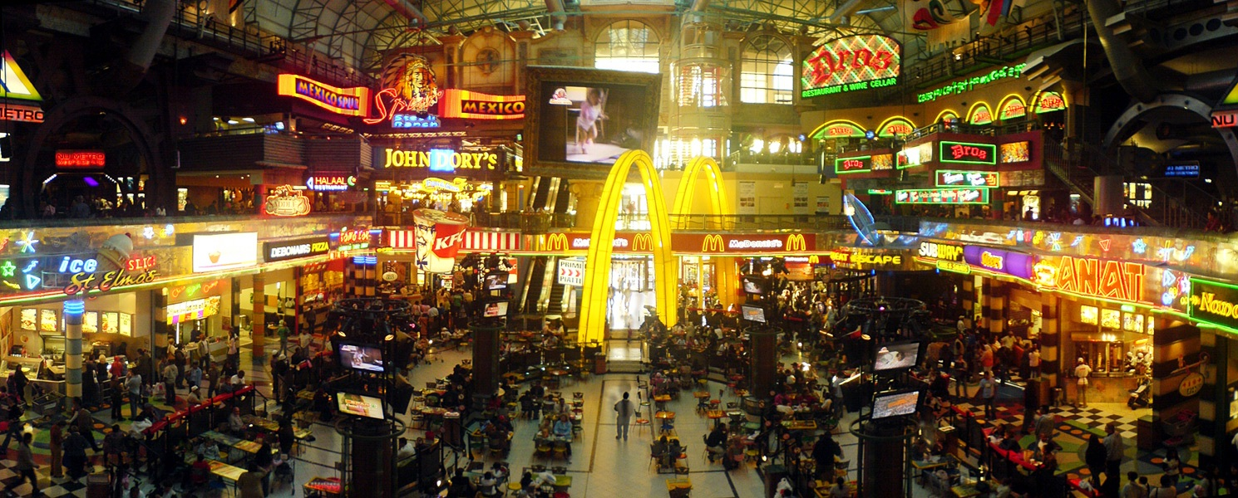

Slide 4
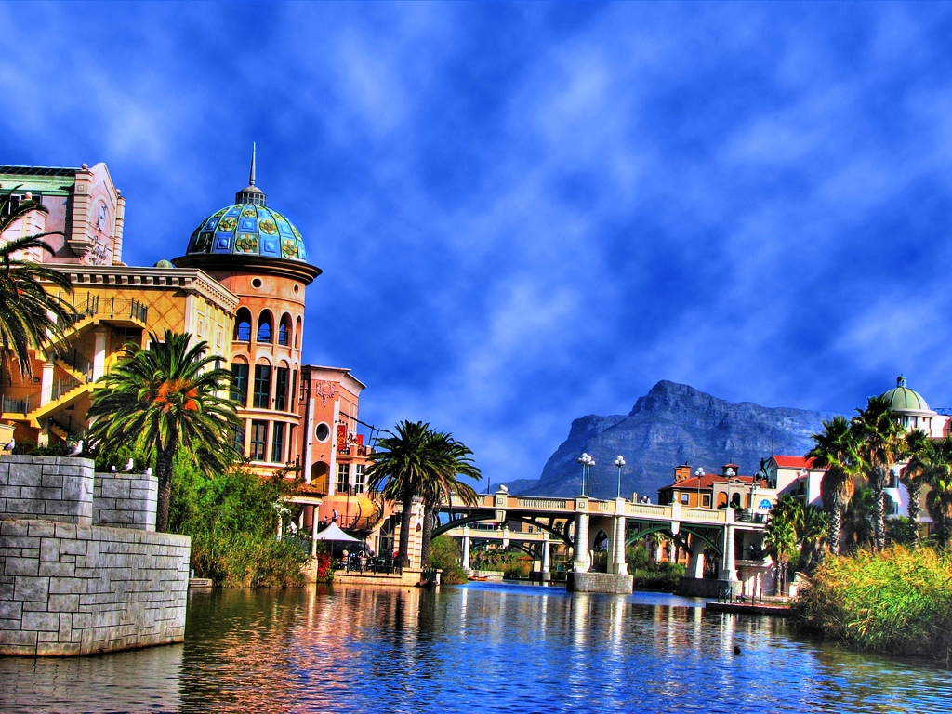

Slide 5
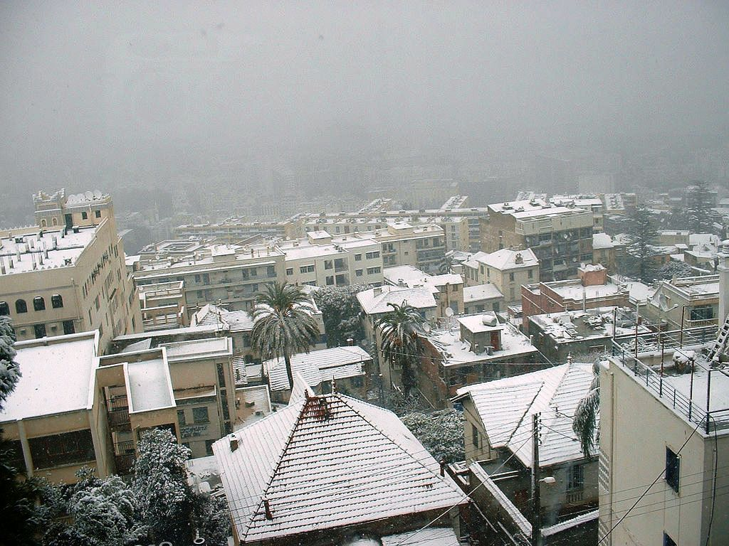

Slide 6
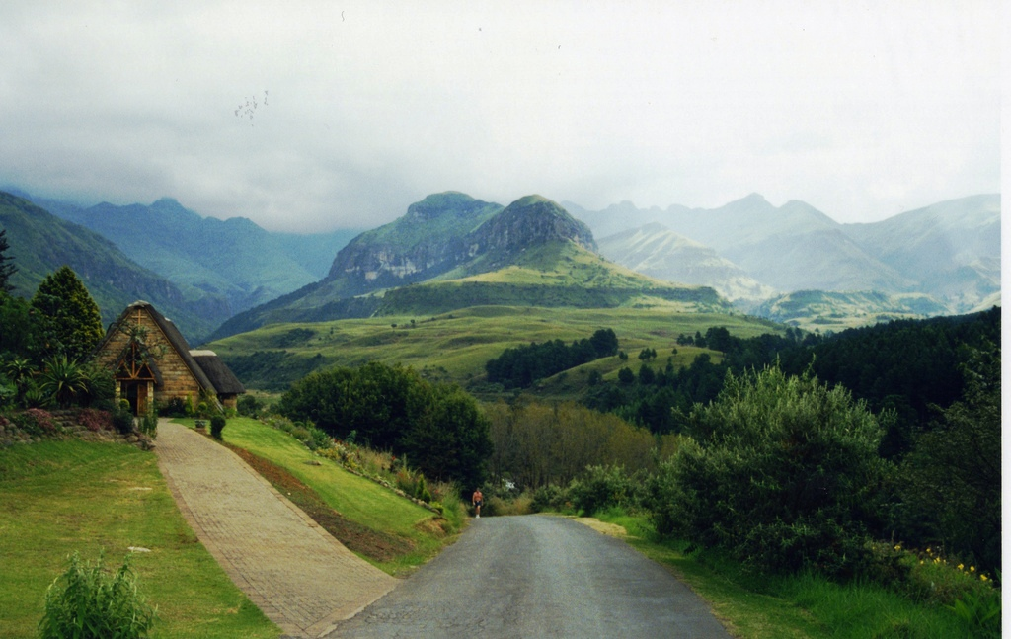

Slide 7
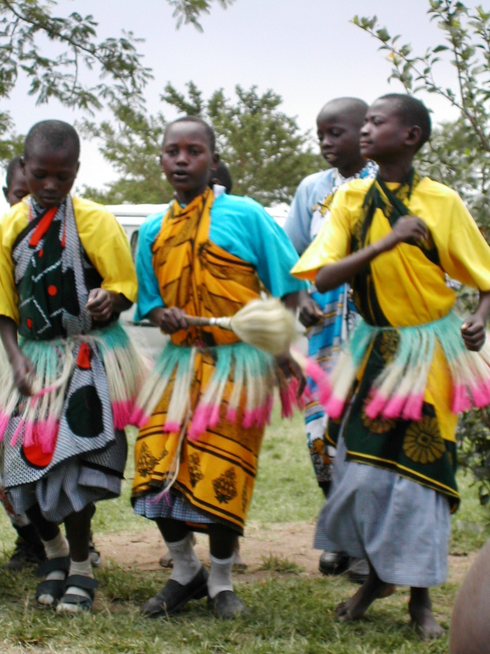

Slide 8
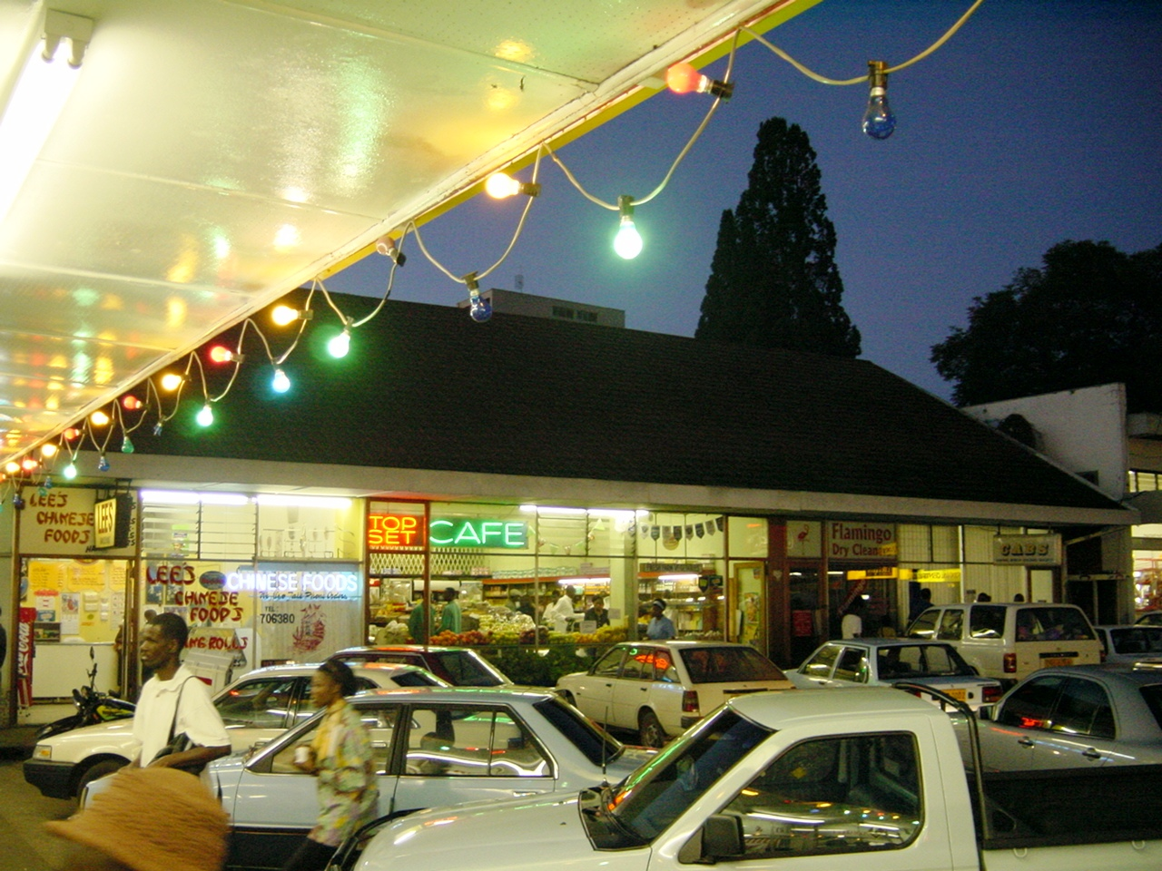

Slide 9
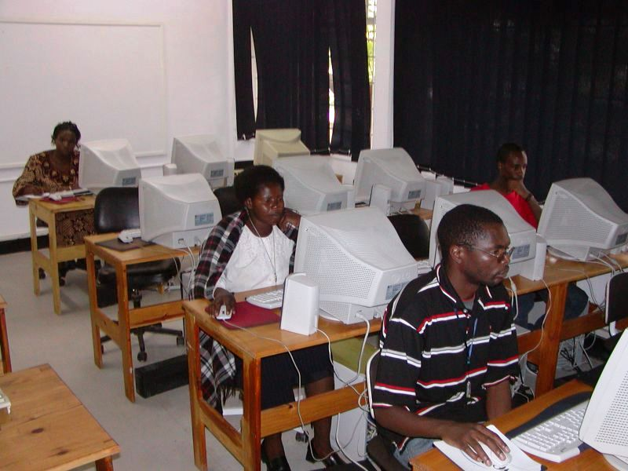

Slide 10
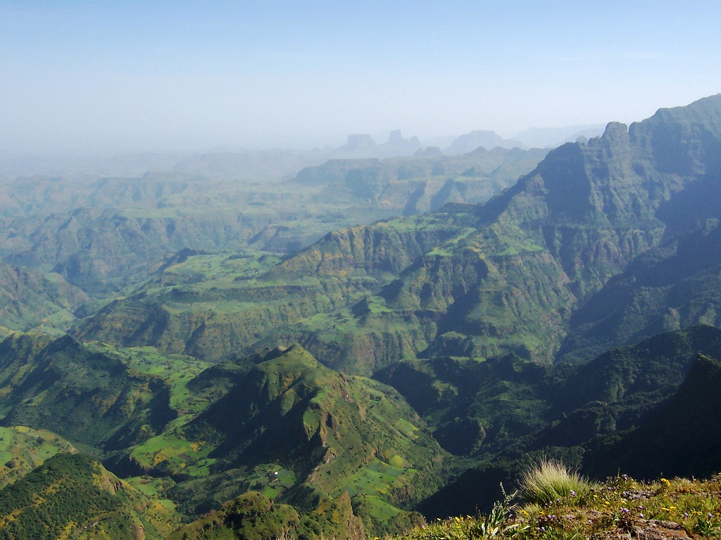

Slide 11
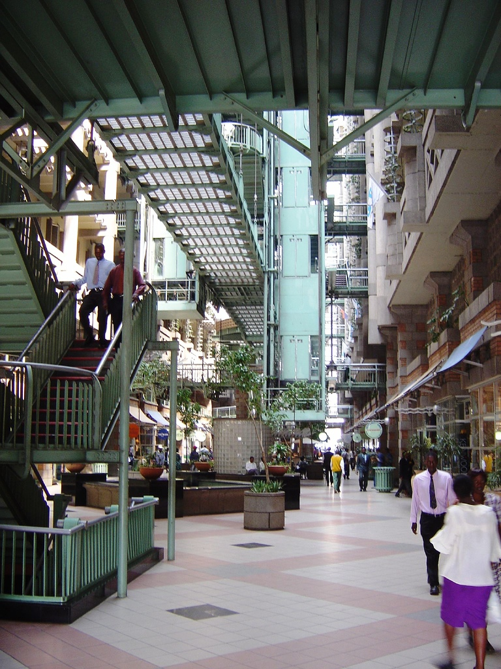

Slide 12
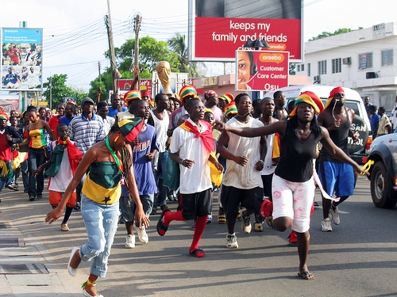

Slide 13
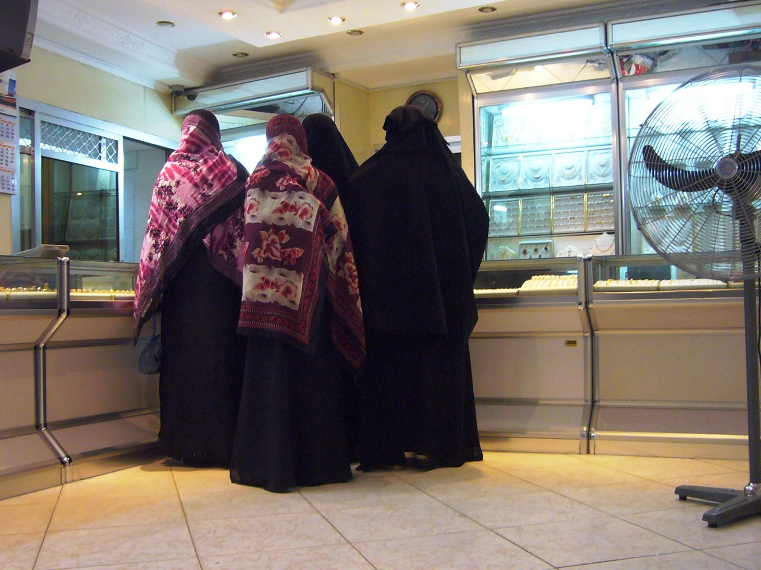

Slide 14
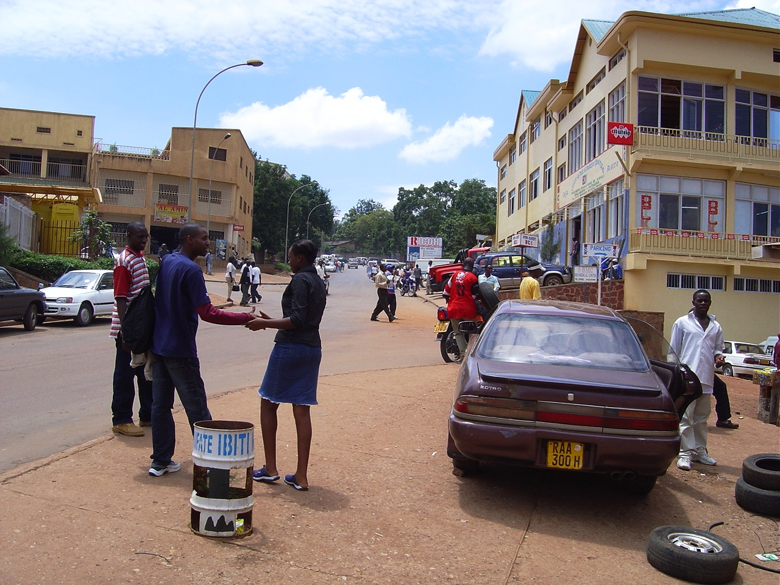

Slide 15
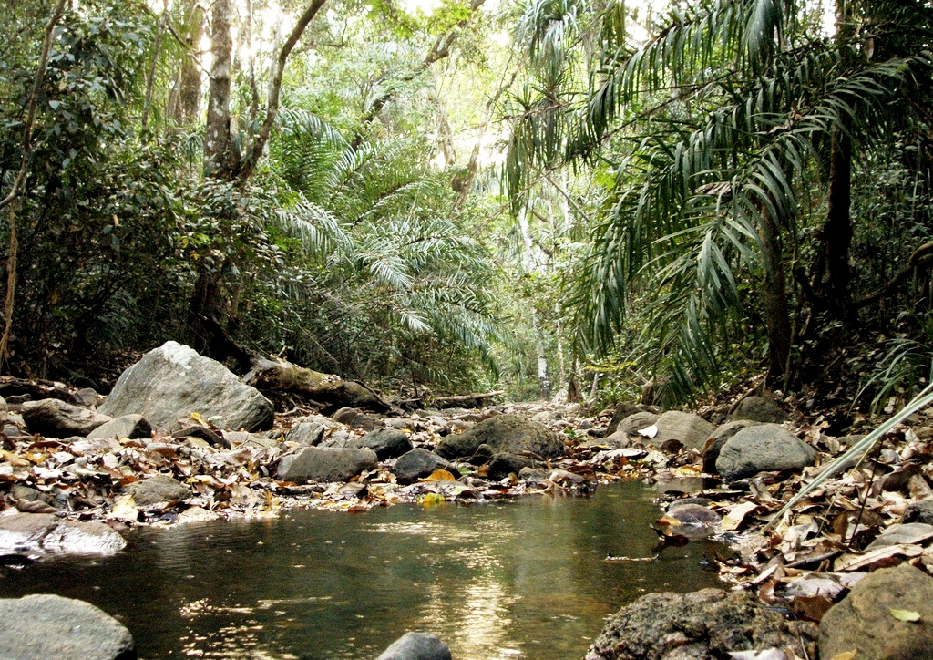

Slide 16
Bwindi Forest, Uganda

Slide 17
Cairo Skyline, Egypt

Slide 18
Shopping centre, Botswana

Slide 19
Cape Town, South Africa

Slide 20
Winter in Algeria

Slide 21
Cathedral Peaks, Lesotho, South African border

Slide 22
Celebration, Kenya

Slide 23
Chinese restaurant, Zimbabwe

Slide 24
Computer room, Zambia

Slide 25
Simien Mountains, Ethiopia

Slide 26
Eastgate shopping centre, Zimbabwe

Slide 27
Ghana football celebrations- World Cup 2006
Ghana 2: USA 1

Slide 28
Jewellery shopping, Zanzibar

Slide 29
Kigali Street, Rwanda

Slide 30
Kwano forest, Nigeria

Slide 31
LO: To understand the perceptions of Africa

Slide 32
Did you know that…
In 2004 the Opportunity International Bank of Malawi (located in South Eastern Africa) introduced the use of special cash cards that read your fingerprints to check your identity?

Slide 33
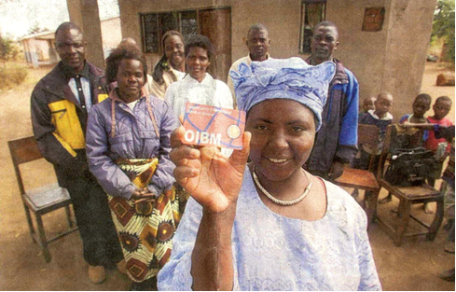

Slide 35
Clever Cards
This technology is called biometrics.
These cards read the patterns on your fingers to identify you as the correct owner, so there’s no need for you to remember a PIN number.
This means that even those who are unable to read or write, or who lack formal identification such as a driving license will be able to access secure banking.
They are not even available in Britain yet.

Slide 36
Did you know that…
Nigeria (located in West Africa) has had its own communications satellite?

Slide 37
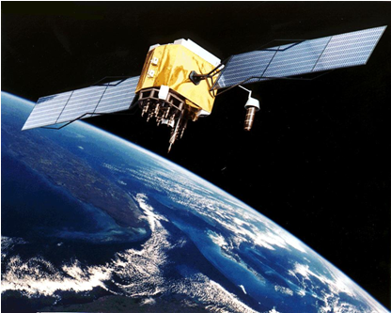

Slide 39
Did you know that…
Did you know that…
Every year, Nigeria (West Africa) produces more movies than the UK or the USA?

Slide 41
Did you know that…
In Kenya, you can make payments, receive your wages and even save money on your mobile phone?

Slide 42
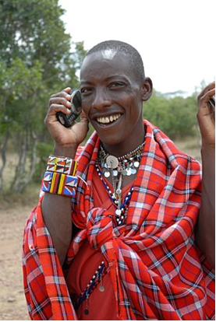

Slide 43
Customers of the ‘Safaricom’ mobile network can keep up to 100,000 shillings (about £700) in a virtual account on their handsets.
This service means that people can have somewhere to store their money even if they have no access to a physical bank.
Payments can be sent from and received by a virtual account via SMS text message.

Slide 44
Did you know that…
By 2012, it is predicted that more than a third of Africans will have access to high-speed broadband Internet?

Slide 45
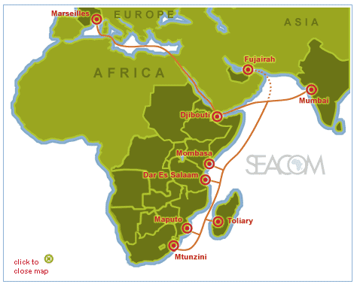
The SEACOM high-speed cable running along the east coast of Africa provides broadband access as shown on the map.
Since going live in 2009, the cable provides a high-speed link to India and Europe.
SEACOM is almost 77% African-owned.
This, along with other regional developments, means that very shortly a third of the continent should have access to broadband.

Slide 46
Did you know that…
In Sub-Saharan Africa, children’s play can mean clean water?

Slide 48
Did you know that…
In 2004, an African woman was awarded the Nobel Peace Prize?

Slide 50
Did you know that…
A 15 year-old Tanzanian schoolboy made a groundbreaking scientific discovery?

Slide 52
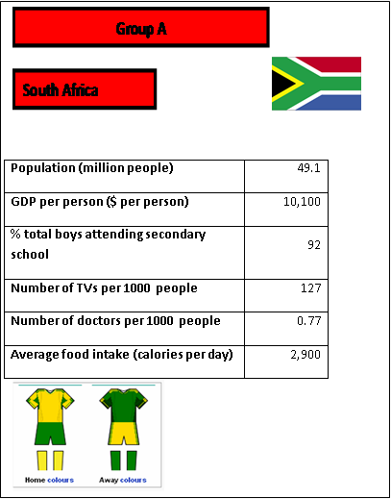
Top trump example:

Slide 53
Homework
Find out the same information on an African country of your choice so we can make an African countries top trump game in the next lesson.

