Slide 1
IB Geography

Slide 2
What is a Geographer?
In small groups try and come up with a description of what a Geographer is…
Have a look at a newspaper and see if you can highlight any articles that you think might be of interest to a Geographer – why?

Slide 3
“The purpose of geography is to provide 'a view of the whole' earth by mapping the location of places." - Ptolemy, 150 CE
"Synthesizing discipline to connect the general with the special through measurement, mapping, and a regional emphasis." - Alexander von Humboldt, 1845
"Man in society and local variations in environment." - Halford Mackinder, 1887
"How environment apparently controls human behavior." - Ellen Semple, c. 1911
"Study of human ecology; adjustment of man to natural surroundings." - Harland Barrows, 1923
"The science concerned with the formulation of the laws governing the spatial distribution of certain features on the surface of the earth." - Fred Schaefer, 1953
"To provide accurate, orderly, and rational description and interpretation of the variable character of the earth surface." - Richard Hartshorne, 1959
"Geography is both science and art" - H.C. Darby, 1962
"To understand the earth as the world of man" - J.O.M. Broek, 1965
"Geography is fundamentally the regional or chorological science of the surface of the earth." - Robert E. Dickinson, 1969
"Study of variations in phenomena from place to place." - Holt-Jensen, 1980
"...concerned with the locational or spatial variation in both physical and human phenomena at the earth's surface" - Martin Kenzer, 1989
"Geography is the study of earth as the home of people" - Yi-Fu Tuan, 1991
"Geography is the study of the patterns and processes of human (built) and environmental (natural) landscapes, where landscapes comprise real (objective) and perceived (subjective) space." - Gregg Wassmansdorf, 1995

Slide 4
Views of the world famous Miss Wood
I believe that a Geographer studies patterns and relationships between humans and how they are interrelated to the physical aspects of the environment. The study encompasses many disciplines as there are social, economic and political factors which affect these relationships.

Slide 5
Part 1: Core theme—patterns and change (SL/HL)
There are 4 compulsory topics in this core theme …………….

Slide 6
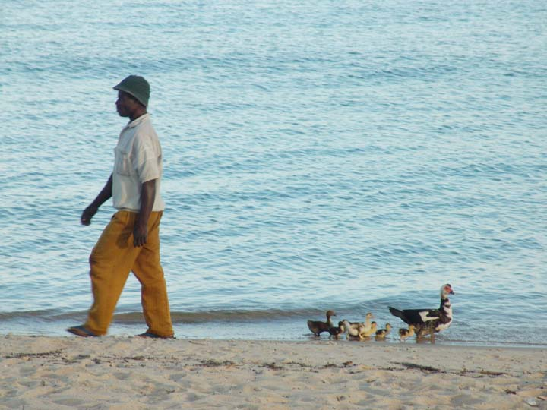
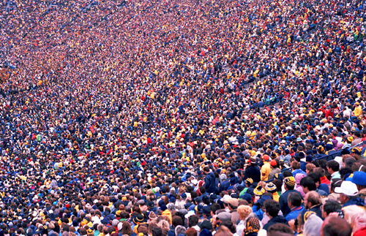
1. Populations in transition
What types of transition might populations be going through?
What changes might there be in population patterns.
Globally
Regionally
Nationally
Locally

Slide 7
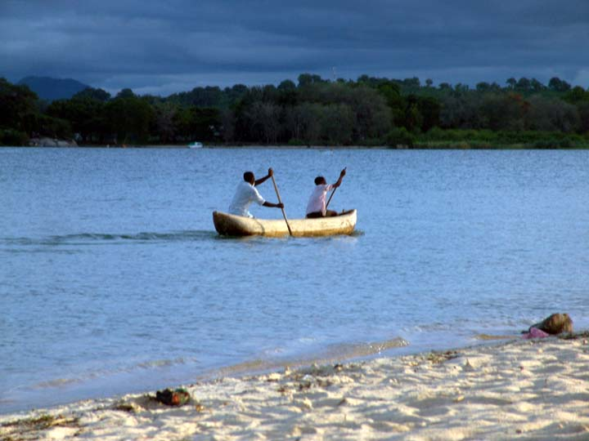
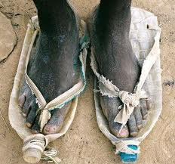
Disparities in wealth and development
How can we measure differences in Wealth and Development?

Slide 8
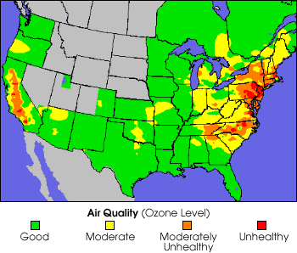
Patterns in environmental quality and sustainability

Slide 9
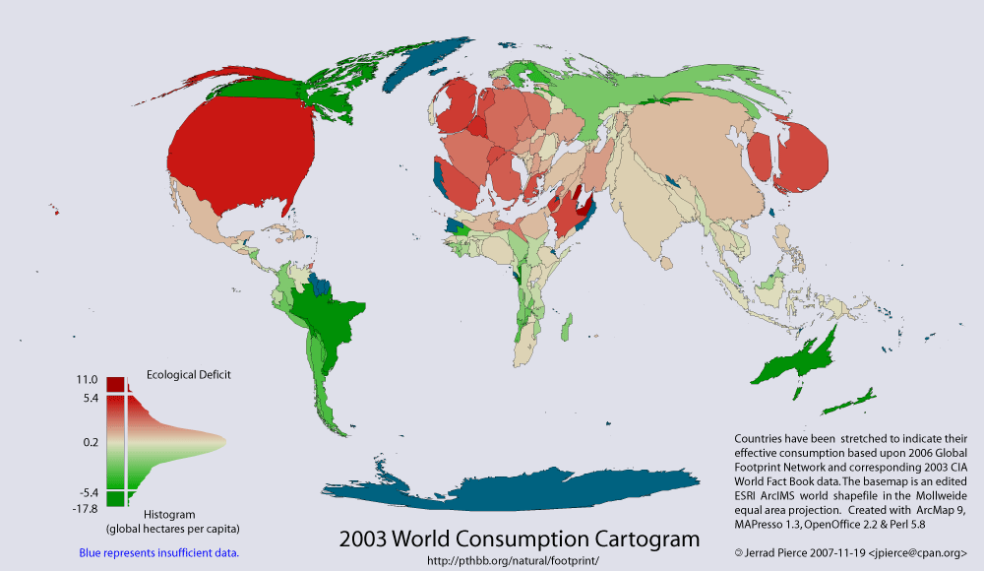
Patterns in resource consumption

Slide 10
Part 2: Optional themes (SL/HL)
There are seven optional themes; each requires 30 teaching hours.
Two optional themes are required at SL.
Three optional themes are required at HL.
A. Freshwater—issues and conflicts
B. Oceans and their coastal margins
C. Extreme environments
D. Hazards and disasters—risk assessment and response
E. Leisure, sport and tourism (higher)
F. The geography of food and health
G. Urban environments

Slide 11
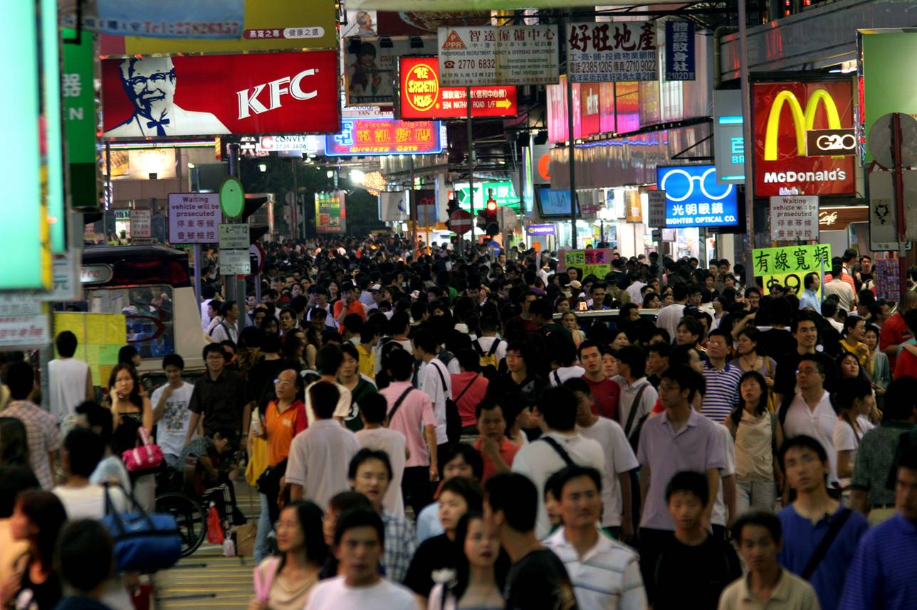
Part 3: global interactions (HL only)

Slide 12
There are seven compulsory topics in the HL extension.
1. Measuring global interactions

Slide 13
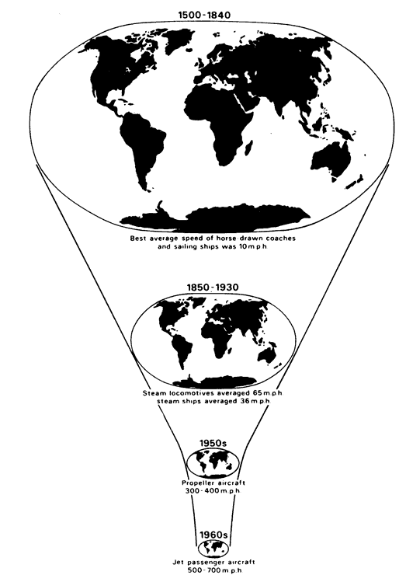
Changing space—the shrinking world

Slide 14
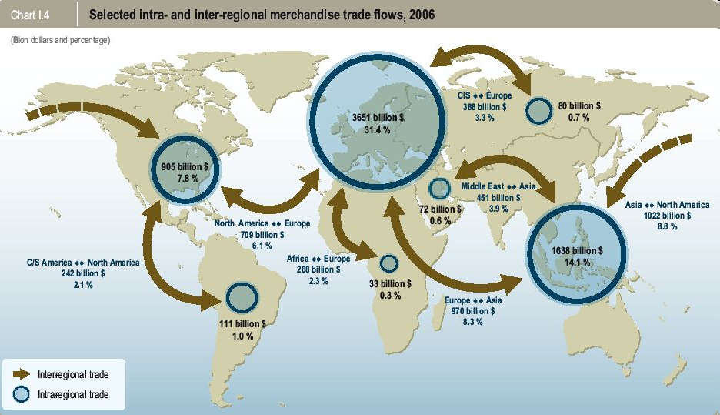
3. Economic interactions and flows

Slide 15
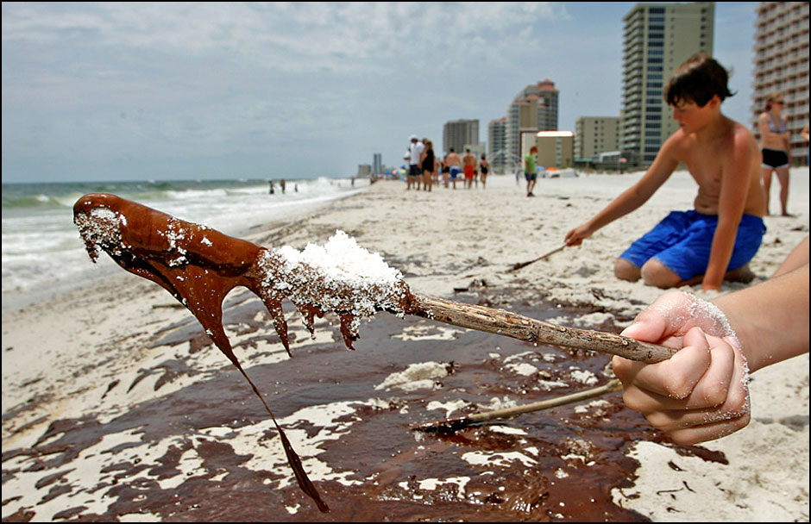
4. Environmental change

Slide 16
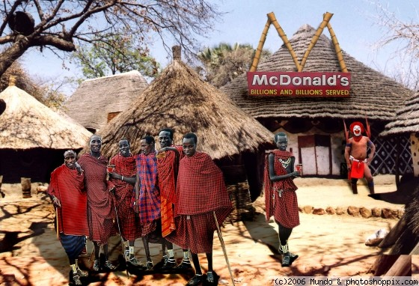
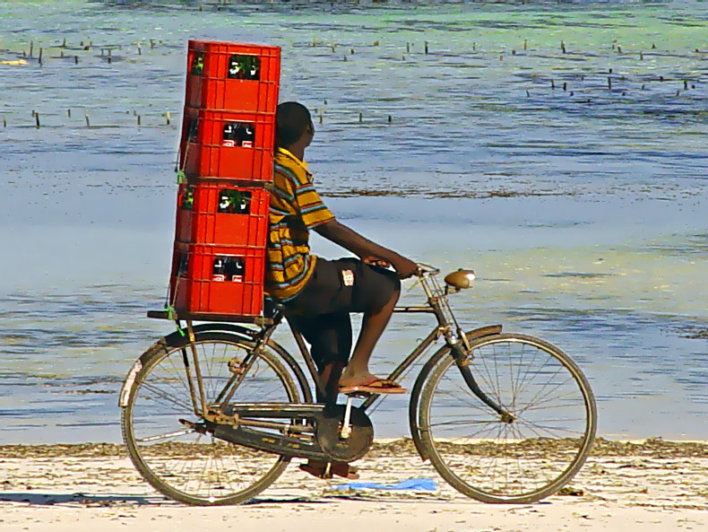
5. Sociocultural exchanges
What positives are there out there?

Slide 17
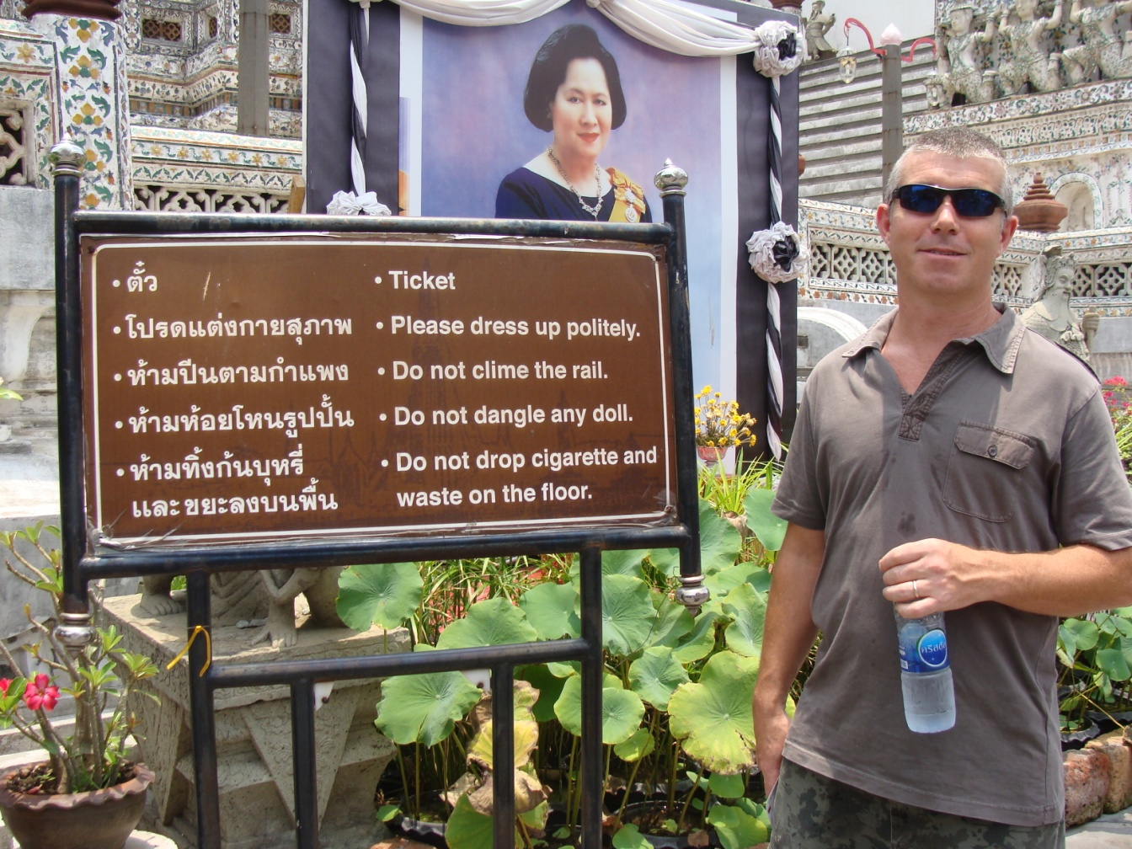
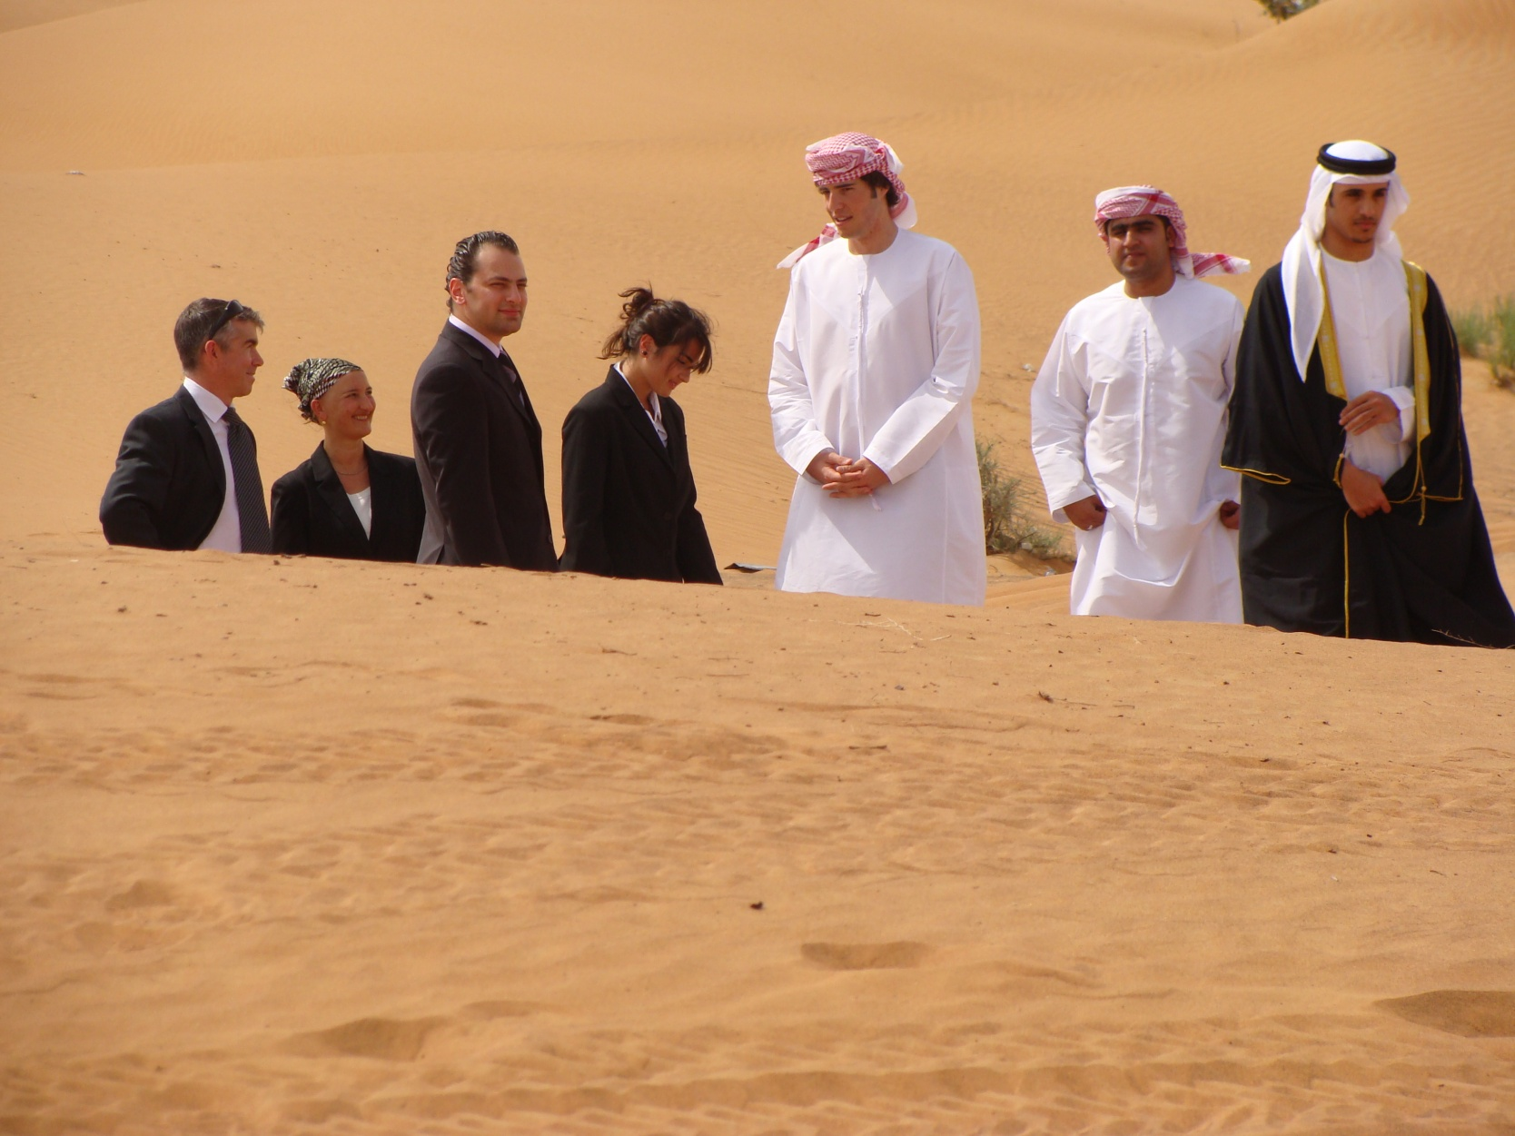

Slide 18
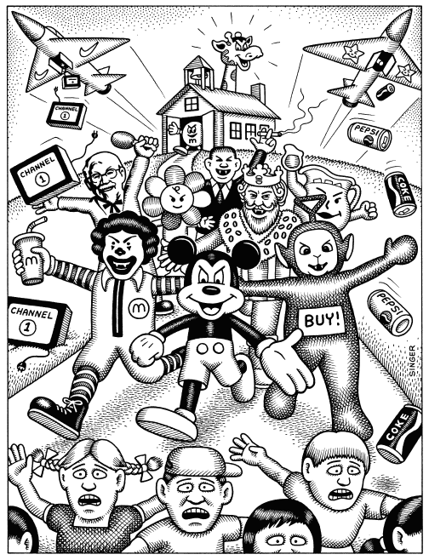
Political outcomes

Slide 19
7. Global interactions at the local level

Slide 20
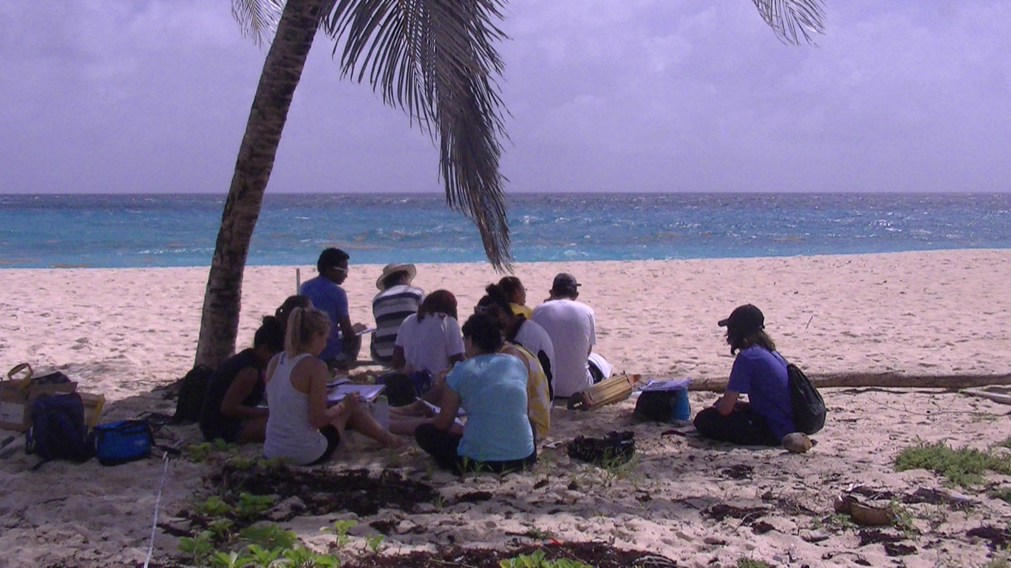
Fieldwork
Leading to write up of 2500 words
Worth 20% (HL) or 25% of final marks

Slide 21
Exams
Assessment:
External assessment
Paper 1 (1 hour 30 minutes) SL and HL (40%)l
Section A: Students answer all short‑answer questions.
Section B: Students answer one extended response
Paper 2 (1 hour 20 minutes (SL) or 2 hours HL)
Students answer two (SL) or three (HL) structured questions based on stimulus material, each selected from a different optional theme. For each theme there is a choice of two questions.
Some stimulus material is included in the resources booklet.
Paper 3 (HL only) 1 hour Students answer one of three essay questions.

