Slide 1
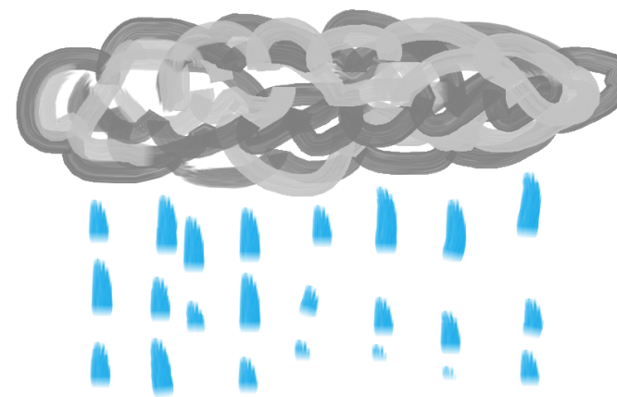
Tropical storms

Slide 2
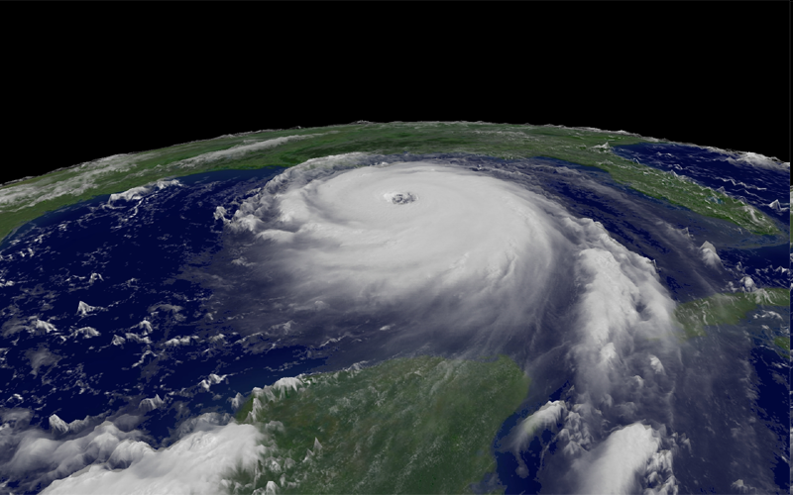
Lesson Aims
You will be able to explain how and why hurricanes are formed

Slide 3
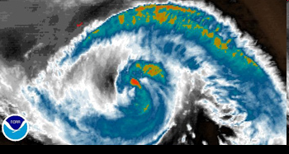

Slide 4
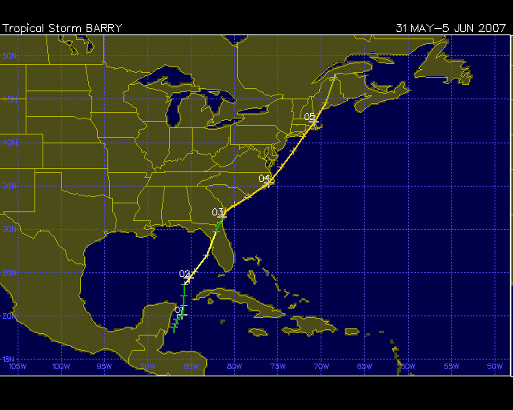

Slide 5
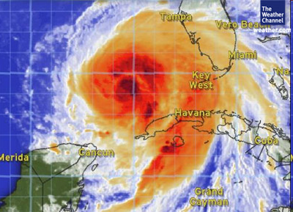

Slide 6
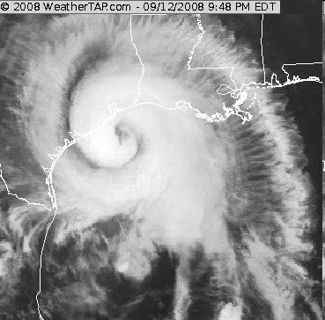

Slide 7
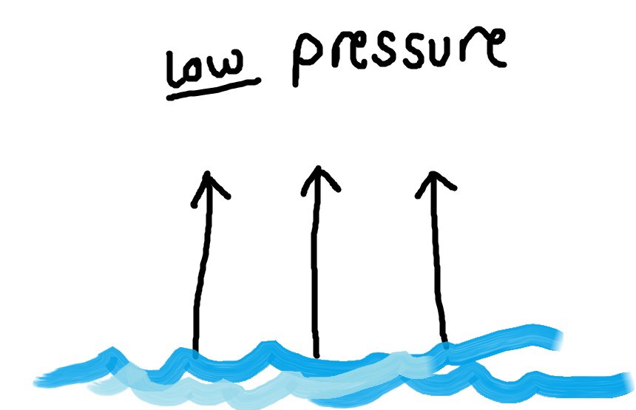
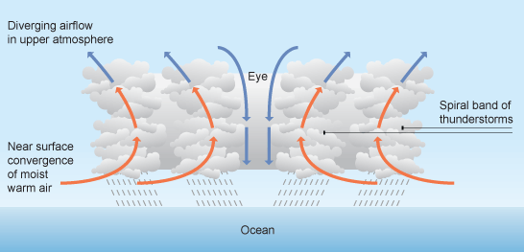
Tropical storms are large areas of intense low pressure and extreme depressions.
On a satellite image, a tropical storm will show as a huge, swirling mass of cloud.
The eye (calm area, no wind) is at the centre
The track is the path taken by a tropical storm

Slide 8
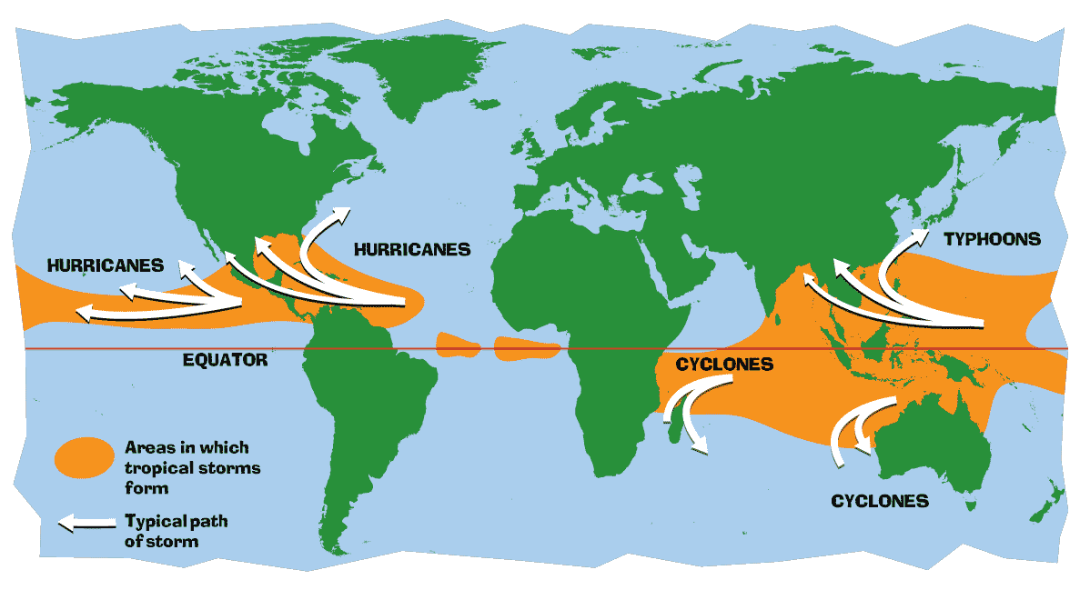
Formation
These storms occur over water in areas where the sea surface temperature is at least 27 degrees. (80F)
Essentially, this means that they form between the Tropic of Cancer and the Tropic of Capricorn (hence the name 'tropical' storm).
They rarely occur within 5 degrees either side of the equator because the Coriolis force is too weak here.

Slide 9
Formation in detail...
Tropical storms use warm, moist air as fuel. That is why they form only over warm ocean waters near the equator. The warm, moist air over the ocean rises rapidly upward from near the surface and becomes saturated with evaporated moisture. This means that there is less air left at the surface (i.e. low pressure). Air from surrounding areas with higher air pressure pushes in to the low pressure area to try to equalise the pressure. Then that “new” air becomes warm and moist and rises, too. As the warm air continues to rise, the surrounding air swirls in to take its place. Trade winds cause the moist air to spin inwards. As the warmed, moist air rises and cools off, the water in the air forms towering cumulonimbus thunderclouds (because there is a huge amount of condensation). The whole system of clouds and wind spins and grows, fed by the ocean’s heat and water evaporating from the surface.
natural-disasters-tornadoes.

Slide 10
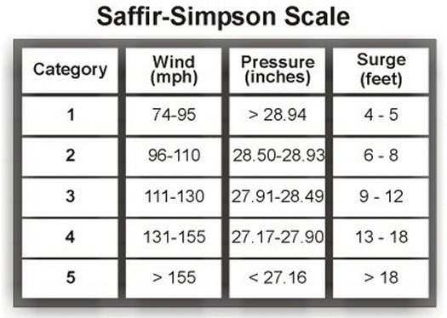
Measuring tropical storms
The strength of a tropical storm is measured using the:
Tropical storms usually weaken when they make landfall (i.e. hit the land) because they are no longer being fed by the energy from the warm ocean waters. In the northern hemisphere they track (i.e. move) westwards due to the Coriolis effect

Slide 11
You will see 8 statements – 5 are true reasons as to how a hurricane is formed.
TASK: In pairs you must decide the 5 which are true.
4 mins…

Slide 12
5. They start to form from really bad thunderstorms.
1. Warm ocean air. (more than 80 F)
2. Warm and cold air come together.
6. Winds flow outward above the storm allowing the air below to rise.
3. Damp air has to rise to make the clouds of the storm.
7. Winds have to be spinning clockwise.
4. Winds have to come together to force air upward.
8. Light winds outside the hurricane steer it and let it go.

Slide 13
hurricanes.
So what about the reality for people who get hit by them??
Watch this and imagine….
Tornado destruction
insurance advert

