Slide 1
How can we conserve the biosphere?
All (D Grade): Know and example of conservation
Most (B/C Grade): Explain various ways in which we can conserve the biosphere
Some (A*/A Grade): …and use examples to show how this works at different scales (e.g. local, national, global)

Slide 2
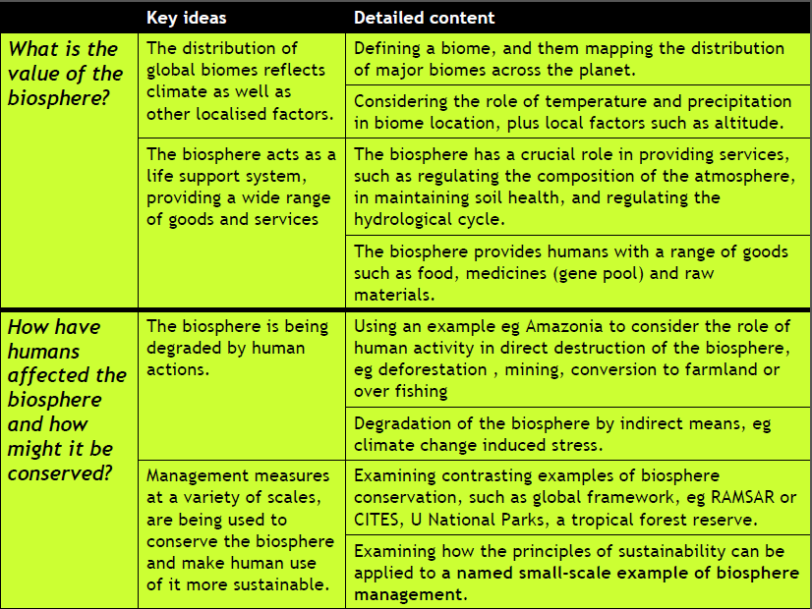

Slide 3
Conservation = protecting the environment (biosphere)

Slide 4
Conservation = protecting the environment (biosphere)
Global Scale
National Scale
Local Scale

Slide 6
Do we save hotspots or bits from every biome?

Slide 7
Should we just conserve in poor countries (as its cheaper to do it there)

Slide 8
Should we bother restoring devastated areas or just leave them

Slide 9
Should we put money into saving high-profile animals (e.g. giant pandas) or keystone species like bees which are important for the food web

Slide 10
Key questions for conservation…
Read page 52
Do we save hotspots or bits from every biome?
Should we just conserve in poor countries (as its cheaper to do it there)
Should we bother restoring devastated areas or just leave them
Should we put money into saving high-profile animals (e.g. giant pandas) or keystone species like bees which are important for the food web

Slide 11
Key questions for conservation…
Read page 52
Do we save hotspots or bits from every biome?
Should we just conserve in poor countries (as its cheaper to do it there)
Should we bother restoring devastated areas or just leave them
Should we put money into saving high-profile animals (e.g. giant pandas) or keystone species like bees which are important for the food web
Task
Using the diagram on p 52, imagine you have a budget of $40 billion. What would your priorities be for conserving the biosphere?
Write out how you would spend you $40bn
Explain the reasons for your choices.
Extension: was the decision hard to make? Explain.

Slide 12
GLOBAL CONSERVATION
Convention on International Trade in Endangered Species

Slide 13
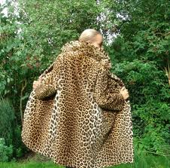
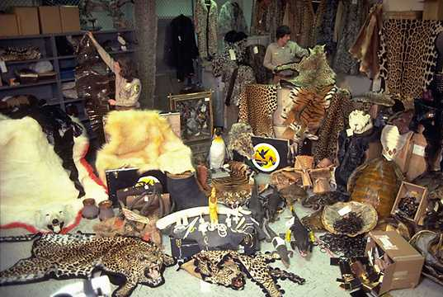

Slide 14
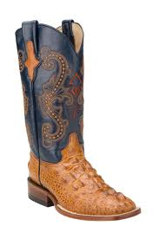

Slide 15
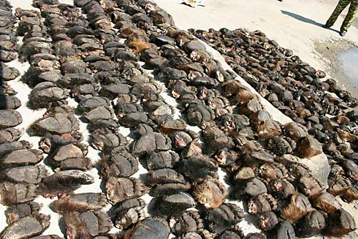

Slide 16
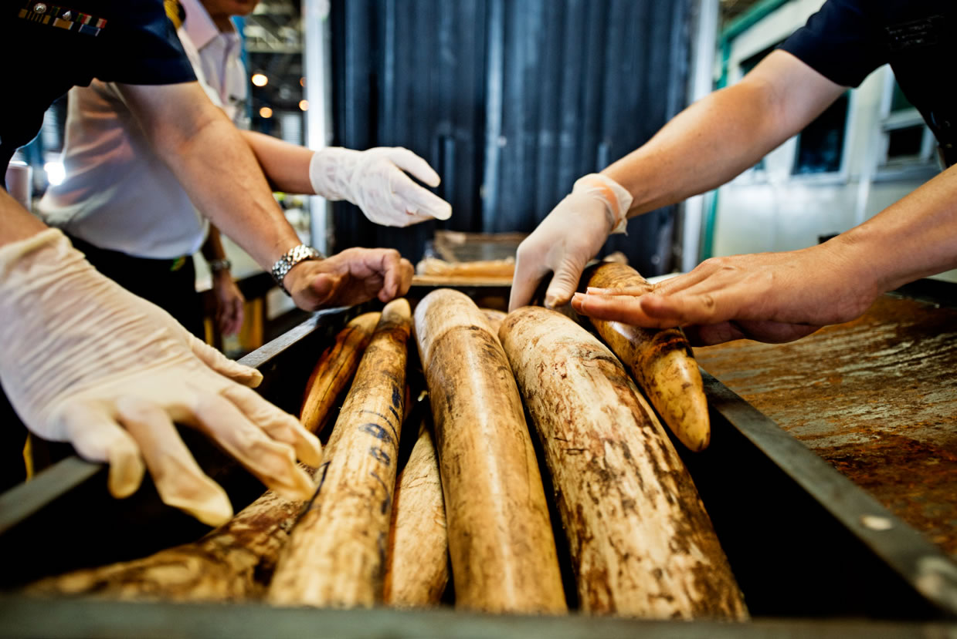

Slide 17
Some animals are endangered because….

Slide 18
Global action: CITES
Who: Convention on International Trade in Endangered Species
Where: Global scale
What: Tries to protect endangered species from hunting/ destruction e.g. elephants, Bengal tigers, hammerhead sharks
How: International law, policing
Protecting sharks
http://www.youtube.com/watch?v=voXqRtM-Tdk sharks
Protecting elephants
http://www.youtube.com/watch?v=wDfYWGPD52g elephants

Slide 19
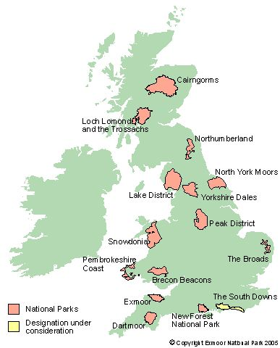
National action: National Parks
Who: UK Government
Where: example is the New Forest or Peak District
What: aims to protect wildlife and manage tourism
How: Providing habitats, paying farmers to replant hedge rows, providing tourist areas, providing footpaths, setting up breeding programmes, stopping new developments

Slide 20
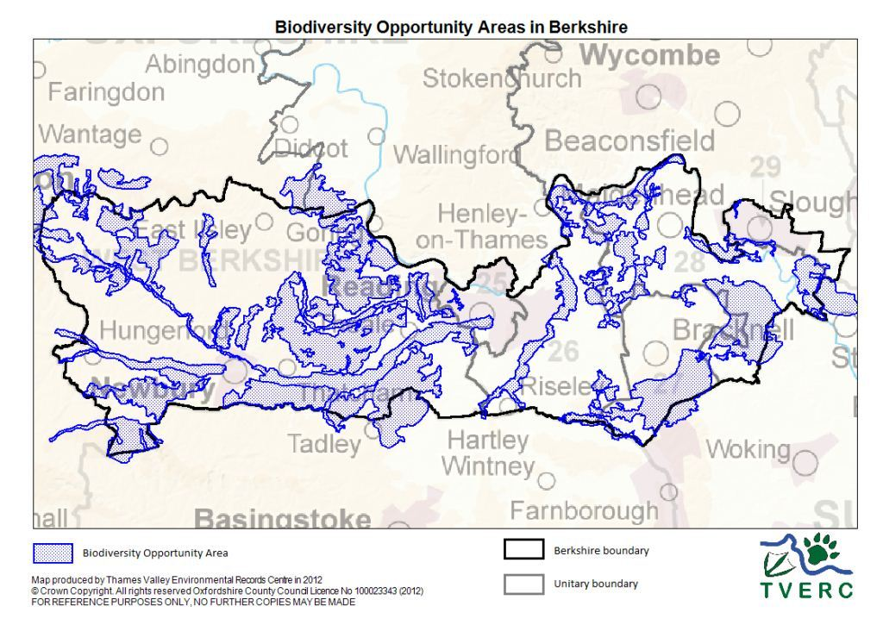
Local action: Biodiversity action plans
Who: Local Government UK
Where: all over UK, e.g. Bracknell forest
What: aims to protect biodiversity
How:
Improve condition of grassland SSSIs currently not in favourable condition
Increase the publics’ understanding of the importance of Bracknell forest
Locally sourced plants/seed to be used for meadow establishment/enhancement projects

Slide 22
Complete the sheet on different approaches to conservation
Global
National
Local
Extension: Evaluate which approach is best and explain why you think this

Slide 26
How can we manage ecosystems sustainably?
All (D Grade): Know the meaning of sustainable management
Most (B/C Grade): Explain what sustainable management involves
Some (A*/A Grade): …and be able to use a case study to explain this.

Slide 27
Starter: Wordsearch

Slide 28
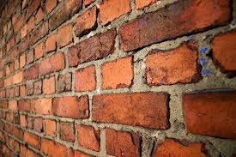
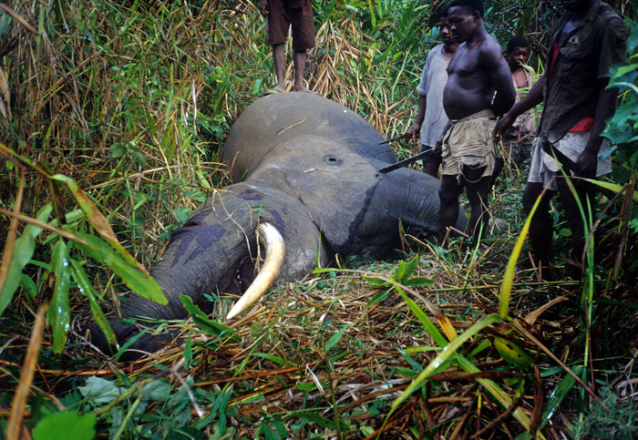
In the 1970s scientists realised that some types of conservation (by ‘closing off’ huge areas) didn’t work
People still harvested and poached/ hunted.
Another way was needed where the needs of people were balanced with conservations needs for the long term = sustainable management

Slide 29
Sustainable management
Scientific reserve (no access)
Wildlife parks and reserves
Economic development with conservation
Extractive reserves
Conservation
Total protection
Total Exploitation

Slide 30
Sustainable management
Scientific reserve (no access)
Wildlife parks and reserves
Economic development with conservation
Extractive reserves
Conservation
Total protection
Total Exploitation
C/D: Explain using p 54 what sustainable management of ecosystems is.
A-B: …. And Copy the diagram to show the continuum of conservation.

Slide 31
Examples
http://www.youtube.com/watch?v=Sw6Ug6RUPTQ La Cruz
http://www.bbc.co.uk/learningzone/clips/sustainable-forestry-using-animal-power/11966.html Sustainable forestry using animals
http://www.bbc.co.uk/learningzone/clips/rainforest-sustainability-costa-rica/3097.html sustainable management of a rainforest – costa rica

Slide 33
How can we manage ecosystems sustainably?
All (D Grade): Know the meaning of sustainable management
Most (B/C Grade): Explain what sustainable management involves
Some (A*/A Grade): …and be able to use a case study to explain this.
crossword

Slide 34
Most (B/C Grade): Explain what sustainable management involves
Task:
Aim: To create a copy of the diagram outside the classroom which shows an example of sustainable management
How: In table groups, appoint one person to be the drawer, and number the rest.
The drawer CANNOT go outside and see the diagram. The other members of the group cannot draw and must take it in turns to see the diagram – 30secs each.

Slide 35
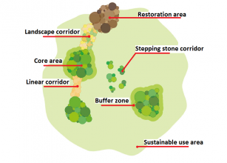
Kilum, Cameroon
Land divided into zones with different levels of protection
Core
Buffer zone
Sustainable use areas
Kilum, Cameroon – sustainable management of biosphere
D: write down four ways it is sustainable in bullet points
C/B: Explain using at least four ideas how sustainable management works here
A*/A: ….and explain clearly WHY this is sustainable in the long term
Extension: draw the diagram to show how zoning works.

Slide 36
Which is it more likely to be: Sustainable management or conservation?
Wildlife is totally protected in theory | All species focussed upon | Locals allowed to live inside reserve
Only scientists allowed inside a reserve | Local people helped out of poverty as part of this | Money gained from tourism in the area
Zoning system is used | Keystone species focussed upon | Poaching might still occur
What else could you add?

Slide 37
Revision
Self review of topic
Study revision guide

Slide 43
Revision lesson – Battle for the Biosphere
What you need to know:

Slide 46
