Slide 1
A2.1 how are energy resources used?

Slide 2
Aims
To know the ways in which modern civilisations depend on energy resources.
interpret data showing changes in patterns of energy consumption with standards of living and the use of different energy resources.

Slide 3
How is energy used?
Make pie charts to show how energy is used in the four displayed sectors.

Slide 4
Sector Name | Description | Major uses
Industrial | Facilities and equipment used for producing and processing goods. | 22% chemical production 16% petroleum refining 14% metal smelting/refining
Transportation | Vehicles which transport people/goods on ground, air or water. | 61% gasoline fuel 21% diesel fuel 12% aviation
Residential | Living quarters for private households. | 32% space heating 13% water heating 12% lighting 11% air conditioning 8% refrigeration 5% electronics 5% wet-clean (mostly clothes dryers)
Commercial | Service-providing facilities and equipment (businesses, government, other institutions). | 25% lighting 13% heating 11% cooling 6% refrigeration 6% water heating 6% ventilation 6% electronics

Slide 5
Displaying the information
Make two sets of bar charts.
The first bar chart will display the breakdown of the energy supply source.
Each of the bars will then be split to show where the energy is being used 9which sector).
The second set of bar charts will focus on the demand sectors – where the energy source is needed.
Again each bar will be split to show the energy resource that supplies the sector.

Slide 6
Supply Sources | Percent of Source | Demand Sectors | Percent of Sector
Petroleum 37.1% | 71% Transportation 23% Industrial 5% Residential and Commercial 1% Electric Power | Transportation 27.8% | 95% Petroleum 2% Natural Gas 3% Renewable Energy
Natural Gas 23.8% | 3% Transportation 34% Industrial 34% Residential and Commercial 29% Electric Power | Industrial 20.6% | 42% Petroleum 40% Natural Gas 9% Coal 10% Renewable Energy
Coal 22.5% | 8% Industrial <1% Residential and Commercial 91% Electric Power | Residential and Commercial 10.8% | 16% Petroleum 76% Natural Gas 1% Coal 1% Renewable Energy
Renewable Energy 7.3% | 11% Transportation 28% Industrial 10% Residential and Commercial 51% Electric Power | Electric Power 40.1% | 1% Petroleum 17% Natural Gas 51% Coal 9% Renewable Energy 21% Nuclear Electric Power
Nuclear Electric Power 8.5% | 100% Electric Power

Slide 7
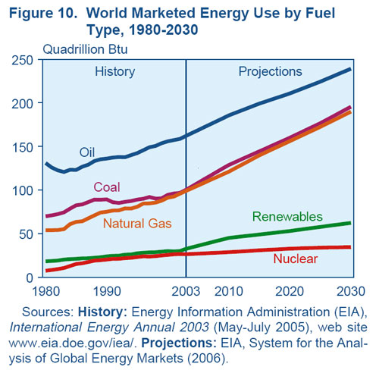
World changes in energy consumption

Slide 8
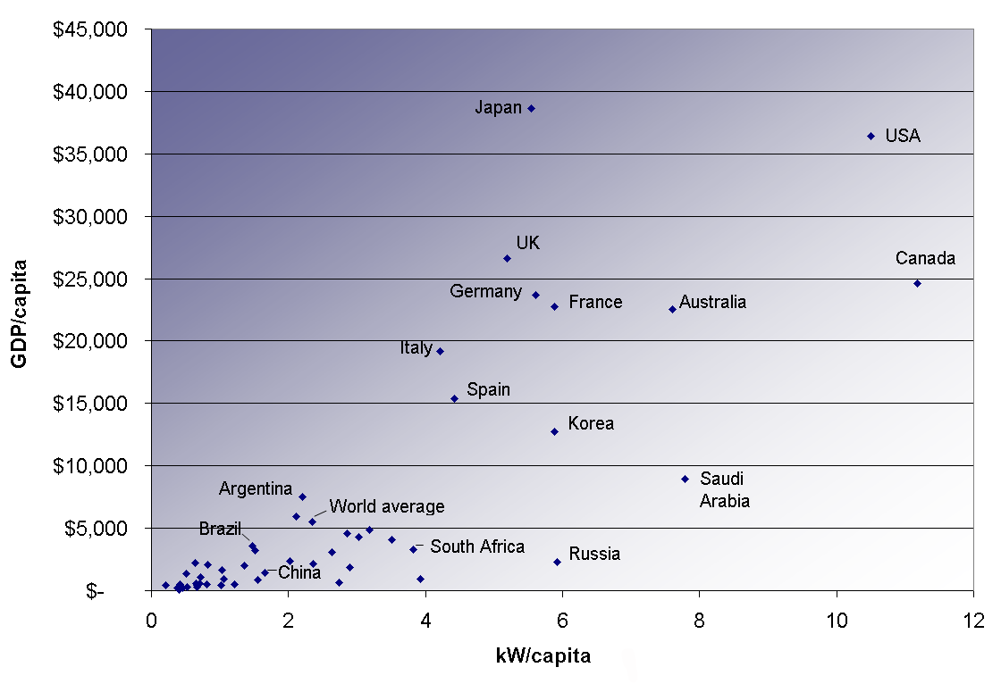

Slide 9
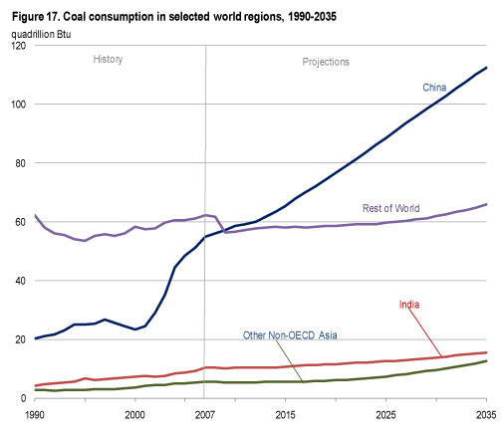
Why?

