Slide 1
Hard and Soft engineering: which is the better option?

Slide 2
Learning objectives
You will learn:
How hard and soft engineering are used to try to manage rivers and flooding
Why there is debate about the two options
How to evaluate the two strategies and come to a supported view about them

Slide 3
http://cgz.e2bn.net/e2bn/leas/c99/schools/cgz/accounts/staff/rchambers/GeoBytes/Content%20Generator%20Quizzes/Multiple%20Choice%20Quizzes/Year%2010%20Rapid%20Rivers%20Revision%202/Rapid_Rivers_Revision2.html
Starter – Quick Fire Quiz

Slide 4
Definitions
Soft engineering strategies – more natural ways to reduce the impact of flooding on humans, with less intervention and more preparation.
Hard engineering strategies – strong construction methods to hold floodwater back or keep it out.
LOOK AT THE FOLLOWING SLIDES DECIDE WHETHER THEY ARE HARD OR SOFT ENGINEERING TECHNIQUES AND THEN COMPLETE THE IMPACT, BENEFIT AND COST OF EACH ON THE SHEET PROVIDED.

Slide 5
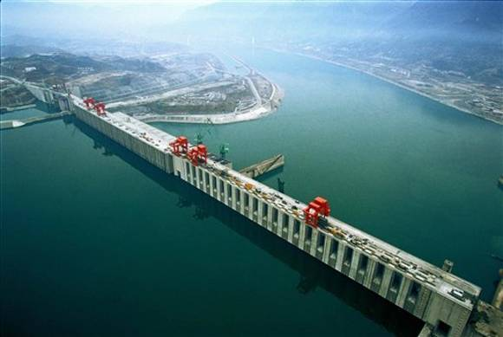
Building dams and reservoirs

Slide 6
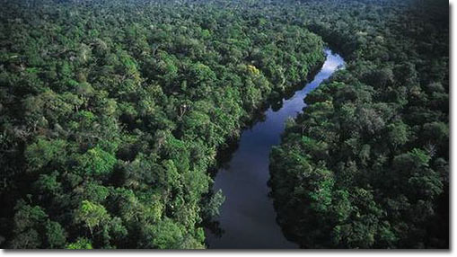
Planting trees in the drainage basin

Slide 7

Warn people

Slide 8
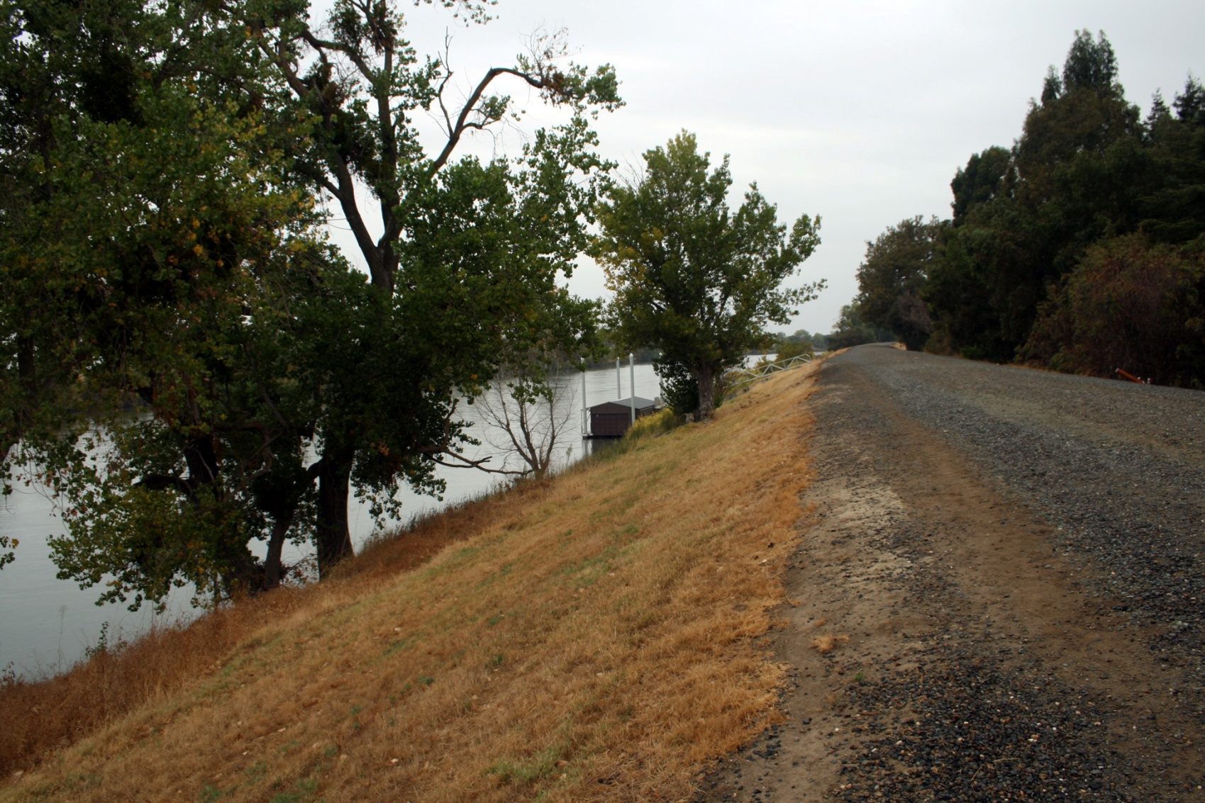
Dredging river beds and raising levees

Slide 9
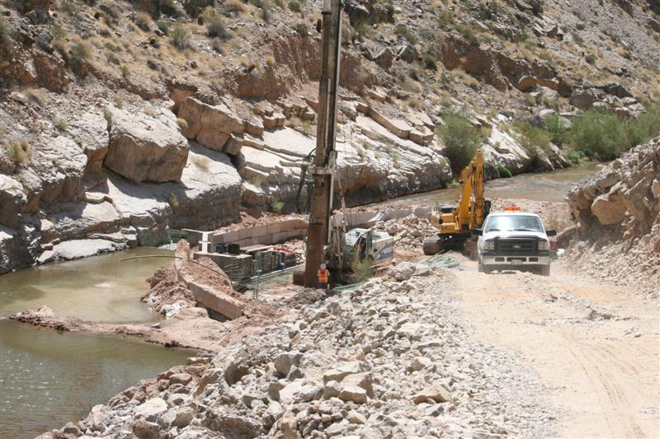
Build concrete walls

Slide 10
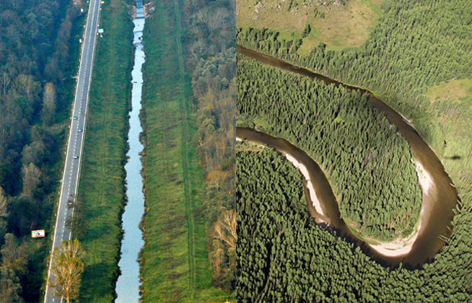
Straightening rivers for a faster flow

Slide 11
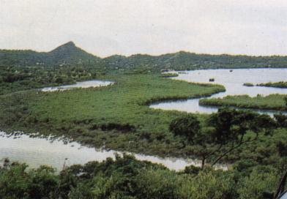
Land use zonation

Slide 12

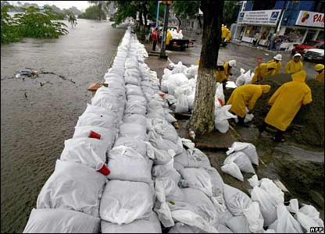
Preparation

Slide 13
Case Study: The three gorges Dam, China

Slide 14
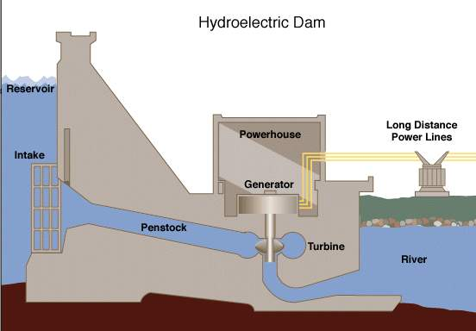
Starter: Take the quiz to find out how Hydro Electric Power works.
http://www.darvill.clara.net/altenerg/hydroquiz.htm

Slide 15
Three Gorges Dam
Watch the clips carefully and complete the casestudy sheet.
http://clipbank/espresso/clipbank/servlet/link?macro=setresource&template=vid&databaseType=cms&resourceID=909
http://clipbank/espresso/clipbank/servlet/link?macro=setresource&template=vid&databaseType=cms&resourceID=907
http://clipbank/espresso/clipbank/servlet/link?macro=setresource&template=vid&databaseType=cms&resourceID=910
http://clipbank/espresso/clipbank/servlet/link?macro=setresource&template=vid&databaseType=cms&resourceID=911
http://clipbank/espresso/clipbank/servlet/link?macro=setresource&template=vid&databaseType=cms&resourceID=914

Slide 16
http://clipbank/espresso/clipbank/servlet/link?macro=setresource&template=vid&databaseType=cms&resourceID=912
http://clipbank/espresso/clipbank/servlet/link?macro=setresource&template=vid&databaseType=cms&resourceID=913
http://clipbank/espresso/clipbank/servlet/link?macro=setresource&template=vid&databaseType=cms&resourceID=915

Slide 17
Plenary: Inside – Out….
How does Hydro electric power generate electricity?
What is the capital of China?
In which continent is China located?
Which countries have a border with China?
What is ‘hello’ in Chinese?
On what river is the Three Gorges Dam?
Why did the Chinese build the Three Gorges Dam?
What was the impact on the natural environment?
What benefits does the Three Gorges Dam provide for the Chinese economy?
What impact has the Three Gorges Dam has on the people?
Three Gorges Dam – Success or Failure?

