Slide 1
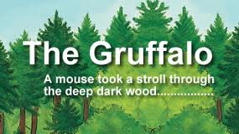
BY Julia Donaldson, Illustrated by Axel Scheffler , Publisher – Macmillan
See the story here

Slide 2
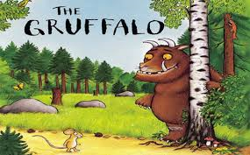

Slide 3
Today I will make a Gruffalo
Food Chain
Food Web
Create an ID Key for the Gruffalo characters

Slide 4
What is What?
Organism
Population
Community
Habitats
Ecosystem
Deep Dark Wood
Foxes
Gruffalo
Snakes, Owls and Mouse
Underground, Logpile and Treetop Houses

Slide 5
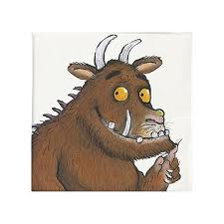
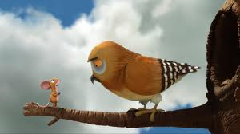
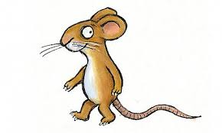
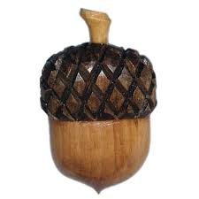
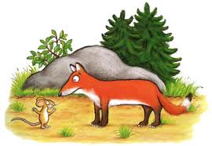
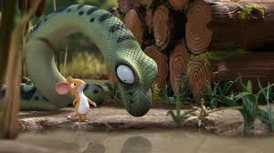
Use your knowledge and create a food chain and food web from these organisms

Slide 6
Food Chain
What do the arrows represent?

Slide 7
Pyramid of Numbers
The acorn has come from 1 Oak Tree
Its acorns are eaten by 50 Mice
Those 50 mice are eaten by 20 owls
The 20 owls are eaten by 1 gruffalo
What would a pyramid of numbers look like?
What would a pyramid of biomass look like?

Slide 8
Food Web

Slide 9
The Gruffalo was very hungry and decided to have roasted Fox every Sunday for a year. Explain in detail the effect of this on the mouse population and how it may have knock on effects to the rest of the animals in the deep dark wood.
The deep dark wood has a long winter which kills off all the Oak trees. Explain the consequence of this to the food web?
The Gruffalo and his child decided to have a massive party and put on a spread. What is the effect of this on the Oak trees if he has roasted fox with scrambled snake and for dessert he eats owl ice cream?
The Gruffalo had his favourite meal last night – mouse on a slice of bread. Describe what happens to the food web.
Mouse hunts the last Gruffalo for Gruffalo crumble. What will happen all the other organisms in the food chain?

Slide 10
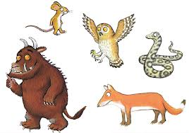

Slide 11
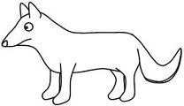
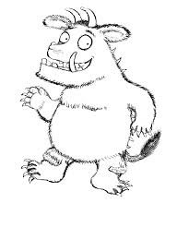
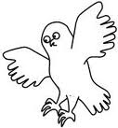
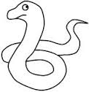

Slide 12
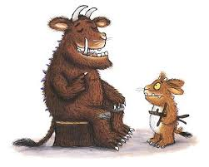
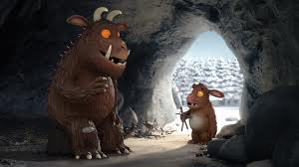
Remember
The Gruffalo and his child are of the same species. What does this mean?
Members of the same species can breed with each other to produce fertile offspring

Slide 13
The Gruffalo – ID Key
He has terrible tusks, and terrible claws, And terrible teeth in his terrible jaws
He has knobbly knees, and turned-out toes, And a poisonous wart at the end of his nose
His eyes are orange, his tongue is black, He has purple prickles all over his back
Are this inherited or environmental factors?
How would you describe the features of the other animals in the deep dark wood. Write down 3 or four features that ‘describe’ them.
-Mouse, Fox, Owl, Snake, Acorn

Slide 14
Use your descriptions to create an ID key
Is it an animal
Yes No

Slide 15
Adaptations
Explain how the Gruffalo is adapted?
He has terrible tusks, and terrible claws, And terrible teeth in his terrible jaws
He has knobbly knees, and turned-out toes, And a poisonous wart at the end of his nose
His eyes are orange, his tongue is black, He has purple prickles all over his back
Design, draw and annotate your own animal that lives in the deep dark wood. How can you describe it (like above)?

