Slide 2
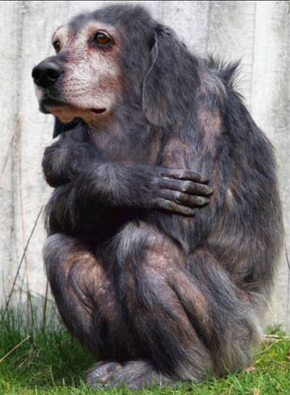
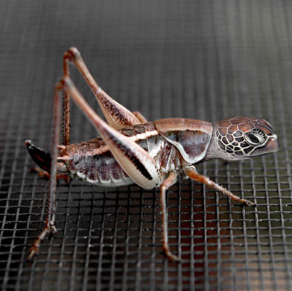
These don’t really exist!
✗
✗
Notes:
These don’t really exist!

Slide 3
The blue rose was created using genetic modification by Suntory Flowers in 2008 while the ‘black’ tulip is actually a dark purple colour and has been around since before the advent of genetic engineering.
✗
✓
Notes:
The blue rose was created using genetic modification by Suntory Flowers in 2008 (see http://www.telegraph.co.uk/news/worldnews/asia/japan/3329213/Worlds-first-blue-roses-after-20-years-of-research.html), while the ‘black’ tulip is actually a dark purple colour and has been around since before the advent of genetic engineering.

Slide 4
Purple tomatoes have been created by genetic modification to contain more antioxidants than normal tomatoeswhereas these purple carrots are naturally occurring and may have been one of the earliest forms of carrot, originating in modern-day Afghanistan over 5000 years ago
✓
✗
Notes:
Purple tomatoes have been created by genetic modification to contain more antioxidants than normal tomatoes (see http://news.bbc.co.uk/1/hi/7688310.stm), whereas these purple carrots are naturally occurring and may have been one of the earliest forms of carrot, originating in modern-day Afghanistan over 5000 years ago (see http://www.carrotmuseum.co.uk/history.html).

Slide 5
This famous mouse with the human ear was neither selectively bred nor genetically engineered to grow that ear. The "ear" was actually an ear-shaped cartilage structure grown by seeding cow cartilage cells (there was never any human tissue used) into a biodegradable ear-shaped mould. It was created to demonstrate a method of fabricating cartilage structures for transplantation into human patients. The glow-in-the-dark mouse, on the other hand, has been genetically engineered to contain a gene from a naturally glowing jellyfish (though I suspect this picture has been enhanced).
✓
✗
Notes:
This famous mouse with the human ear was neither selectively bred nor genetically engineered to grow that ear. The "ear" was actually an ear-shaped cartilage structure grown by seeding cow cartilage cells (there was never any human tissue used) into a biodegradable ear-shaped mould. It was created to demonstrate a method of fabricating cartilage structures for transplantation into human patients (See http://www.famouspictures.org/mag/index.php?title=Ear_Mouse). The glow-in-the-dark mouse, on the other hand, has been genetically engineered to contain a gene from a naturally glowing jellyfish (though I suspect this picture has been enhanced).

Slide 6
More glow-in-the-dark creatures: a glowing version of the zebrafish, known as the Night Pearl, is now on sale as a pet. The glowing jellyfish do that naturally, and it is their genetic material which has been inserted into the zebrafish.
✓
✗
Notes:
More glow-in-the-dark creatures: a glowing version of the zebrafish, known as the Night Pearl, is now on sale as a pet (see http://www.guardian.co.uk/uk/2003/jun/15/science.highereducation1). The glowing jellyfish do that naturally, and it is their genetic material which has been inserted into the zebrafish.

Slide 7
Glowing tobacco plant and piglets – both genetically engineered.
✓
✓
Notes:
Glowing tobacco plant and piglets – both genetically engineered.

Slide 8
Learning Objectives
Discuss ideas for and against designer babies
Understand some of the uses and potential problems associated with GM food production
Write a letter regarding your views on GM food production

Slide 9
Designer babies
Should we be able to...
Choose to have a girl because a boy is likely to have haemophilia
Select whether to have a boy or a girl
Choose to have a boy because the baby’s bone marrow could be used to save his 2 year old brother
Choose to have a girl because a boy is likely to be colour blind
Choose to have a gene added that would improve intelligence
Select the eye colour of the baby

Slide 10
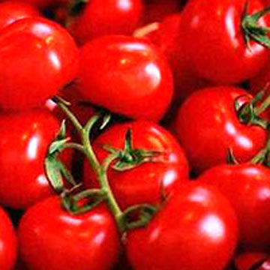
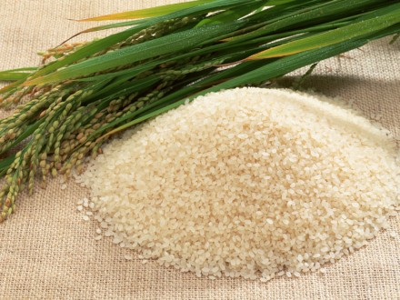
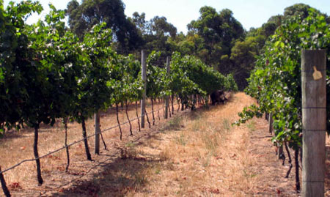
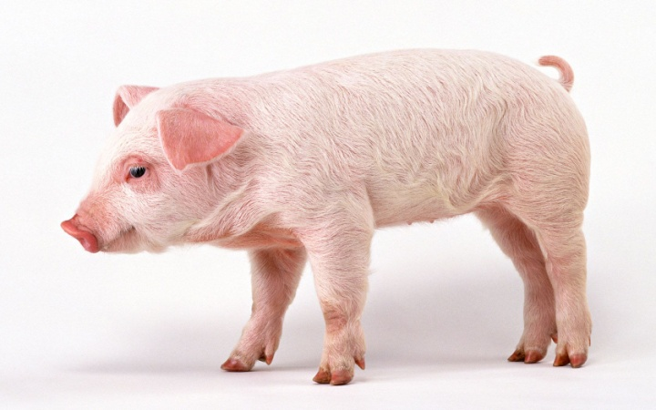
GM Foods

Slide 11
Your task:
What do you think will be the future of farming?
Write a Wikipedia entry for the year 3012 to explain your opinions.
Give a brief definition of your chosen method of farming.
Give it’s positive points
Outline the negative points for opposing this farming method.
Conclusion – briefly sum up your main points, stressing how your method of farming helps people in the longer term.

Slide 12
How should you write a Wikipedia page?
Formal conectives, you need to sound professional: however, although, therefore
Opinion words: I believe, I think, I feel, it is my belief that
Are you in favour of the idea or not
Reasoning: because, since, due to
Consider the opposite argument

Slide 13
Produce a fact sheet that details the advantages and disadvantages of growing GM crops
Success criteria
Include a definition of the term ‘genetically modified’
Give examples of three different GM crops
List four advantages and four disadvantages of growing GM crops
Factsheet should contain colour and pictures
Include at least one link to a recent news article about GM crops
Bonus criteria – comment on the reliability of your evidence (Where did it come from? Is it fact or opinion? Can you trust the source?)
Need help?
Instead of searching ‘everything’ or ‘images’, search the ‘news’ section in Google for help finding recent news articles.
Watch the following videos to help you (but use your ear phones!):
http://www.youtube.com/watch?v=4QFhD1E8GEs
http://www.youtube.com/watch?v=VGDdteUKwLQ
http://www.youtube.com/watch?v=jvZZg5uia-Y
Try the following websites:
http://news.bbc.co.uk/cbbcnews/hi/find_out/guides/tech/gm_foods/newsid_1746000/1746923.stm
http://www.nerc.ac.uk/research/issues/geneticmodification/
http://www.who.int/foodsafety/publications/biotech/20questions/en/
http://www.guardian.co.uk/environment/2007/jul/26/gmcrops
http://www.bionetonline.org/english/content/ff_cont3.htm
http://www.livestrong.com/article/370046-examples-of-gmo-foods/

