Slide 1
Anagrams
rasttionlanan radsnb
incomatucmnoi
Lgoo ycneoom
emoelnvpdte

Slide 2
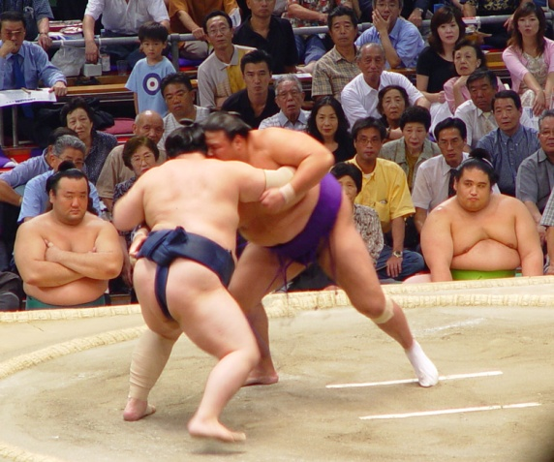
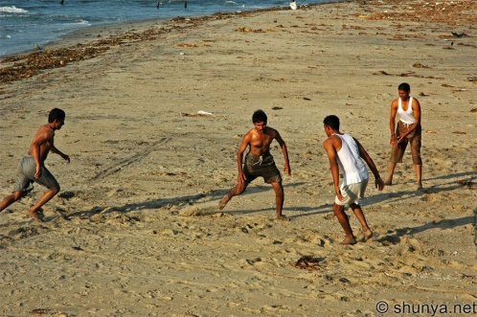
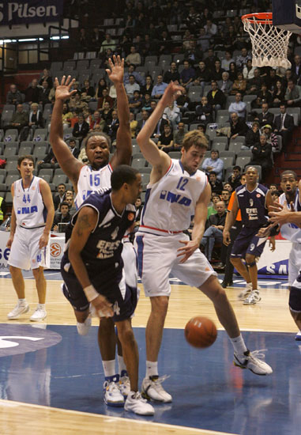
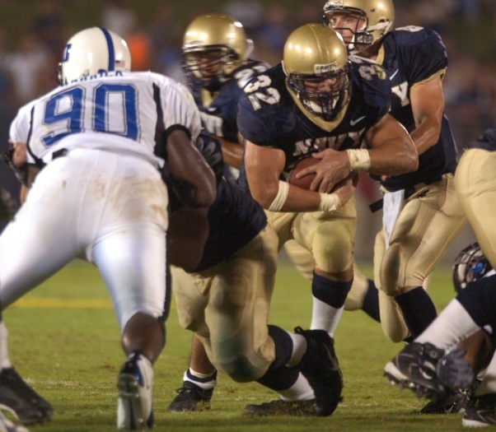
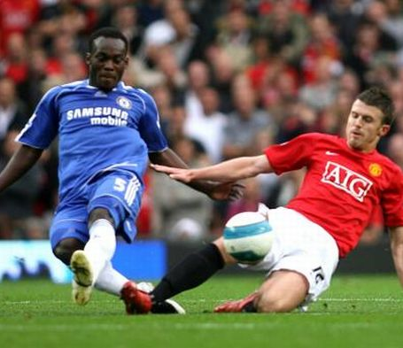
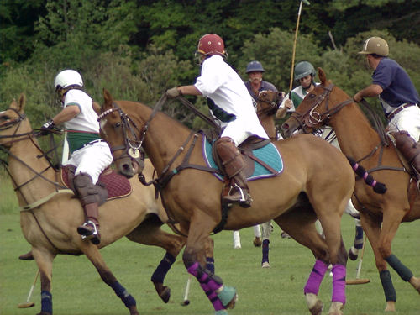
GLOBAL SPORTS
Rank the sports you have seen in order of which are most global
Kabbadi
Sumo wrestling
Basketball
American football
Football
Polo
Notes:
Culture, class, money, advertising, popularity, leisure, economy?

Slide 3
GLOBAL SPORTS
Why have you ranked them this way?
Explain your choice for the most global sport.
‘The reason why I chose …….. for the most global sport is…..’
Possible answers
Played by more people
Played in more countries
Lots of different people play it
Seen more on television.

Slide 4
LESSON 1
TITLE: Is success in football related to a countries level of development?
We Are Learning To:
Use an atlas to locate nations.
Describe and explain patterns building on what we have started.
What I’m Looking For:
1. A completed world map of countries who played in the 2006 world cup.
2. A description of the pattern of the locations of the countries.
3. An answer to ‘Is success in football linked to development?’

Slide 5
GLOBAL SPORT
What makes football a global sport and why is it a global sport?
It is not linked
with a culture.
Different countries play
Most of the world know about it.
Popularity
It is a popular leisure activity.
Teams across the world
Shown on television
Advertising
Big companies sponsor football.
A lot of money in it.

Slide 6
If a country is developed it has better….

Slide 7
Key Ideas/Words
Location
Development
Economy
Place
Sponsorship

Slide 8
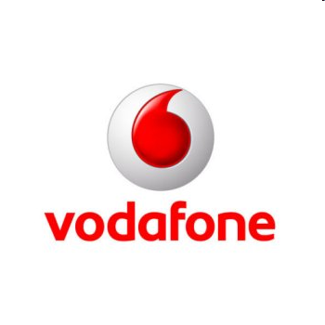
Football Team Sponsorship
Chelsea Samsung Mobile (Electronics) £10 million
Manchester United Vodafone (Telecoms) £9 million
Manchester City Thomas Cook (Travel) £1 million
Birmingham City Flybe (Airline) £800 000
Portsmouth Oki (Printers) Japan £350 000
Newcastle United Northern Rock (Finance) £5 million
Bolton Wanderers Reebok (Sportswear) £500 000
Wigan JJB (Retailer) £350 000
Liverpool Carlsberg (Brewing) £5 million
Charlton Athletic All:Sport (Retailers) £500 000

