Slide 1
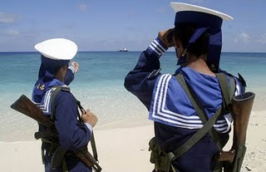
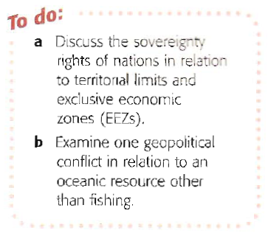
The International Community and the Ocean
1. Attempts to deal with problems
2. Geopolitics and emerging problems.

Slide 2
Some Issues
In recent years there have had to be a number of meetings to discuss problems that cross boundaries and EEZ’s
1972 – Stockholm convention on dumping of waste at sea – aim to urge governments to stop this practice
1996 – The International Maritime Organisation given powers to further enforce this.
In Europe a number of further laws have banned dumping of toxic and radioactive waste in drums, as well as set limits on Sewage and other effluent.
International Whaling Commision reduction in whaling since 1980s has seen a rise in stocks.
Note – the Role of Civil Society in getting to this level.

Slide 3
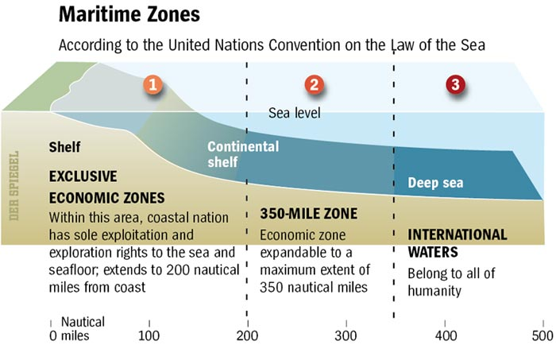
UN Convention on the Law of the Sea
Signed in 1982 but not enforced until 1992 this has been important in defining who owns what
Potentially claimable
EEZ’s have a large impact on management and conservation of resources.
Recognises rights to over 98million km2
Those states can exploit all resources – fish, oil, gas etc
Almost 90% of all known oil reserves fall within EEZ’s
Up to 98% of worlds fishing zones fall within an EEZ
Source – Nagle and Cooke

Slide 4
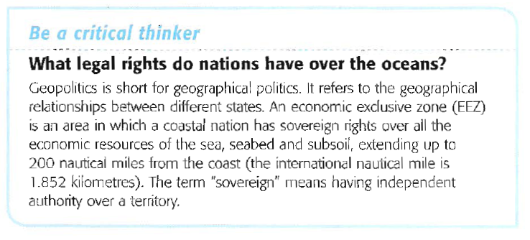
The Geopolitics of Oceans

Slide 5
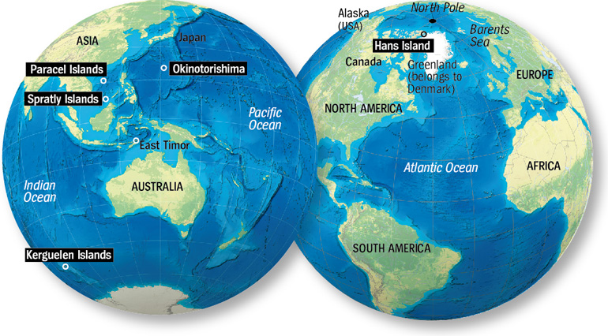
Case Studies of Geopolitics
http://www.spiegel.de/international/world/0,1518,557487,00.html

Slide 6
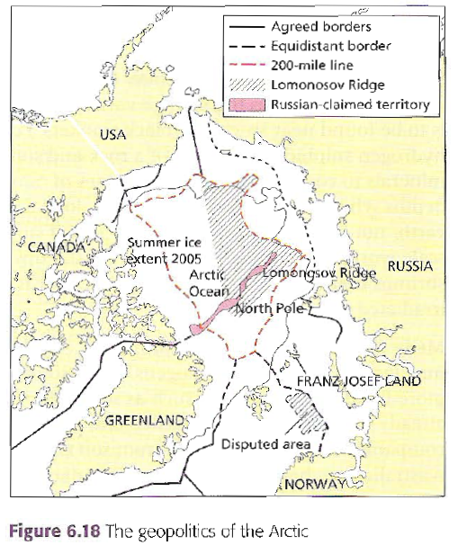
Case Study 1 – The Arctic Ocean and the Scramble for Resources
Create a case study
What is the problem all about?
Why is it happening now?
Who are the nations involved and what does each want?
How have they tried to resolve the problem?
What are the claims of each country?
When did this happen and is it still happening?
Which groups are for and which are against it?
Maps are important, and they must be annotated

Slide 7
Case Study 2 – The Indian Ocean
Prepare a 3 minute speech in which you will inform the rest of the class about the Geopolitical situation in either
A: The Indian Ocean
B: one of the locations on the map

