Slide 1
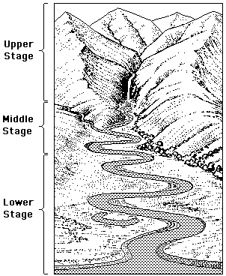
GCSE revision
3 stages and features of rivers

Slide 2
Upper-course river features include:
steep-sided V-shaped valleys,
interlocking spurs,
rapids,
Waterfalls
gorges.
These are all features formed by EROSION!

Slide 3
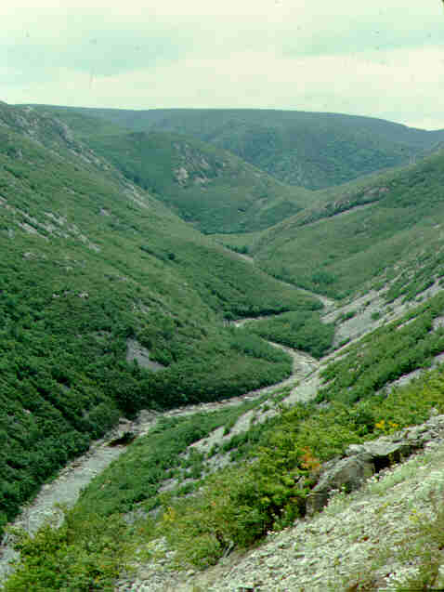
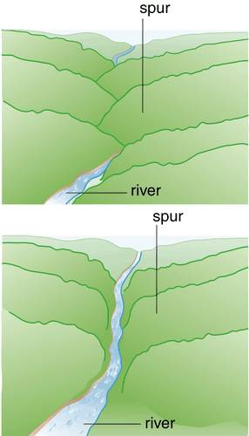
Spurs…..

Slide 4
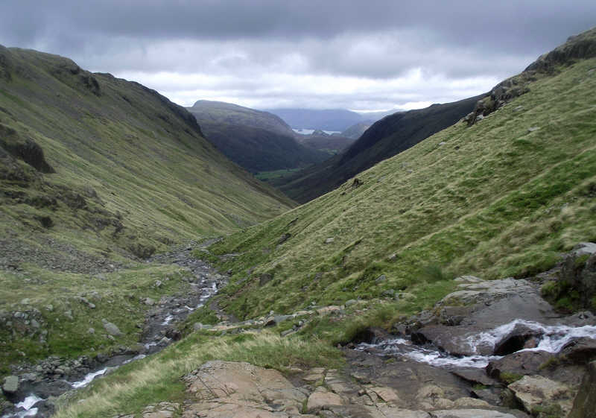
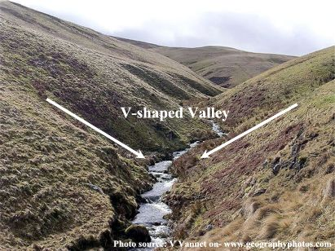
V-shaped valley

Slide 5
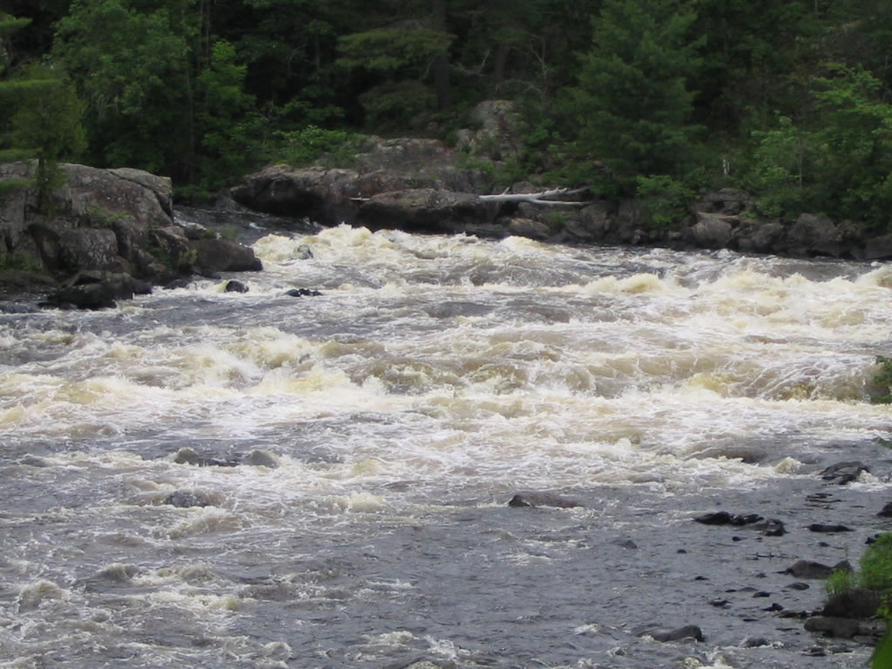
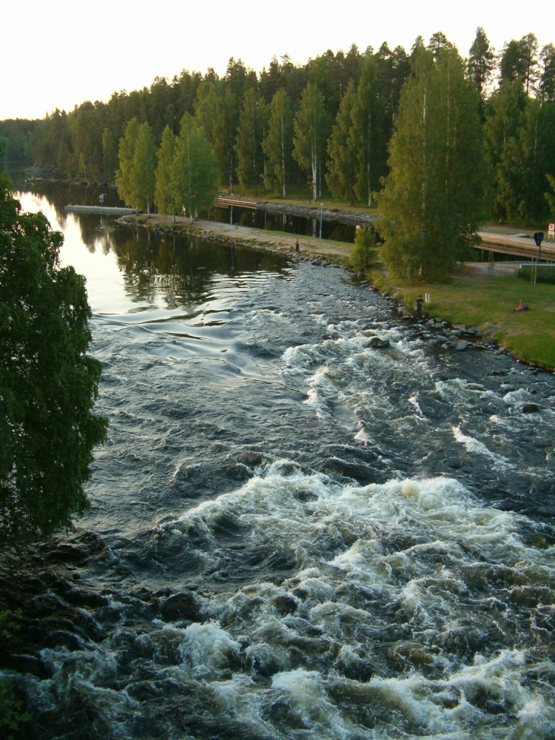
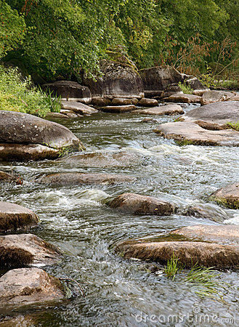
Rapids…….

Slide 6
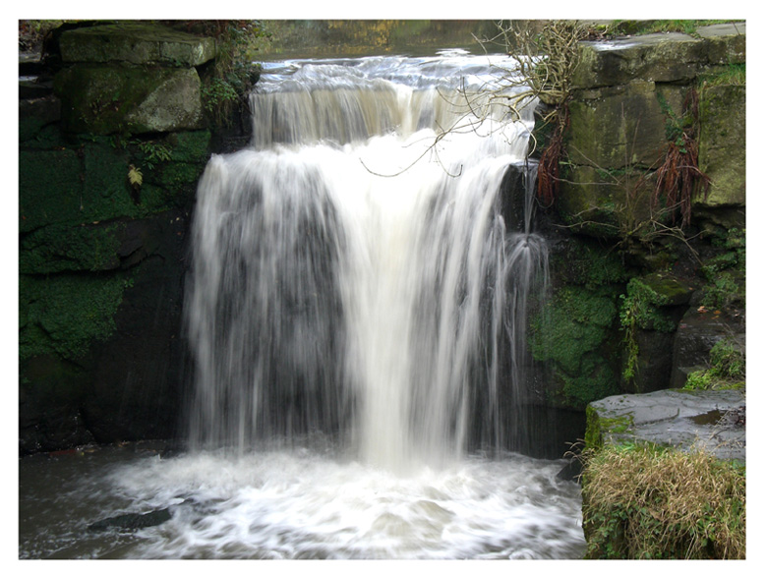
Waterfalls….

Slide 7
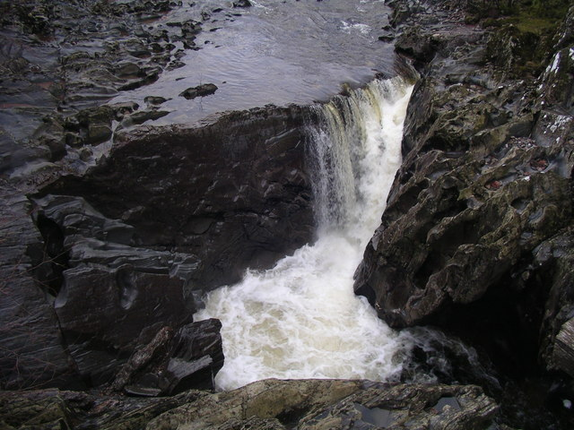
Gorges….

Slide 8
Key Words
Hydraulic Power
Corrasion
Corrosion
Attrition
Water/debris is forced into cracks
Rocks /stones erode bed and sides of river bank.
Rocks get smaller by chemical action
Rocks such as chalk and Limestone
Rocks get smaller when knocked together

Slide 9
The Upper Course of a river
Processes of erosion
Hydraulic power
This is the force of the water on the bed and banks of the river, powerful when in flood, the force of the water removes material from the bed and banks of the river.
Corrasion
When the river is particularly full, pebbles and boulders are carried along by the water. These rub against the bed and banks of the river and wear them away. The process is called abrasion.

Slide 10
Processes of Erosion
Corrosion
River water sometimes causes some rock to slowly dissolve. (e.g. limestone dissolves in slightly acid water and is carried away in solution (as a liquid) as calcium hydrogen carbonate).
Attrition
The pebbles and small rocks being carried by the river- the load- collide and rub against each other, breaking up into smaller and smaller pieces. The rough edges become smooth, forming smaller rounded material. Eventually the particles are reduced to sand and silt-sized particles

Slide 11
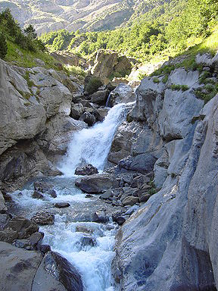
In your table groups write down answers to these questions on an upper course photograph
How steep are the slopes?
How wide is the channel?
What is the bed load like?
What are these?
Where has most of the erosion happened here?
How fast is the water moving?

Slide 12
The Middle Course
Learning Objective
To know the 4 ways a river transports its load.
Success Criteria
I can explain river transport and apply key vocabulary.

Slide 13
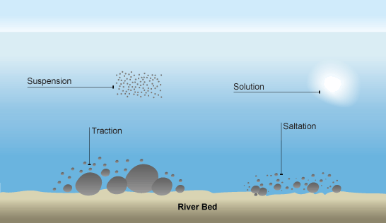
Transportation

Slide 14
Traction
Heavy rocks and boulders are rolled along the river bed. Happens most in times of flood, when the current is strongest.

Slide 15
Saltation.
Small stones and pebbles are ‘bounced’ along the river bed. Saltation can take place when the river flow is less than that needed for ‘Traction’ to take place.

Slide 16
Suspension
Very small particles of sand or clay that are ‘suspended’ in the water. These particles will ‘settle’ if kept in a jar of water overnight and the water will look clear.

Slide 17
Solution.
Takes place when material is dissolved in the water, it is invisible and does not colour the water. Occurs often in limestone landscapes where the water if very acidic. Some pollutants like weedkiller are also held in solution in the water

Slide 18
Methods of transport
river processes video
Copy this picture into your books and add the title above and labels for each type of transport
Shows the rate of flow needed
Traction Saltation Suspension Solution

Slide 19
The middle course of a river
Meanders
Deposition on inside bend
Erosion on outside bend

Slide 20
Feature of the middle course
A Meander (cross-section)
A
B
A
B
Label the diagram with the following words and statements:-
Outside bend, inside bend, erosion, deposition, river cliff, deepest water and fastest current.

Slide 21
Feature of the middle course
A Meander (cross-section)
A
B
A
B
Outside bend, inside bend, erosion, deposition, river cliff, deepest water and fastest current.

Slide 22
The lower course of a river
Ox-bow lakes
Flood plains

Slide 23
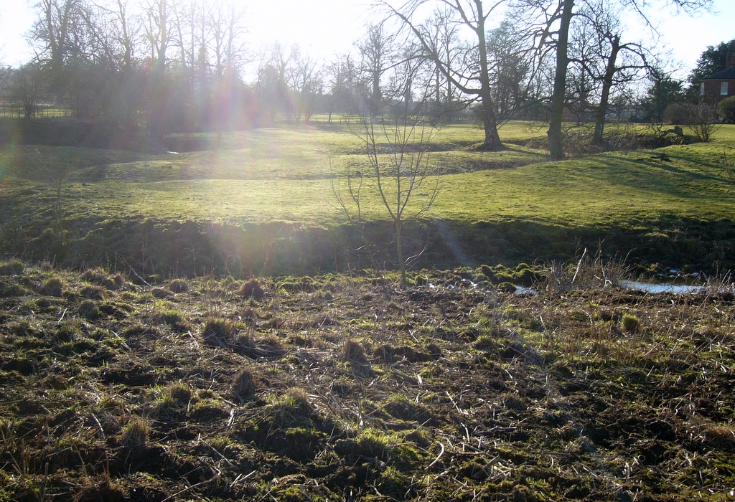
River straightens at this point and cuts off the ox-bow
Steep undercut bank
Oxbow or ‘cut-off ’ lake
New course of the river
Part of the flood plain

Slide 24
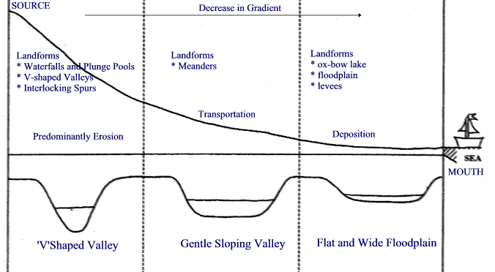
Long Profile of a River

