Slide 1
Watch carefully
What does this show us???
Notes:
Show next slide ask students to write on their white boards what this has actually shown them in scientific terms (food chain) although there are more than one animal that eats the producers and there could be more than just us that eats the primary consumer. Chicken can be eaten by fox etc
Introduce the move from food chain into food web

Slide 2
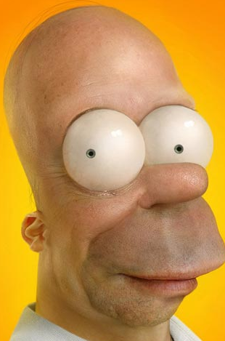
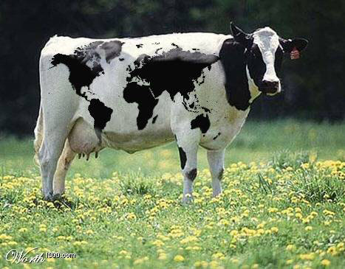
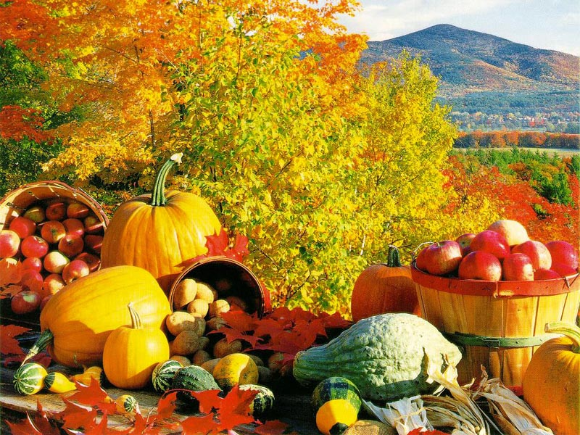
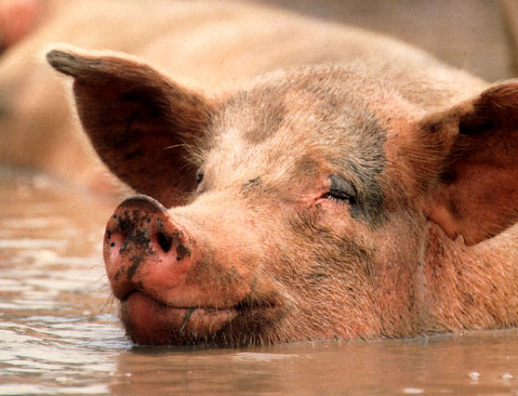
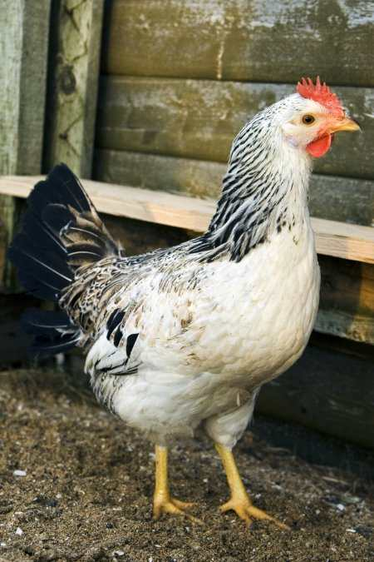
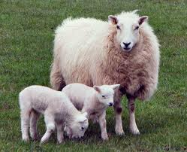

Slide 3
Guess your title
FOOD WEB

Slide 4
Food Webs
Describe the feeding relationships shown by food webs (Level 4)
Explain how changes to one population can affect another (Level 5)
Explain how specific human activities deplete the resources available for organisms (Level 3-6)

Slide 5
Food Chains: shows us who is eating who
eg grass → rabbit → fox
Sort these into TWO food chains:

Slide 6
Food Webs: a number of interlinked food
chains together – animals don’t tend to eat
only one thing!
eg page 59 Exploring Science 8

Slide 7
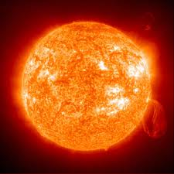
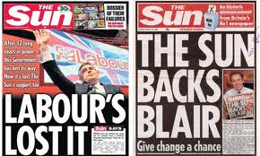
Any food web has four major elements:
1) The SUN: provides the energy in every
food chain

Slide 8
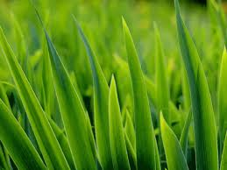
2) Producers: plants can make their own food,
harnessing the sun’s energy through
photosynthesis, and can be found at the
bottom of all food chains.They are the largest
part of any food web.

Slide 9
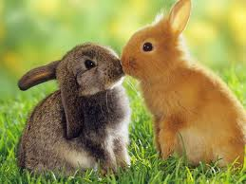
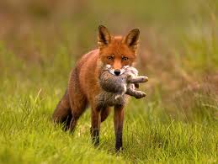
3) Consumers: organisms that eat other
organisms. They can’t make their own food
from sunlight so get it by eating others.
Primary consumers – eat producers, eg rabbits,
also known as _________
herbivores
Secondary consumers – eat primary consumers,
eg foxes, also known as _________
carnivores
Omnivores - eat producers and consumers (meat
and plants)
Parasites - live off other animals, using the
victims energy
Scavengers - feed on carcasses (dead bodies)

Slide 10
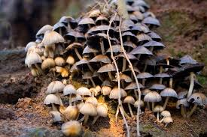
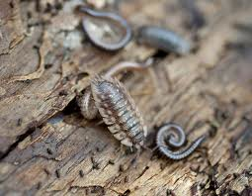
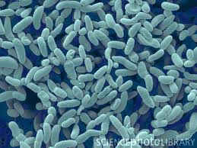
4) Decomposers: mostly bacteria and fungi,
cause mould and the rotting of dead plants
and animals. Very important as they allow
nutrients to be recycled. They are very
rarely written in food chains or webs but are
vitally important in all of them.

Slide 11
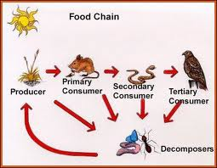
A truly accurate food chain should look
like this:
Actually, where is there an arrow missing?

Slide 12
Learning Objectives
Describe the feeding relationships shown by food webs (Level 4)

Slide 13
Learning Objectives
Explain how changes to one population can affect another (Level 5)
You’ve done it the more complicated way –
by looking at food webs.
The graph on page 59 shows a population of
predators and their prey;
explain the relationship as simply as you can.

Slide 14
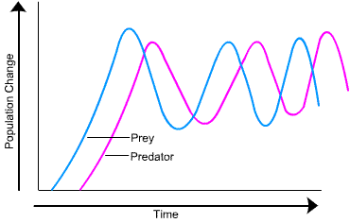
In a stable environment the populations of predators and prey will fluctuate in a regular pattern, as shown in the graph.
If the population of prey increases, there will be more food for predators, so their population will also increase.
However, as the population of predators increases more food is needed so eventually the population of prey will decrease.
This means less food for the predators, so their population falls again.

Slide 15
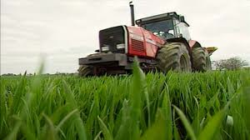
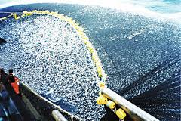
Explain how specific human activities deplete the resources available
for organisms (Level 6)
With the person next to you come up with
as many different examples you can think of…
HINT: Think in terms of the following types
of activity – what others impact food webs?

Slide 16
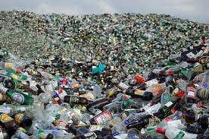
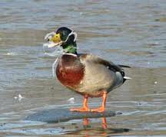
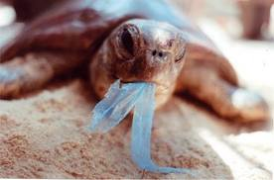
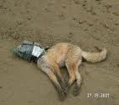
YOU CAN DIRECTLY AFFECT FOOD CHAINS
IF YOU DON’T PUT YOUR LITTER IN BINS!!!

