Slide 1
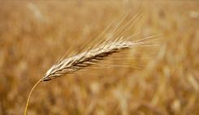
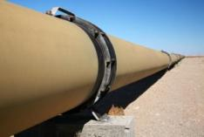
Task 1
Types of Biofuels
Bioethanol from trees, grasses, waste
Bioethanol from duel–use crops
Biogas
Biofuels from algal

Slide 2
Circle the room to read about each biofuel type – Answer the following questions on your worksheet!
Where is the biofuel used?
How does it work?
What are the possible advantages of using this biofuel? Clues, environment, people, wildlife, money
What are possible disadvantages of using this biofuel?
Document any other interesting information

Slide 3
YOUR TASK
You need to choose the biofuel you would be most likely to sell to a businessman.
Write a report on your chosen biofuel:
Introduce your biofuel and location
outline the advantages
Acknowledge the disadvantages
Sum up your points and explain why this is the best renewable energy source for the future

Slide 4
plenary –
Which biofuel type do you think is the worst and why?

Slide 5
Read, write, run!
Read about your case study –
write the Answers to the following questions as you find them on your colour post it!
Have the chosen runner from your team come to stick them on the board under your case study.
The first team to finish is the winner. Chose someone to present your case study.

Slide 6
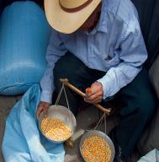
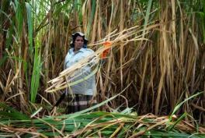
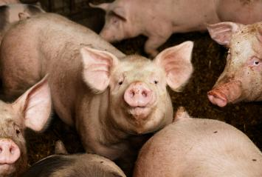
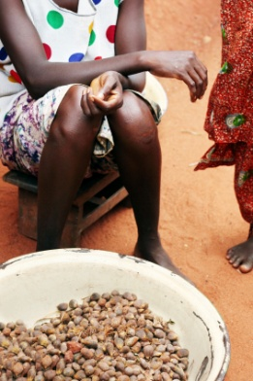
Task 2
Bioethanol from corn in the USA
Bioethanol from sugar cane in Brazil
Biodiesel from palm oil in Malaysia
Biogas from pig poo in the UK

Slide 7
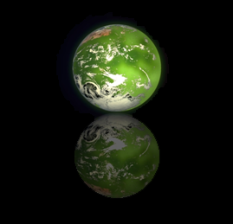
How did it affect local people?
Why was the biofuel attractive to use in the first place?
Was everybody happy with the outcome? Why or why not?
How might it affect future generations?
How did it affect the environment?
In the end do you think producing the biofuel was a morally good thing to do or not? Explain why…
How did it affect wildlife?
How did it affect human rights?

Slide 8
 | Why was the biofuel attractive to use in the first place? | How did it affect local people? | Was everybody happy with the outcome? Why or why not? | How did it affect the environment? | How did it affect human rights? | How did it affect wildlife? | How might it affect future generations? | In the end do you think producing the biofuel was a morally good thing to do or not? Explain why…
Malaysia
UK
Brazil
USA

Slide 9
Feedback your case study to the class!
This was our country and this is what they did
These were the main effects
Fill in your worksheet with the other case studies.

Slide 10
Starter:
From what we have learnt so far, do you think biofuels production should have gone ahead in each case?
‘body’ vote - move to 3 sections of the room, those who think that: 1) yes they should have gone ahead, 2) no they shouldn’t, 3) it depends or not sure
Be prepared to explain your position

Slide 11
What do you think?
Ready?

Slide 12
What do you think?
Should not
WHY?
Should
Depends/not sure

