Slide 1
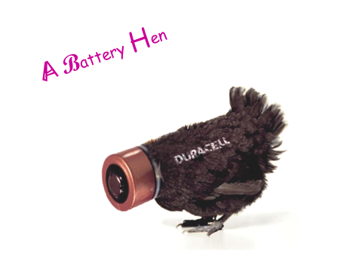
Crime in the local farms – Where do your eggs come from?
Objective:
1)Describe and explain animal welfare
2) Understand the problems of Battery Hens
3) Develop a sense of responsibility towards the food you eat.

Slide 2
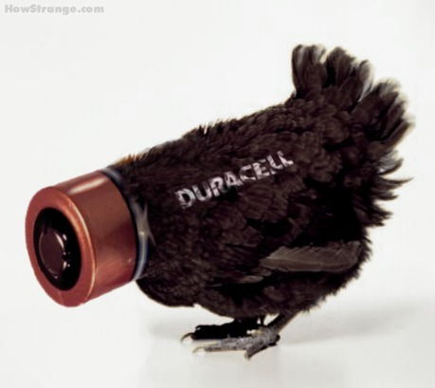
A Battery Hen

Slide 3
Starter
What does your A4 paper have to do with today’s lesson?

Slide 4
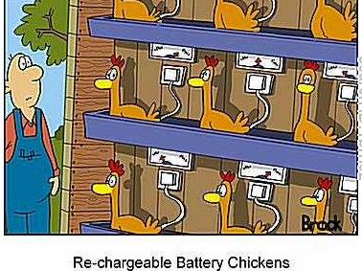
Animal Welfare

Slide 5
Learning Objectives
Describe and explain animal welfare
Understand the problems of Battery Hens
Develop a sense of responsibility towards the food you eat.

Slide 6
What is animal welfare?
Animal welfare is the protection of animals. It is taking care of an animal’s physical and psychological well being.
Just like humans they have certain rights.
Can you list some of your rights as a human?
LO1) Describe and explain animal welfare

Slide 7
Animals and the Law
Animal Welfare Act 2006
A suitable place to live.
Suitable food and water.
To be able to behave normally
To be with other animals or alone- whatever suits that type of animal.
To be protected from pain suffering and injury and disease.
Are any of these the same as what we would expect as humans?
LO1) Describe and explain animal welfare

Slide 8
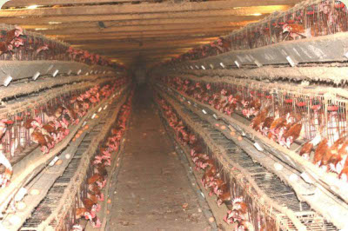
Battery Hens

Slide 9
What do we mean by battery hens?
These are hens which are kept in small cages, their only purpose is to lay eggs.
No room to turn round, no natural light, fed high protein food.
The food and water is constantly in front of them and they have nothing else to do but eat and lay eggs.
No perches, they sleep in their wire crates.
They have false or extended daylight hours by keeping the lights on for much of the day to encourage them to lay.
LO2) Understand the problems of Battery Hens

Slide 10
What happens next?
At 18 months old they are past their maximum producing egg laying days for the industry, so they are sent off to be slaughtered.
Most hens can and do live for up to 10 years or more but because they spend approx 18 hours of their days for 18 months of their lives under false lighting to stimulate them into laying more eggs, they are spent out of eggs for mass production.
LO2) Understand the problems of Battery Hens

Slide 11
Some don’t even make it to a cage
These are day old cockerel chicks which are on the conveyor belt to death. Straight down into the mincing machine.
This is what happens, so the consumer can buy CHEAP EGGS FROM BATTERY HENS.
chicks
LO2) Understand the problems of Battery Hens

Slide 12
Battery Hen Mission
You are a specialist advisor for the government. Your mission is to find out whether hens should be kept in batteries or whether they should be free.
However there is a twist…
LO2) Understand the problems of Battery Hens

Slide 13
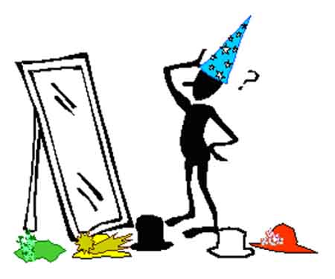
Thinking hats
LO2) Understand the problems of Battery Hens

Slide 14
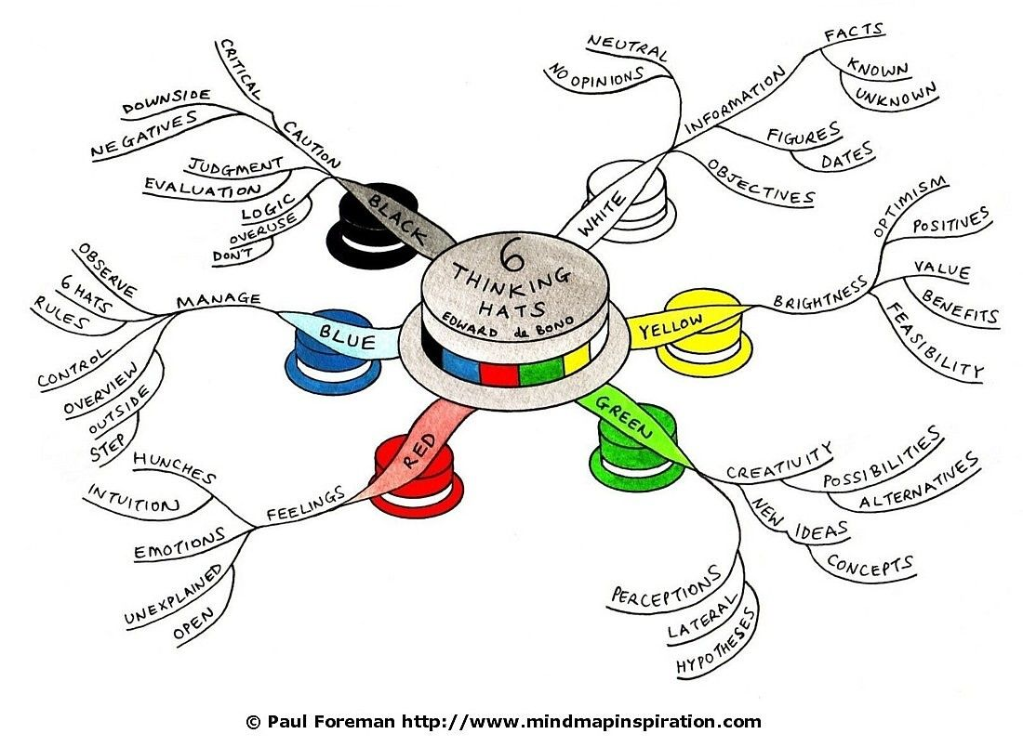
LO2) Understand the problems of Battery Hens

Slide 15
Thinking Hats
Answer the following question in your hat:
“Should hens be kept in battery cages or should they be free“
E.g. If you are RED… you are emotional, you look at the feelings behind battery hens.
GREEN…. Can you think of any alternative solutions for battery hens.
You have 10 minutes
LO2) Understand the problems of Battery Hens

Slide 16
Steps to Success
Understand your thinking hat- know what you are looking for.
Write up your answer to the question:
“Should hens be kept in battery cages or should they be free“
You have 10 minutes
LO2) Understand the problems of Battery Hens

Slide 17
Peer Assessment
What Went Well…
Remember which thinking hat your partner had on!
Even Better If…
LO2) Understand the problems of Battery Hens

Slide 18
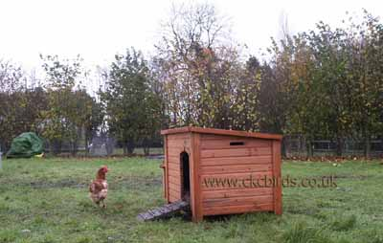
Free Range Hens
LO3) Develop a sense of responsibility towards the food you eat.

Slide 19
Battery hens see grass
picture your life
Make a note of how the chickens react in their new home
Does their behaviour change over time?
Why do you think this might be?
LO3) Develop a sense of responsibility towards the food you eat.

Slide 20
What can we do to help?
?
LO3) Develop a sense of responsibility towards the food you eat.

Slide 21
Task
Which type of farming is better: Intensive or extensive?
Using pages 112 -115 of your IGCSE Geography books complete the note taking worksheet and then making reference to the case studies you have researched answer the above question.

Slide 22
Plenary
What does your A4 paper have to do with today’s lesson?

Slide 23
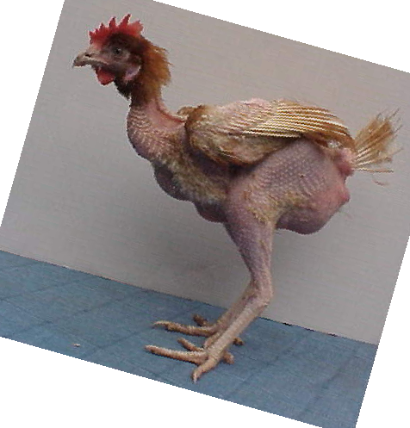
The legal requirement for a bird in a battery cage is currently 550cm².
Less than an A4 piece of paper.

