Slide 1
What’s the evidence for Climate Change?
Aim: To find out what evidence there is for climate change.

Slide 2
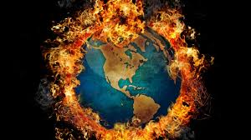
Are humans heating up the planet?
In some ways climate change is nothing new as the atmosphere changes all the time.
The Earth’s atmosphere has evolved over millions of years.
So critics deny the enhanced greenhouse effect as being human induced.

Slide 3
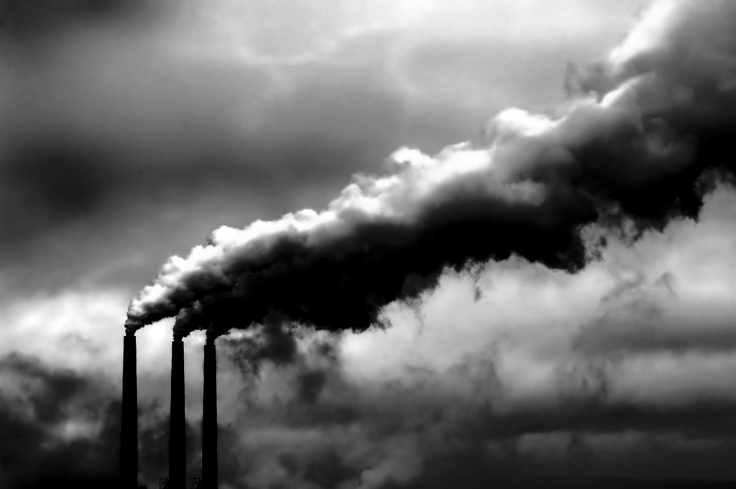
For the first two billion years of the Earth’s life the atmosphere was mostly Carbon dioxide.

Slide 4
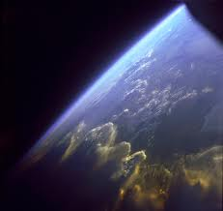
Over the next two billion years green plants evolved removing the carbon and producing oxygen.
As the plants died, the carbon that was locked within them was buried under ground – creating our fossil fuels.
In the last billion years the build-up of oxygen created the ozone layer that blocked the harmful rays from the sun and allowed complex organisms like us to develop.

Slide 5
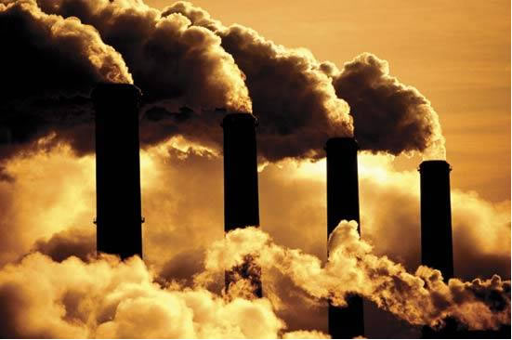
Today there should be virtually no carbon dioxide in our atmosphere, however, with deforestation and the burning of fossil fuels the locked-up carbon is released and the levels of it in our atmosphere are rising.
Watch the first part of hot planet on you tube which proves climate change happening faster since the industrial revolution.

Slide 6
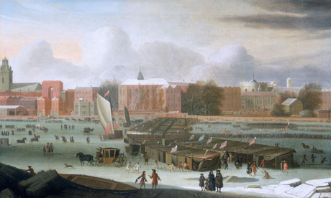
Evidence from Art Work
Notes:
Frozen River Thames – late 1600s. Little ice age

Slide 7
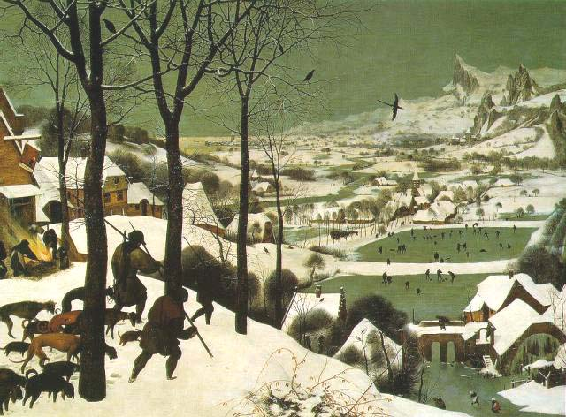

Slide 8
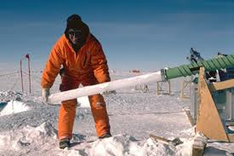
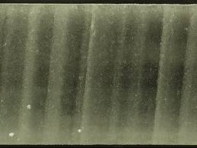
Evidence from Ice Cores Climate Scientists have collected data to show that Co2 levels were 325ppm in 1950 and are predicted rise to 600ppm by 2050
Layer upon layer of compacted snow and ice contain information about temperature and gases

Slide 9
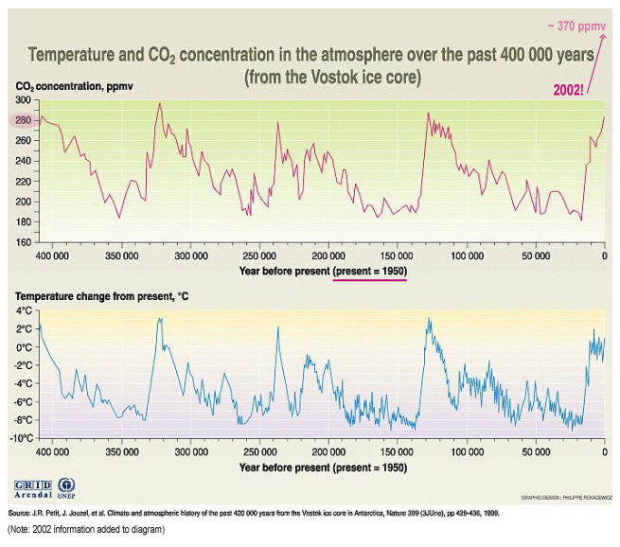

Slide 10
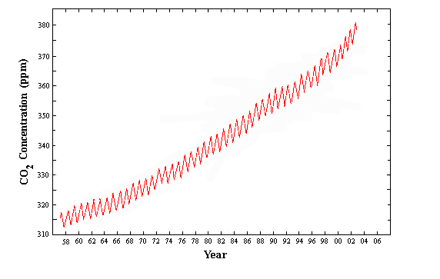
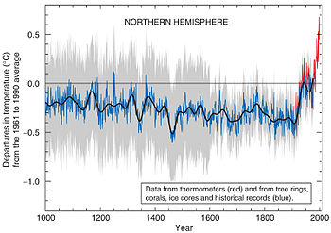
Evidence from Graphs
The Keeling Curve: Graph showing the increased levels of CO₂ in the atmosphere.
The Hockey Stick Graph: Graph showing the increase in the Earth’s temperature over the last 1000 years.

Slide 11
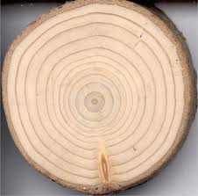
Evidence from Tree Rings
Tree growth rings are added each year the tree is growing. These rings are recording the growing season and the thicker the ring, the better the growing season. These rings can give information on temperature and moisture.

Slide 12
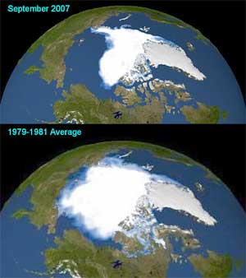
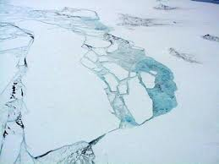
Melting Ice Sheets

Slide 13
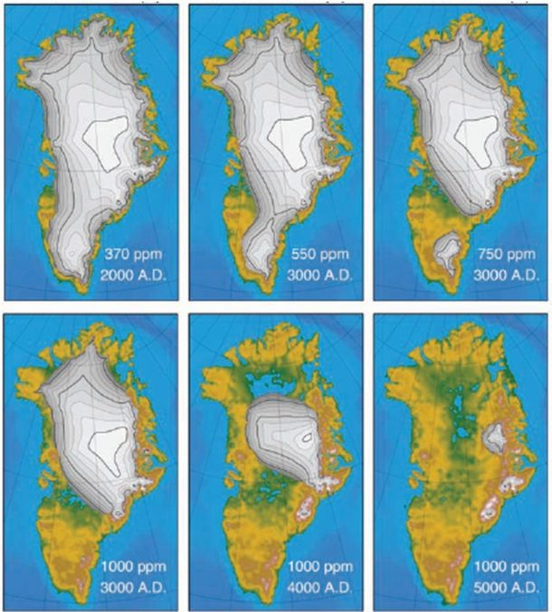

Slide 14
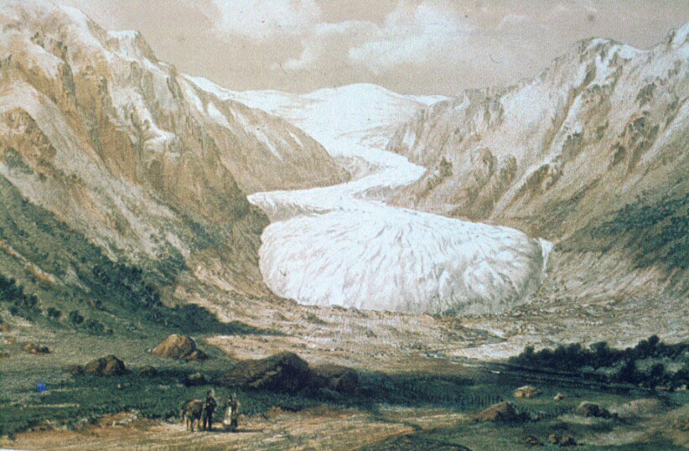
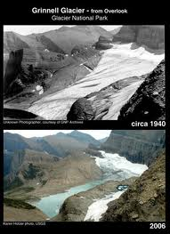
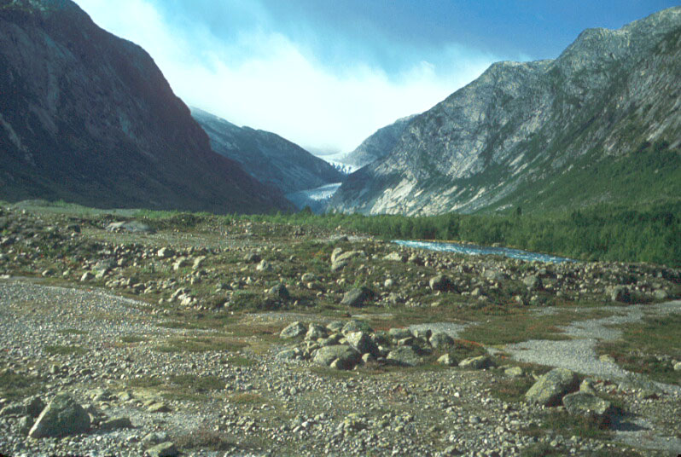
Glacier Retreat
1851
Today
Glacier in Norway

Slide 15
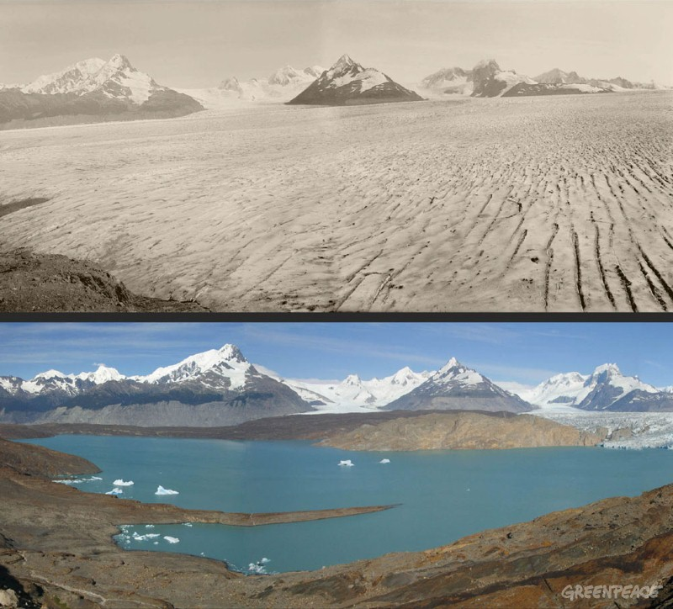
1928
Upsala Glacier, Patagonia
2004

Slide 16
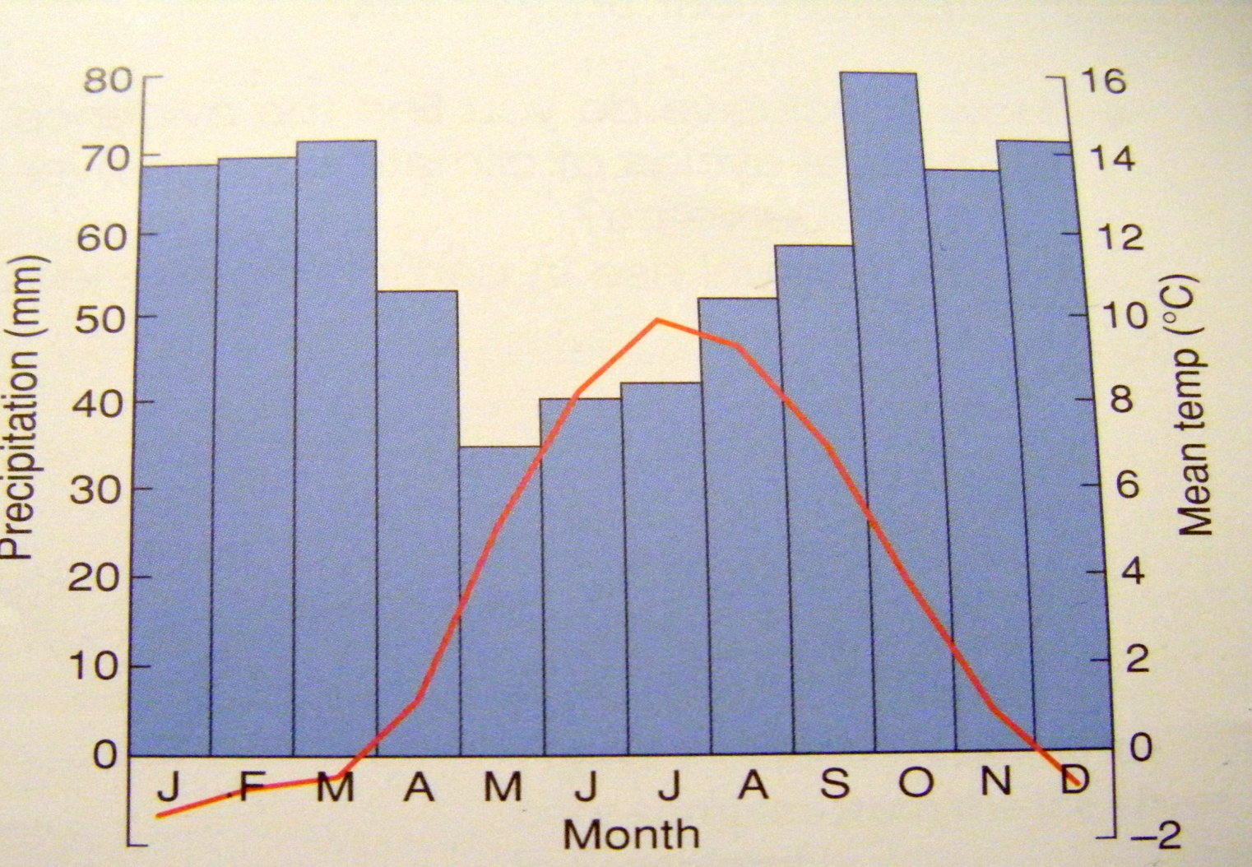
Changing Weather

Slide 17
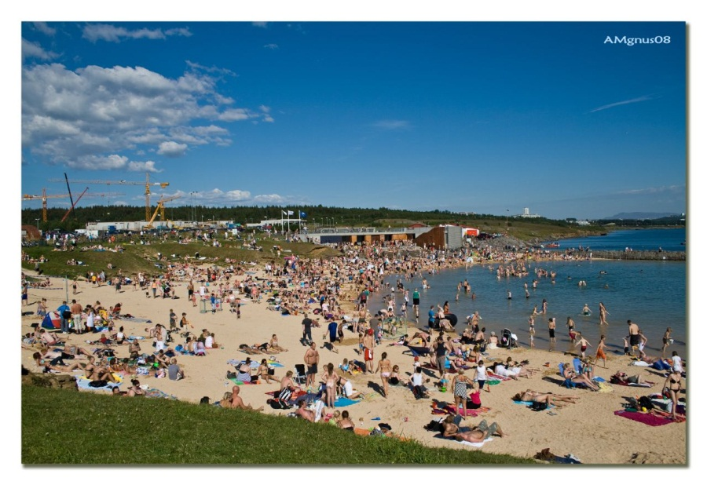
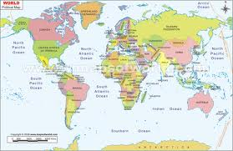
Summer 2008
Hottest Summer on record in Iceland
Temperatures hit 26.2⁰C

Slide 18
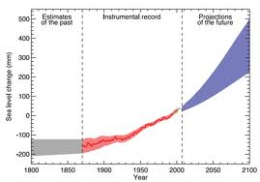
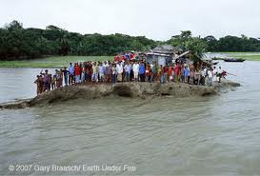
Sea Level Rise
Warming temperatures
Ice melt
Oceans expanding
Sea levels rising

Slide 19
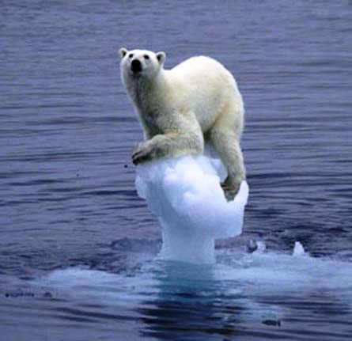
Warning Signs from Nature
Changes in temperature and rainfall can change the distribution and behaviour of animals.
Polar Bears in Hudson Bay, Canada 1,200 polar bears
Hunt on the ice during Spring
Put on 50-75% of their body fat in these months
But: Ice in Hudson Bay melts 3 weeks earlier now
Less chance for the bears to feed
Come on to shore 10kg lighter

Slide 20
Group Task: Diamond 9
In your group, discuss the pieces of evidence you have heard about. Arrange them in order of importance in a diamond-9 shape, with the most important piece of evidence at the top and the least important at the bottom.
You will be expected to discuss your reasons with the rest of the class.

Slide 21
Individual Task:
Write a paragraph outlining what you think is the most important piece of evidence for climate change. You need to explain what the evidence is and give reasons as to why its so important.
Write a paragraph outlining what you think is the least important piece of evidence for climate change. You need to explain what the evidence is and give reasons as to why its so important.

