Slide 1
5.1.3. How do various players affect the development gap?
Players involved in development

Slide 2
5.1.3. How do various players affect the development gap?
The UN | Unilever, Nike, Nestle | Development projects and relief programmes, bottom-up, unreliable funding
Promotes trade, can create unfair barriers to free and fair trade | Raise awareness of concerns, aid and practical help given | Encourages free trade
Regulate economy, create conditions for business, provide physical infrastructure, public services | Monitors development and provides investment | Capitalist enterprises creating supply chains
Influence economic and social conditions in a country | NGOs | TNCs
World Bank | E.U. / ASEAN | Provides investment for economic and social projects (top-down)
WTO/ Trade Blocs | Governments | Unicef, Oxfam
Provide employment and investment in countries, exploit workers and most profit sent to home country | IMF (International Monetary Fund) | Ghana, Uganda
Evaluate which players contribute most to the development gap.

Slide 3
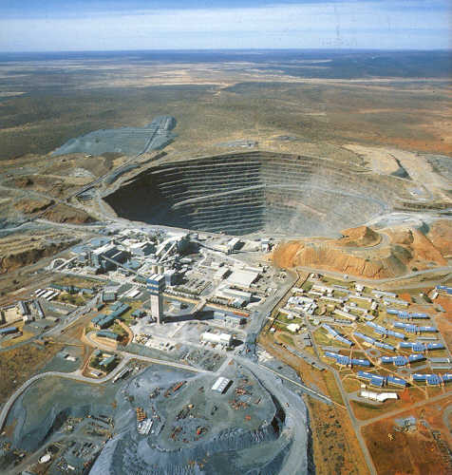
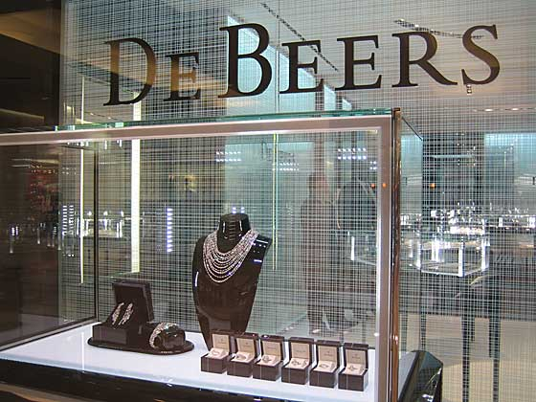
5.1.3. How do various players affect the development gap?
TNCs – mining in Botswana
Negative impacts of mining in Botswana

Slide 4
5.1.3. How do various players affect the development gap?
TNCs – mining in Botswana
Positive impacts of mining in Botswana
Negative impacts of mining in Botswana

Slide 5
What players can exacerbate the development gap? Explain how

Slide 6
What players can exacerbate the development gap? Explain how
Player type and example – positive or negative for widening gap – because….

