Slide 1
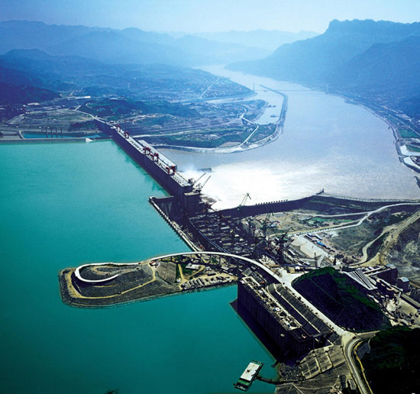
Dams: Development or Destruction?
To know the advantages and disadvantages of large scale dams.
To be able to explain why dams are controversial.
To understand why the 3 Gorges Dam is an ecological disaster.

Slide 2
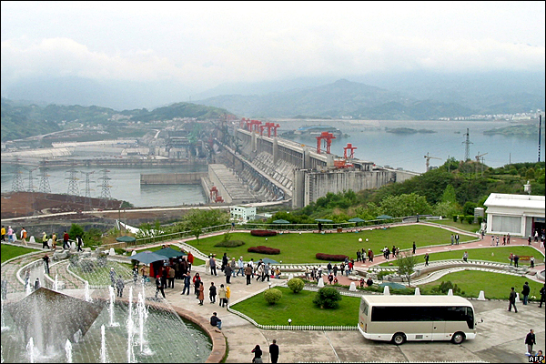
Write down 3 geographical things
that are happening here

Slide 3
Large Scale Water Management
Large scale projects to increase water supply tend to involve big dams. They are usually complex, multi purpose projects. The big dam age began in the 1930s. Since then, dams have increased in scale because of technology. Up to the 1980s the rate of building increased most of the best sites in North America and Europe had been developed.
Currently dams supply…
- 40% of the world’s irrigated water
- 20% of the world’s electricity
- 15% of all blue water

Slide 4
TASK
Study the diagram of a large scale dam project…
Bullet point six problems that can be solved through building large scale dams.
DEBATE
You need to organise yourself into two teams – read the opinions regarding pros and cons of large scale dams. You should complete the worksheet in preparation for a debate.

Slide 5
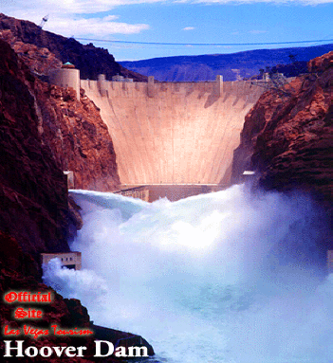
The 3 Gorges Dam
Whilst watching the video you should note down…
Why the dam was built
Advantages about the dam
Disadvantages about the dam
http://www.youtube.com/watch?v=T2JMVxnMqxU

Slide 6
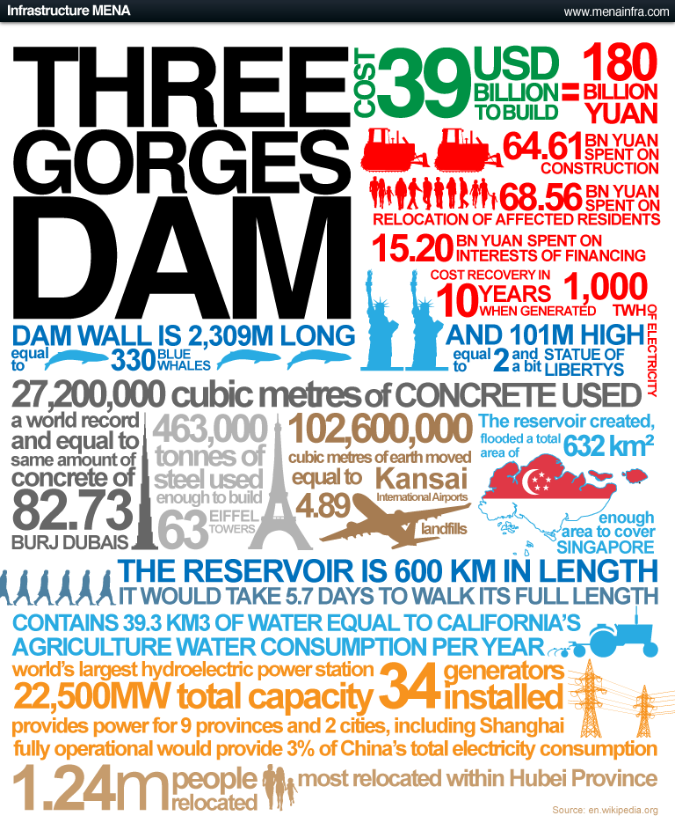
1.Write down 2 facts
about the size of the dam
2. Write down 1
fact about
energy
3. Write down one social and on economic impact

Slide 7
The 3 Gorges Dam
Task – Fill in the blanks using these words!
Three Gorges Dam
1-in-100
Compensation
1 billion tonnes
15 million
Polluted
Positive
Reduce
Factories
$30 million
Cities
Yangtse
People
Farmland
Flooding
Power Generation
Silt
Power stations

Slide 8
The Three Gorges Dam
The 3 Gorges Dam
Task – Stick your fact-file in your books. Fill in the missing information!
181 km high and 2.3 km wide.
632 km2
$25.5 billion
Started 1994; Finished 2006
110m (reduced to 80m when flood risk downstream)

Slide 9
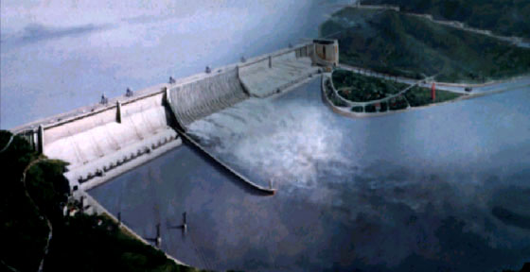
But why is the dam an ecological disaster?
Read the information sheet very carefully – highlight any key words. Answer questions 1-4 in detail, you may need to do them in your book to write longer answers.

Slide 10
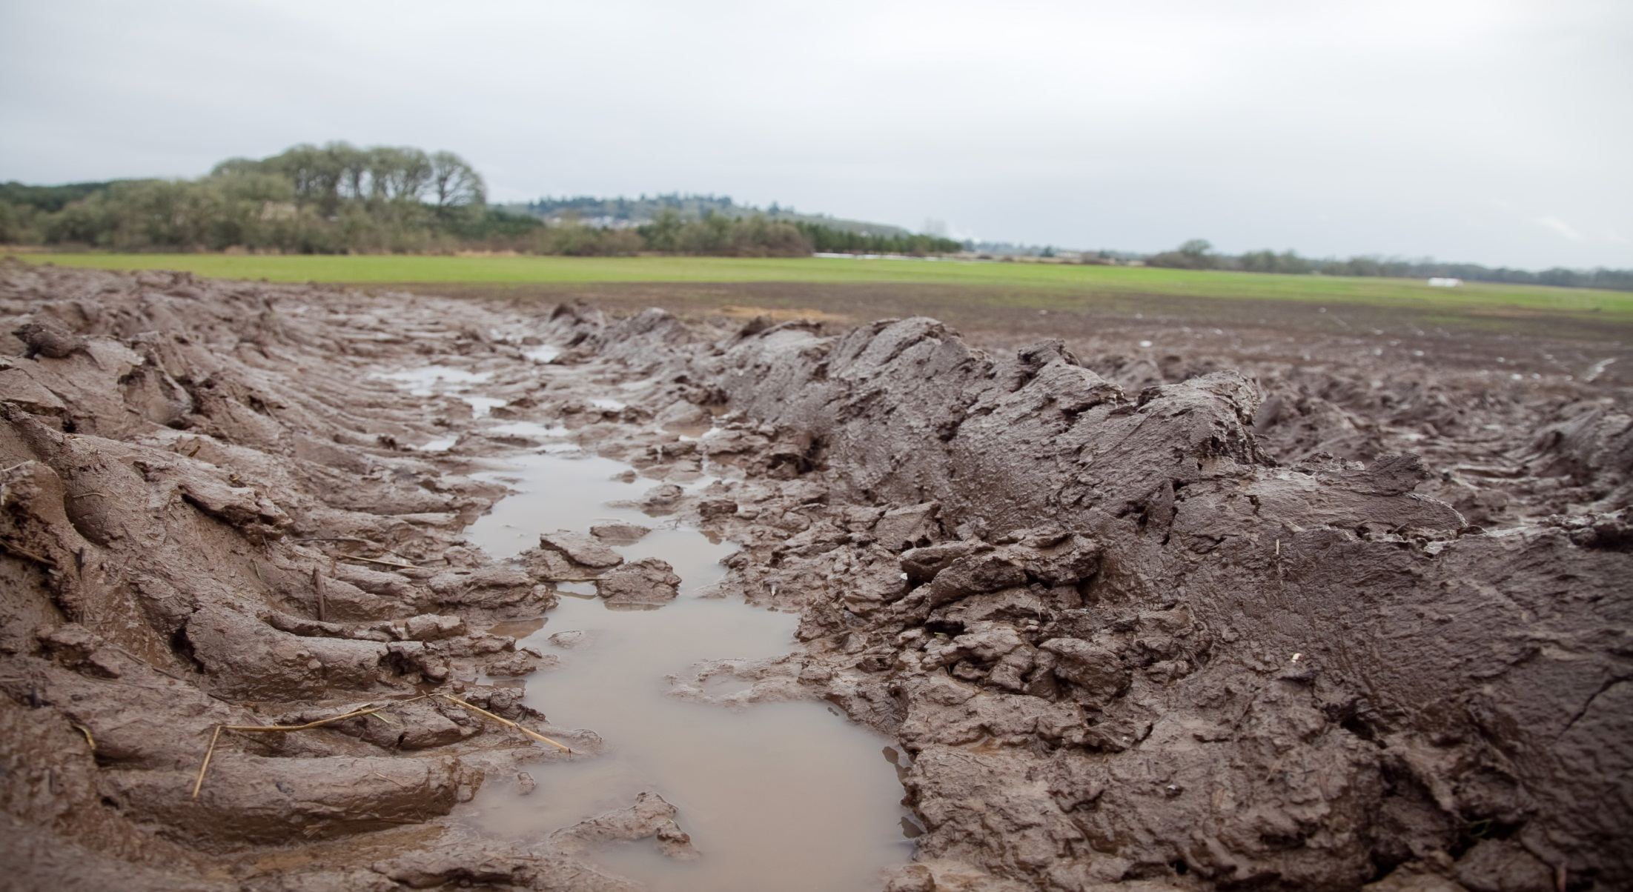
Muddiest Point
Write down on your post it notes 2 points from the lesson which you feel least clear about.

Slide 11
The power would kickstart industries such as those processing natural resources, provide tax income for government and jobs for many people. It would also change the infrastructure, from water processing to electrification of homes.

Slide 12
The dam would supply water for growing settlements

Slide 13
It would be a centrepiece of regional and national development, and have a political impact for the government.

Slide 14
Such a major investment will normally require a huge loan and commitment to paying it off for many decades. If the project does not bring the planned economic benefits, these repayments could cripple the country, sending more of its people into poverty and ill health as the country would not be able to afford healthcare or to subsidise food or fuel.

Slide 15
Experts predict that rising temperatures in Africa could dry up some rivers. This might threaten water supply to the project, especially if there is water conflict with neighbouring countries whose rivers are fed by the same rivers.

