Slide 1
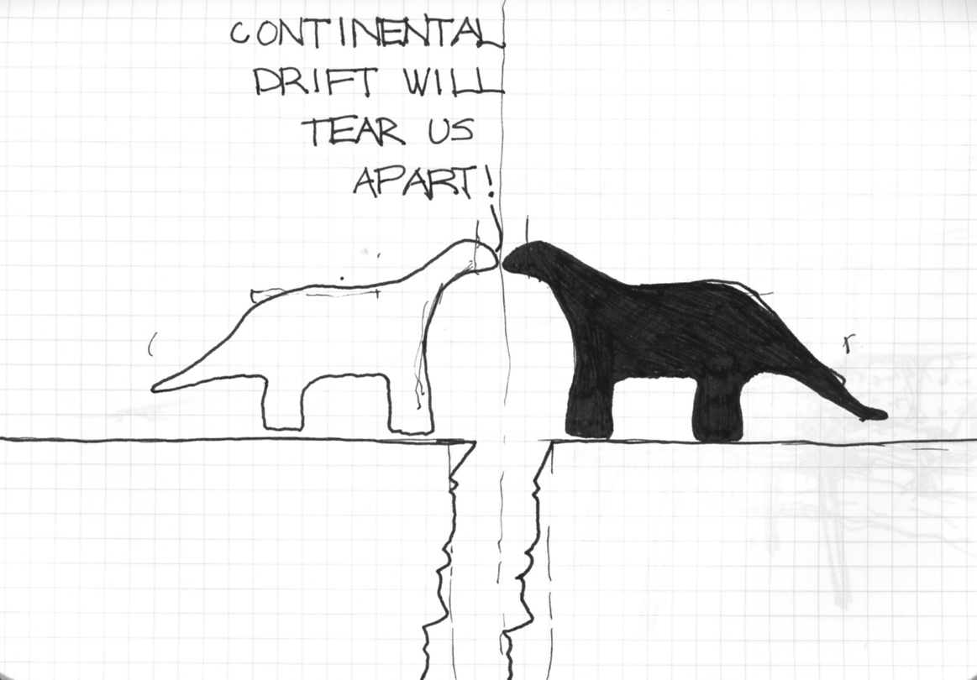
Plate Tectonics!
LO: 1)To know the structure of the Earth. 2) To understand the process of plate tectonics.
Notes:
When the children saw this image they had a little laugh... The Ice Age film had come out the same week so they already had some idea about what continental drift was!

Slide 2
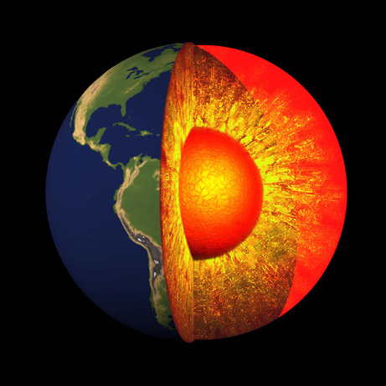
The Structure of Earth!

Slide 3
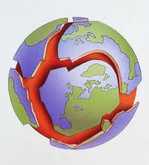
Plate Tectonics
Notes:
Good to ask the children what they already know...

Slide 4
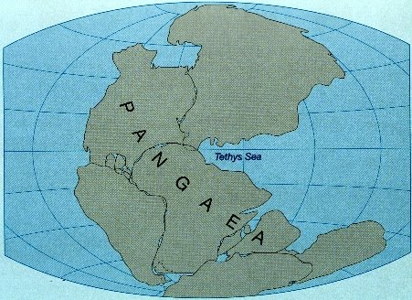
How do we know Earth’s plates have moved?
http://www.youtube.com/watch?v=MucQmSIKElU
Notes:
The Bill Nye video is brilliant as his visual on moving plates is a great way of understanding and remembering how they plates move (Important to make sure that the video is not blocked by the school before you get into lesson!)

Slide 5
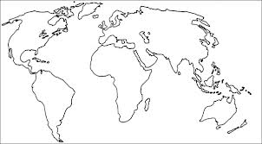
Where will the plates move next?
http://www.break.com/index/650-million-years-in-1-min-20-sec.html
Notes:
I showed the video at the end of the lesson after the children had predicted where the plates would move next... Great lesson for getting the children to sketch diagrams of the Earth and which direction the plates are moving in.

