Slide 1

Soil and Water Conservation Principles Applied to Climate Change Mitigation and Adaptation
Principles for Communication of Soil and Water Conservation Programs
Slide # 19

Slide 2
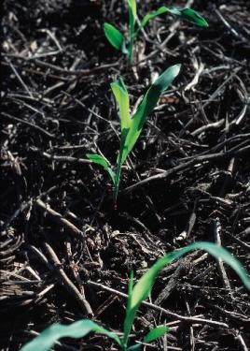
Teach the Value of Soil Carbon.
  Increasing soil carbon (C) benefits soil and water quality.
  Conservationists, farmers, policy advisors, K-12 and university students—in short, the general public—should understand how soil carbon helps mitigate climate change and adapt to climate change.
Slide # 20

Slide 3
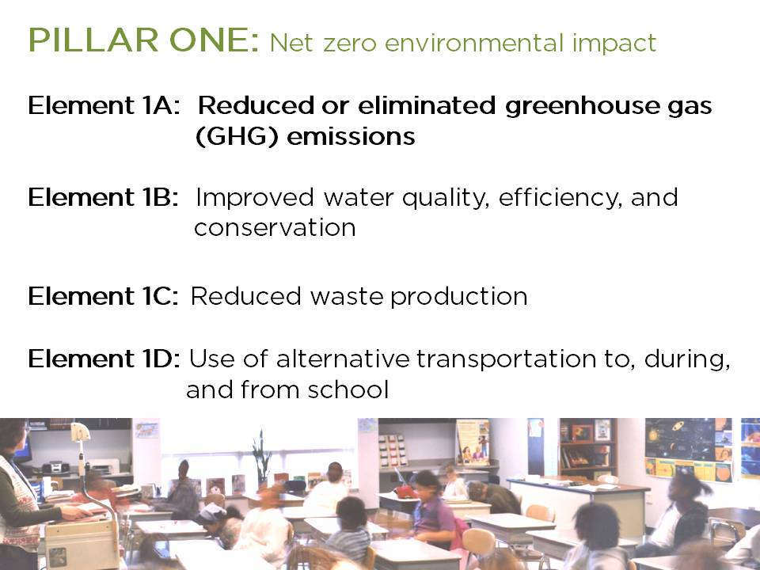
http://www2.ed.gov/programs/green-ribbon-schools/index.html
Source US Department of Education – Add Value of Carbon to Green Ribbon School Overview
Slide # 21

Slide 4
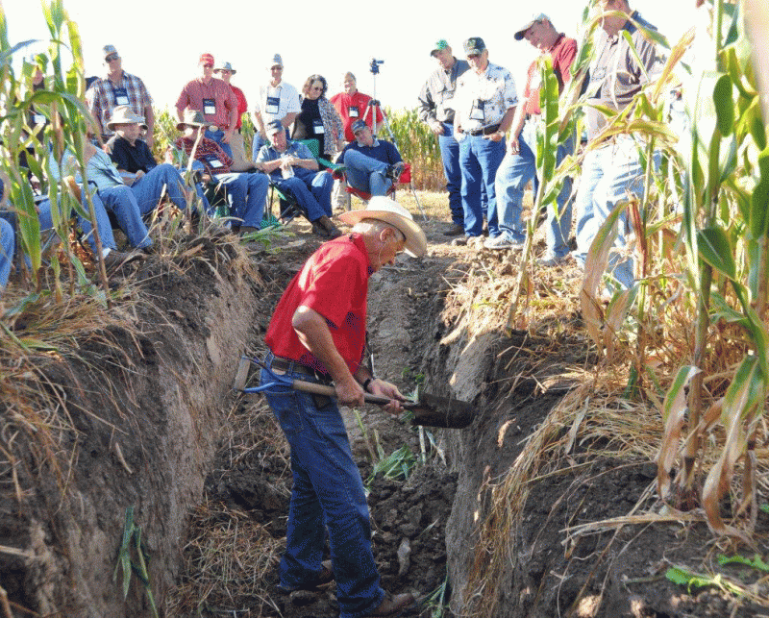
Develop Communication that Connects Science to Land Managers
  -Better communication with farmers and farmers’ groups is key.
Slide # 22
http://www.ctic.org/Partners%20Magazine/2011/October/57/

Slide 5
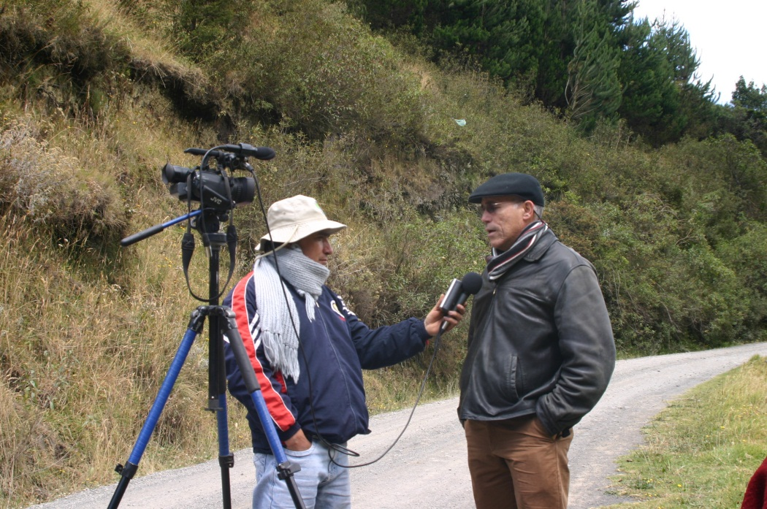
Develop Communication that Connects Science to the Public
  -Better communication with the general public is essential to increasing awareness of the benefits of soil and water conservation
ARS
Slide # 23

Slide 6

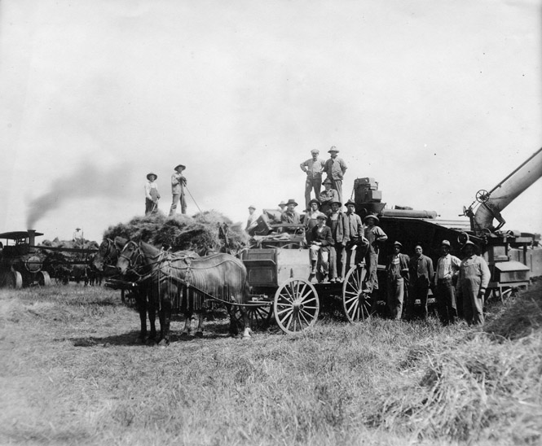
Improve Historical Context
  -Long-term data records, programs, and studies are important for developing conservation programs that contribute to climate change mitigation and adaptation.
Slide # 24
http://www.illinoishistory.gov/TOC1203IH.htm
http://www.agclassroom.org/gan/timeline/ag_edu.htm

Slide 7
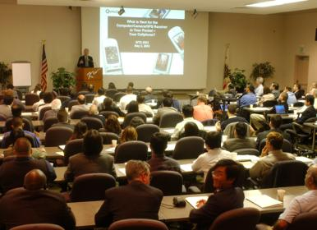
Ongoing Training Essential
  -Education programs and the mentoring of new personnel are important for maintaining an educated workforce.
Slide # 25
http://polycentric.csupomona.edu/news_stories/2011/04/history-symposium-agriculture-environment-relationships.html

Slide 8
Enhance Exchange
  -We need forums for exchanging information among farmers, professional societies, scientists, conservation practitioners, and the general public and for discussing the advantages and disadvantages of recent advances to continue advancing the field of soil and water conservation. Through information exchanges, we learn what works for mitigation of and adaptation to climate change.
Slide # 26

Slide 9
Soil and Water Conservation Principles Applied to Climate Change Mitigation and Adaptation
Principles for Soil and Water Conservation Practices for Climate Change Mitigation and Adaptation
Slide # 27

Slide 10
Cover the Surface
  -Harvesting of plant residues should be avoided if soil function will be compromised.
Slide # 28

Slide 11
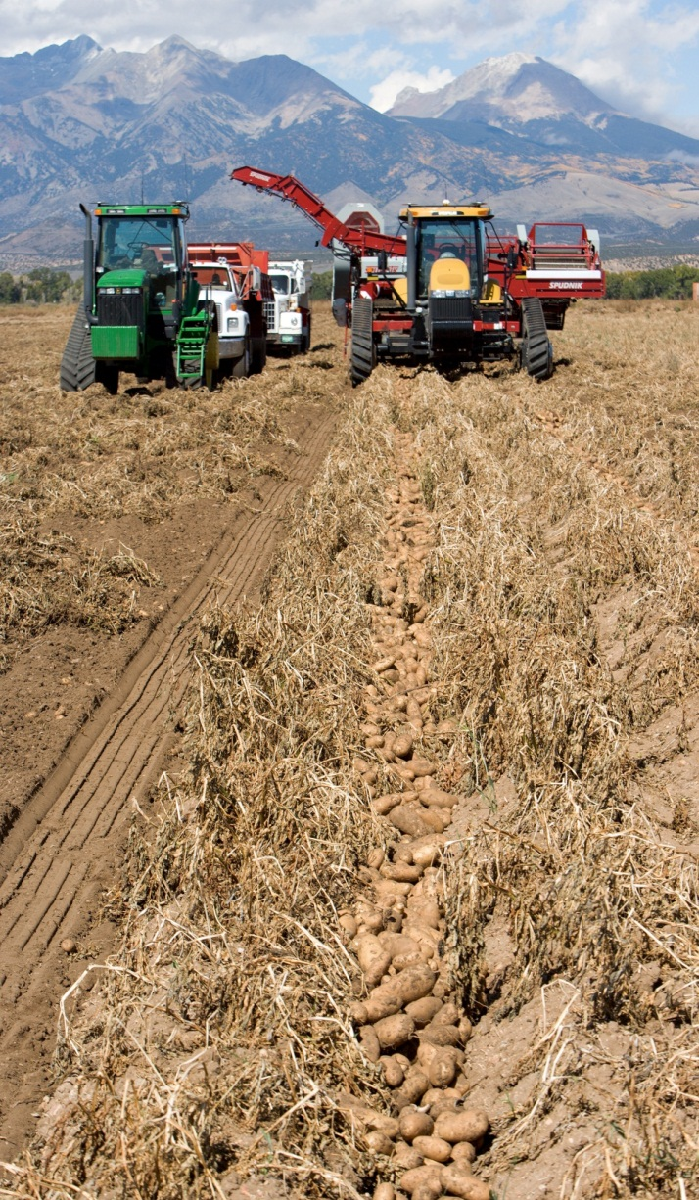
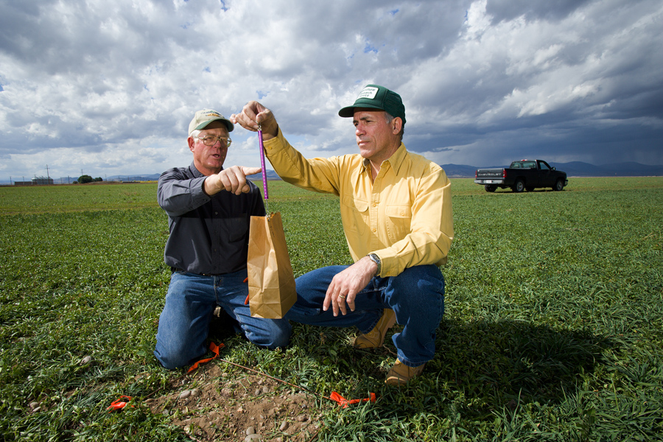
Soil Function Improves with Soil Carbon (Organic Matter)
  -Soil C sequestration is beneficial for the environment.
Potential Use of Cover Crops for potato systems
Rotations with deeper rooted crops
ARS
Slide # 29

Slide 12
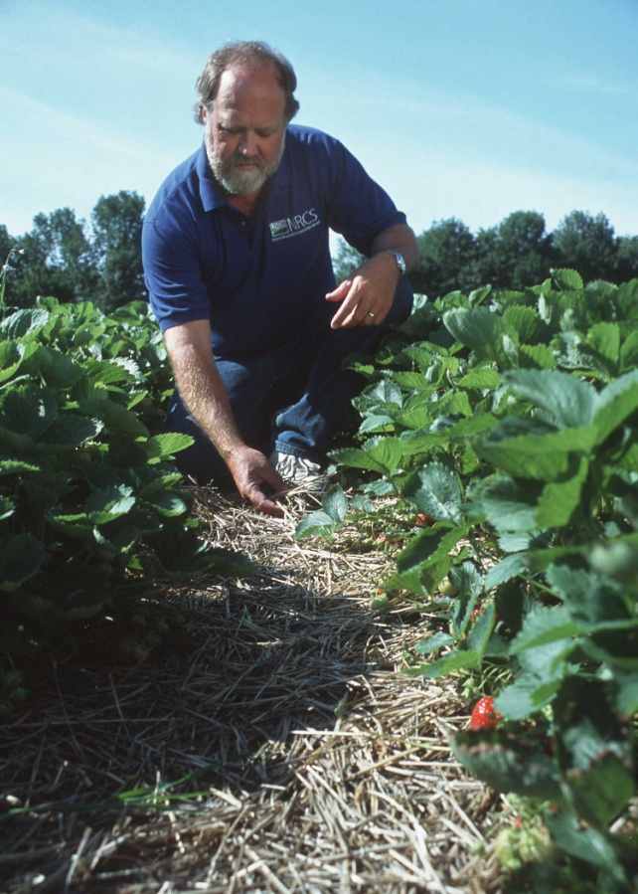
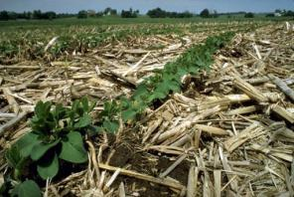
Surface Residue Protects
  -Conservation agriculture increases sustainability.
NRCS
Slide # 30

Slide 13
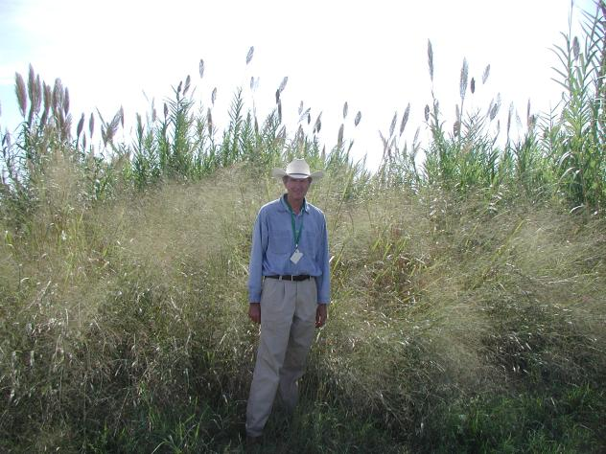
Value Perennial Crops
  -Perennial bioenergy crops (e.g., switchgrass) can contribute to C sequestration and protect the environment better than the growing of grain crops used for energy.
http://www.ars.usda.gov/Research/docs.htm?docid=16619
Slide # 31

Slide 14
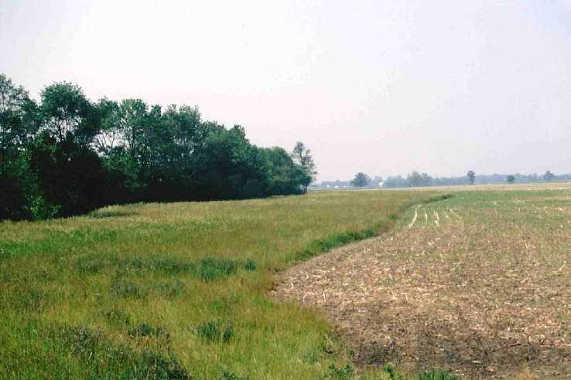
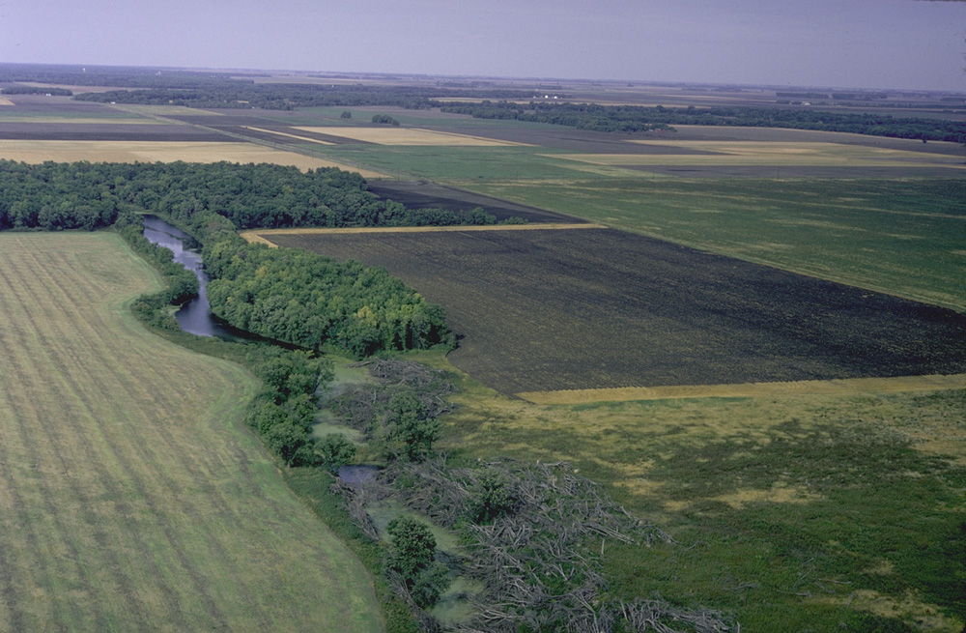
Off-Field Remediation Practices Help
  -Off-the-field conservation practices can contribute to climate change mitigation and adaptation ( e.g., riparian forest buffer, wetland).
Slide # 32

Slide 15
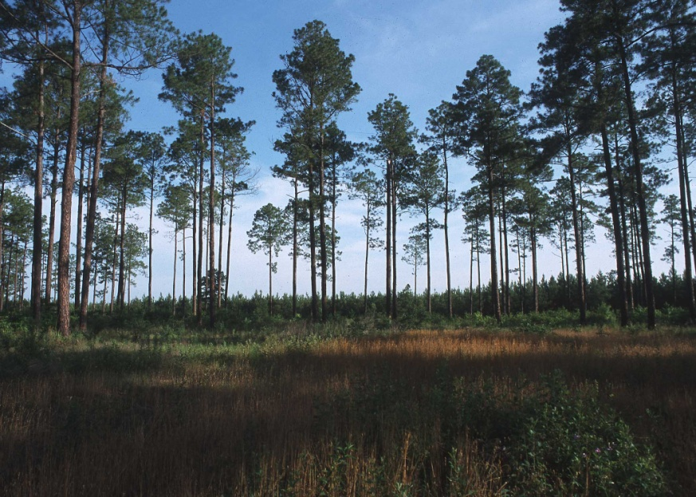
Improve Landscape Diversity with Agroforestry
  -Agroforestry can contribute to landscape diversity, benefiting the environment.
NRCS
Slide # 33

Slide 16
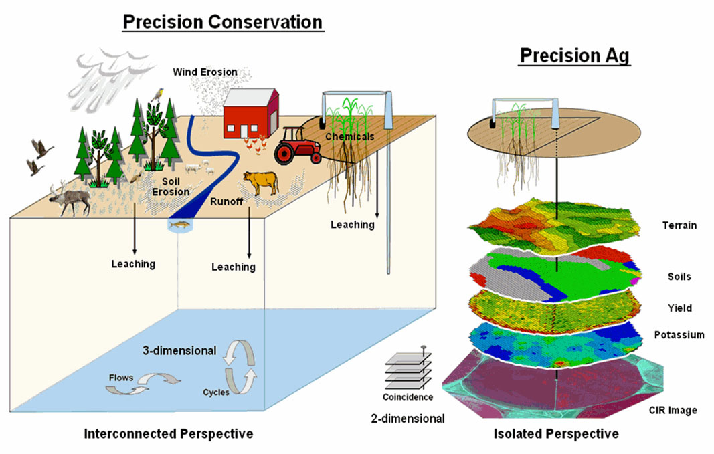
Enhance Effectiveness with Landscape-Targeting Precision Conservation
  -We need to account for spatial and temporal variability and avoid a one-size-fits-all approach if we are to maximize conservation.
Slide # 34

Slide 17
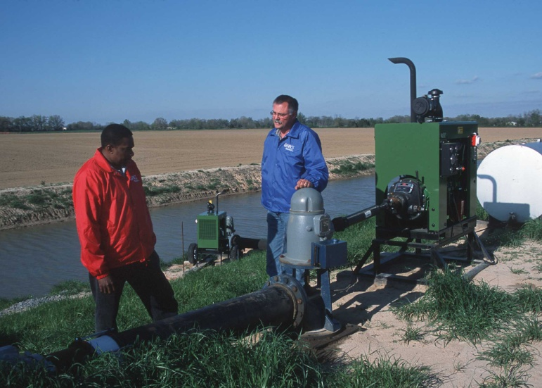
Value Water Appropriately
  -Water-use efficiency needs to be increased, and water quality needs to be protected.
NRCS
Slide # 35

Slide 18
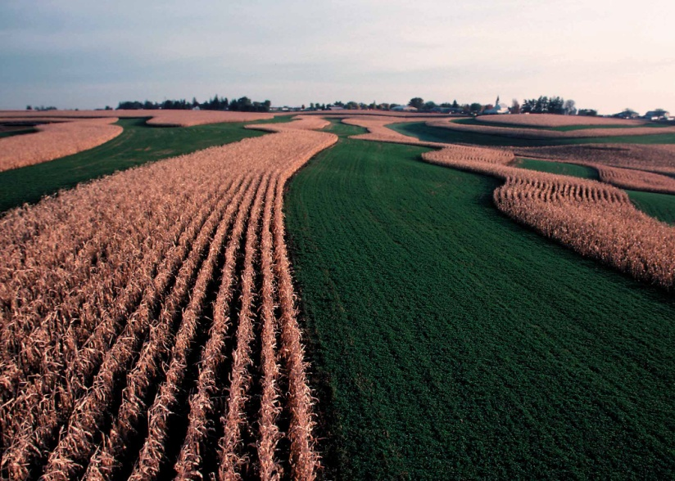
Diversify Crops and Crop Varieties
  -Diverse cropping systems will be key to mitigating and adapting to climate change. We need to develop new varieties that can be used for tolerance of drought, temperature stress, and other effects of climate change.
NRCS
Slide # 36

Slide 19
Reduce Greenhouse Gas Losses
  -Practices that can reduce emissions of carbon dioxide (CO₂), nitrous oxide (N₂O), and other greenhouse gases at the farm contribute to sustainability.
Slide # 37

Slide 20
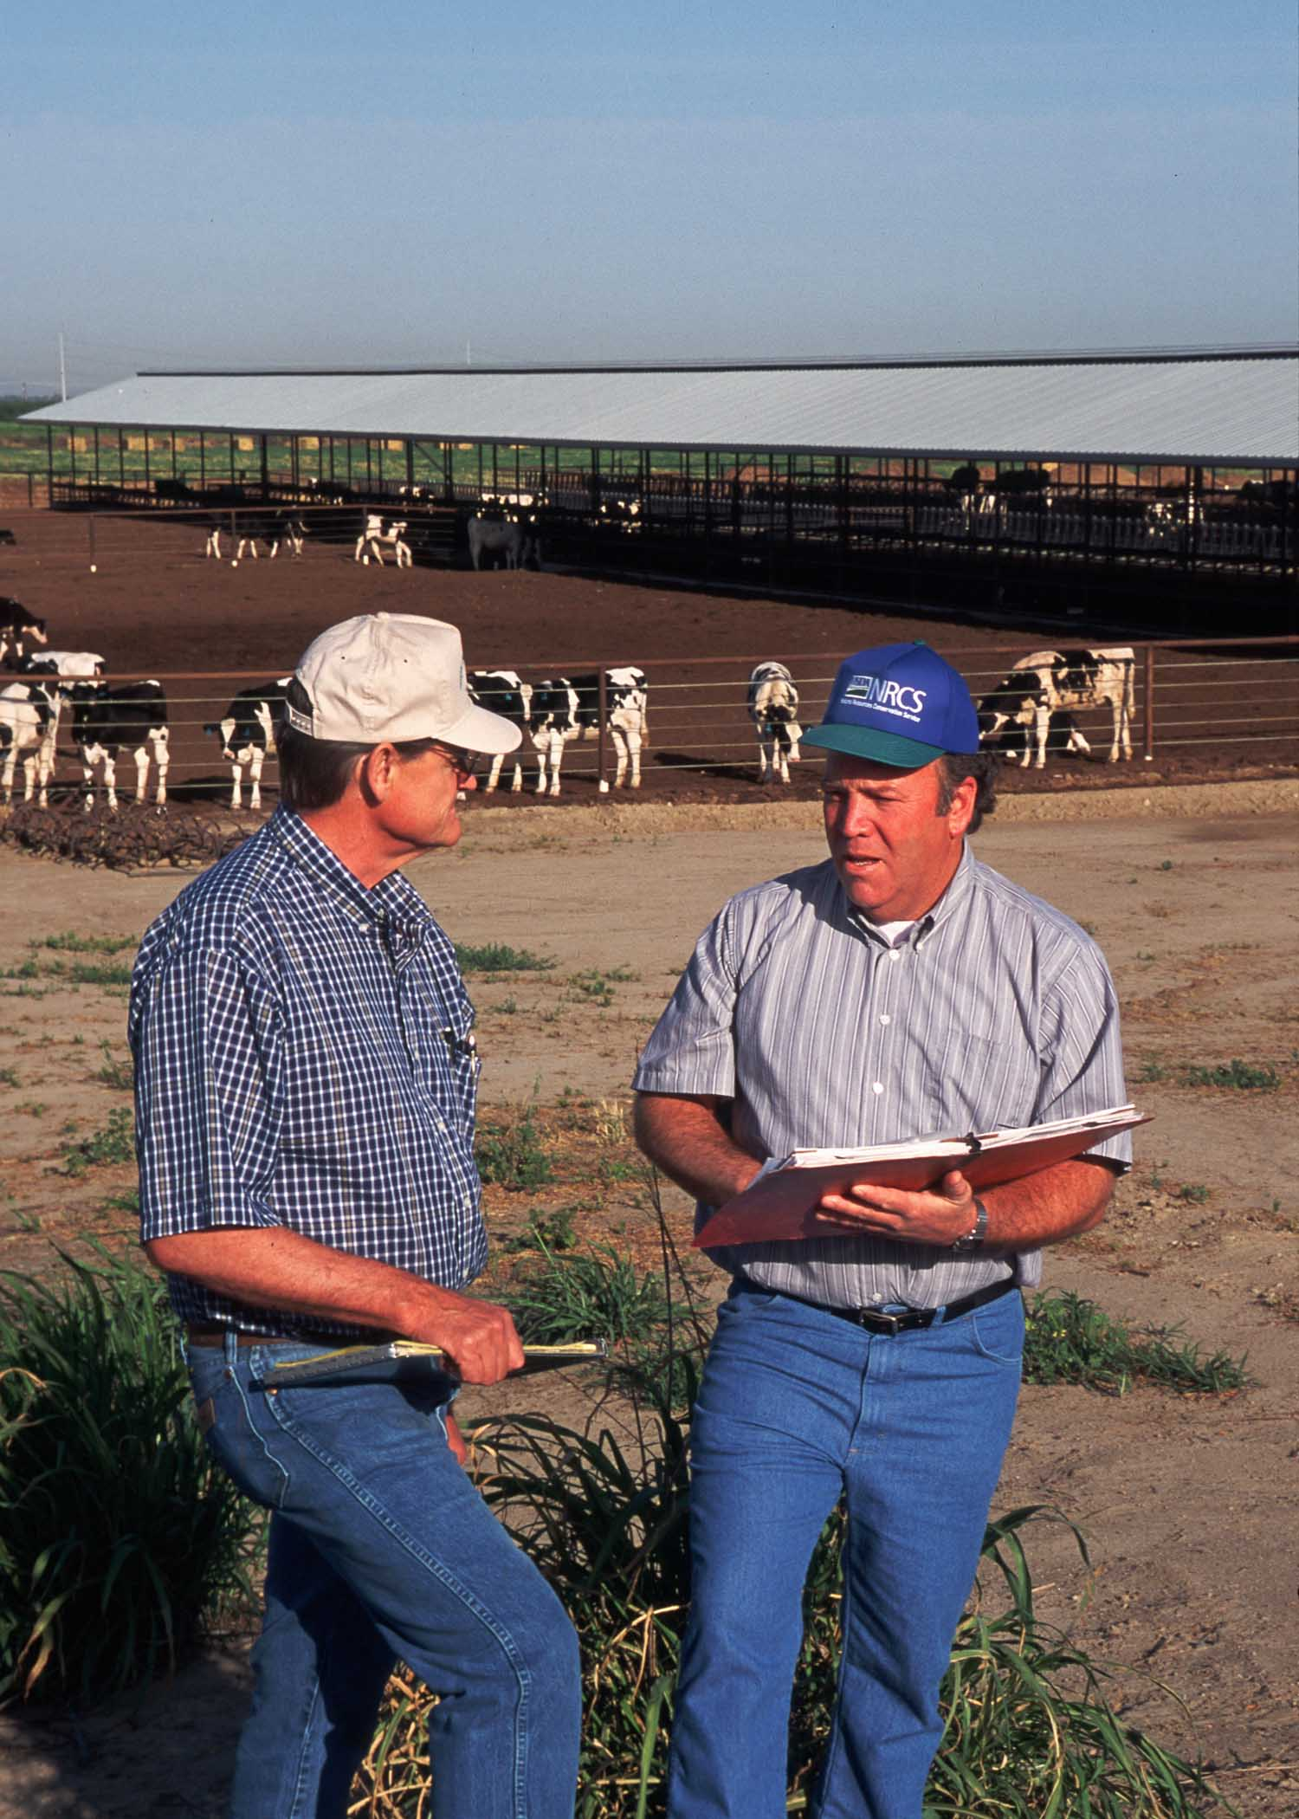
“Tighten” Nutrient Cycles
  -Practices that can capture nutrients and energy from manure contribute to conservation. Cycling of crop residues, use of cover crops, and increasing fertilizer-use efficiencies are some examples of ways to contribute to tighter nutrient cycles.
NRCS
Slide # 38

Slide 21
Need for agronomic expertise: Different cropping systems can reduce soil nutrients and risks of nutrient loss
Grain following potatoes lowers N levels
Slide # 39

Slide 22
Soil and Water Conservation Principles Applied to Climate Change Mitigation and Adaptation
Principles for Developing New Science and Technologies
Slide # 40

Slide 23
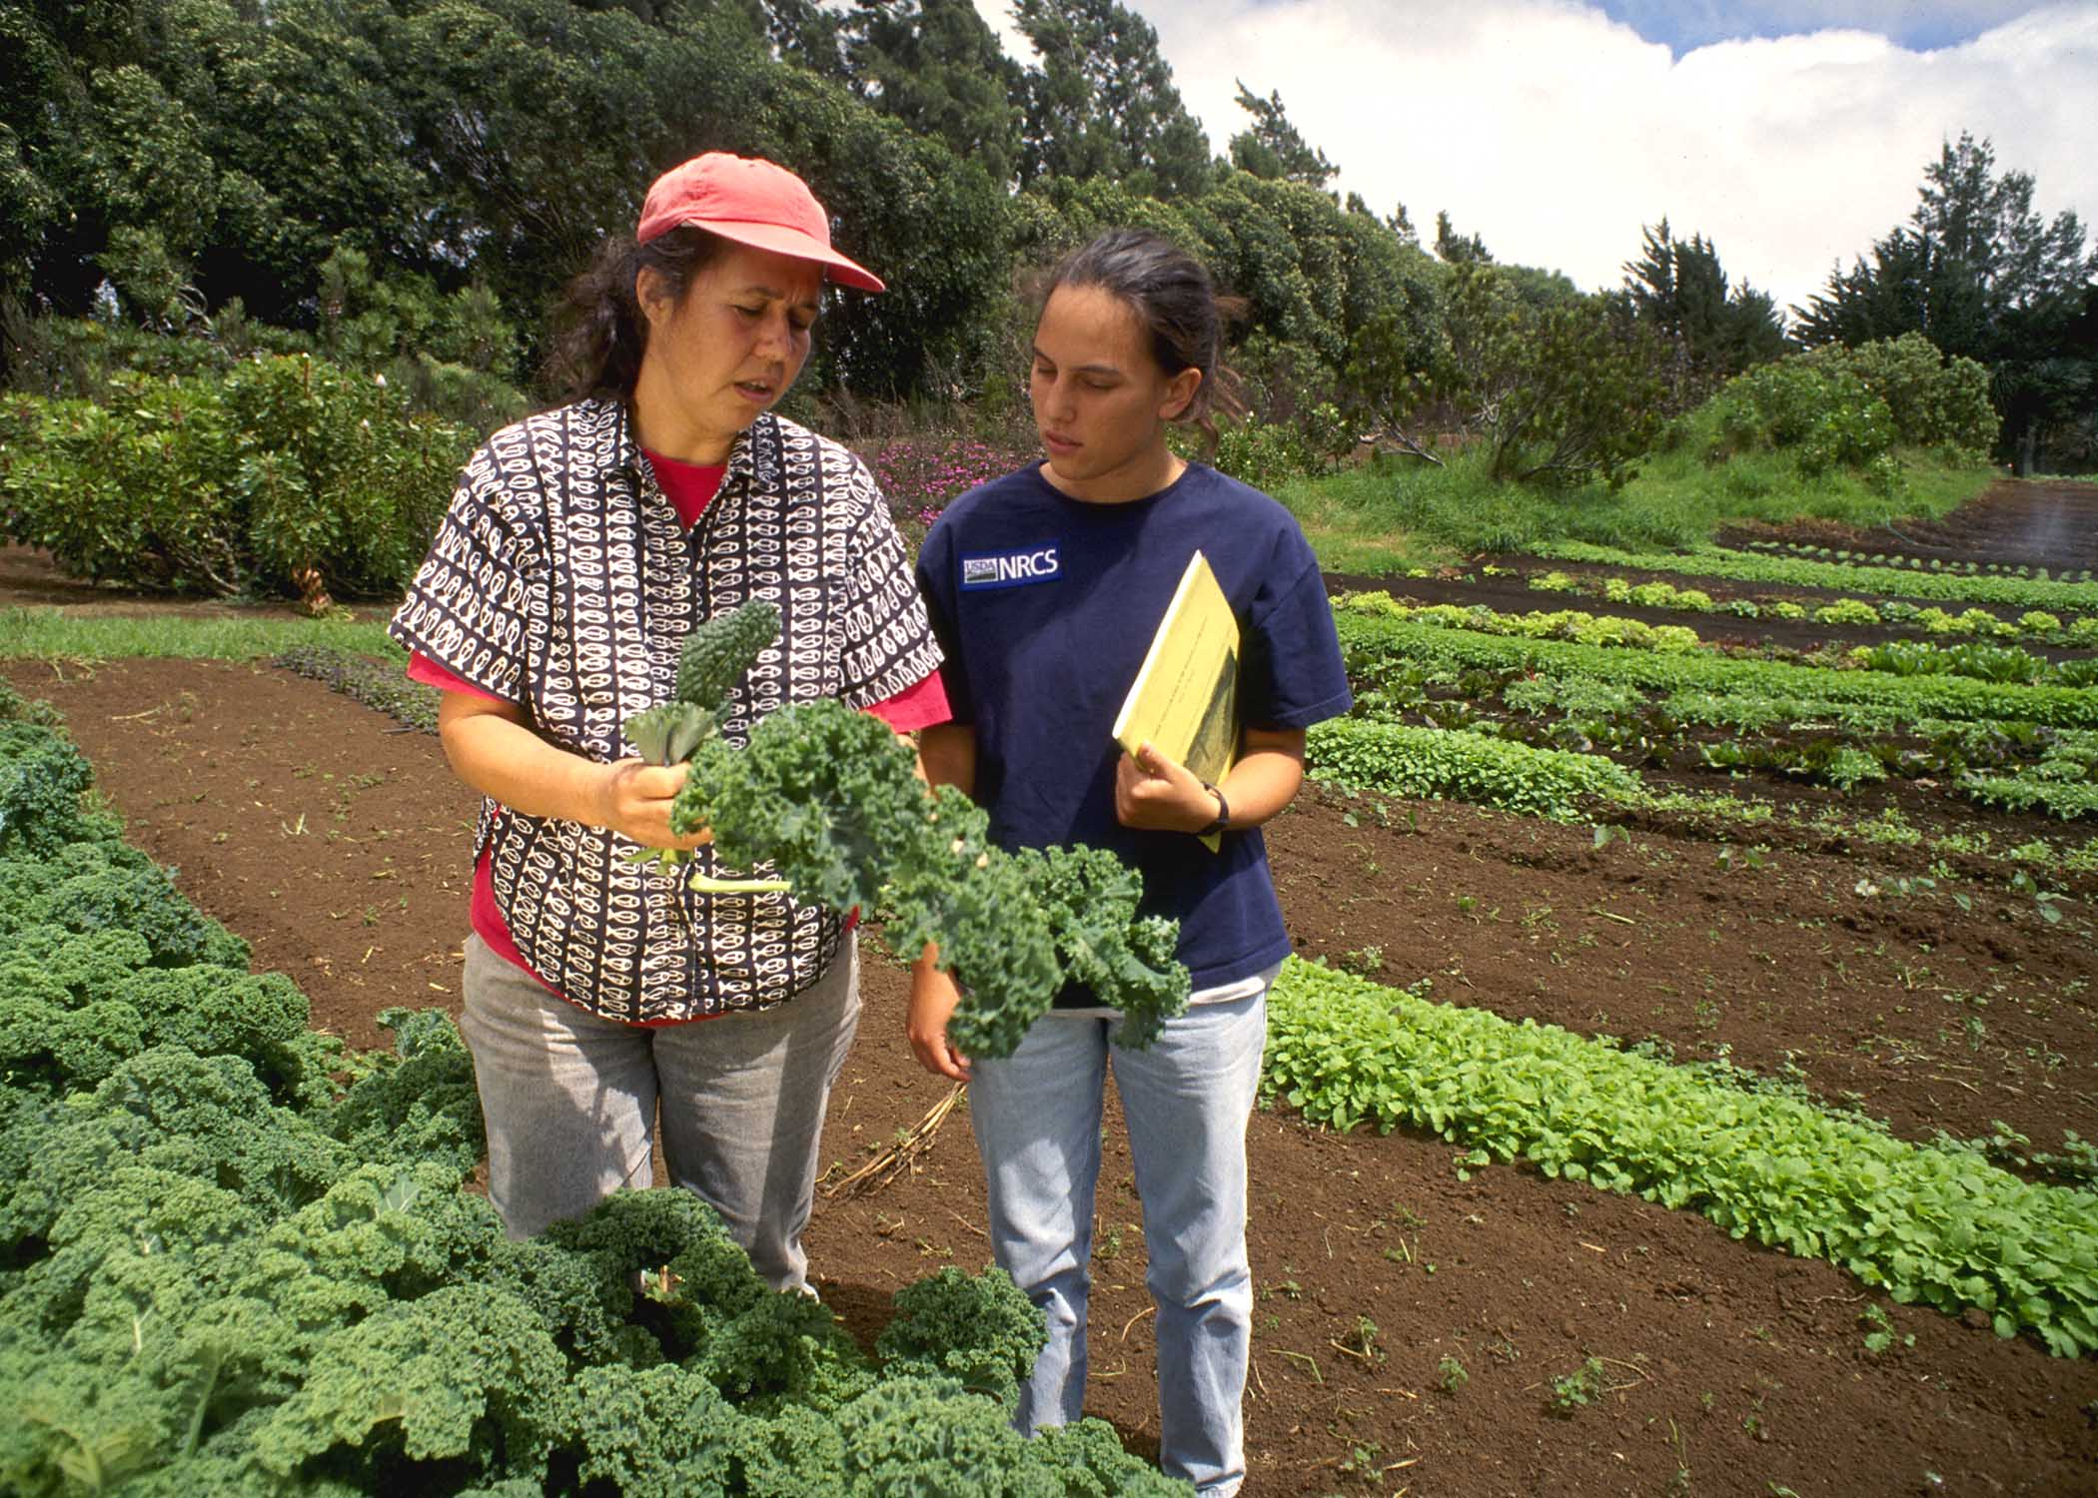
Research Pays Dividends over the Long Term.
  -Research programs greatly contribute to soil and water conservation, making them important for both mitigating climate change and adapting to it.
NRCS
Slide # 41

Slide 24
Current Mitigation and Adaptation Efforts and Findings From Research
More needs to be done to prepare for climate change, i.e., adaptation.
Agriculture may be the most resilient or adaptable sector to climate change as crops, livestock, and fish have relatively short life spans. This short cycle allows farmers to try new types, genetics, or management practices of crops to suit changing conditions.
Some work has already been done towards developing drought-tolerant crops and increasing water-use efficiency and nutrient cycle efficiency.
We need research that follows both climate and natural resource trends (monitoring) over a longer term as well as research in conservation practices for mitigating and adapting.
Slide # 42

Slide 25
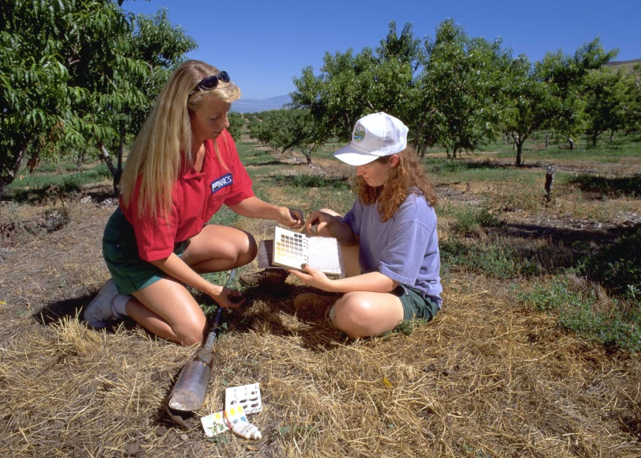
Examples of Mitigation Strategies for Agricultural Production
1. Increasing soil C to improve soil functions.
2. Capturing nutrients and energy from manure, crop residue, and cover crop management (close the nutrient cycles).
3. Using more efficient power sources and renewable energy (more efficient tractors, green power).
NRCS
Slide # 43

Slide 26
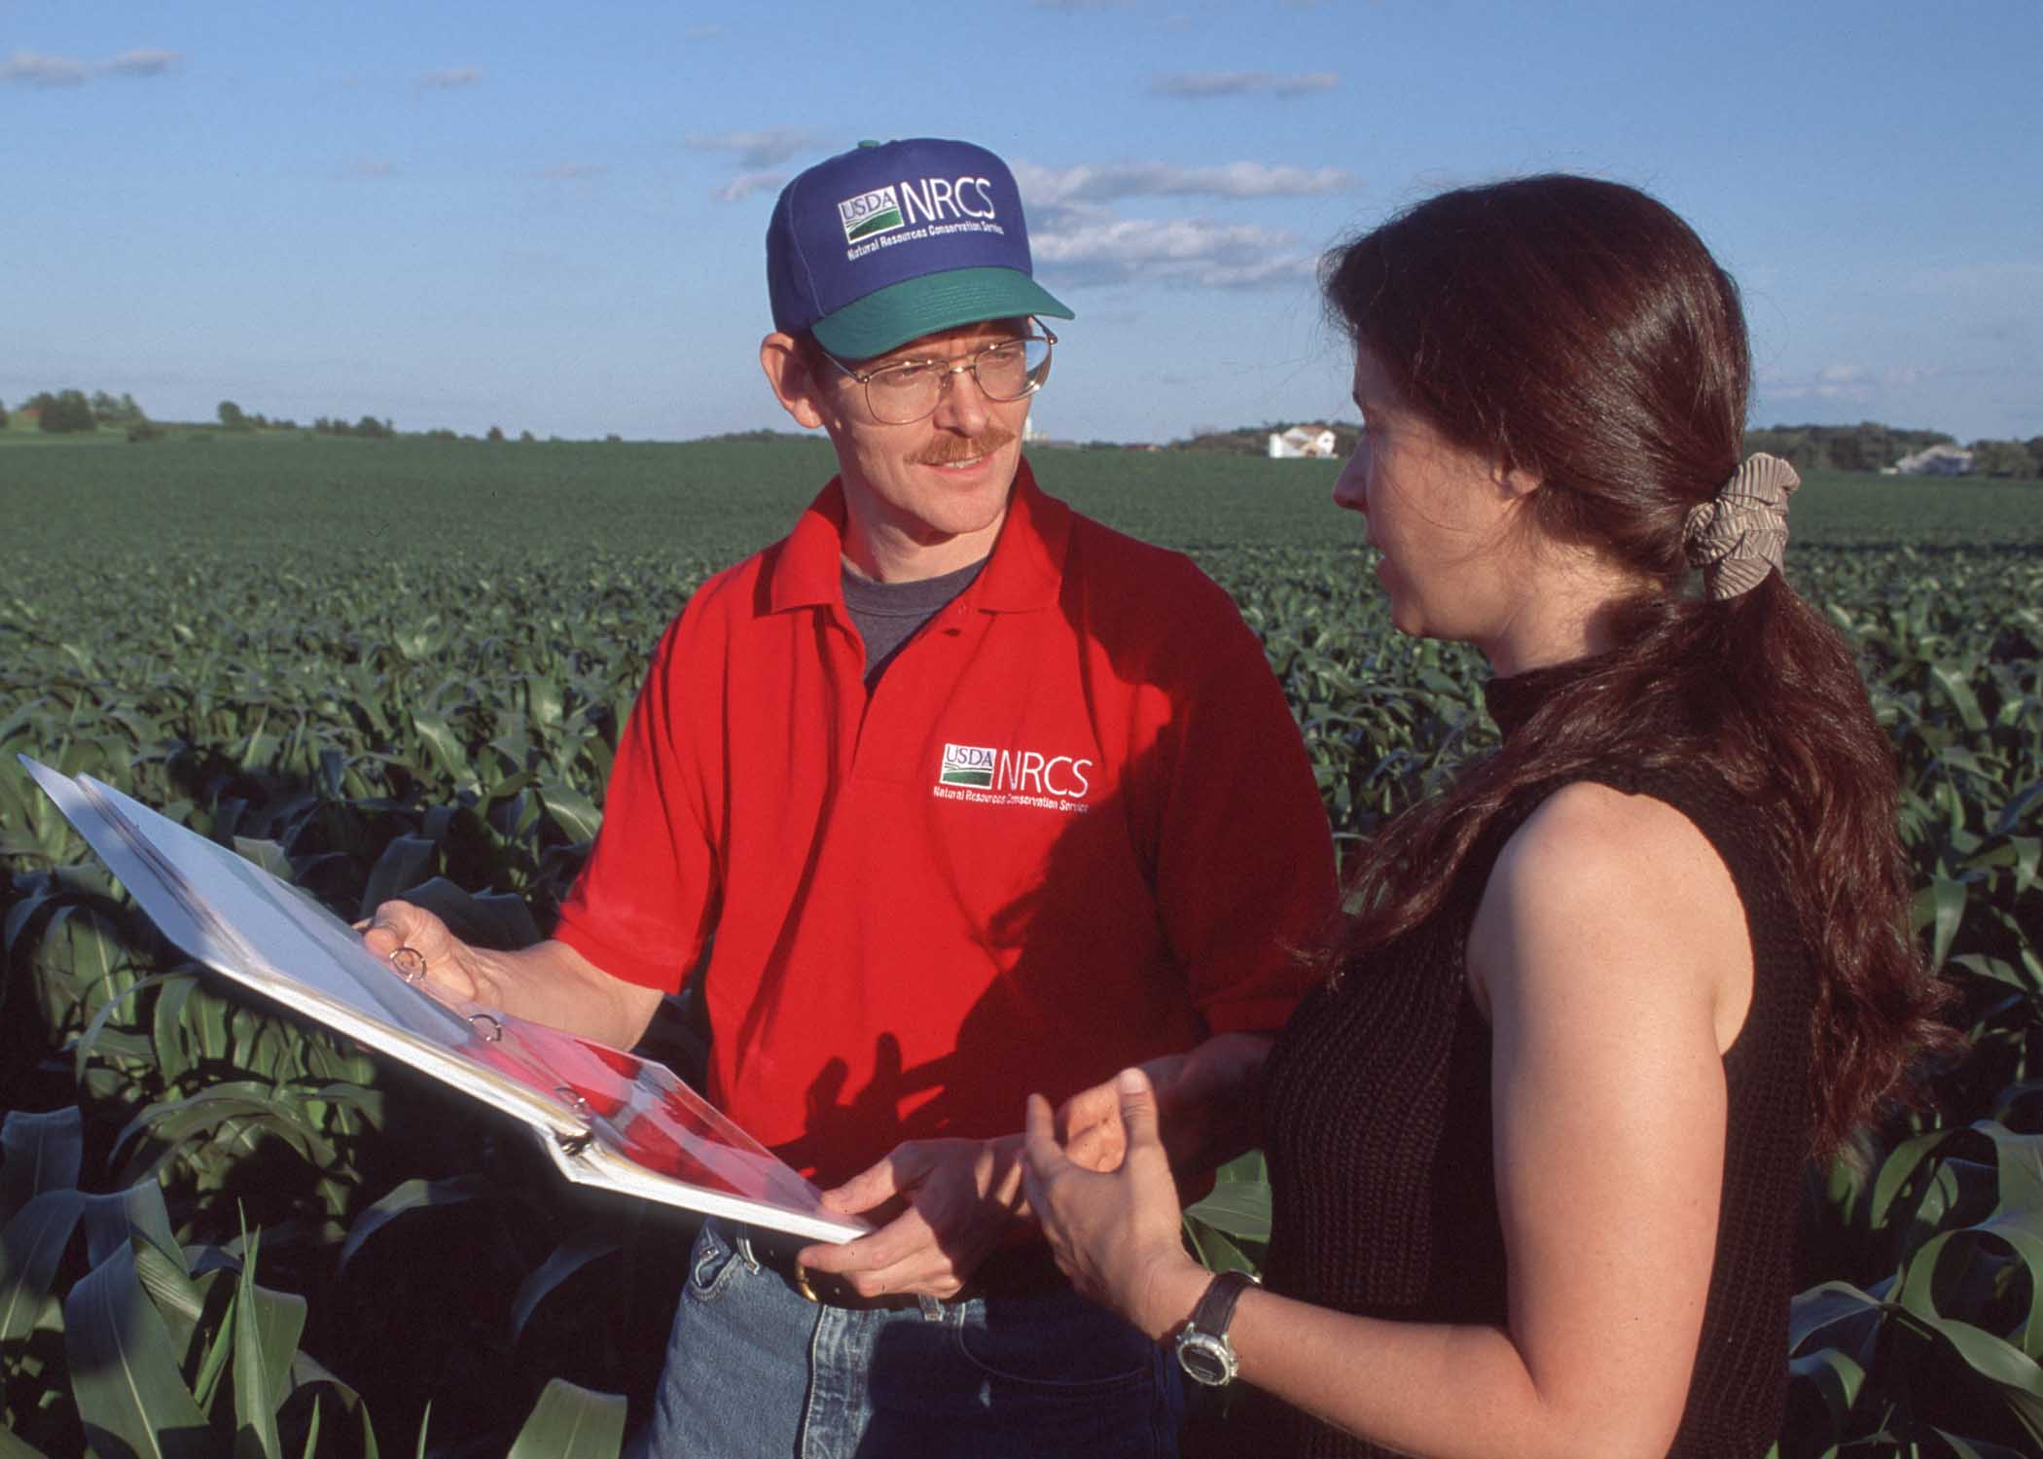
4. Reducing methane emissions from ruminants with feeding management, use of edible oils, and other practices.
5. Using slow-release N fertilizers with proper timing, placement, and rates to minimize N2O emissions.
6. Increasing N-use efficiencies for cropping systems.
NRCS
Slide # 44

Slide 27
Examples of Soil and Water Adaptation Needs for Climate Change
Erosion prevention and protection from extreme weather events, which may become more damaging in the future.
Irrigation infrastructure to reduce water losses and increase irrigation efficiencies.
More diverse cropping systems to adapt to variable climates and new pest and disease pressures.
Development of crop varieties that are drought-tolerant and more resistant to heat stress, with higher N-use efficiencies.
Slide # 45

Slide 28
5. Improvements in the synchronizing of planting and harvesting operations with shifts in the hydrologic cycle (rainy season).
6. Management of soil and crops to increase water-use efficiencies.
7. Valuating agricultural commodities for their water footprint or environmental traits.
8. Increasing soil C sequestration to improve soil functions.
9. Increasing N-use efficiencies for cropping systems.
10. Applying the concepts of precision/target conservation to increase conservation effectiveness across spatial and temporal variability.
Slide # 46

Slide 29
Conclusion
In this presentation, we reviewed the science of conservation and climate change. Although there is no silver bullet to address every site-specific situation, the scientific literature tells us that there are practices/systems that will help in many situations. We need more research. We need to do better transferring/disseminating information. And we need to implement conservation programs that integrate systems that maximize agricultural productivity with conservation systems that help us mitigate climate change and/or adapt to it.
Slide # 47

Slide 30
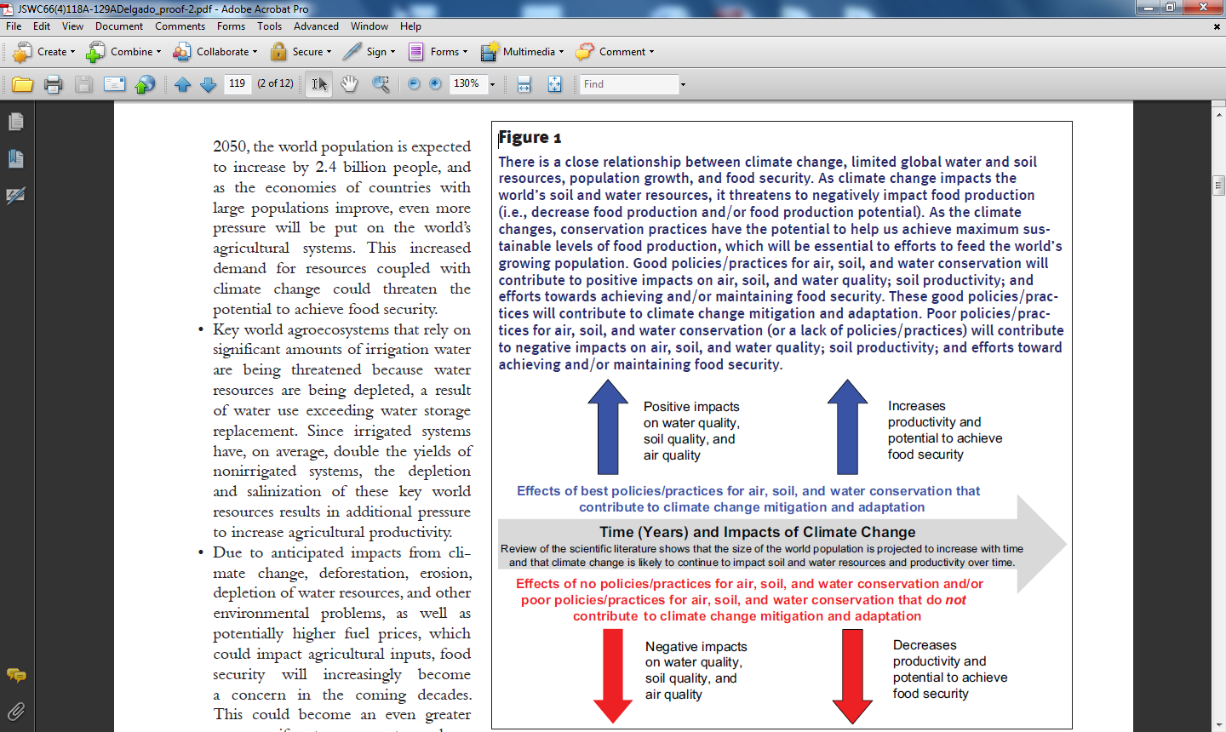
        The scientific literature argues that, with good policies, conservation programs, and practices, we can achieve food security (good air, soil and water quality). The alternative--business as usual--is lower air, soil, and water quality and ever greater food insecurity and associated social instability.
Slide # 48

Slide 31
A Few Points on the Link between Climate Change and National Security:
The Department of Defense has identified Climate Change as an important security topic. See quote below and link
“Climate change and energy are two key issues that will play a significant role in shaping the future security environment.”
http://www.defense.gov/qdr/QDR%20as%20of%2029JAN10%201600.pdf
USA Central Intelligence Agency ( CIA )
https://www.cia.gov/news-information/press-releases-statements/center-on-climate-change-and-national-security.html
Among several other additional readings see the following links
http://www.ens-newswire.com/ens/apr2007/2007-04-16-05.asp
http://image.guardian.co.uk/sys-files/Environment/documents/2011/03/10/PrepubAllClimateChange110218.pdf
Slide # 49

Slide 32
Conclusion – an additional thought
Hugh Hammond Bennett stated, “From every conceivable angle—economic, social, cultural, public health, national defense—conservation of natural resources is an objective on which all should agree.”
This statement applies, too, to the implementation of practices that conserve our soil and water while mitigating and adapting to climate change.
Slide # 50

Slide 33

“Conservation Practices to Mitigate
and Adapt to Climate Change ”
  Additional information about this slide show is available at the SWCS website (http://www.swcs.org/) and also published in the Journal of Soil and Water (JSWC) Conservation (http://www.jswconline.org/).
  Go to the following links by right clicking and opening the hyperlink at:
  SWCS Press Release
  SWCS Position Statement
  JSWC Viewpoint article
  JSWC Feature
  JSWC Research Editorial
Photo NASA
Slide # 51

Slide 34
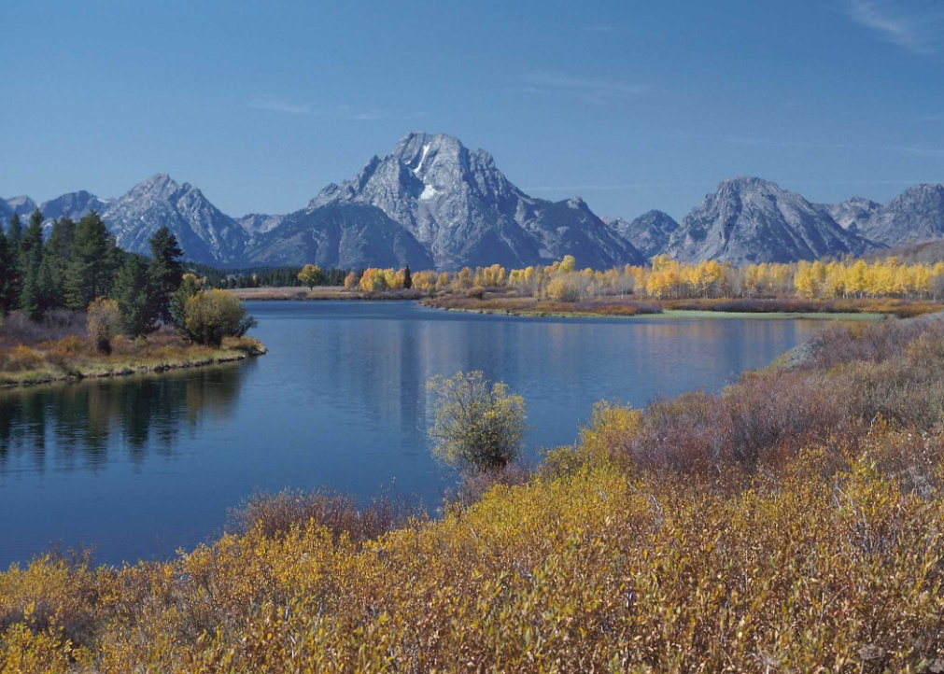
Additional Information/Final Comments
  All of this information is available at the SWCS website (http://www.swcs.org/) and also published in the Journal of Soil and Water Conservation (http://www.jswconline.org/).
NRCS
Slide # 52

