Slide 1
Soil and Water Conservation Society (SWCS) is a nonprofit scientific and educational organization -- founded in 1943 -- that serves as an advocate for conservation professionals and for science-based conservation practice, programs, and policy. SWCS has over 5,000 members around the world. They include researchers, administrators, planners, policymakers, technical advisors, teachers, students, farmers, and ranchers. Our members come from nearly every academic discipline and many different public, private, and nonprofit institutions.
SWCS mailing address: 945 SW Ankeny Road Ankeny, Iowa 50023-9723 Phone: (515) 289-2331 Fax: (515) 289-1227 swcs@swcs.org
Slide # 1

Slide 2
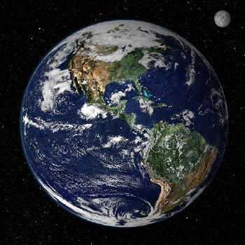
“Conservation Practices
to Mitigate and Adapt to Climate Change ”
Soil and Water Conservation Society
Photo NASA
Slide # 2

Slide 3
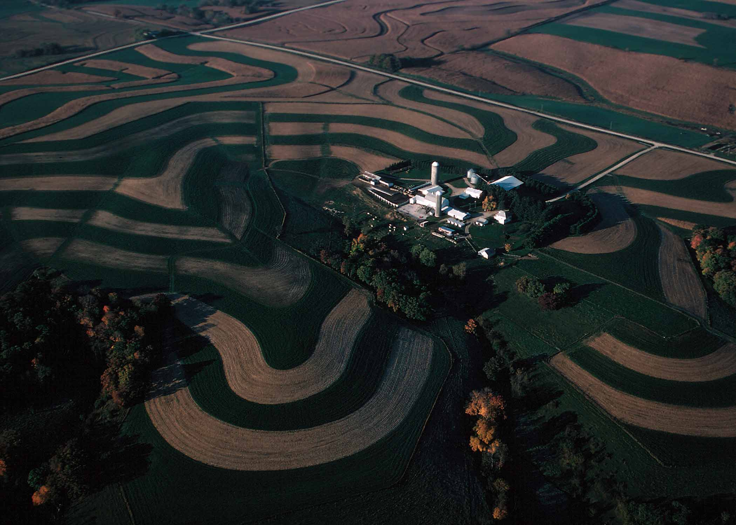
The Soil and Water Conservation Society invited a group of scientists to review the science of conservation practices and their potential for climate change mitigation and adaptation.
Photo USDA
Slide # 3

Slide 4
The 20th century’s Green Revolution showed that science-based solutions can provide answers to major global challenges.
Our planet in the 21st century faces a new threat that is among the most severe that civilization has ever faced. Science must again provide solutions (USDA NRCS 2010).
Slide # 4

Slide 5
A Major Global Challenge for Soil and Water Conservation
Slide # 5

Slide 6
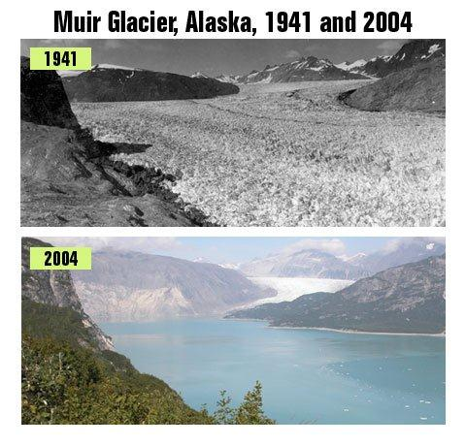
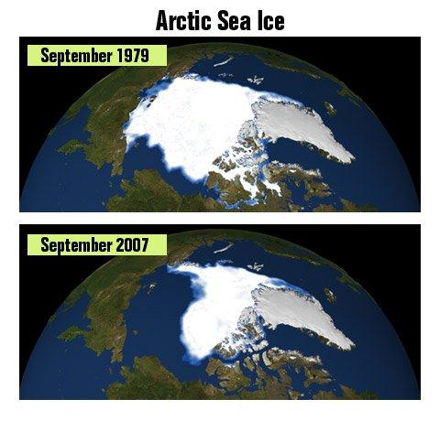
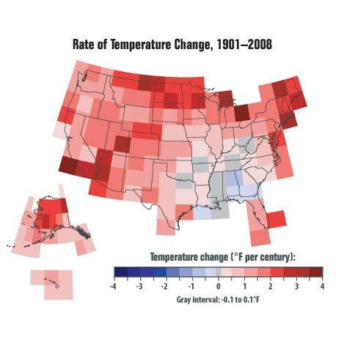
Climate change is real and here now. We must implement sound conservation practices to protect public health, social stability, and security.
Photos EPA
Slide # 6

Slide 7
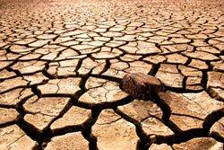
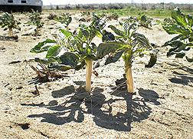
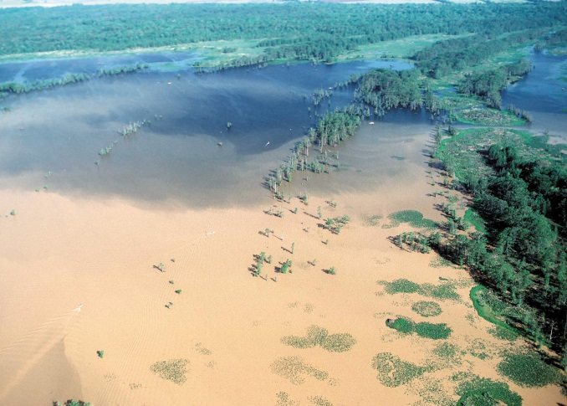
Extreme weather events, which may become more common, create environmental problems, accelerate the rate of erosion, and threaten agricultural production essential for food security and social stability.
Photo EPA
Photo ARS
Photo NRCS
Slide # 7

Slide 8
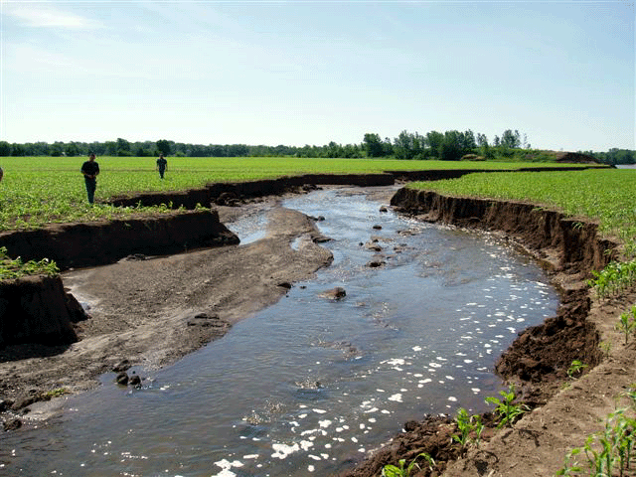
Climate change increases the potential for higher erosion rates. Erosion can lower agricultural productivity.
Source:
Iowa
NRCS
Slide # 8

Slide 9
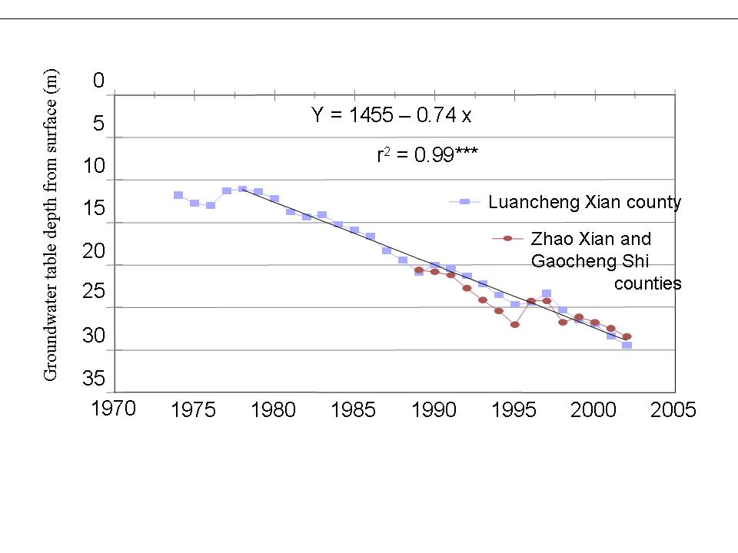
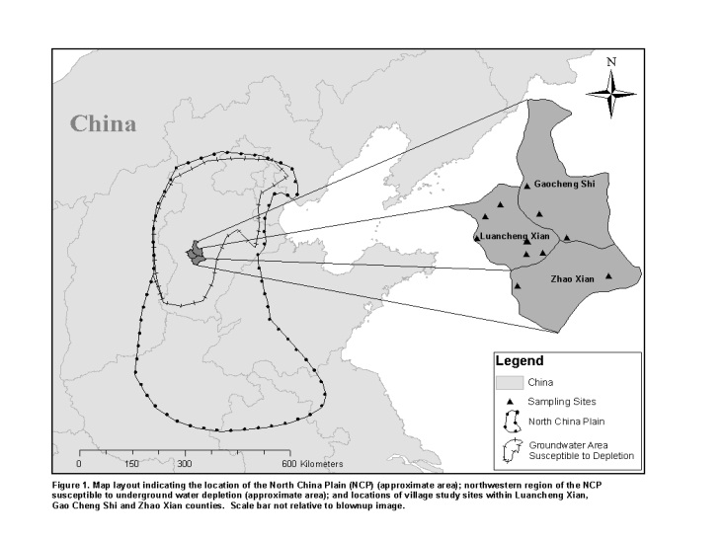
At risk are key world agroecosystems that rely on irrigation water. Using water faster than it can be replaced, we deplete water resources.
JSWC
JSWC
Slide # 9

Slide 10
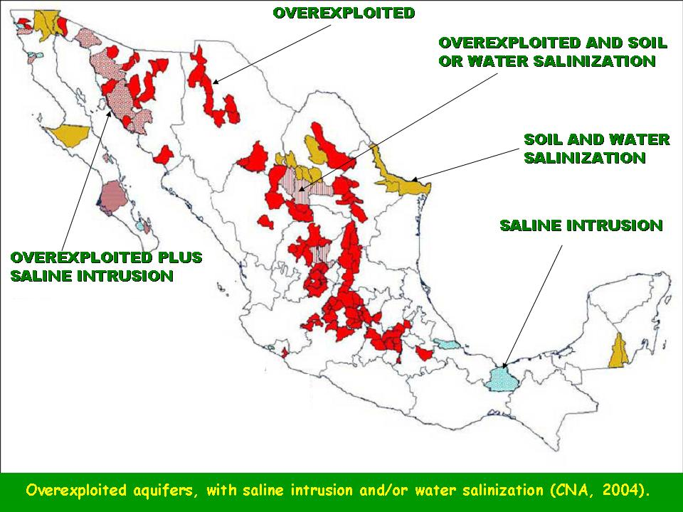
If we deplete and salinize these key world resources, we lose our highest yielding agricultural systems. Irrigated systems have, on average, double the yields of non-irrigated systems. Any yield loss has to be made up elsewhere, further straining agricultural productivity.
CNA 2004
Slide # 10

Slide 11
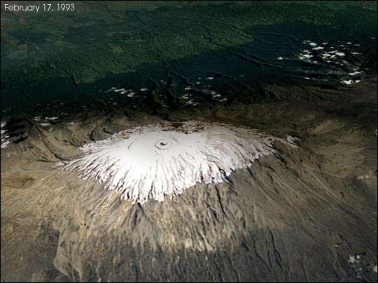
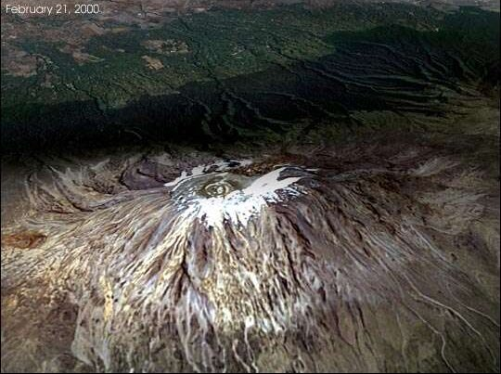
The melting of glaciers can affect the availability of water for cities and/or irrigated lands.
Kilimanjaro, 1993 - 2000
(Jim Williams, NASA GSFC)
http://earthobservatory.nasa.gov/IOTD/view.php?id=3054
Slide # 11

Slide 12
Yields in rainfed systems can also decline. For every increase in temperature of 1°C (1.8°F), agricultural yield can decline. Grain yield falls by 10%. Not only heat, but also drought stresses crops.
http://www.scientificamerican.com/article.cfm?id=climate-change-impacts-staple-crop-yields
Slide # 12

Slide 13
Across Africa, an increase in temperature of 1°C under drought conditions can affect 100% of the corn crop. Yields can fall by 20% and more.
Wheat yields are affected around the globe, see figure on right.
http://www.scientificamerican.com/article.cfm?id=climate-change-impacts-staple-crop-yields
Slide # 13

Slide 14
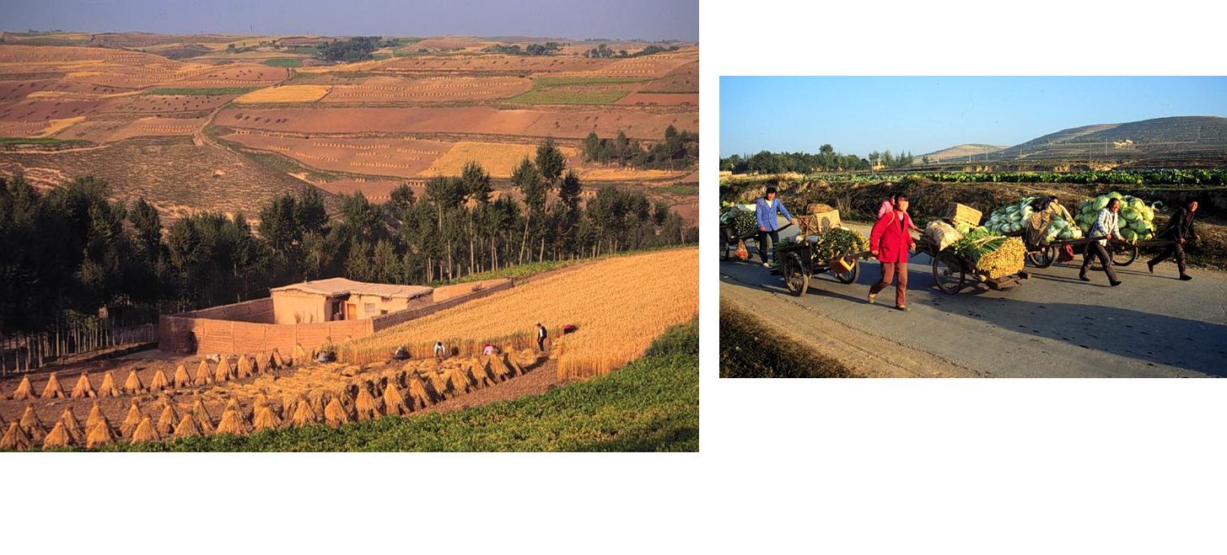
By 2050, the world will add 2.4 billion people. Widespread growth in developing economies puts more pressure on the world’s agricultural systems. The combined impact of climate change and increased demand on resources threatens food security.
Slide # 14

Slide 15
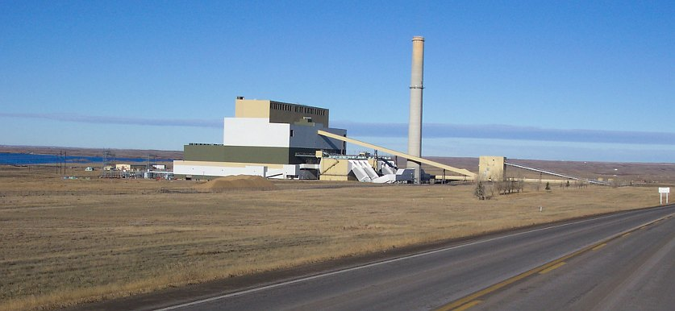
Rising energy costs adversely affect higher yields by raising the cost to farmers of key fertilizer and agrochemical inputs.
Photo credits – T. Goddard, SWCS Canada
Slide # 15

Slide 16
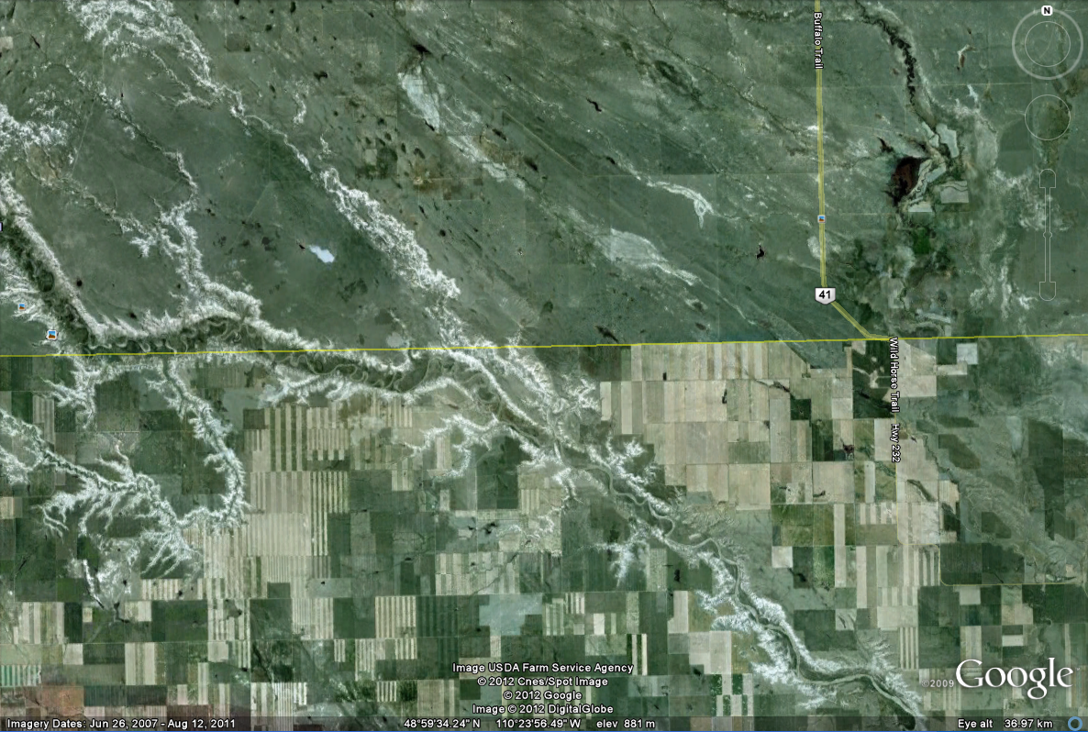
Deforestation, soil erosion, depletion of water resources, and other environmental problems threaten both agricultural productivity and the ecosystem services upon which people depend.
Slide # 16
Satellite image of contrasting land use along Canada-USA border (Alberta/Montana)

Slide 17
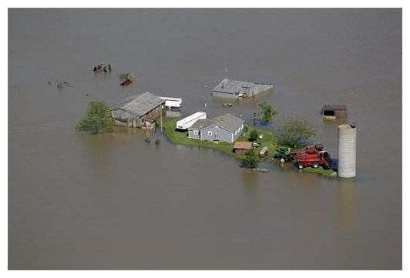
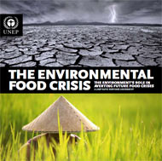
Extreme events, such as droughts, floods, or even extreme pest or disease outbreaks (e.g., blight, a potato disease that contributed to the infamous potato famine in Ireland) will test the resilience of our systems.
http://calclimateag.org/crop-insurance-reform-must-reflect-climate-realities/
Source - UNEP
Slide # 17

Slide 18
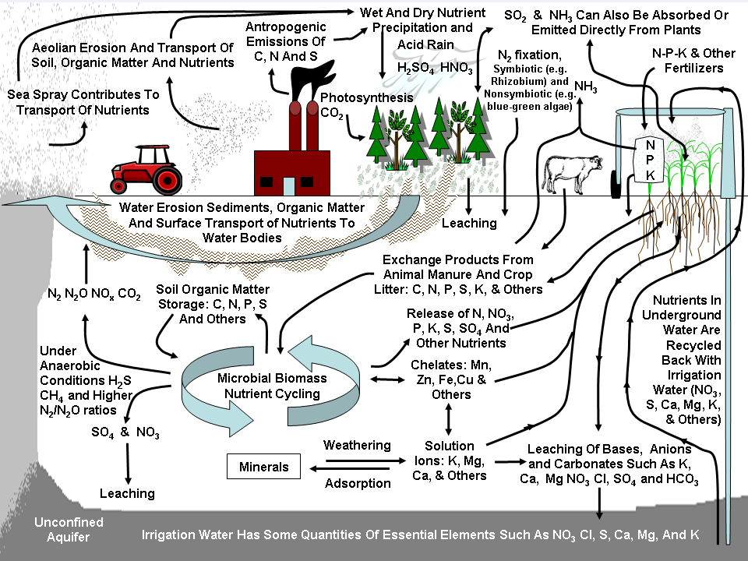
The Carbon and Nitrogen Cycles and Agricultural Contribution to Greenhouse Gases
Greenhouse Gases Contributed by Agriculture are an Important Factor in Climate Change.
Agriculture plays an important role in the GHG fluxes of carbon dioxide (CO₂), nitrous oxide (N₂O) and methane (CH₄), contributing 6% of total United States GHG emissions (USEPA 2010b).
Slide # 18

