Slide 1
The need for conservation
Is there a need to manage wildlife?

Slide 2
Aims
Understand some of the reasons behind the idea of conservation.
Use case studies to argue the need for conservation.

Slide 3
Why do animals seem to be going extinct at a faster rate?
Habitat loss - deforestation
Hunting, overfishing, over farming
Pollution
Increased rate of extinction

Slide 4
Why should we care?
Aesthetics
Educational
Economic
Recreational
Ecological
Ethical

Slide 5
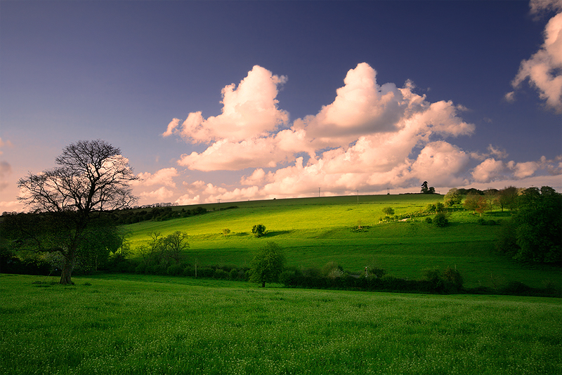
Aesthetic
Many people believe that wildlife, habitats and species should be conserved simply because they are beautiful.
People take pleasure in looking at them in a way which is similar to the pleasure they might gain by looking at a painting, sculpture or other work of art.

Slide 6
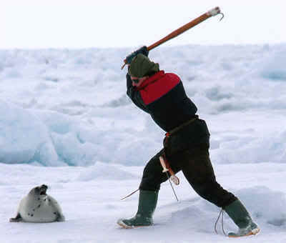
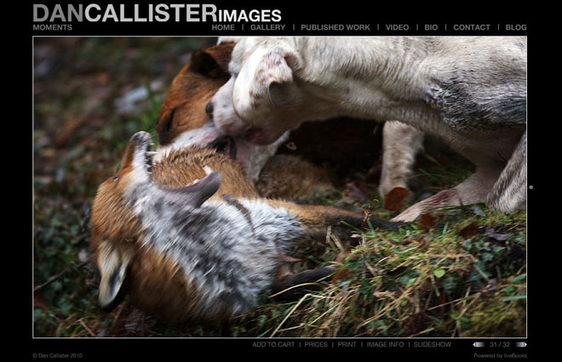
Ethical
Ethical reasons are about what people believe is right or wrong. Some people believe that it is wrong to kill or harm any animals for any reason. Others may be against the killing of certain groups of animals (e.g. Whales or seals) or the killing of animals for sport or for their fur or other body parts.

Slide 7
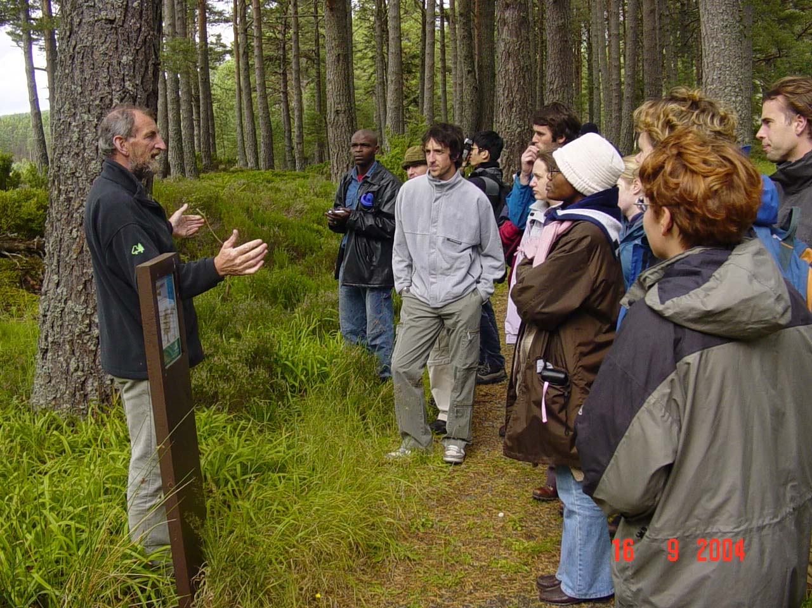
Education
Schools, colleges and other groups often use nature reserves as 'outdoor class- rooms' where students can carry out field work in Biology, Environmental Science and other subjects.

Slide 8
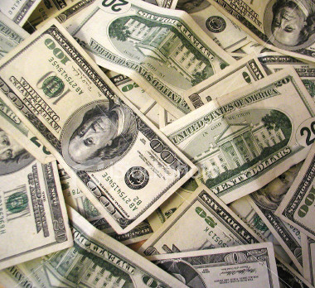
Economic
Wildlife and beautiful landscapes can be important sources of jobs and income. This can happen in a variety of ways - people may simply visit an area and spend money in local shops or on accommodation or they may spend large amounts on specialist wildlife watching or outdoor activity holidays. Some species have been used as the focus for new tourist activities, for example the Red Kite, which is a scarce bird of prey in the UK, has been used as part of a campaign to encourage more tourists to visit mid-Wales.

Slide 9
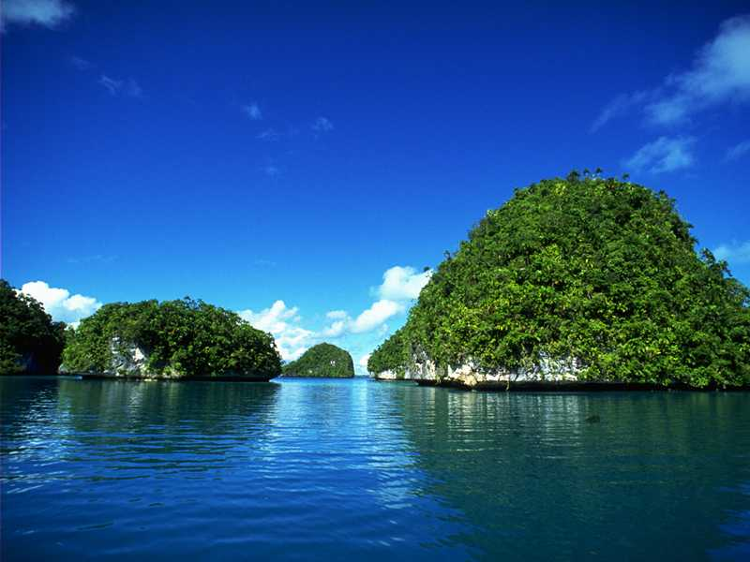
Beautiful location

Slide 10
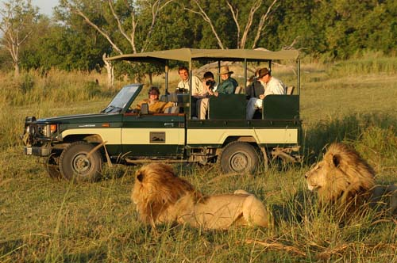
Eco tourism

Slide 11
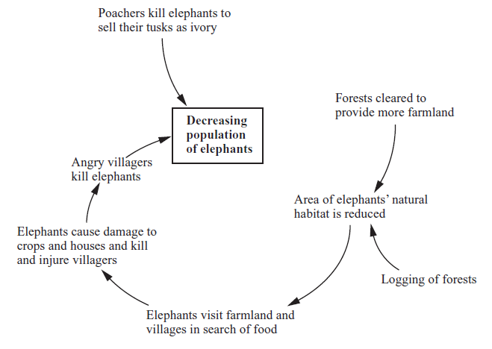
Year | Estimated number of elephants in Sri Lanka
1815 | 30,000
1900 | 12,000
2003 | 2,800
Calculate the percentage decrease of elephants between 1815 and 2003.
The population of sri lanka is increasing. Use the diagram to explain why the population of elephants is decreasing

Slide 12
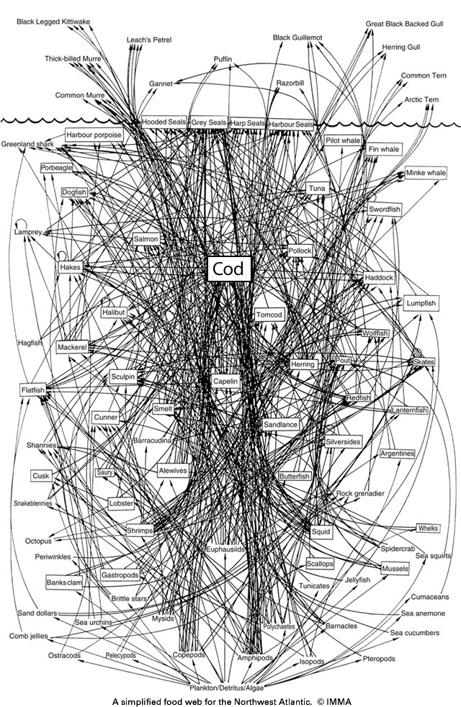
Interdependance
Organisms are dependant on each other. Neither could exist without the other.
Taking one organism out of a food web can have a devastating effect on the ecosystem

Slide 13
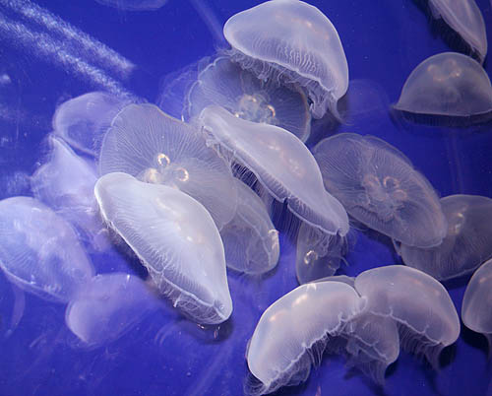
Ocean of the future without sharks?

Slide 14
Recreational
Many people enjoy watching wildlife, walking, climbing and other outdoor activities in areas of unspoilt countryside. Wildlife and landscapes will need to be conserved so that people in the future will also be able to enjoy them.

Slide 15
Ecological
The whole range of different species on Earth is sometimes referred to as biodiversity and people often talk about the need to conserve global biodiversity or the biodiversity of particular countries or areas. As well as the reasons which have already been mentioned there are also ecological arguments in favour of conserving biodiversity.

Slide 16
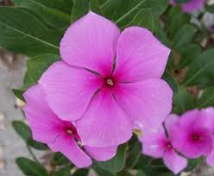
Medicinal reasons
Scientists have only studied a fraction of the planets plants but already they have discovered many that have valuable medicinal compounds.
This plant only grows in Madagascar and has been shown to have powerful anti cancer compounds.

Slide 17
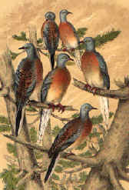
The passenger pigeon
The story of the Passenger Pigeon shows the need for conservation very clearly.
In the early nineteenth century the Passenger Pigeon was still North America's commonest bird species, with huge flocks of up to 2 billion birds migrating through the forests, feeding mainly on acorns and beech seeds.
The Passenger Pigeon was adapted to live in huge flocks. When they settled in an area to breed there were so many that natural predators could kill and eat as many as they could without affecting the total population very much.
Native Americans and early settlers hunted the pigeons but did not make much impact on the huge numbers of birds.

Slide 18
Why did they go extinct?
rapid growth in the human population of North America;
development of the railways (which allowed pigeon meat to be transported for sale in major cities);
the invention of the telegraph (allowing hunters to spread news of places where the huge migrating flocks had settled to nest);
deforestation, destroying the pigeons' food supply and nesting and roosting sites.

Slide 19
Timeline of Death
The last large wild flock, containing about 250,000 birds was found in 1896. Hunters travelled to the site and only about 10,000 birds escaped.
The last wild Passenger Pigeon was shot by a 14-year-old boy in Pike County, Ohio on March 24th 1900.
A small group were kept in the Cincinnati Zoo. The last Passenger Pigeon, a female which had been named Martha, died on September 1st 1914. The Passenger Pigeon was extinct.

Slide 20
Draw up a list of all the ways that you could generate income from the forest. For each method state the advantages and disadvantages.
How the rain forest can generate income | Advantages | Disadvantages
Sell land to a logging company | Will generate a lot of money immediately | No income for future year. Native tribes will lose their income. Biodiversity will decrease. Rainfall will cause flooding.

