Slide 1
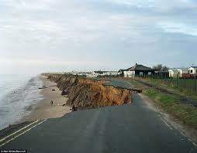
Coastal Erosion

Slide 2
Learning objectives
To be able to define the five processes of marine coastal erosion.
To be able to explain the factors affecting coastal erosion.
To describe the difference between concordant and discordant coastlines.

Slide 3
Homework
Answer the exam question:
“Describe two or more landforms resulting from coastal erosion and their formation (15 marks).”
Due: next lesson

Slide 4
Classwork
Complete the worksheets that accompany the slides.
Put it into your revision folder.

Slide 5
Attrition
Material carried by the waves bump into each other and so are smoothed and broken down into smaller particles.
Hydraulic action
This process involves the force of water against the coast. The waves enter cracks (faults) in the coastline and compress the air within the crack. When the wave retreats, the air in the crack expands quickly causing a minor explosion. This process is repeated continuously.
Corrosion/solution
This is the chemical action of sea water. The acids in the salt water slowly dissolve rocks on the coast. Limestone and chalk are particularly prone to this process.
Abrasion/Corrasion
This is the process by which the coast is worn down by material carried by the waves. Waves throw these particles against the rock, sometimes at high velocity.

Slide 6
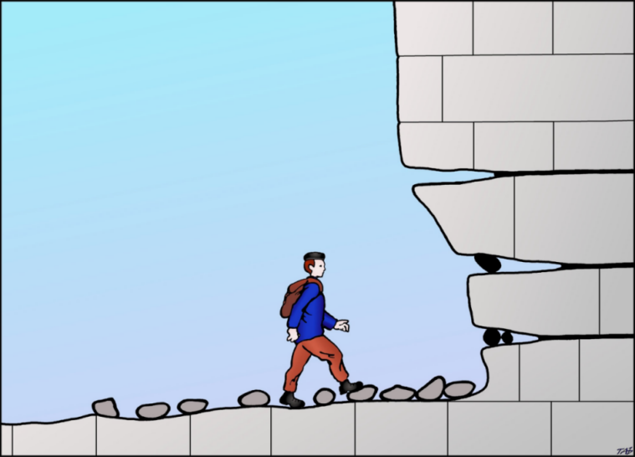
Sub-aerial: surface runoff/ rain wash/ wind/ frost/ mass movements
Corrosion: Salt Crystallization
disintegrates weaker layers
HIGH TIDE LEVEL
Abrasion/ corrasion
Wearing away of cliffs
by materials
Hydraulic pressure
Compression of
trapped air
Attrition: Wearing down
of broken materials
Solution: Dissolving by acidic
sea water

Slide 7

Think, pair, share
Why does erosion matter?

Slide 8
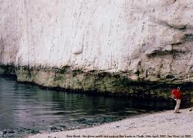
Quiz
1

Slide 9
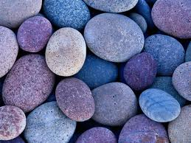
Quiz
2

Slide 10
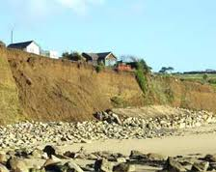
Quiz
3

Slide 11
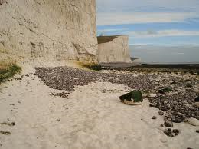
Quiz
4

Slide 12
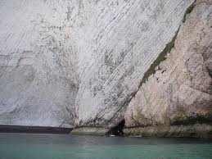
Quiz
5

Slide 13
Answers SA
Solution – Evidence?
Attrition – Evidence?
3. Abrasion – Evidence?
4. Hydraulic action and abrasion – Evidence?
5. Corrosion– Evidence?

Slide 14
Sub-aerial or cliff face erosion
Sub-aerial processes include:
Salt weathering – sodium and magnesium compounds expand in joints and cracks thereby weakening rock structures.
Freeze-thaw weathering – The process whereby water freezes, expands and degrades jointed rocks
Biological weathering – Carried out by molluscs, sponges and urchins.

Slide 15
Physical Factors which influence the rate of erosion
Wave characteristics –
Key words: constructive/destructive
Coastal geometry –
Key words: Wave refraction
Nature of any beach present
Geology –
Key words: Lithology/Concordant/Accordant/Discordant

Slide 16
Wave characteristics
Wave energy is determined by two factors:
Height (distance between trough and crest)
Length (distance between the two crests)
Wave energy is results from three factors:
The speed of the wind blowing over the surface of the sea
The length of time a wave has been moving
The fetch – the distance of open sea
Any or all of these factors can combine to make steeper, higher-energy waves.
The higher the wave energy, the higher the rate of erosion (all other things being equal).

Slide 17
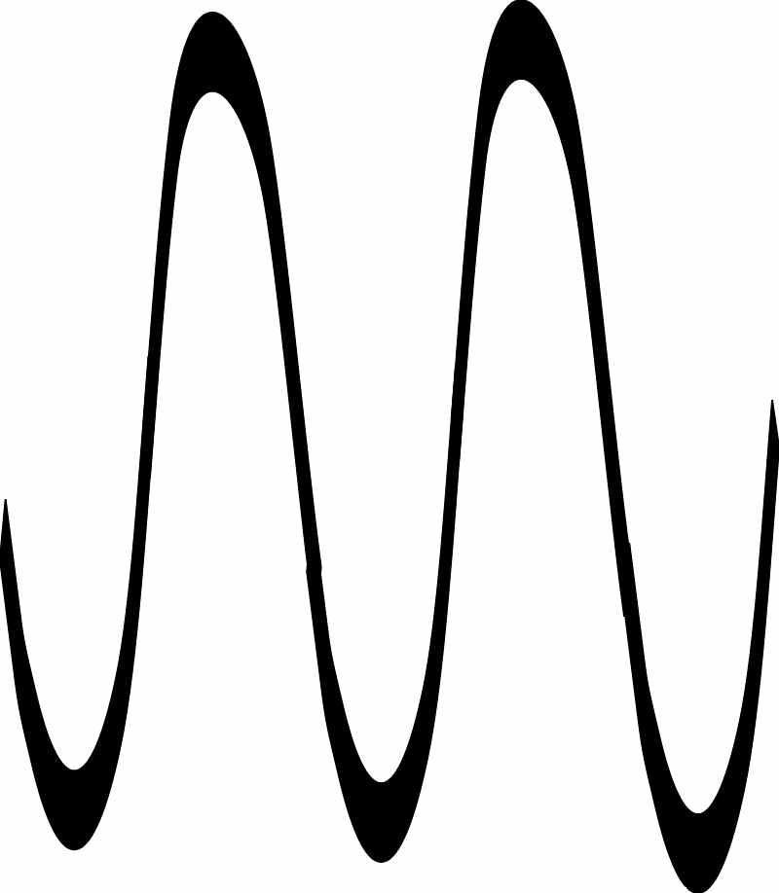
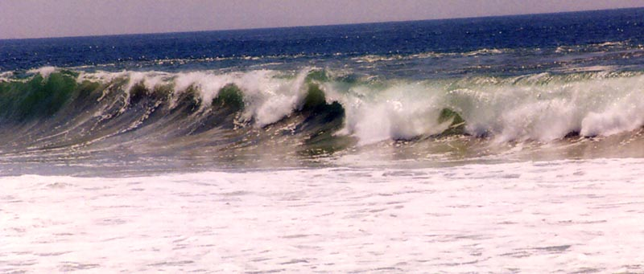
Types of waves
Destructive Waves
backwash>swash
Constructive Waves
swash>backwash

Slide 18
Coastal geometry
The GEOMORPHOLOGY (or shape) of the coastline will also affect the rate of erosion. Headlands cause wave refraction, making waves converge and combining their energy. Wider, shallower bays, meanwhile, allow waves to diverge, losing energy due to friction with the sea bed.

Slide 19
Geometry: Nature of any beach
Where the wave breaks effects the energy of the impact.
A wider beach will cause more wave energy to be lost due to friction before the waves can break. A narrower beach will mean that the breaking point of the waves is closer to the coastline. If the beach gradient is steep, this will encourage steeper, higher-energy waves.

Slide 20
Geology properties
Lithology - If the coast is made of a more resistant type of rock the erosion rate will be lower. hard rocks = granite and basalt and soft rocks = sands and gravels.
Erosion rates:
Granite 1mm per year
Limestone 1cm per year
Chalk 1m per year
Boulder clay 10m per year

Slide 21
Geology structure
Concordant
Orientation is parallel to the coast
(Coves)
Discordant
Orientation is at right angles to shore.
(headland and bays).

Slide 22
Ask the Expert
Put whether you agree or disagree with our experts answers.
How many factors are there which influence the rate of coastal erosion?
Name them.
Which wave has a higher wave energy? Constructive or destructive.
A steep beach gradient means a steeper, higher energy wave. True or false?
How fast does chalk erode?
4
Waves, geometry, beach, geology
1m per year

Slide 23
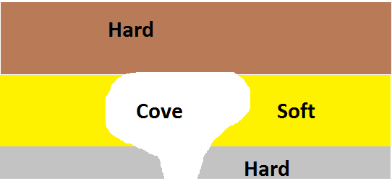
Formation of a cove

Slide 25
Exam practice
Decode the question
Using the marking criteria mark the mock answer.
Discussion – What mark would you give it?
How could this answer be improved?

Slide 26
Learning objectives
To be able to define the four processes of coastal erosion.
To be able to explain the factors affecting coastal erosion.
To describe the difference between concordant and discordant coastlines.

Slide 27
On post stick notes answer
What did you learn this lesson?
What would improve your learning?

