Slide 1
Coastal Defences
Groynes, Physical Stone defences.
Case study location :
Barton On Sea Southern England

Slide 2
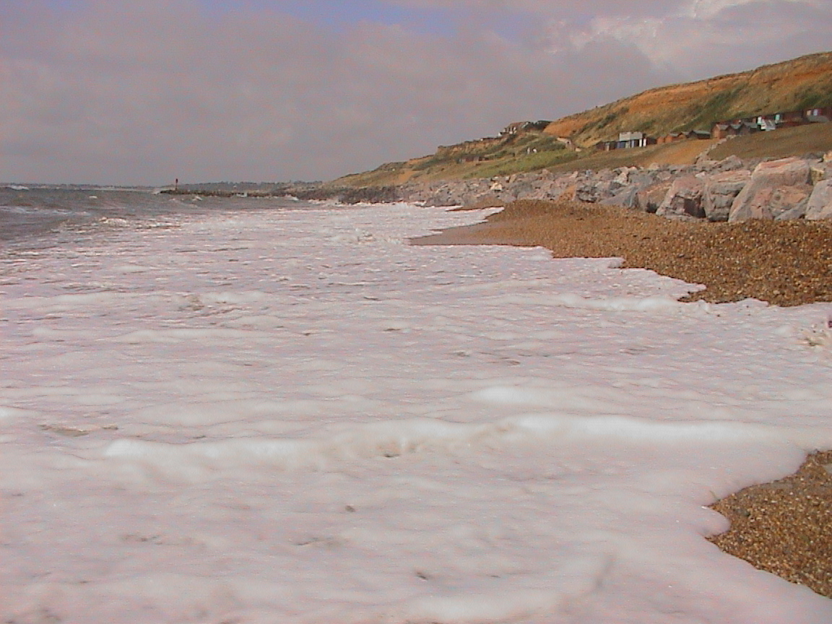
Soft rock on the back wall of the coast
First line of coastal defence- heavy large rocks
Waves break on the beach and moves up the beach- SWASH

Slide 3
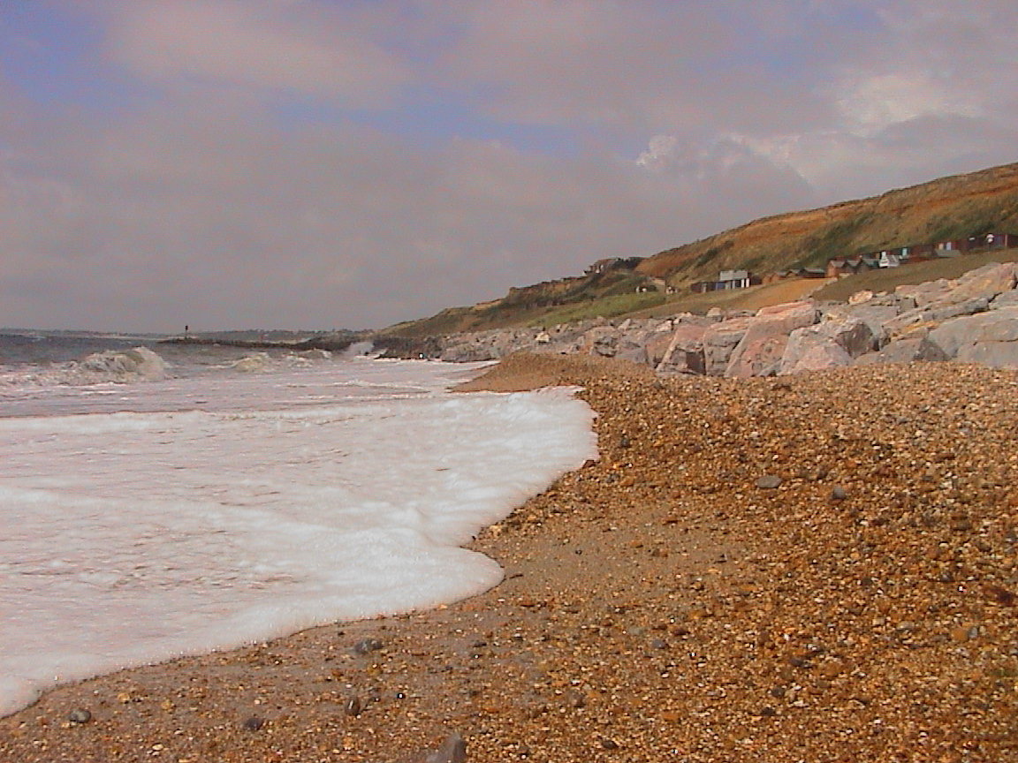
Waves move back down the beach dragging along beach material- BACKWASH

Slide 4
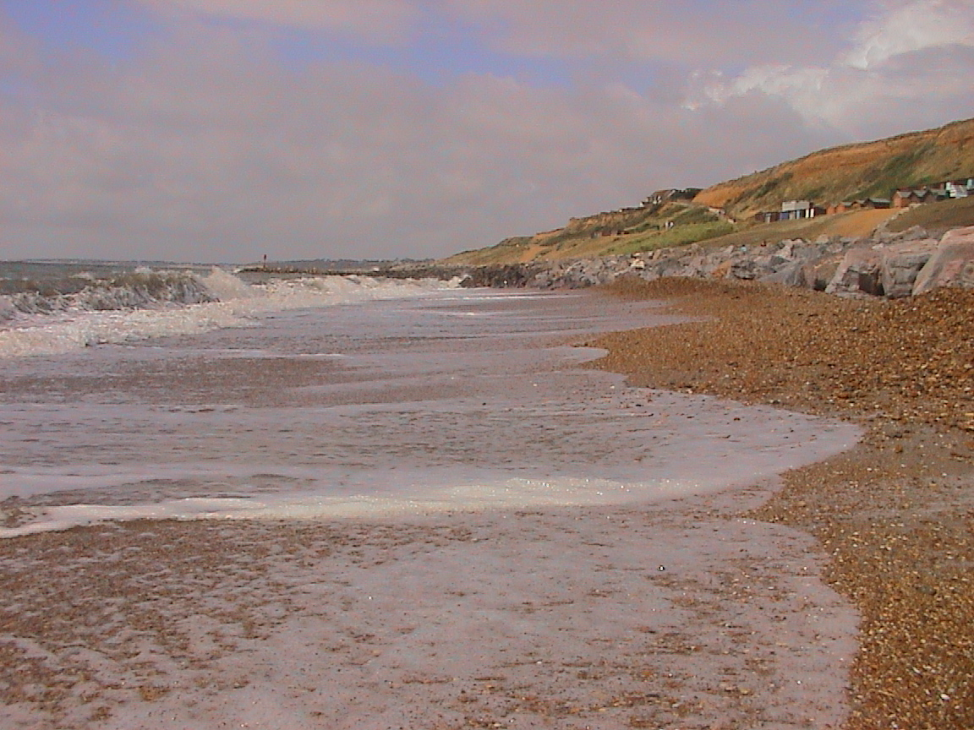
Water nearly totally drains back ready for the next wave to break on the beach

Slide 5
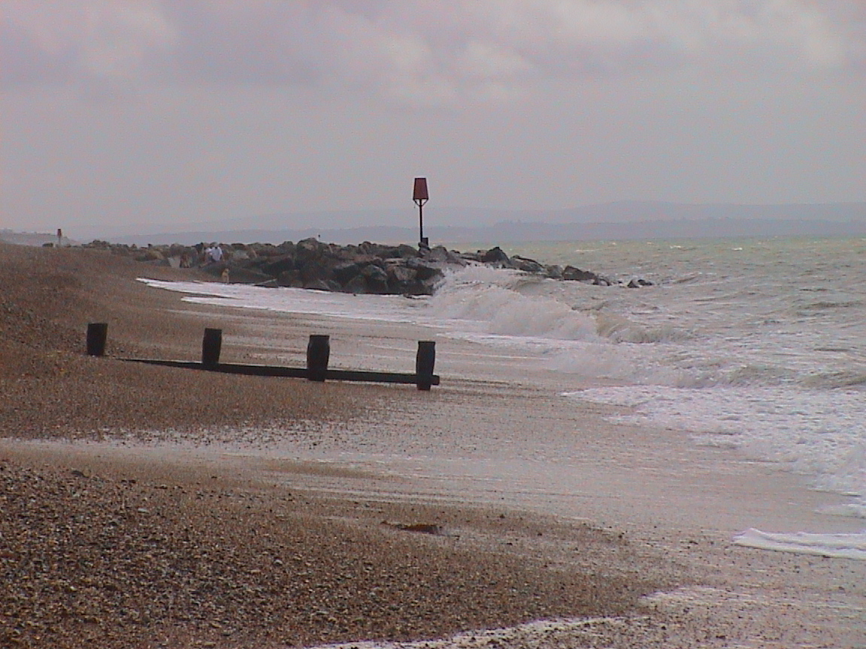
Heavy stone groyne
Wooden groyne
WAVE DIRECTION

Slide 6
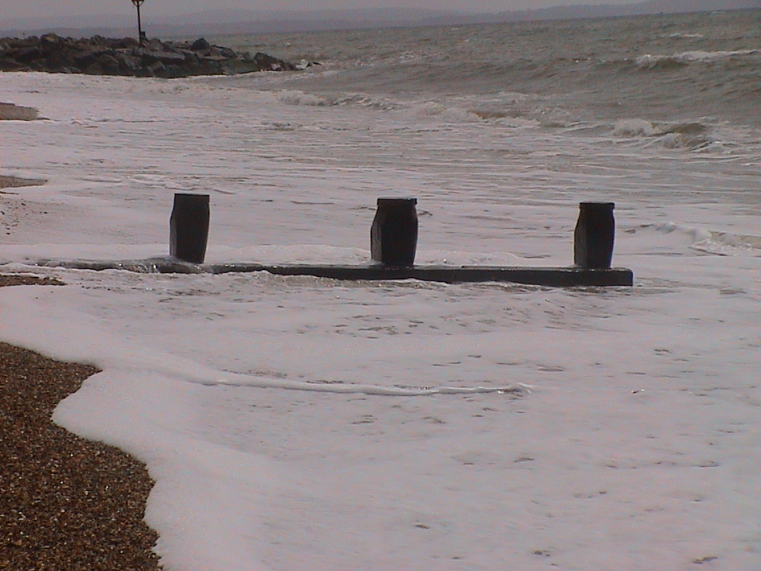
WHEN THE WAVE BREAKS ON THE BEACH IT TOTALLY COVERS THE GROYNE

Slide 7
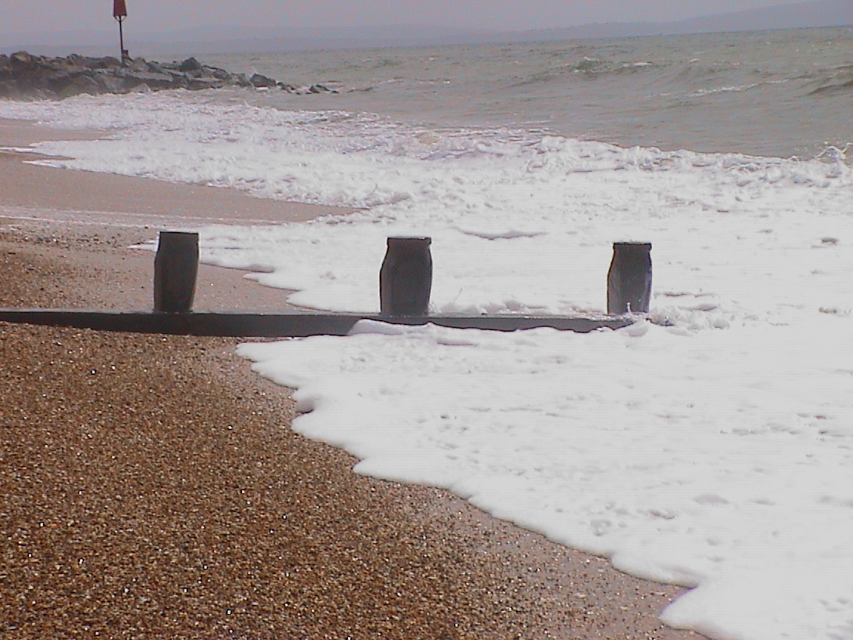
Note how the waves retreat at different rates down the beach.

Slide 8
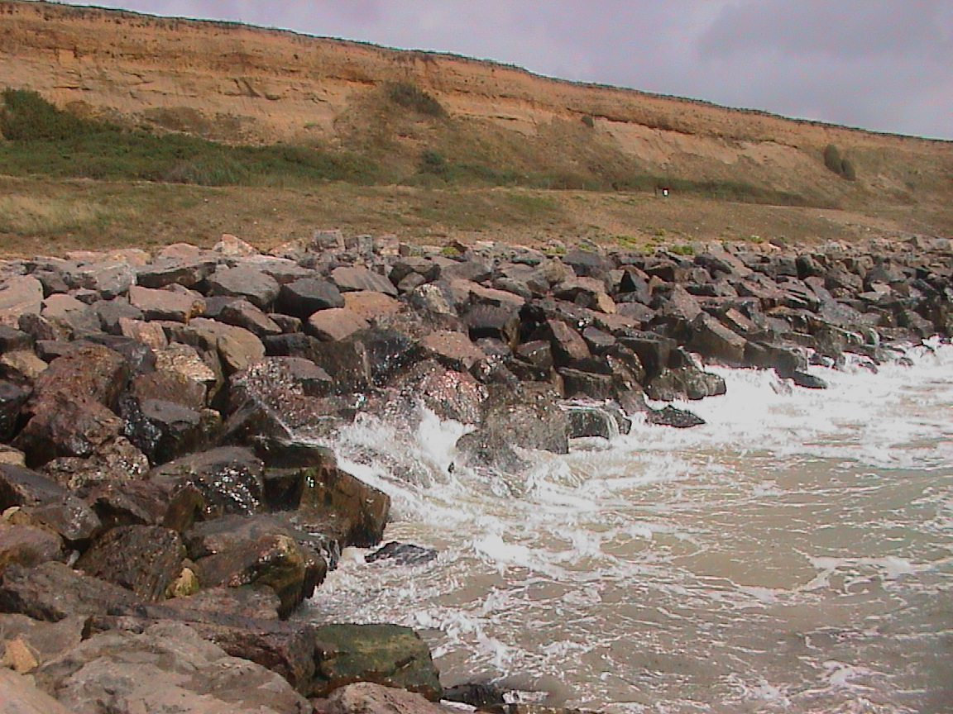
Large angular rocks break the energy of the waves

Slide 9
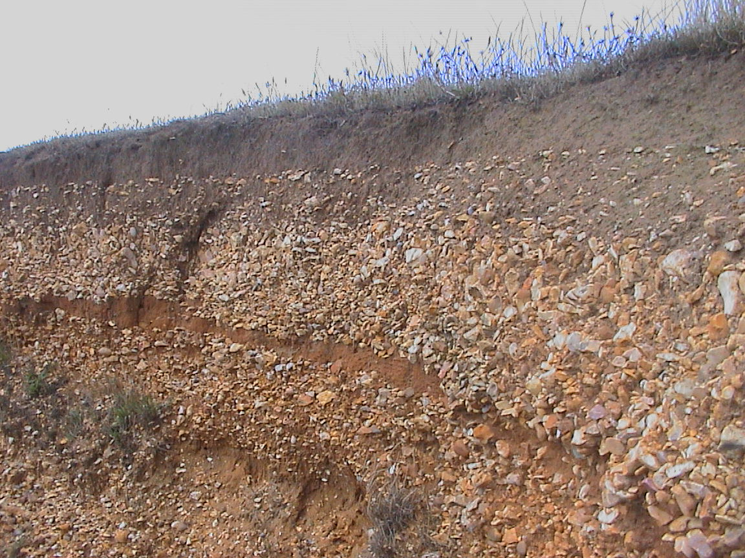
Cliffs constructed from soft unconsolidated material

Slide 10
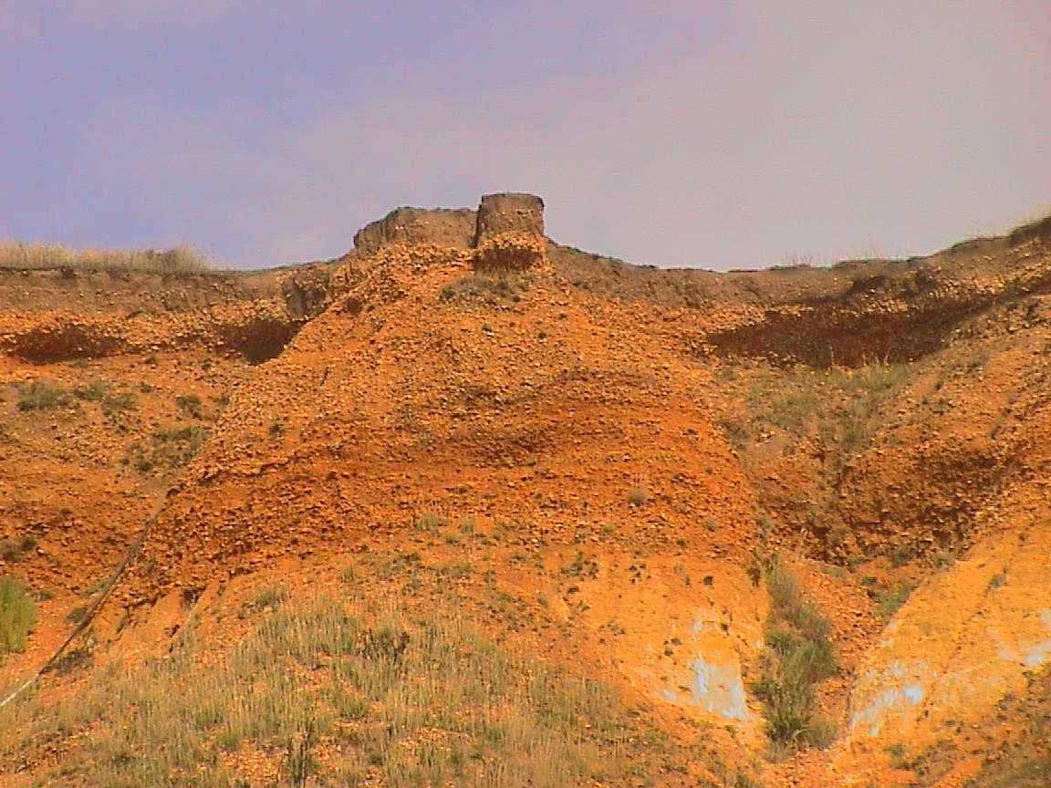
Aerial erosion also takes place e.g. Wind and rain

Slide 11
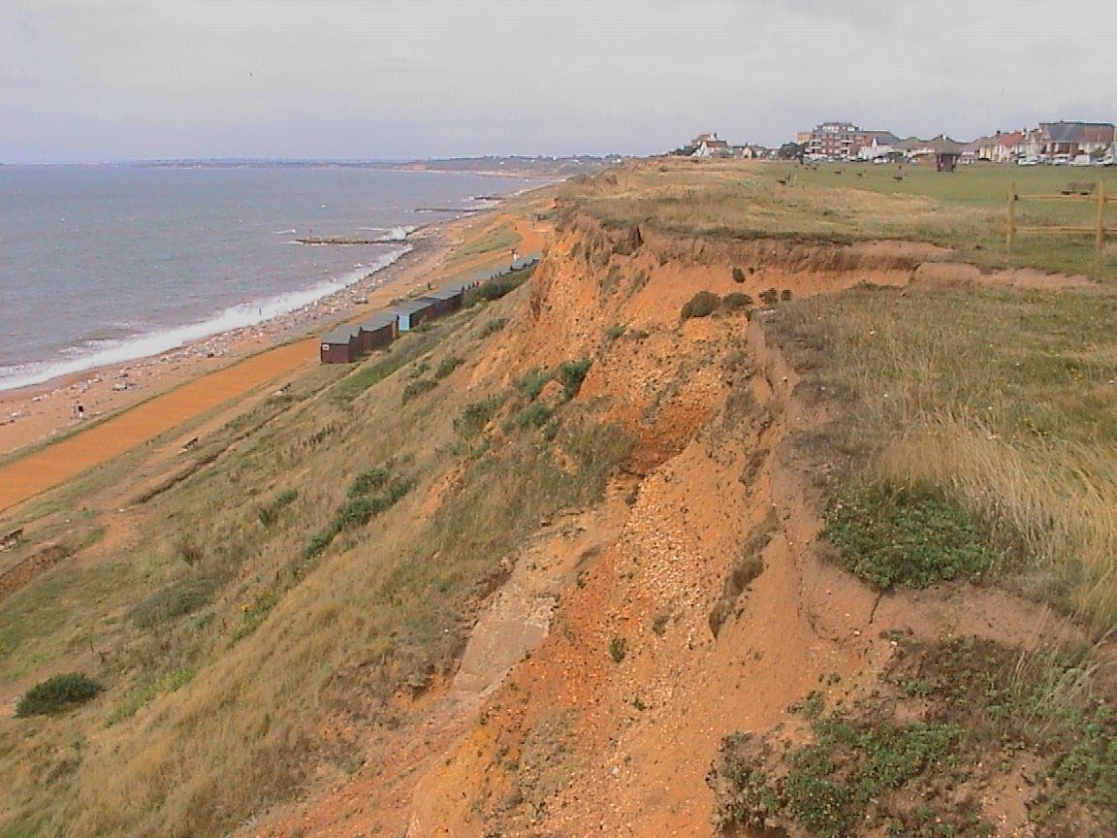
Large part of cliff has fallen down the slope

Slide 12
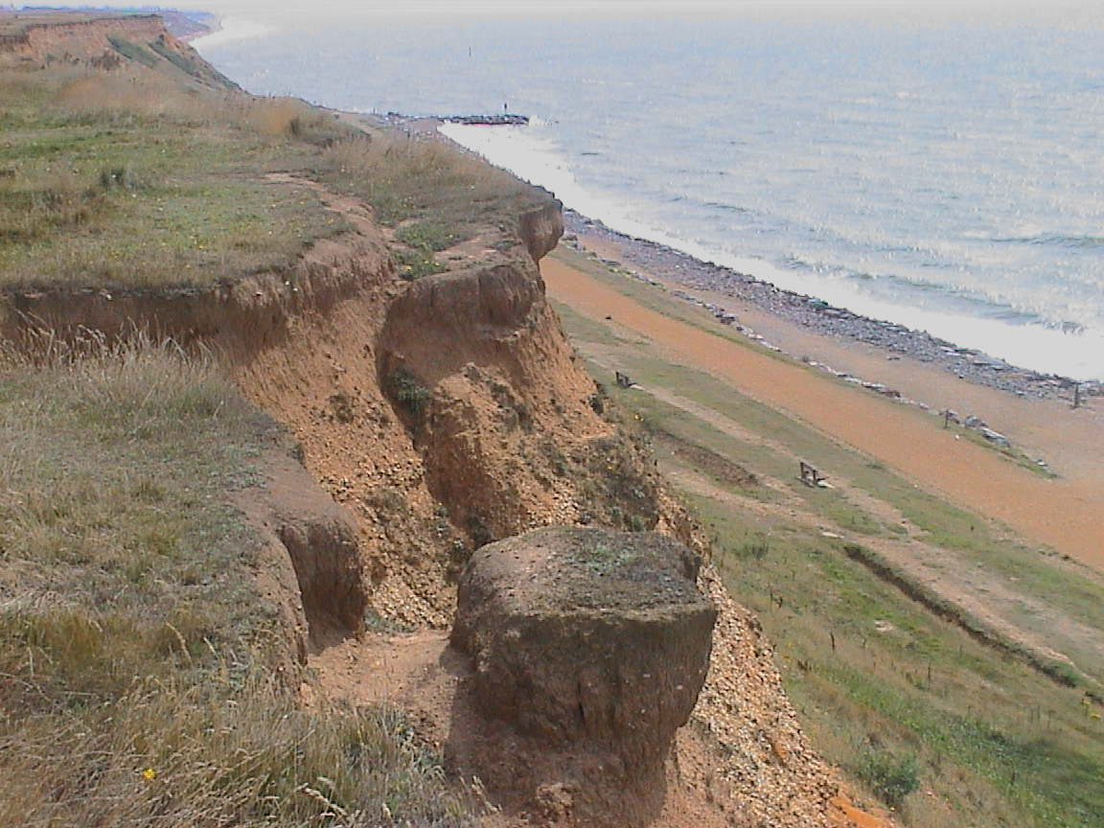
Cliff line erodes and becomes dangerous

Slide 13
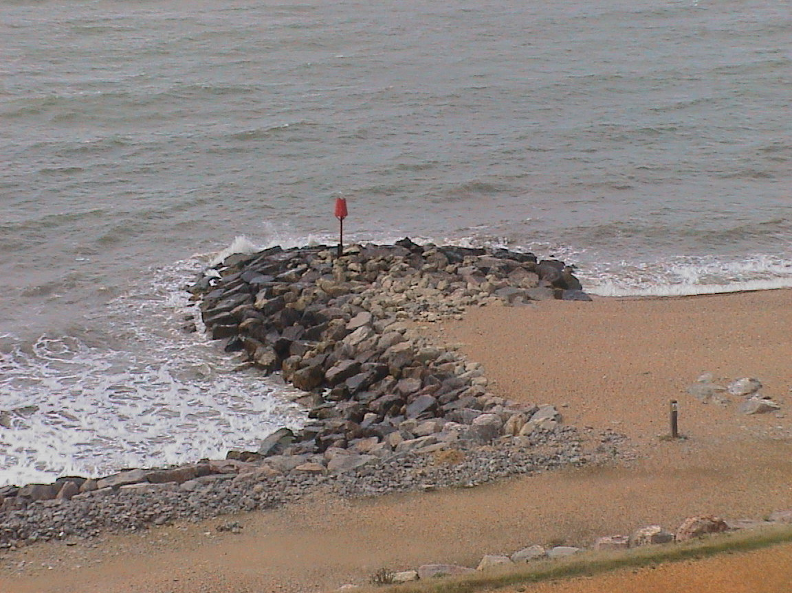
Direction of the waves
Deposition
Erosion

