Slide 1
China and the rest of the World
Friday 18th May
Learning Objective- To investigate how China is governed and the relationship with the World
capitalist
democracy
communism
I can describe what communism is – Level 4
I can contrast the differences between a Communism and Democratic government – Level 5
I can analyse China’s role as global leader – Level 6

Slide 2

What is this?
Have you seen
it anywhere?
What do you think it means?

Slide 3
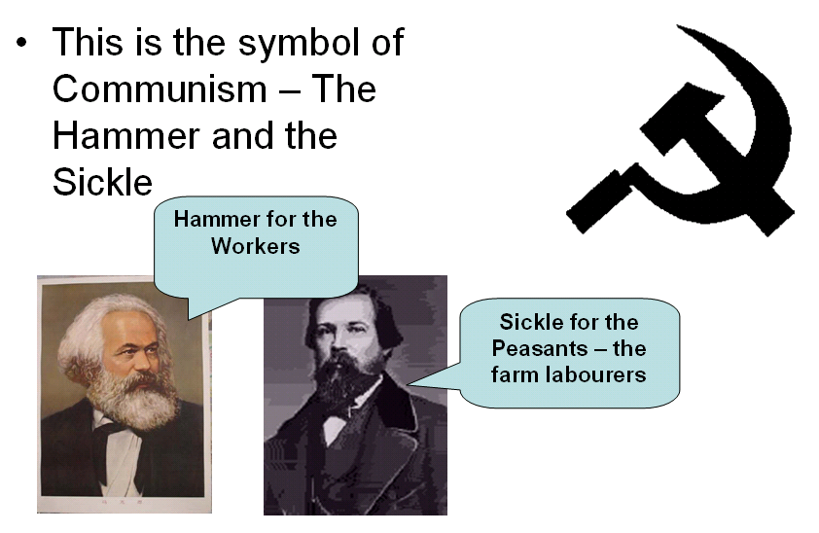
L/O - To investigate how China is governed and the relationship with the World

Slide 4
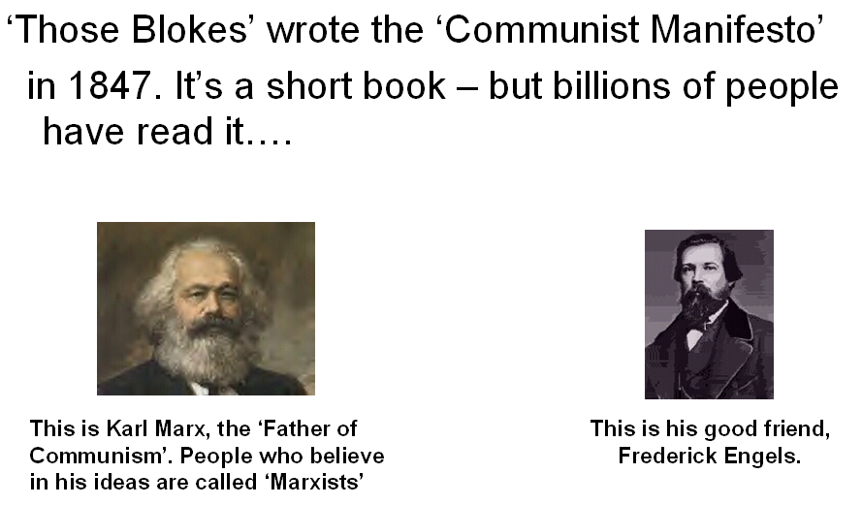
L/O - To investigate how China is governed and the relationship with the World

Slide 5
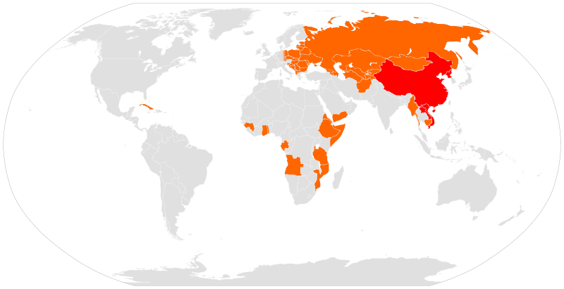
Where has communism occured?
L/O - To investigate how China is governed and the relationship with the World

Slide 6

L/O - To investigate how China is governed and the relationship with the World

Slide 7
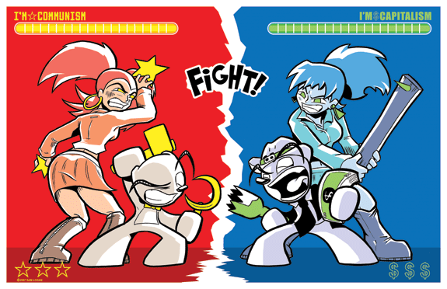
L/O - To investigate how China is governed and the relationship with the World

Slide 8
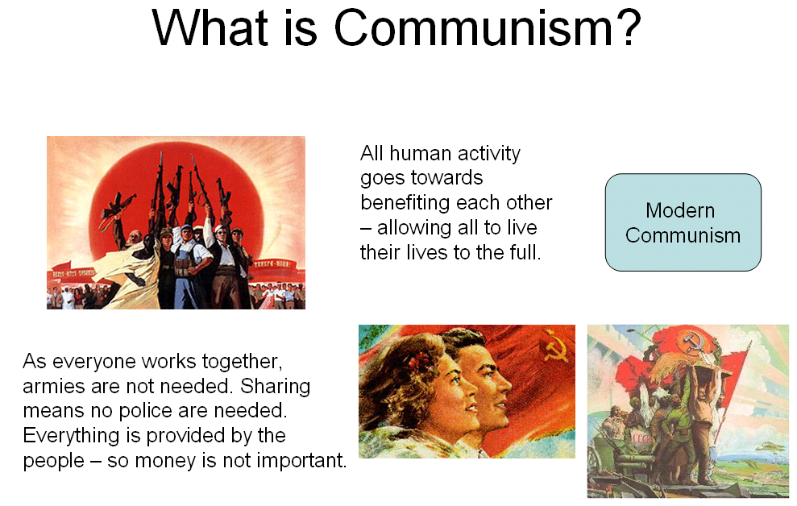
L/O - To investigate how China is governed and the relationship with the World

Slide 9
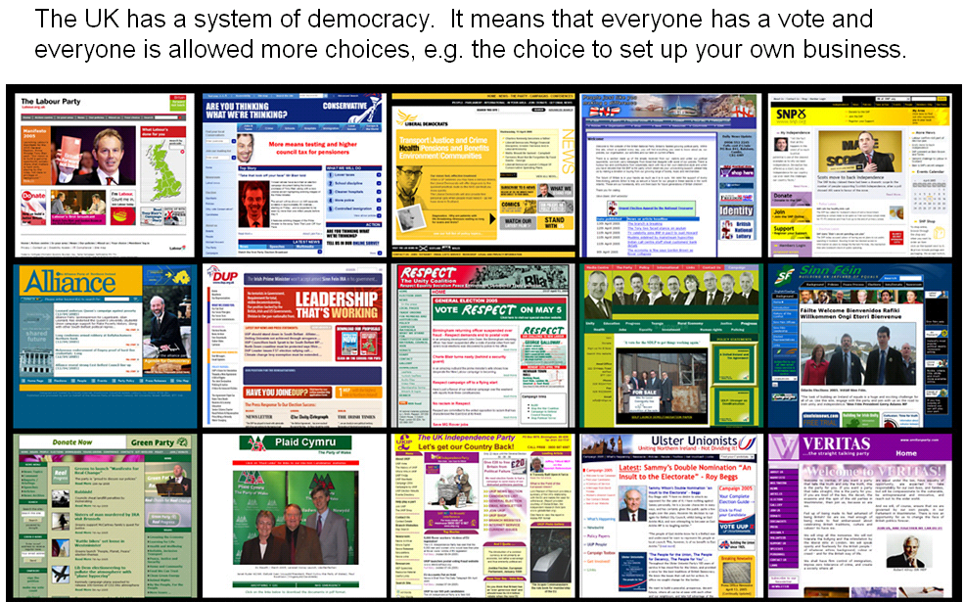
What is democracy?
L/O - To investigate how China is governed and the relationship with the World

Slide 10

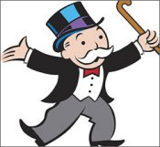
What is capitalism?
L/O - To investigate how China is governed and the relationship with the World

Slide 11
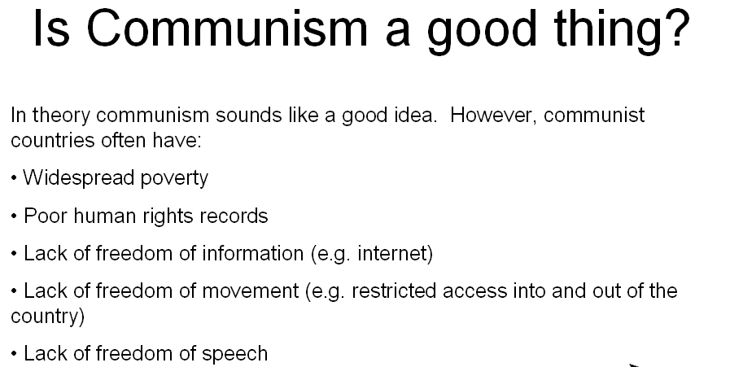
L/O - To investigate how China is governed and the relationship with the World

Slide 12
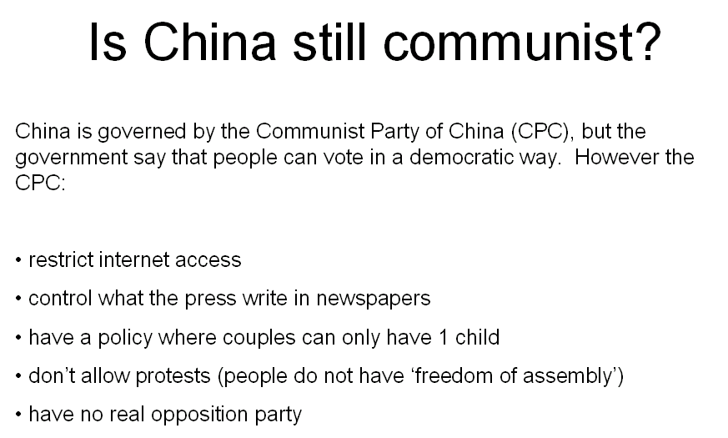
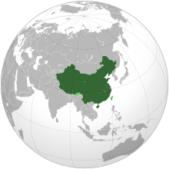
L/O - To investigate how China is governed and the relationship with the World

Slide 13
I can contrast the differences between a Communism and Democratic government – Level 5
Communism
Democracy
Consider
Political governance (vote??)
Employment and wage
Freedom of speech, leave the country
Examples
Task: Sort the cards into the sides of your tables. Remember to read them as you will need this information to write your own opinion.
L/O - To investigate how China is governed and the relationship with the World

Slide 14



I can contrast the differences between a Communism and Democratic government – Level 5
On your poster:
1. Draw a picture of what life would be like in a communist country
2. Then a democratic country
L/O - To investigate how China is governed and the relationship with the World

Slide 15
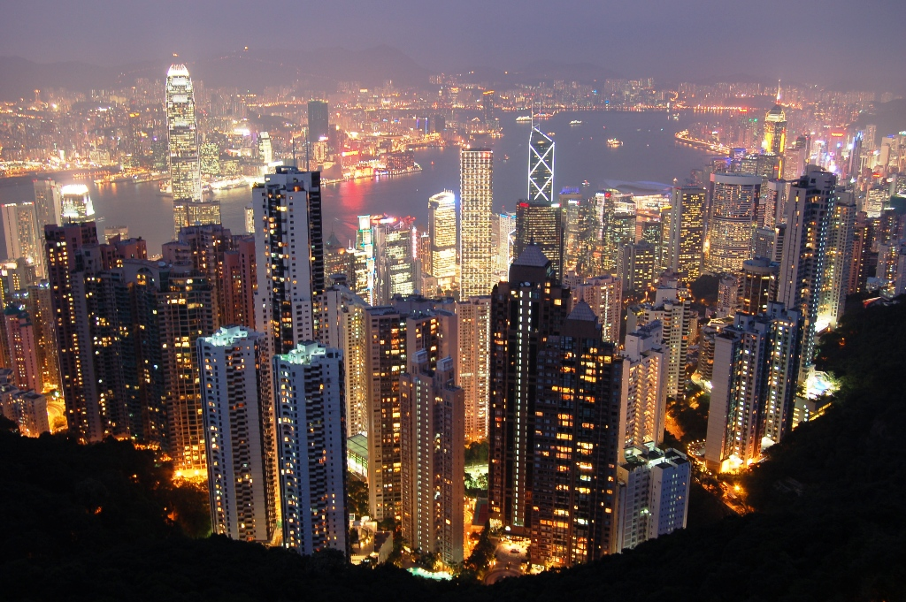
Compare and contrast communism and democracy?
Use the information on your posters to help you.
Can you find any similarities?
L/O - To investigate how China is governed and the relationship with the World

Slide 16
Is China a global leader?
Use page 48 – 49 to investigate
Show both sides of the argument, present however you like.
L/O - To investigate how China is governed and the relationship with the World

Slide 17
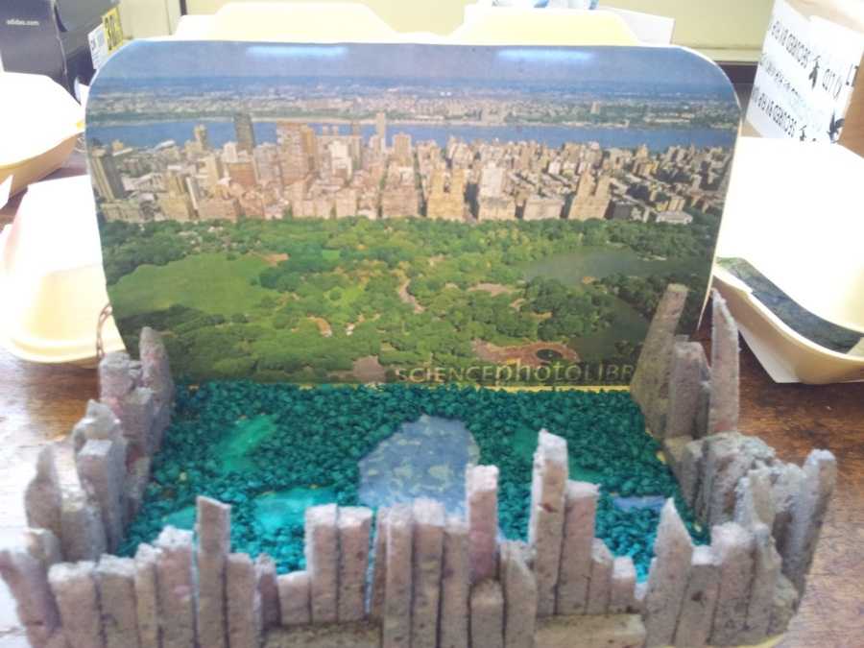
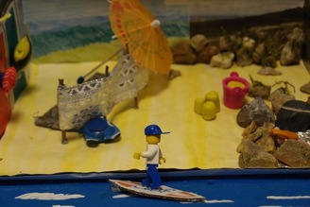
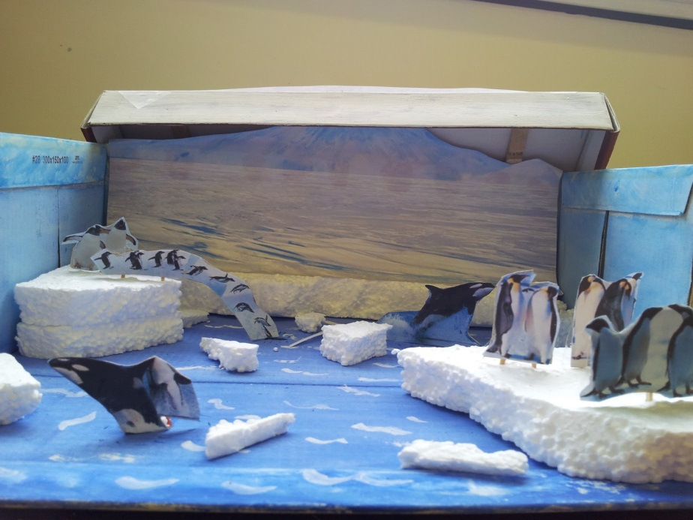
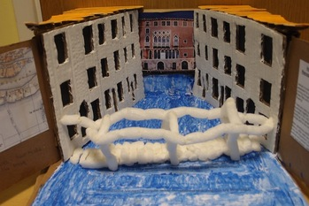
China in a box!
L/O - To investigate how China is governed and the relationship with the World

Slide 18
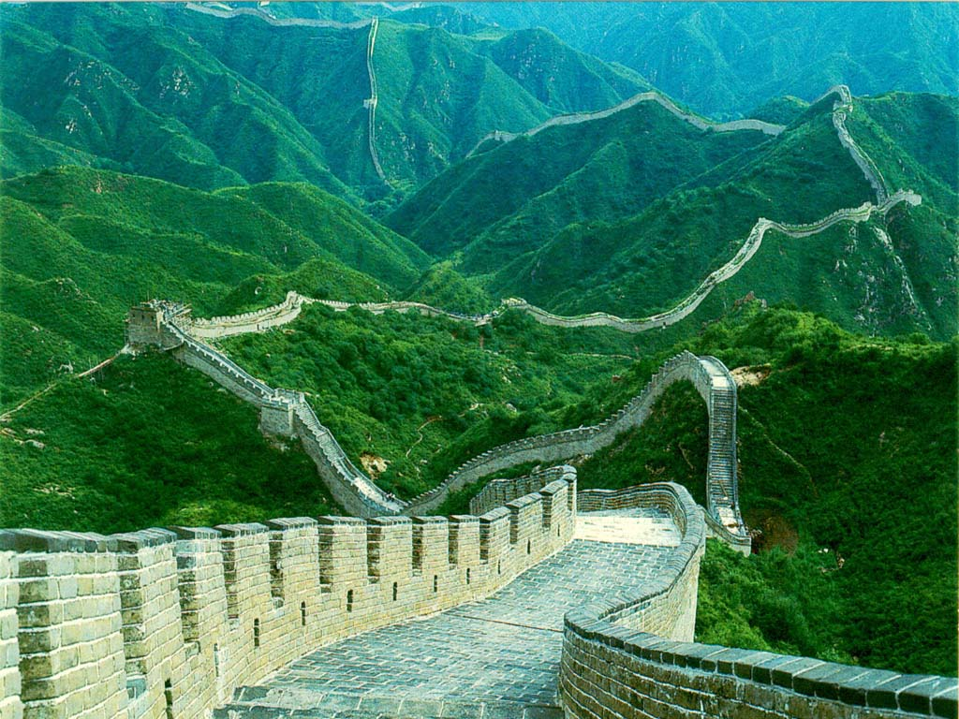
Great Wall of China

Slide 19
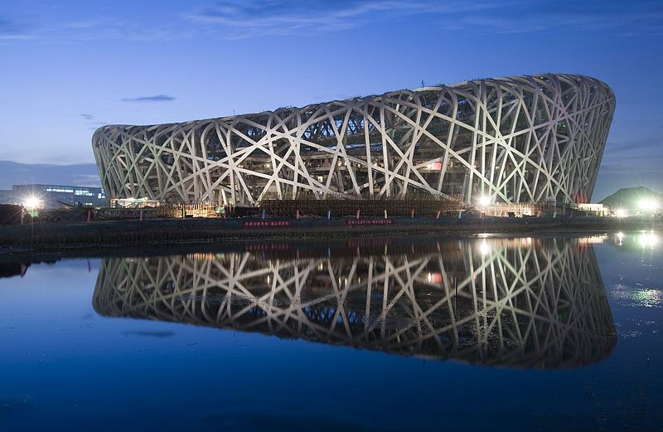
Birds Nest Stadium - Beijing

Slide 20
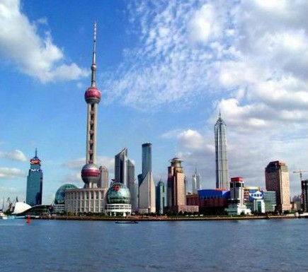
Shanghai skyline from the River

Slide 21
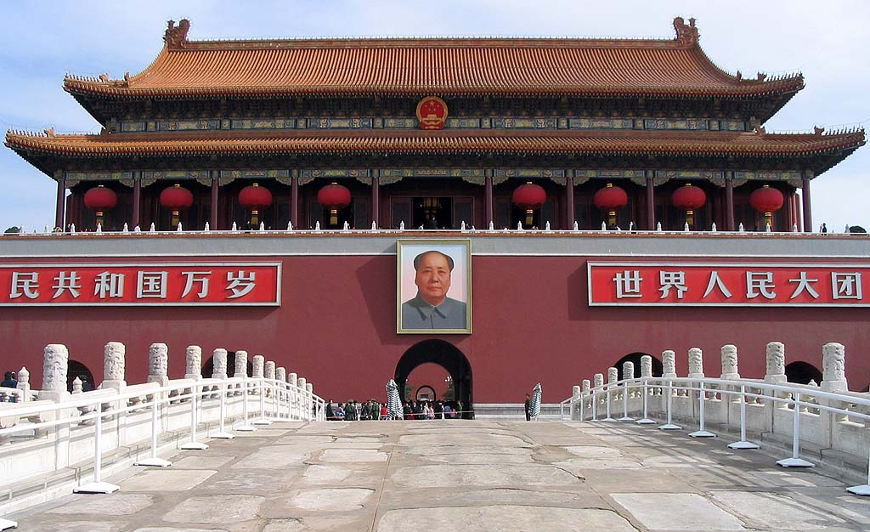
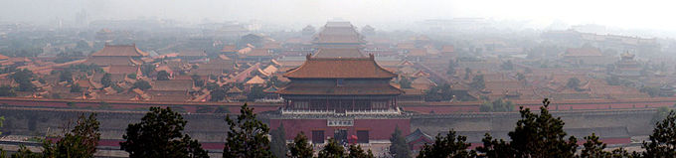
Forbidden City - Beijing

Slide 22
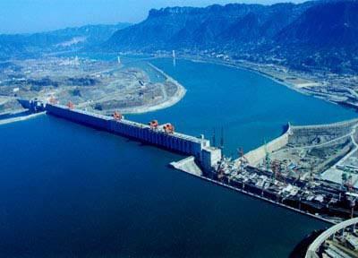
Three Gorges Dam

Slide 23
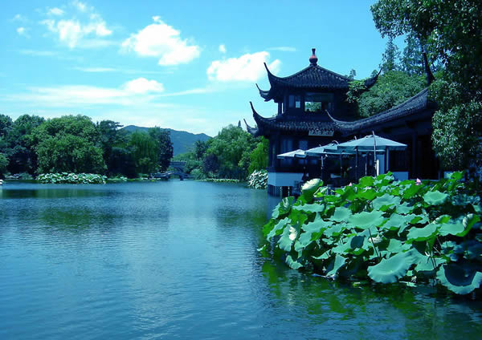
Hangzhou

Slide 24
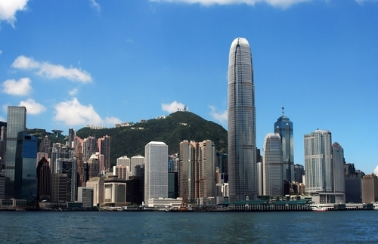
Hong Kong

Slide 25
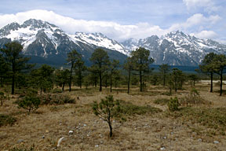
Himalayas

Slide 26
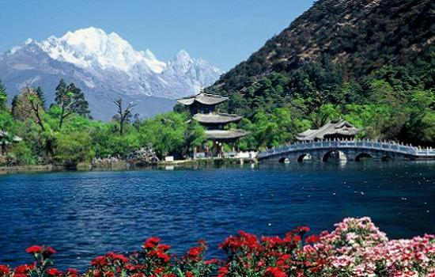
In SILENCE write down 3 keywords that sum up what you have learnt today
Share your words with your table, have you got any the same?
L/O - To investigate how China is governed and the relationship with the World

Slide 27
China and the rest of the World
Learning Objective- To investigate how China is governed and the relationship with the World
capitalist
democracy
communism
I can describe what communism is – Level 4
I can contrast the differences between a Communism and Democratic government – Level 5
I can analyse China’s role as global leader – Level 6

