Slide 1
Look at the following photographs:
Where do you think they were taken?
What do you think were the causes of the flood?
What happened to people and the environment?

Slide 2
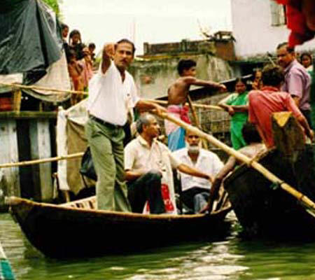

Slide 3
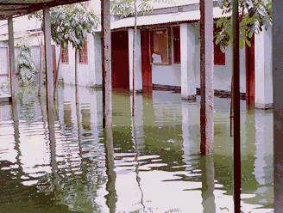

Slide 4
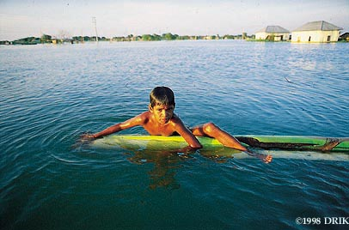

Slide 5
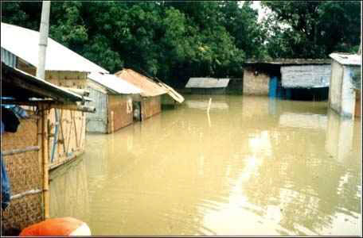

Slide 6
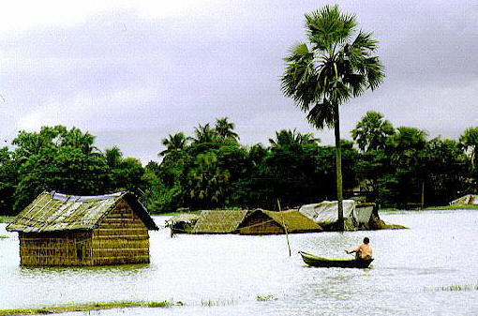

Slide 7
Where was the flood?
Answer
Bangladesh
Were you right?

Slide 8
Look at the following photographs:
Where do you think they were taken?
What do you think were the causes of the flood?
What happened to people and the environment?

Slide 9
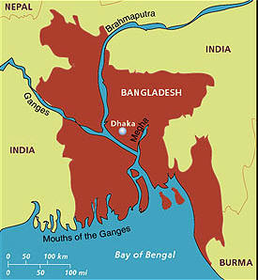
Using an atlas label the features on the map you have been given.

Slide 10
What are the main causes of flooding in Bangladesh?
70% of the land area is less than 1 metre above sea level
Prolonged monsoon season
Snow melt in the Himalayas
Deforestation in Nepal
There are three main rivers – Brahmaputra, Meghna and Ganges

Slide 11
Video
Causes impacts and management
You are now going to watch a video on flooding in Bangladesh.
You are to make notes on the worksheet that has been provided
The notes that you make will help you complete a newspaper article which will be your assessment for this term.
Hot Planet 59 mins

Slide 12
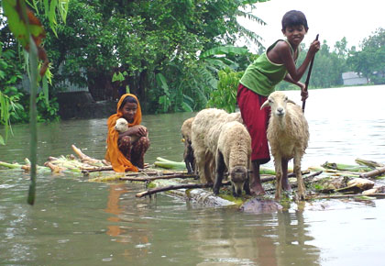
Flooding in Bangladesh

Slide 13
Learning Outcomes
Objective:
To understand the causes, consequences and solutions to flooding in Bangladesh
Outcome:
To be able to explain the causes and consequences of flooding in Bangladesh
To be able to rank and justify the solutions to flooding in Bangladesh

Slide 14
What are the people doing in this picture? Why do you think they are there?

Slide 15
Cause | Consequence | Human Response

Slide 16
You have been given a set of cards that all relate to Flooding in Bangladesh..
Each set of cards can be divided into three different categories; you have to sort out the cards and decide what those categories are.

Slide 17
Animals are drowned
Building houses, roads and railways are on raised ground
Crops and seeds washed away
The river leaves mud and sand as it flows into the sea, forming new land just above the water level
Flat, low-lying land
Bangladesh has a season of heavy rains called monsoons
Storm surges during tropical cyclones
A huge amount of ice melts every spring
Raising duck, rather than chickens as a source of food
Women prepare food and remedies for health problems at home before the flood season
Many trees have been cut down and the soil has been washed away
Schools, offices and factories are damaged and shut down
Soil exhaustion by over cultivation is easily washed away
Build more cyclone shelters
People are drowned by water that rushed across fields and roads
Planting trees
Trees cut down for firewood, the roots no longer bind the soil
Predicting in advance when a very bad flood is going to happen
Flood water runs into drinking water wells and makes the water unhealthy to drink
Houses, possessions and food ruined or washed away

Slide 18
Copy and complete this table using the cards you have sorted into categories:
Cause | Consequence | Human Response

Slide 19
Now colour code the causes and consequences to represent human or physical.
Then rank the consequences in order of degree from 1 (being the most serious) to 10 (being the least serious).
Discuss with your partner.
Using your table to help you, explain the causes of flooding in Bangladesh in one paragraph in your book.

Slide 20
What are the solutions to help prevent flooding in Bangladesh?

Slide 21
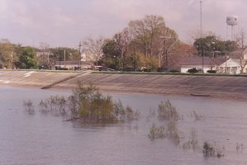

Slide 22
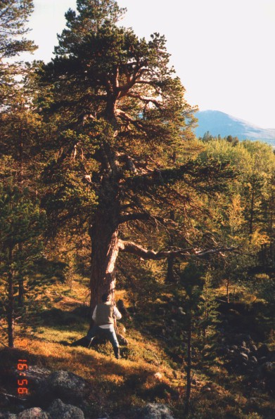

Slide 23
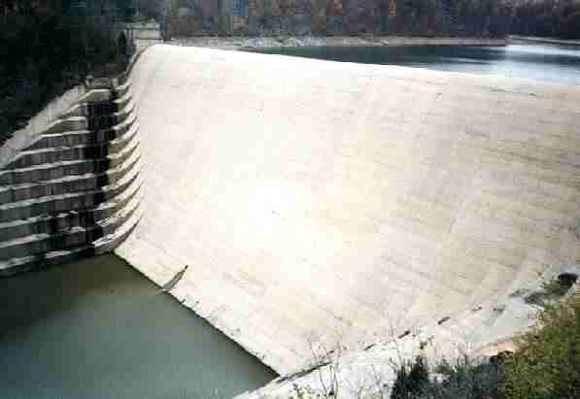

Slide 24
Assessment
You have to write a newspaper article both describing and explaining the causes, effects and solutions of the flooding in Bangladesh, 1998.
You need to make sure that you have a newspaper outline and level descriptor sheet
You need to make sure you know how to achieve the highest level you are capable of achieving

