Slide 1
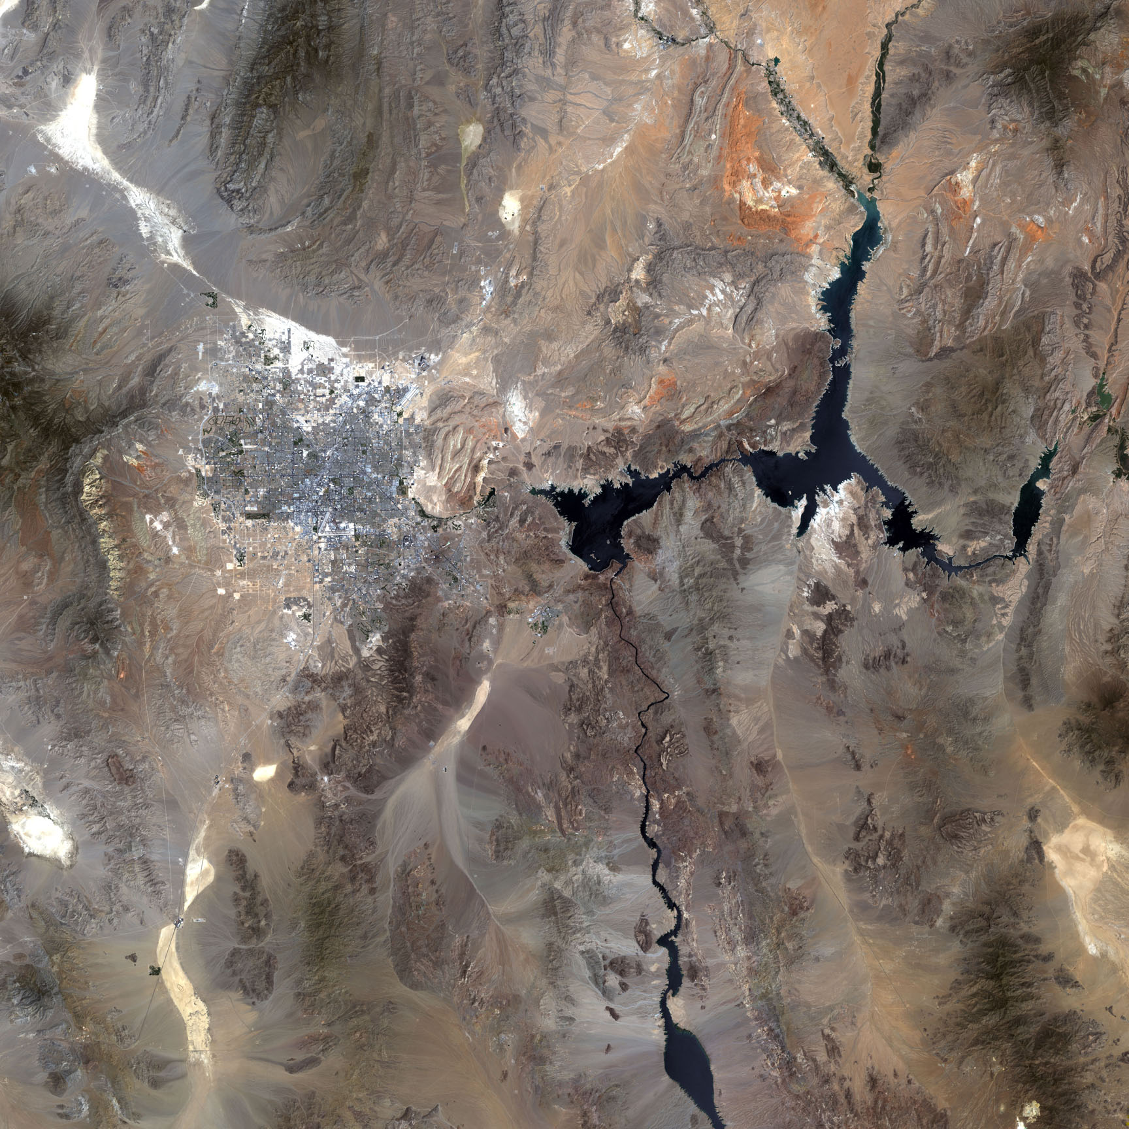
Lake Mead
Task: What are the causes and effects of Lake Mead’s disappearing water?
Riley christopher-gallagher

Slide 2
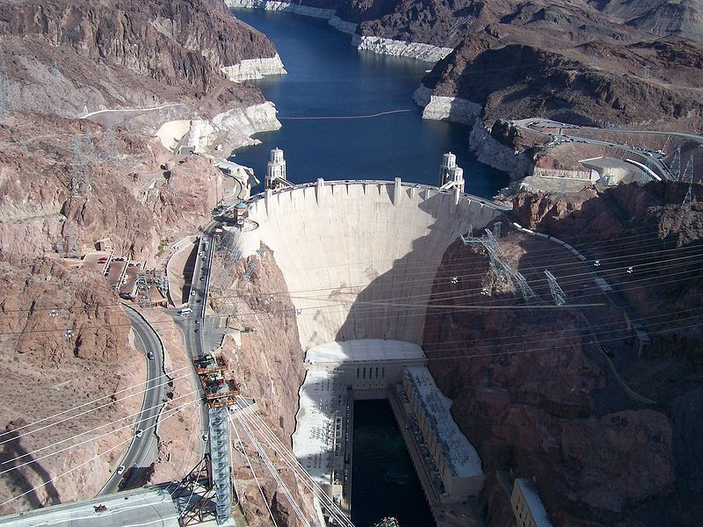
Lake Mead Facts
Lake Mead was formed in Black Canyon when the Hoover Dam was finished in 1935.
Water source for over 22 million people.
Lake Mead supplies water to:
Las Vegas
90% of the supply comes from Lake Mead
Los Angeles
San Diego
Southern California Agriculture
Extends 110 miles behind the dam
Capacity is 28.5 million acre-feet
Saylorville = 641,000 acre-feet

Slide 3
Lake Running Dry? The Causes
Colorado River system is seeing a deficit of
1 million acre-feet of water per year
This amount can supply 8 million people for 1 year.
The water supply is not being replenished
8 years of continued drought in the region
Below average snowfall within the Colorado River watershed
Human factors
Human demand has increased as populations in the southwest have exploded.
Increased evaporation off the lake
Human induced climate change

Slide 4
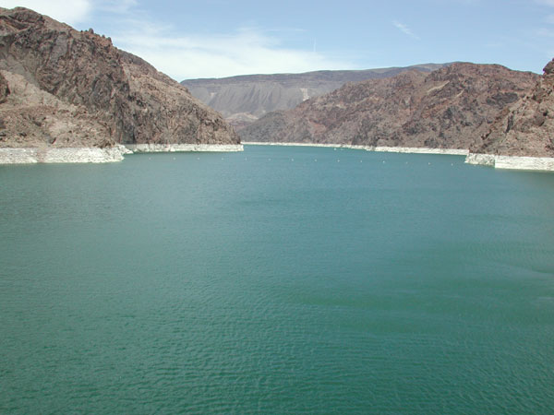
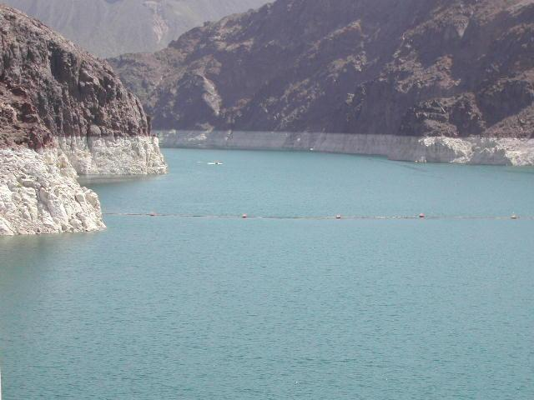
A Comparison
Lake Mead has dropped over 100 feet in the last 10 years to its lowest level since the 1960s.
September 1998 June 2008

Slide 5
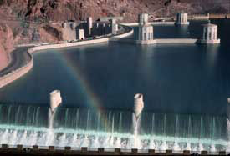
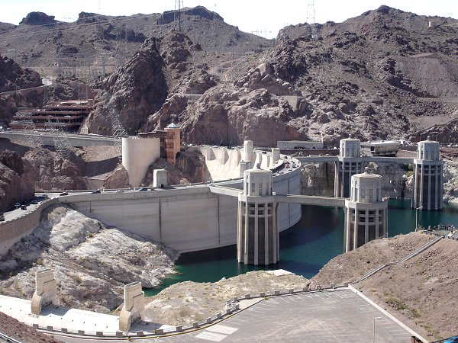
Personal Experience (R. C.-G.)
A photo I took of the The same view behind
1998 flood at the dam - the dam in June 2008.
water topped the 8 years of drought and over-use of water
spillways for 4 days.
May 1998 Las Vegas flood and above average snowfall

Slide 6
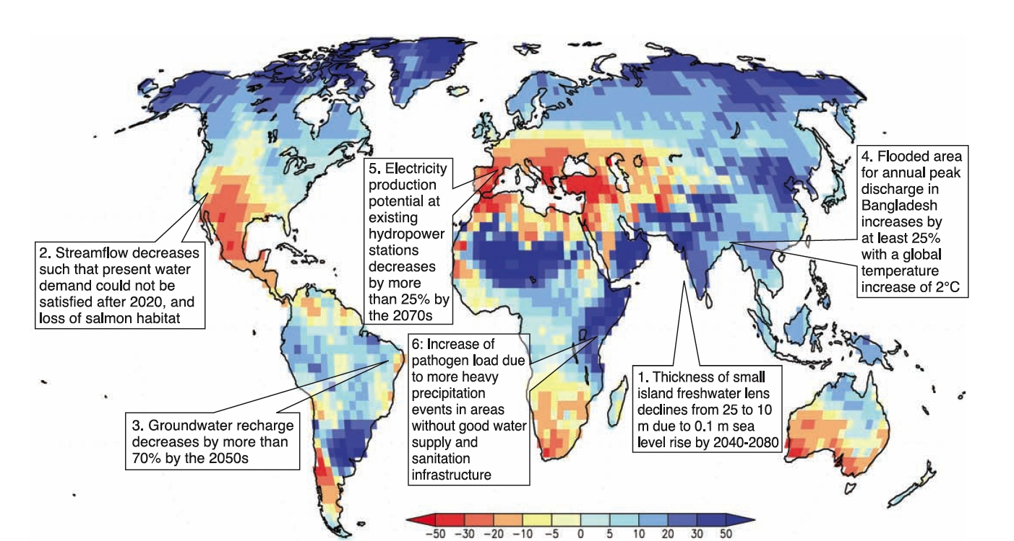
Water Cycle Changes - Impacts
A1B Scenario
(2081-2100) minus (1981-2000)
(derived from Nohara et al. 2006)
Notes:
Figure 3.8. Illustrative map of future climate change impacts on freshwater which are a threat to the sustainable development of the affected regions.
1: Bobba et al. (2000), 2: Barnett et al. (2004), 3: Döll and Flörke (2005), 4: Mirza et al. (2003) 5: Lehner et al. (2005a) 6: Kistemann et al. (2002).
Background map: Ensemble mean change of annual runoff, in percent, between present (1981 to 2000) and 2081 to 2100 for the SRES A1B
emissions scenario (after Nohara et al., 2006).

