Slide 1
FARMING
How can you grow anything anywhere?

Slide 2
Food and farming
Starter: Where did the food I ate originate?
On your sheets: Complete the table:
To be able to describe the difference between arable and pastoral farming.
Food item | Where the food I ate started off
Onion | Beneath the ground in the farmer’s field
Beef mince
Tinned tomatoes
Pasta
This is my dinner last night. It is a delicious lasagne.
Challenge yourself: Where was the food grown? Add a column to your table the country the food originated (came from).

Slide 3
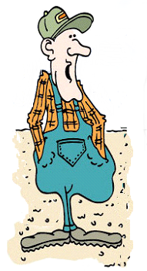
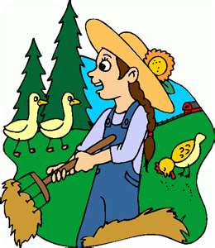
Our Food – where does it come from?
Hi! I’m Jake and this my friend Jessie.
An important question to start with Jessie: Are all farmers the same?
Certainly not Jake – you’re an ARABLE farmer and I am a PASTORAL farmer!

Slide 4
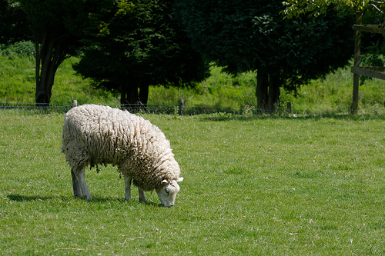
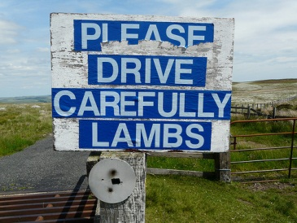
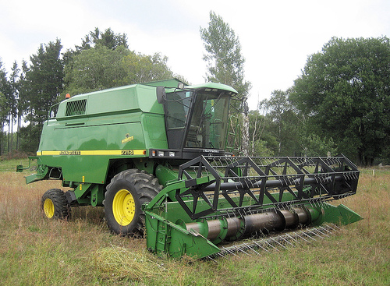
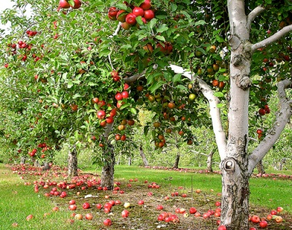
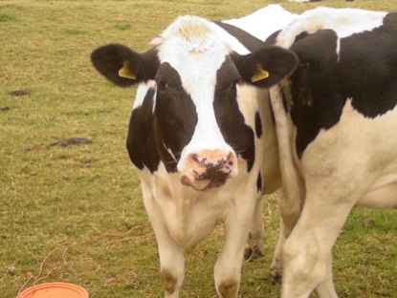
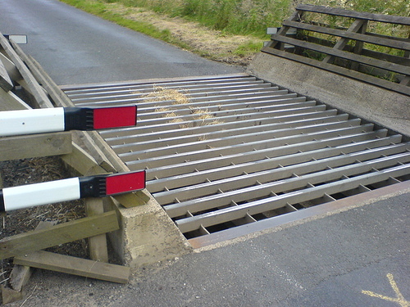
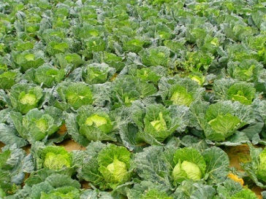
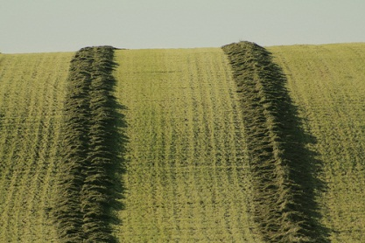
Challenge yourself: What sector of economic activity do the farmers belong in? Add this your sentences.
Here are some clues as to what they do…
Write down a definition of what you think an arable farmer is and what a pastoral farmer is.
Jake is an ARABLE farmer.
Jessie is a PASTORAL farmer.

Slide 5
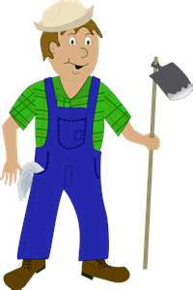
I grow fruit, flowers, vegetables and cereal crops…..I am an ARABLE farmer.
I rear animals and birds for their meat or milk or eggs…..I am a PASTORAL farmer.
….and some farmers may decide to grow a mixture of both crops and animals like me!

Slide 6


You are winners!!!
The Government have heard we are starting a new unit in Geography and want to make farmers out of you!
You have each been given a certificate of ownership of a piece of land.
Can you grow anything, anywhere???

Slide 7

You will need to:
Locate your piece of land using your brilliant map skills.
2) Find out what the climate is like there from the weather centre.
3) Read the information the government has provided you to advise you to make the best decision about what to farm. Read this through carefully and decide which is the best option for your farm, given its location, relief and climate.
4) Collect a sticker and write your farmer name and the type of farm you are running.
SUPER DUPER CHALLENGE: Come to the front and become a top government advisor!

Slide 8
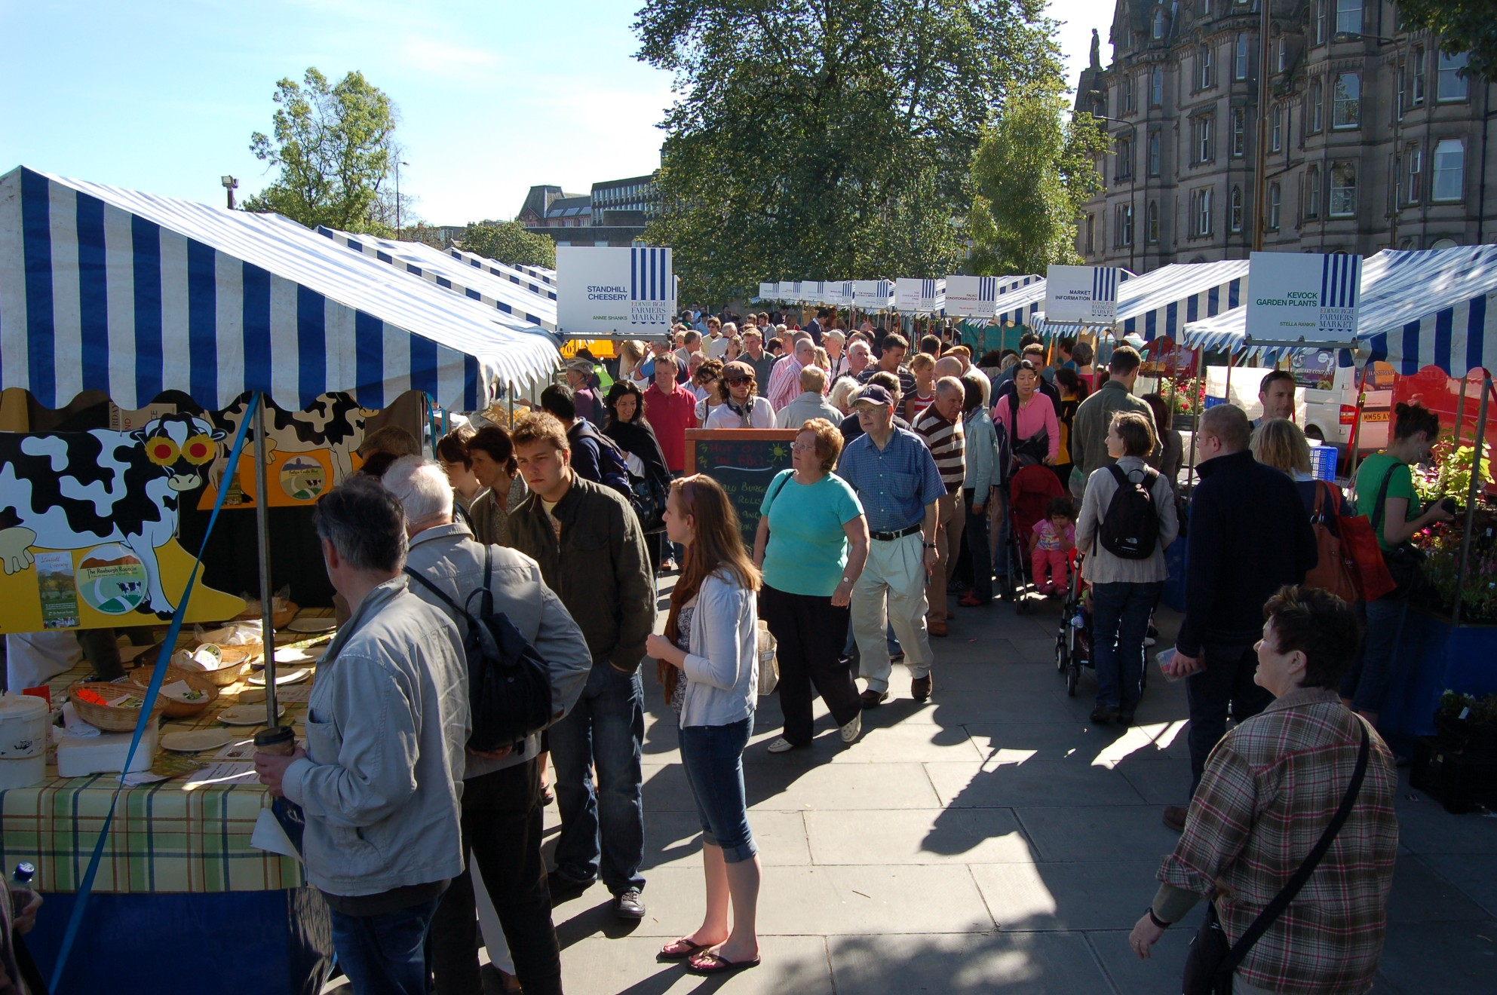
We’re going to the farmer’s market!
You will go to the farmer’s market where you will meet other farmers. You will have the opportunity to meet other farmers from all round the country.
You need to meet another farmer, who is a different type of farmer to what you are.
You will need to be prepared to introduce your new farmer friend to the rest of us at the farmer’s market.
You need to tell us:
The farmer’s name,
the type of farmer they are and
why they have chosen to farm what they have.

Slide 9
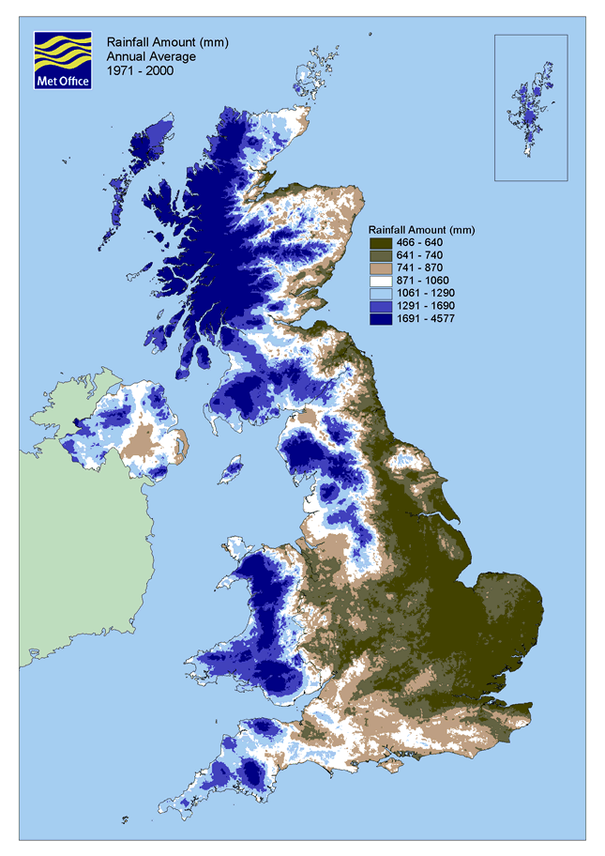
Here, it rains a great deal.
Here, it is rains very little and there is shelter from the wind because of the mountains to the West.
Here, it rains a lot.
Here, it rains the least.
Here, it rains quite a lot, but not as much as the rest of the UK

Slide 10
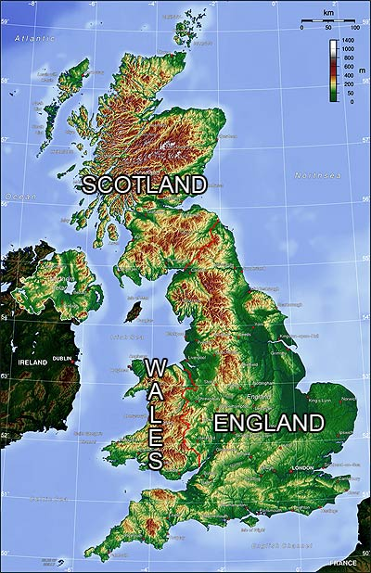
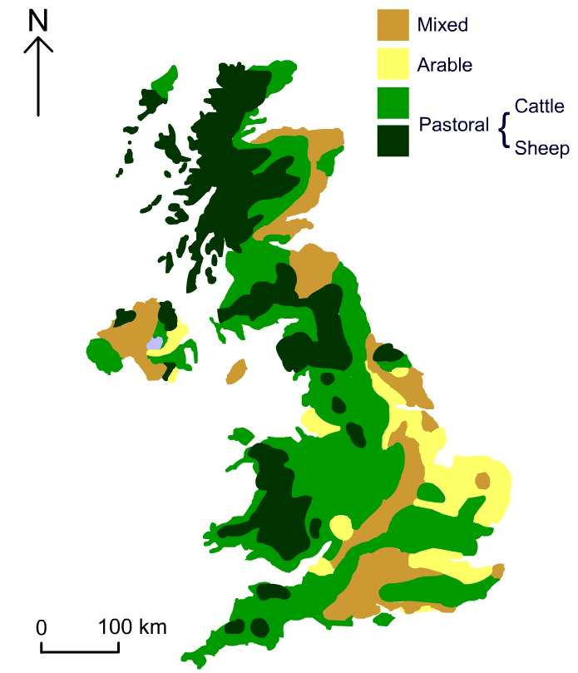

Slide 11
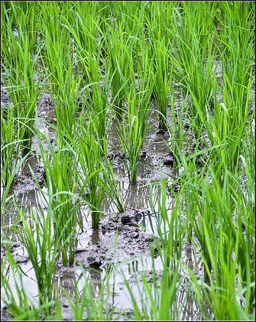
STAND UP IN SILENCE
Put your hands on your heads for arable and your hips for pastoral.
Arable
or
Pastoral?

Slide 12
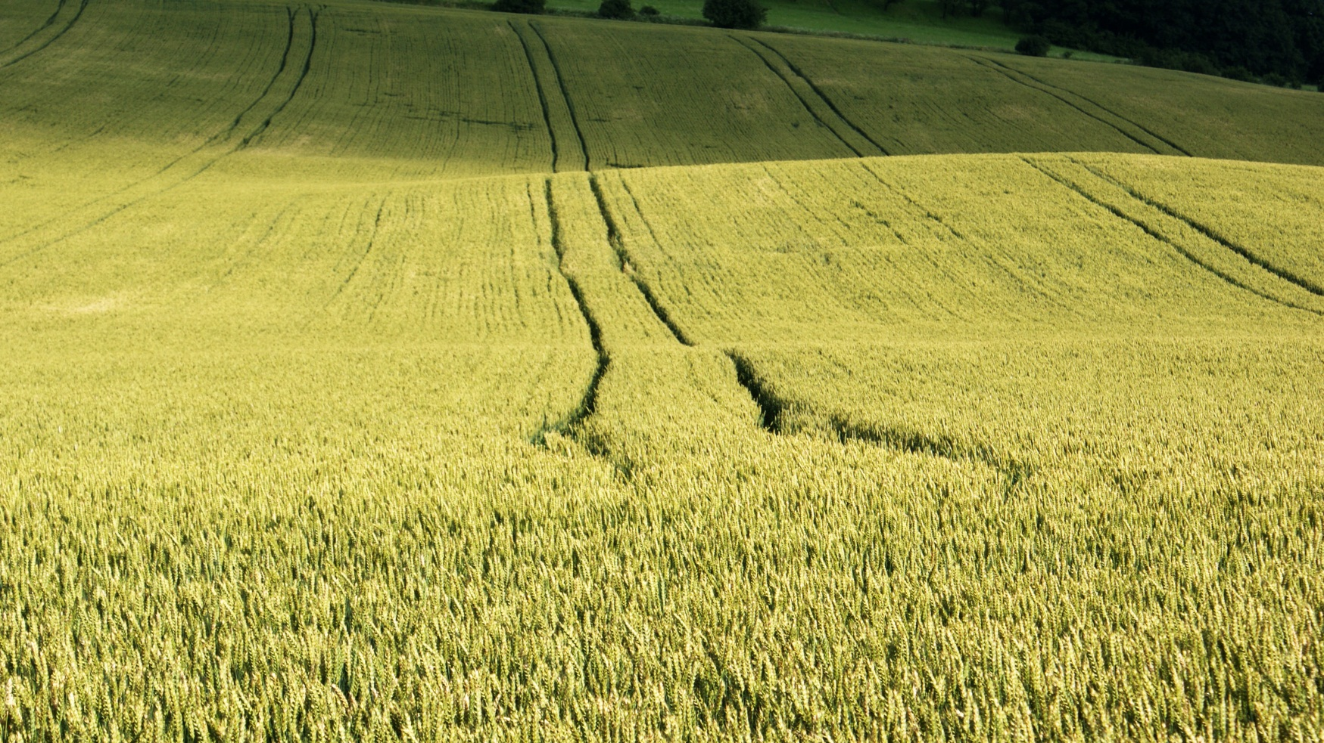
Arable or Pastoral?

Slide 13
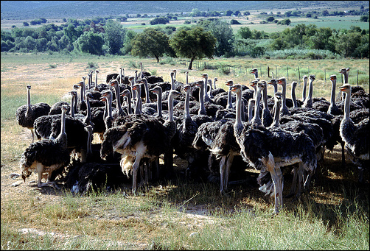
Arable
or
Pastoral?

Slide 14
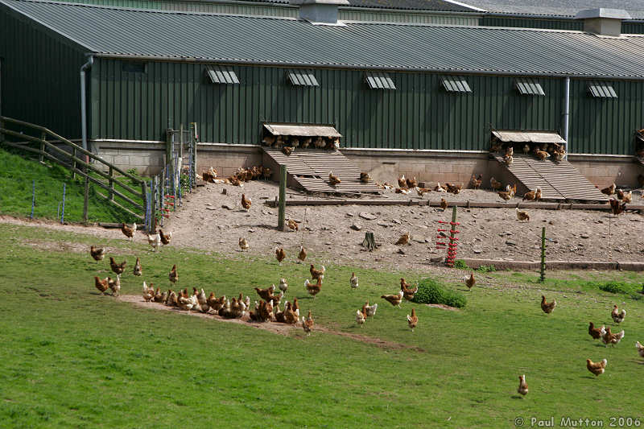
Arable
or
Pastoral?

Slide 15
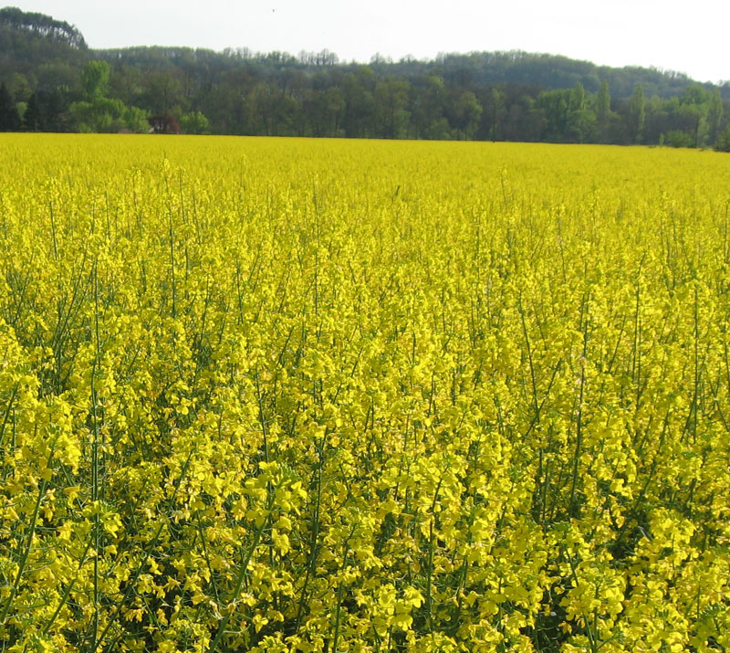
Arable
or
Pastoral?

Slide 16
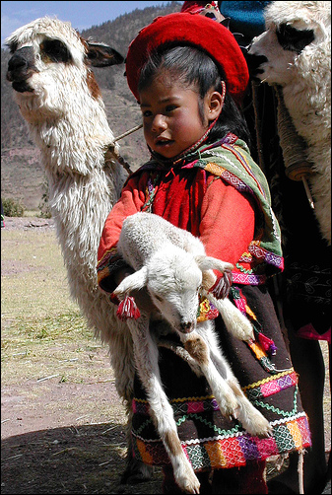
Arable
or
Pastoral?

Slide 17
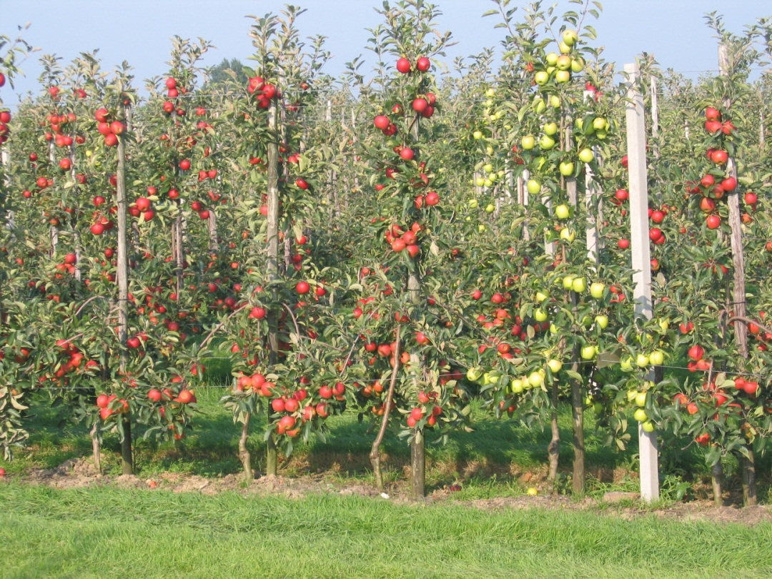
Arable
or
Pastoral?

Slide 18
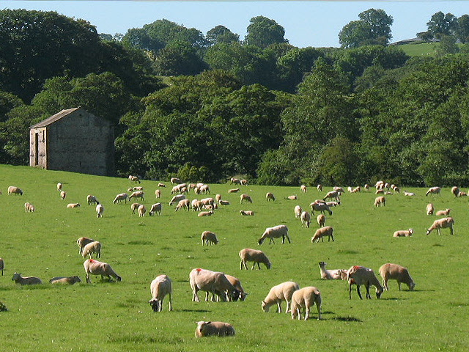
Arable
or
Pastoral?

Slide 19
CONGRATULATIONS!
We are pleased to announce that ______________________________ has won a piece of land in the United Kingdom.
Size of the land: It is 270m² (About ten football pitches big)
Your farm is in grid square: Describe its location:………………………….................
………………………………………………………………………………………………………………………………………………..
What is the relief (shape of the land)of your farm like?.............................................................
What is the climate like at your piece of land?............................................................................
From the information you have been provided with you need to decide what to do with your land. (MIXED ARABLE OR PASTORAL)
I will farm ……………………………………………because…………………………………………………………………………………………………………..
..............................................................................................................................................................................................
………………………………………………………………………………………………………………………………………………………………………………………………………………………………………………………………………………………………………………………………………………………………………………………………………………………………………………………………………………………………………………………………………………………………………………………………………………………………………………………………………………………………………………………………………………………………………………………………………………………………………………………………………………………………………………………………………………………………………………………………………………………………………………………………………………………………………………………………………………………..............................................................................................................................................................................................................................................……………………………………………………………………………………………………………………………....

Slide 20
CONGRATULATIONS!
We are pleased to announce that ______________________________ has won a piece of land in the United Kingdom.
Size of the land: It is 270m² (About ten football pitches big)
Your farm is in grid square: Describe its location: The farm is in the ……………..
of the U……………………..K…………………………………………………………………………………………………………..
What is the relief (shape of the land)of your farm like?.............................................................
What is the climate like at your piece of land?............................................................................
From the information you have been provided with you need to decide what to do with your land. (MIXED ARABLE OR PASTORAL)
I will farm ……………………………………………because…………………………………………………………………………………………………………..
..............................................................................................................................................................................................
………………………………………………………………………………………………………………………………………………………………………………………………………………………………………………………………………………………………………………………………………………………………………………………………………………………………………………………………………………………………………………………………………………………………………………………………………………………………………………………………………………………………………………………………………………………………………………………………………………………………………………………………………………………………………………………………………………………………………………………………………………………………………………………………………………………………………………………………………………………..............................................................................................................................................................................................................................................……………………………………………………………………………………………………………………………....

Slide 21
CONGRATULATIONS!
We are pleased to announce that ______________________________ has won a piece of land in the United Kingdom.
Size of the land: It is 270m² (About ten football pitches big)
Location: Your farm is in grid square:
This is in the ………………………………………….of the United Kingdom.
What is the relief (shape of the land)of your farm like?......................................................
What is the climate like at your piece of land?....It rains.....................................................
Is the land flat or mountainous?
From the information you have been provided with you need to decide what to do with your land. (ARABLE, PASTORAL OR MIXED)
I will farm ……………………………………………because …………………………………………..…………………..
...................................................................................................................................................
…………………………………………………………………………………………………………………………………………………………………………………………………………………………………………………………………………………………………………………………………………………………………………………………………………………………………………………………………………………………………………………………………………………………………………………………………………………………………………………………………………………………………………………………………..

Slide 22


You need large open fields, a gentle relief and flat land. It grows well in dry climates. Your crop will fail if there is too much rain.
You need large open fields, a gentle relief and flat land. They grow well with llamas as llamas will not eat potato plants.
Chickens need a large open space, secure from foxes, with little rain fall. They like living in the south of the UK.
You need large open fields, a gentle relief and flat land. They do not cope well with heavy rain in the winter, but do well in salty air from the sea.
You need large open fields, a gentle relief and flat land. These like the climate of the south and can be grown on the same land as pigs since pigs like apples.
Llamas need large fields, gentle relief. They do not like a lot of rain and the farm needs to where it is not very windy.
Sheep can live happily on mountains. They need plenty of grass and don’t mind the rain.
Cows like mountainous terrain, they can cope with high rainfall.
You need large open fields, a gentle relief and flat land. Can be mixed with chickens if the rainfall is low.
Pigs need open flat land and plenty of rain. They do not like the cold temperatures of the North of the UK

Slide 23
You need large open fields, a gentle relief and flat land. Would grow well with llamas in the field.
You need large open fields, a gentle relief and flat land. Will not grow if it is rainy.
Chickens need a large open space, secure from foxes, with little rain fall.
You need large open fields, a gentle relief and flat land.
You need large open fields, a gentle relief and flat land. Could grow well with pig farming because pigs like eating apples.
Llamas need large fields, gentle relief, a fair amount of rain.
Sheep can live happily on steep ground. They need plenty of grass and don’t mind the rain.
Cows like mountainous terrain, they can cope with high rainfall.
Pigs need open land, gentle relief, plenty of rain and do not like the coldness of the North, but do well in the West of the UK.
You need large open fields, a gentle relief and flat land.

Slide 24
Can you grow anything anywhere?
Use you mapping skills to describe the distribution of agricultural activities in the UK.

Slide 25
What factors affect farming?
Physical factors
    Aspect
    Weather
    Soil
    Climate
Human factors
    Transport & access
    Machinery
    Money

Slide 26
UK Relief
What kind of farming here?
What kind of farming here?
What kind of farming here?

Slide 27
UK Rainfall
What similarities are there between rainfall and relief?
-
How does rainfall affect farming?
What grows well in wet weather?

Slide 28

Sunshine…
What do you know about sunshine and the UK?

