Slide 1
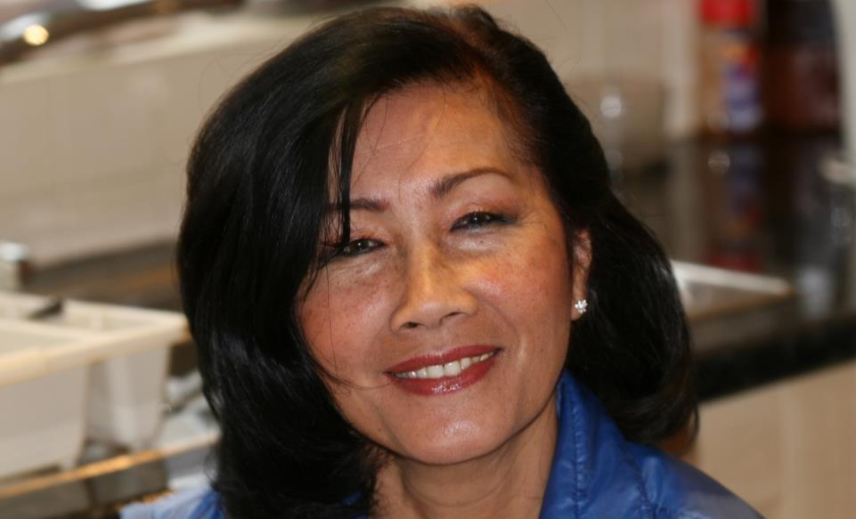
Var ashe houston

Slide 2
Var ashe houston
The date, April 17th, 1975, would stay in the minds of millions for years to come. It marked the beginning of almost four years of terror as the Khmer Rouge turned Cambodia into a vast concentration camp.
A few hours later, our misery started. The Khmer Rouge ordered us to leave the city “for three hours only” and to carry nothing with us...I left my house with my mother, my two daughters, three sisters and two brothers.
Two million people were forced out of the city and on the road. A general air of misery hung over the whole crowd as we trudged along. Our entire fabric of life had been torn apart…I had never seen the streets so packed with people before.

Slide 3
Var ashe houston
Five hours passed, one day, two days, three days…. We realised by now that this was a trip without return. The Khmer Rouge fired machine-gun rounds in the air to force us to advance under the intense heat of the scorching sun.
After about a month, completely exhausted, we stopped in a village where the Khmer Rouge started to integrate arriving city-dwellers like us into the life of the rural inhabitants. My family were assigned to dig irrigation canals, ponds, dams, and cut trees in the forest and the jungle. We were then forced to attend brainwashing sessions between 9 and 11 o’clock. The Khmer Rouge used to keep us on the move from village to village so that we couldn’t organise an insurrection. We usually travelled on foot or by ox-cart, but on one occasion we were sent by train.

Slide 4
Var ashe houston
My family were evacuated, from the south of Cambodia, to the north of Cambodia. The train was packed like sardines, altogether 3,000 of us in one train. And it took three days…that was a nightmare in itself. People die[d] on the train, and they wouldn’t stop for us to bury the dead, eventually they started to smell and we had to throw them through the window of the train”.

Slide 5
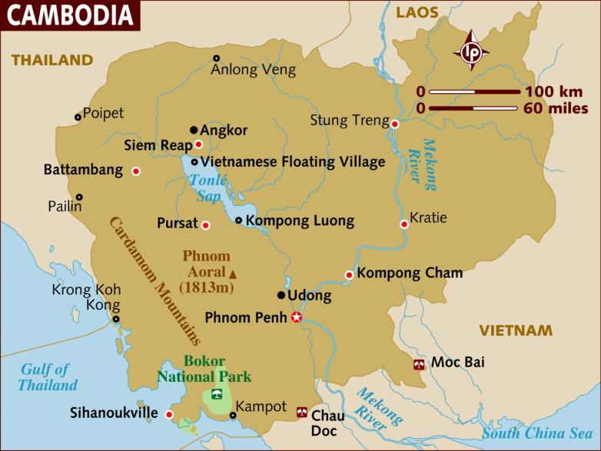
Map of Cambodia

Slide 6
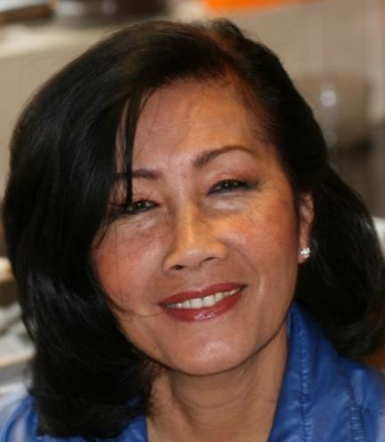
Var ashe houston
My memory is absolutely clear about our arrival in England. As we approached Heathrow Airport, I looked down first at the green fields and then at the rows of houses and larger buildings that made up London…
As we walked out of the airport
terminal, the sense of freedom
became very real to me. I felt
like doing a little dance and
shouting, “We’re free!”

