Slide 1
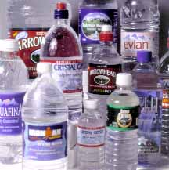
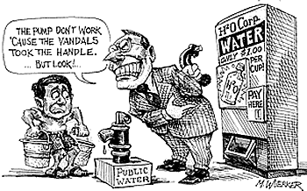
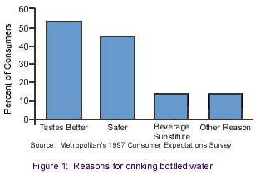
Bottled water costs more than oil

Slide 2
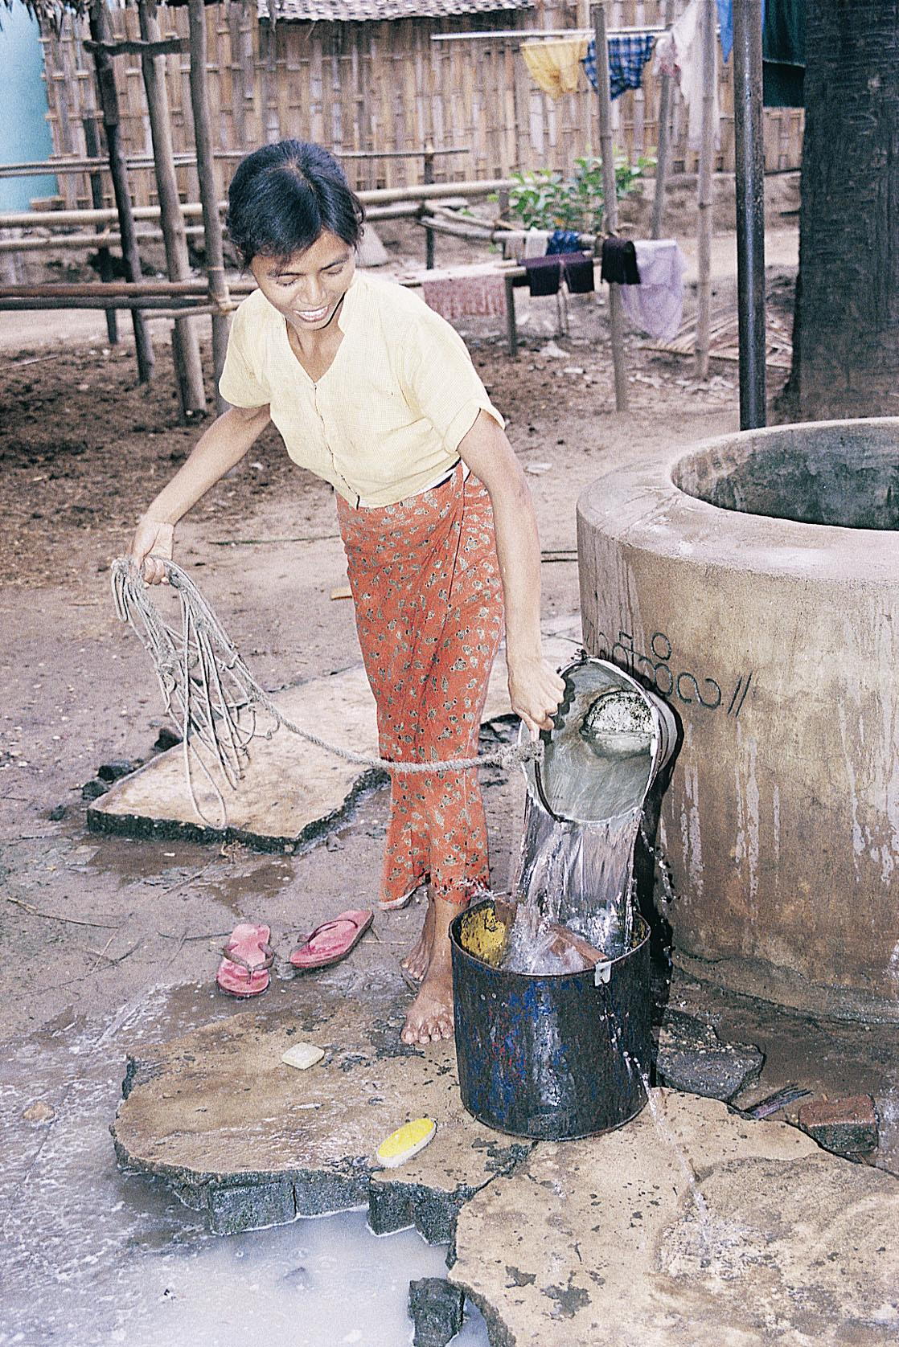
Price Mechanisms
Charging a higher proportion of real costs to users of public water projects has helped encourage conservation.
Yet discriminates against poor.

Slide 3
Water multinationals

Slide 4
Public/private water in EU countries

Slide 5
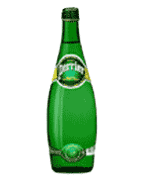
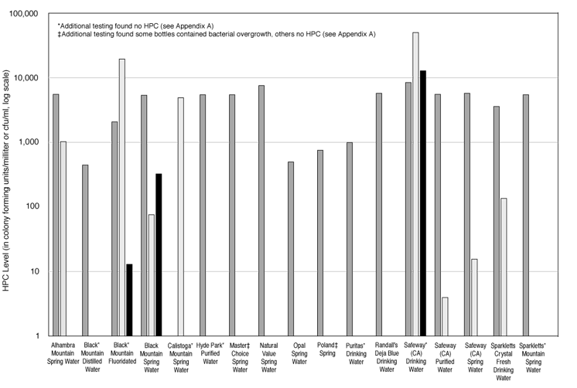
Bottled water quality in question

Slide 6
Bottled water growth

Slide 7
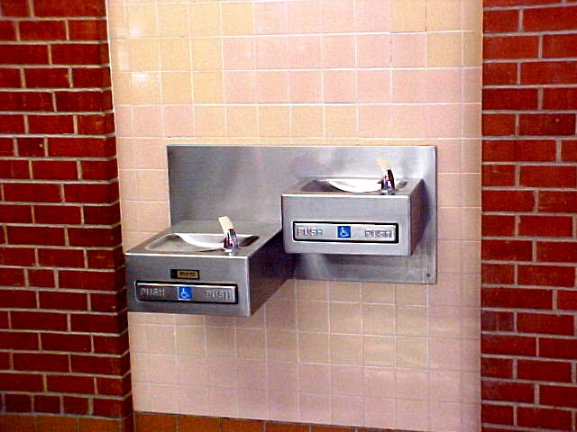
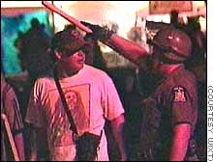
Water
Privatization
Woodstock
Riot 1999
Fewer
bubblers in
public
buildings?

Slide 8
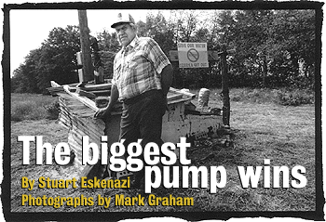
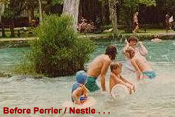
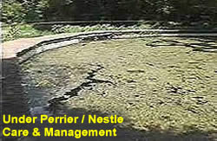
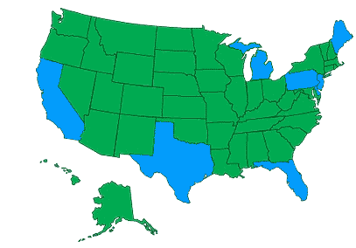
Perrier/Nestle in the U.S.
Texas
Florida

Slide 9
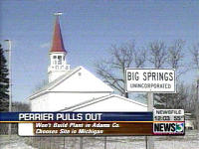
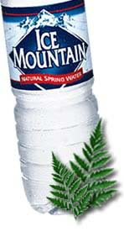
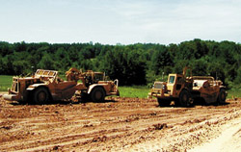
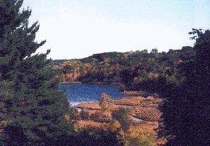
Perrier/Nestle in the Midwest
Wisconsin
Michigan
Mecan Springs
(Waushara Co.)
1999-2000;
Big Spring
(Adams Co.),
2000-2002
Protection of
rural supplies
from high-
capacity wells

