Slide 1
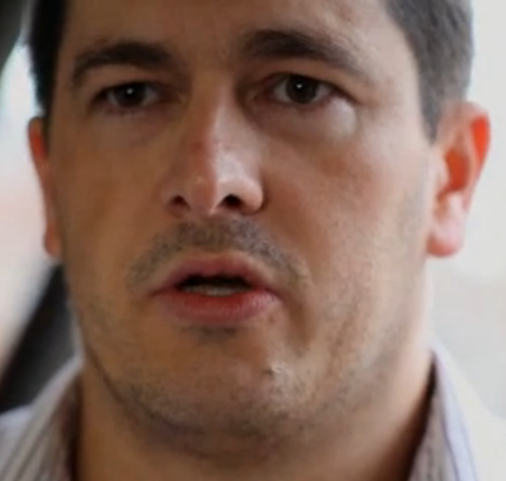
Safet Vukalić
Safet Vukalić is a Bosnian Muslim and survivor of the ethnic cleansing in Prijedor, Bosnia. His father and brother were imprisoned by the Bosnian Serb Army in concentration camps.

Slide 2
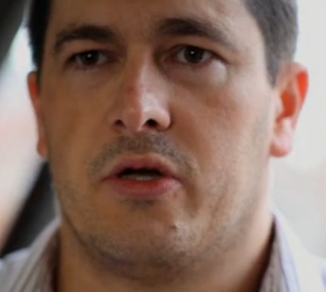
Safet Vukalić
I was a victim of all this. I was an innocent person. And people are victims of crime innocently, you know. Walking down the street, get beaten up, and it is helpful when you’ve got someone to understand where you’re coming from and to say, “I understand you. I am here to try and help you. I’m here to listen to you”. It means a lot.
Sometimes you might not be able to change anything, but at least if I know that at least you understand, and you are in a way on my side, even though you’re not able to change anything physically, you are on my side, and I know, OK, there is hope. Not everyone’s the same.

Slide 3
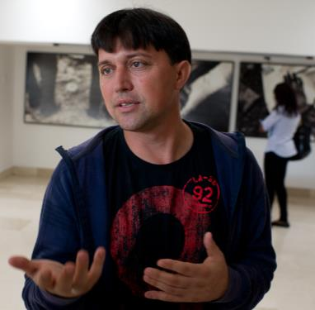
Hasan Hasanović
was 19 years old when the town of Srebrenica fell to Bosnian Serb forces in July 1995. He endured a 100 kilometre march through hostile terrain to escape the massacre of over 7,000 Muslim men and boys that took place there.
‘It wasn’t going to be an easy journey, but we had no other option. We wanted to live.’

Slide 4
Hasan Hasanović
Hasan and his family were forced to move to a Muslim-held enclave around the town of Srebenica after the Bosnian war started in March 1992, and Bosnian Serb forces attacked towns in the east of Bosnia. The Srebrenica enclave was captured by Bosnian Serb forces and Hasan, his father and twin brother decided to flee as the Serbs wanted to kill all the Muslim men.
Between 10,000 and 15,000 Muslim men, mostly unarmed civilians, set out on a gruelling 100 kilometre march towards the Muslim-held town of Tuzla; Hasan and his father and brother were among them. The terrain was mountainous and littered with minefields, and many Serb soldiers lay between Hasan and safety: ‘It wasn’t going to be an easy journey, but we had no other option. We wanted to live.’

Slide 5
Hasan Hasanović
‘We weren’t soldiers who had prepared for this kind of journey’ says Hasan. ‘We were just ordinary men.’… Days of walking had turned his feet into a blistered mass of agonizing pain. He wanted to lie down and sleep but another man told him, ‘if you sleep now, you’ll sleep forever’.
Hasan was one of only 3,500 who survived the march; his father and brother did not, and Hasan still does not know how and where they were killed.

Slide 6
Hasan Hasanović
Hasan is now married and has a young daughter. He works as a Curator at the Memorial Centre, where he shares his story with visitors from all over the world on a daily basis. He sees this as both his duty to those who were murdered and a cathartic experience for himself. ‘I want to speak to people, and share my story because my heart speaks. And now, finally, someone is listening.’

