Slide 1
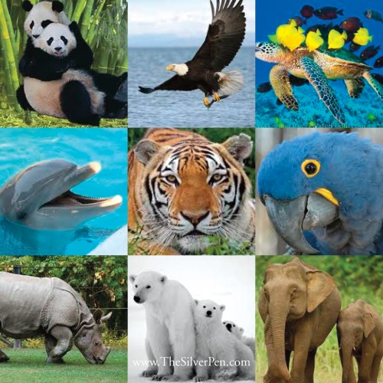
What are biodiversity hotspots?
All (D Grade): Know what biodiversity hotspots are
Most (B/C Grade): Be able to explain why these biodiversity hotspots are threatened
Some (A*/A Grade): Use case study detail in an exam answer

Slide 2
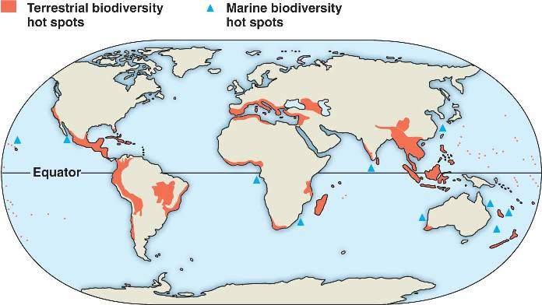
A biodiversity hot spot is a relatively small area with an exceptional concentration of endemic species (found only in one particular area) and a large number of endangered and threatened species.

Slide 3
Copy the pattern showing hotspots (terrestrial ones = land based)

Slide 5
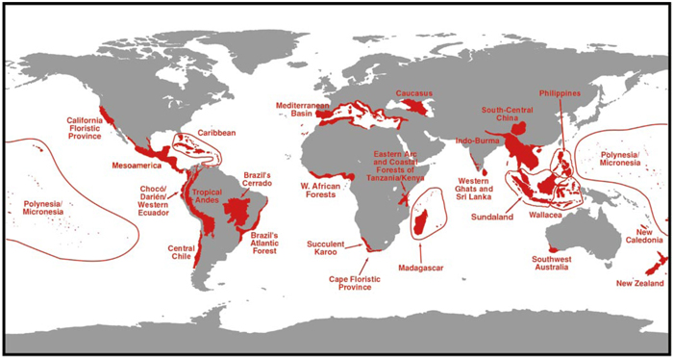
A*-B
Go around the room and find details on different hotspots, :Include
what the hotspot is like
Species found there
Threats
Go on to describe the distribution of hotspots using this map
C-D
Go around the room and find details on different hotspots, Include bullet points to show:
what the hotspot is like
Species found there
Threats

Slide 6
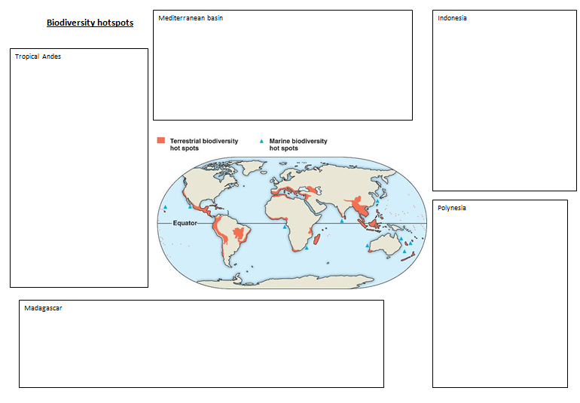
The red list
Task: around the room are pieces of information on each hotspot.
Draw a line on to the right location on your map
Write a bullet point in each box about the location (use real species)
Write a bullet point describing any threats it faces

Slide 7
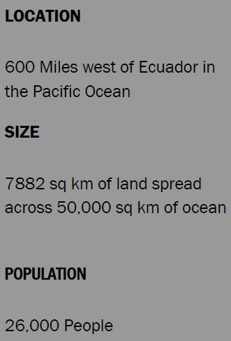
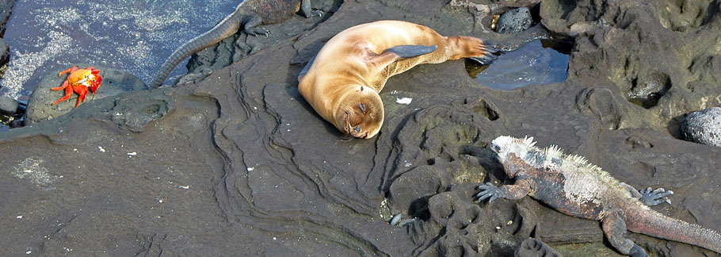
Case study - Galapagos Islands

Slide 8
Case Study: Galapagos Islands

Slide 9
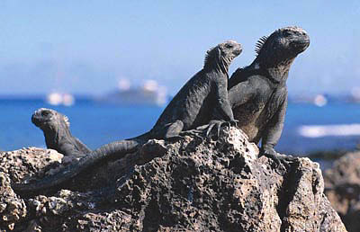

Slide 10
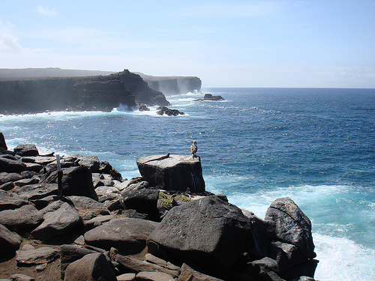

Slide 11
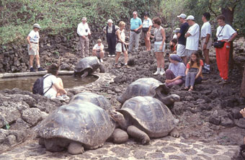

Slide 12
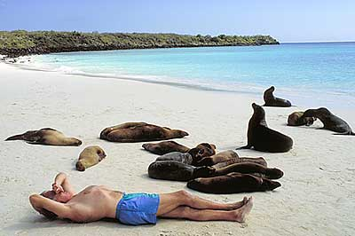

Slide 13
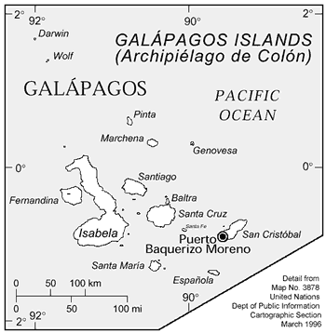
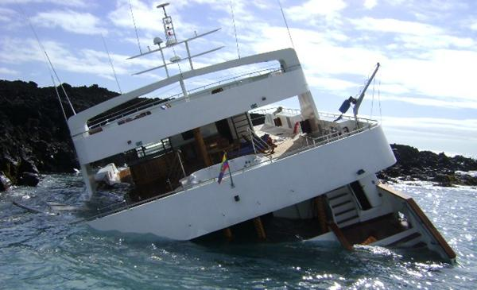
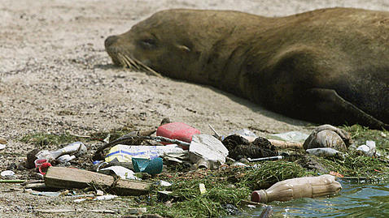

Slide 14
The Galapagos Islands' significance and biodiversity – they contain more than 1,300 species found nowhere else on earth – led to them being named one of the first World Heritage Sites in 1978. Since then human intervention has had a devastating effect.
The population and economy of the islands are expanding rapidly and unsustainably. With people come demands for resources, as well as pollution and waste. These issues are by no means unique to the Galapagos – but in a natural paradise like this, balancing the needs of the human and natural worlds is more critical.
Much of this growth is directly or indirectly due to tourism. The unregulated expansion of tourism was one of the reasons behind Unesco's decision to declare Galapagos a World Heritage Site In Danger in 2007. Annual visitor numbers have increased from 12,000 in 1979 to more than 160,000 now, and the rise in both invasive species and population mirror this pattern. More than 40 Galapagos species are now "critically endangered".

Slide 15
Questions
1. In do the following terms mean:
Endemic
Invasive species
2. Give examples of endemic species of the Galapagos
.

Slide 16
Questions
1. In do the following terms mean:
Endemic
Invasive species
2. Give examples of endemic species of the Galapagos
Homework
Research 5 reasons why the Galapagos island hotspot is under threat from man – bullet pointed reasons with examples.

Slide 17
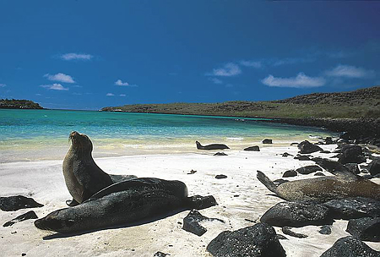
Case Study: Galapagos Islands
What’s being done? – eradication of feral cats and rodents, rounding up stray dogs and removing the quinine tree, a serious alien plant invader.
What’s the biggest pressure? – the thousands of tourists who visit every year to marvel at what Charles Darwin first saw in 1835

Slide 19
What possible problems for biodiversity can you see from this photo?

Slide 20
Exam Question
Using examples, explain why species are under threat on the Galapagos islands. (4)

Slide 21
Exam Question
Using examples, explain why species are under threat on the Galapagos islands. (4)
1-2 marks | One or two threats described. Real places/species are not mentioned or used. SPAG errors. No/ Few key words.
3-4 marks | A good range of reasons why they are under threat (3 or 4). Real places are used as well as real species examples. Explanation of the threats are shown. SPAG errors rare. Lots of key words, e.g. endemic, invasive species etc.

Slide 22
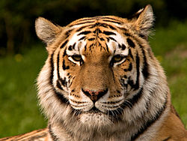
Are we heading for mass- extinctions?
All (D Grade): Understand how humans affect other species
Most (B/C Grade): Explain global and local effects on species
Some (A*/A Grade): Evaluate if we are heading for mass extinctions

Slide 24
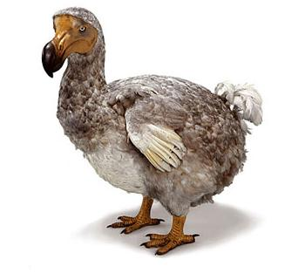

Slide 25
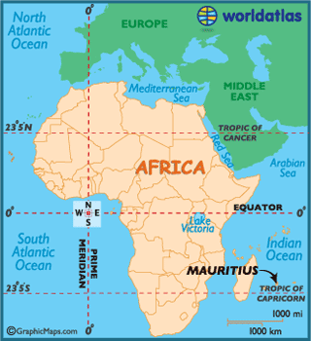
The Dodo’s story
In 1598 a ship of Portuguese sailors landed on the island of Mauritius and discovered, a previously unknown species of bird.
This bird was like nothing they had ever seen before, and having been living in solitude on the island with no natural predators it was a surprisingly fearless.
Over the course of the next century the dodo was killed by humans and other non-indigenous animals that were brought with them and less then 100 years after it was discovered, it was completely wiped out.
The Dodo remains one of the most widely known cases of animal extinctions.
http://www.youtube.com/watch?v=36b9ox8iF24

Slide 27
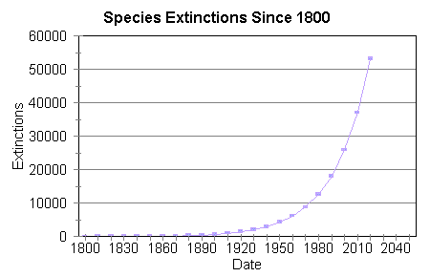
Complete the following sentences using the correct words from the list:
‘Over time ________have always naturally become _____. Scientists are now worried that ________and degradation of the ________is happening at an ____________ rate and many species are becoming extinct over a _______ period of time.’
Words to use: destruction, Species, accelerating, Extinct, biosphere, short

Slide 28
Complete the following sentences using the correct words from the list:
‘Over time ________have always naturally become _____. Scientists are now worried that ________and degradation of the ________is happening at an ____________ rate and many species are becoming extinct over a _______ period of time.’
Words to use: destruction, Species, accelerating, Extinct, biosphere, short
Extension: Use these key words to add you own sentences describing what is occurring: climate change, mass extinction, foodchain

Slide 29
http://www.youtube.com/watch?v=7QY-FY9nz-M
Holocene mass extinction
Make notes on:
Species extinct and heading for extinction and
Reasons for extinction
Species | Why extinct

Slide 30
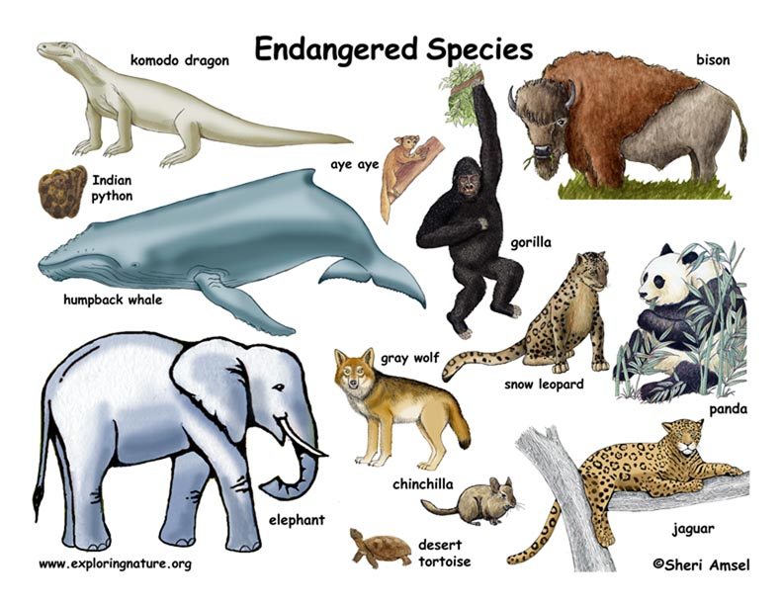
What role do people play in species extinctions?
What impacts can climate change have on species?
Give 3 examples of species which have been affected by climate change (bottom of p 50 information)

Slide 31
What role do people play in species extinctions?
What impacts can climate change have on species?
Give 3 examples of species which have been affected by climate change (bottom of p 50 information)
Extension: Take a handout and make detailed notes on one species in the UK which is heading for extinction

Slide 32
Are we heading for mass- extinctions?
All (D Grade): Understand how humans affect other species
Most (B/C Grade): Explain global and local effects on species
Some (A*/A Grade): Evaluate if we are heading for mass extinctions

Slide 34
How can we conserve the biosphere?
Mass extinction
Biodiversity hotspot
Indigenous
Endemic
Invasive species
Precipitation
Nutrient cycle
Biome
savannah
Latitude
Continentality
Deforestation
Overfishing
Climate change
How many definitions do you know?
Can you give a case study for any of these?

