Slide 1
Fashion and Globalisation
Today We are learning to:
Develop an understanding of the lives of the people who make our clothes
We will do this by:
Investigating a well known high street shop and see where their clothes come from

Slide 7
The true cost of cheap clothes
the_hidden_face_of_globalization

Slide 8
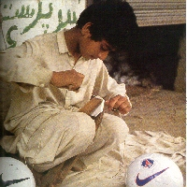
The Clean Clothes Campaign Code for Garment Workers Ensures:
Freedom to join a trade union
No discrimination
No forced or slave labour
No workers under 15 years of age
Health & safety checks
48 hour working week maximum
A fair wage

Slide 9
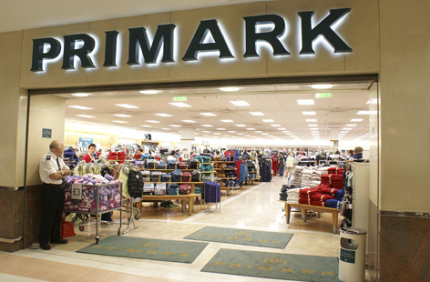
How many of you buy your clothes from here?
Why has Primark been in the News?

Slide 10
http://www.youtube.com/watch?v=kEgnimnkZ5Y
YouTube - Primark: On The Rack - Panorama Preview - BBC One
Would anyone consider boycotting (not buying) goods from Primark now?
Should the Government force these large Multi-National Companies to trade in a more responsible and ethical way?
What would you do if you were the Prime Minister?

Slide 11
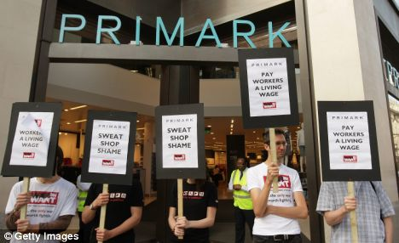

Slide 12
Questions
Why do you think it is important for companies to have an ethical and fair trading policy?
What do you think needs to be done so that you know more about the goods you are buying?
What would cause you to boycott stores and goods?
How can you as a consumer apply pressure on a large multi-national company?

Slide 13
Homework
Make a list of at least 5 products that can be bought as Fair-Trade items in British Supermarkets and Stores

