Slide 1
Bad Tourism

Slide 2
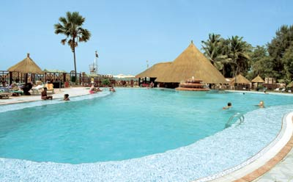
It’s a lovely hotel but we don’t leave it much…
They seem to think we’re all millionaires.
They try to sell us tat that we don’t want.
… when we do, we get pestered by the locals.

Slide 3
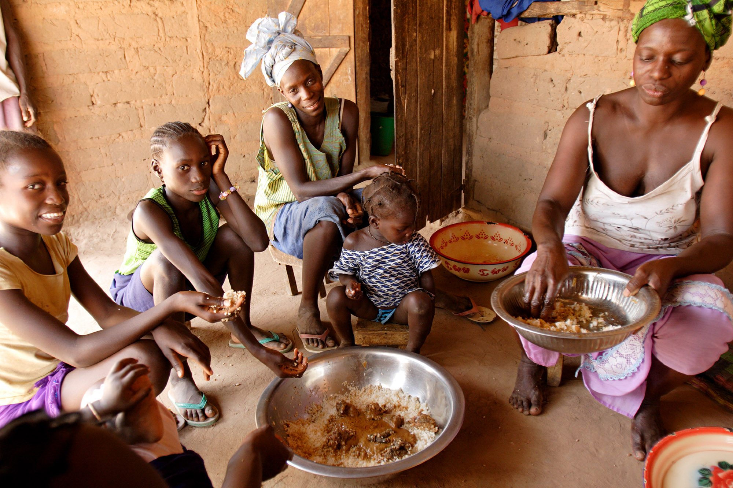
Those rich people come here and take over our beaches…our village only has one tap… they have pools and showers everywhere.
… when we do, we get pestered by the locals.
We’d love to sell fruit and other food to the hotels...But they import nearly all their food from abroad!
My son is a hotel waiter. But he doesn’t get paid much. Though at least it’s honest work…Most of our young men hang out at the beach, chatting up tourists and trying to charm money from them… This is shameful to us.
They dress in skimpy clothes, which offends us…
But the worst things is that we don’t get much money from tourism. Most of it goes to foreign companies.
… when we do, we get pestered by the locals.

Slide 4
What problems can tourism bring?

Slide 5
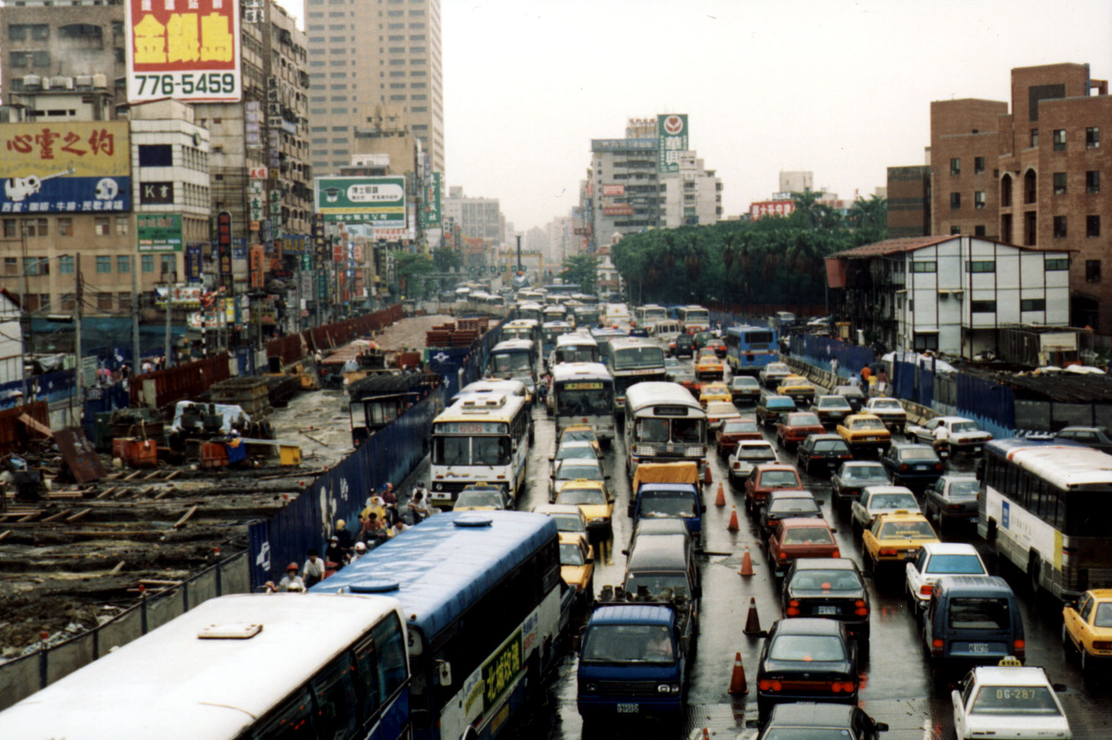

Slide 6
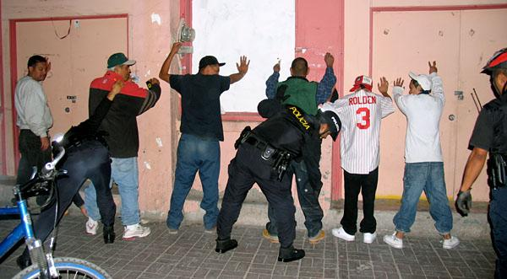

Slide 7
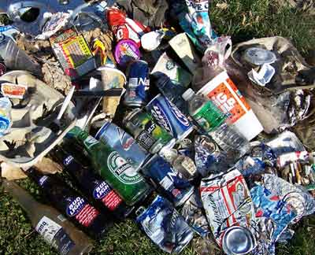
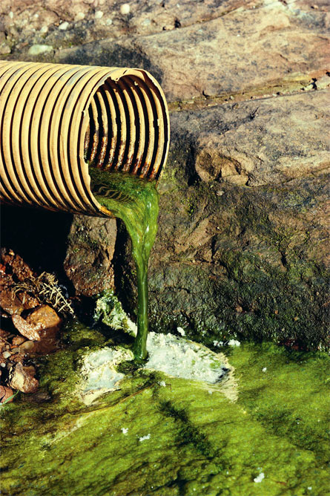
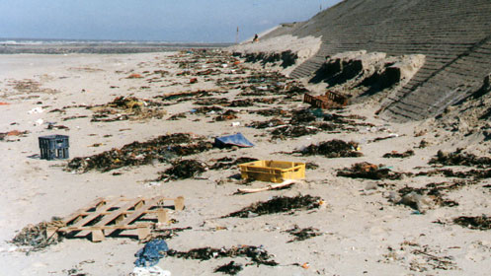

Slide 8
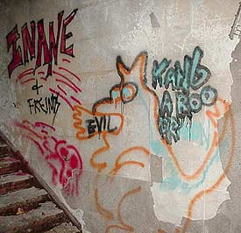
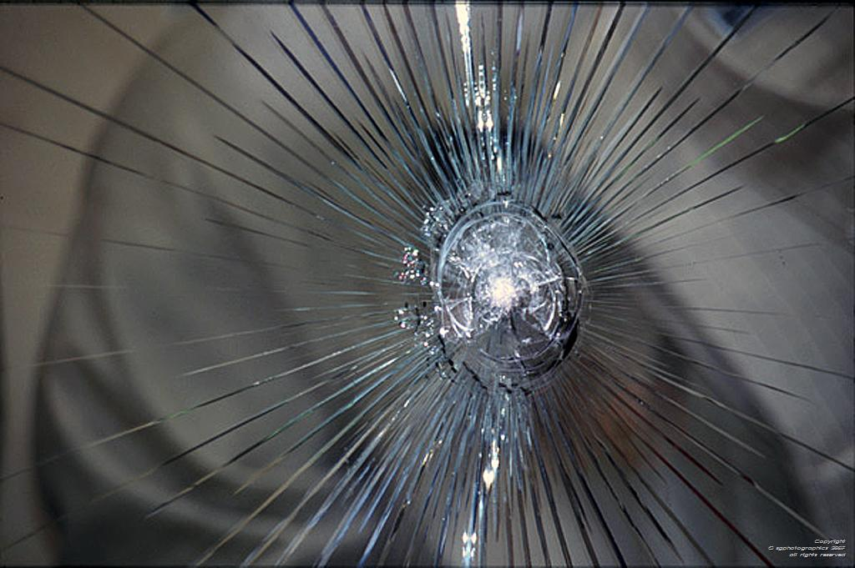
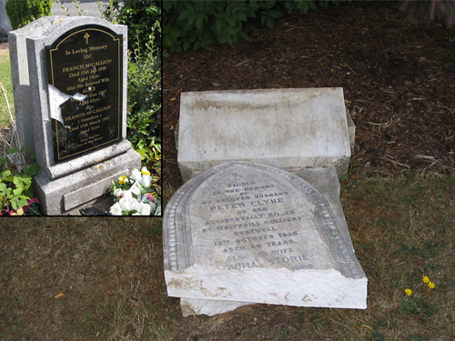
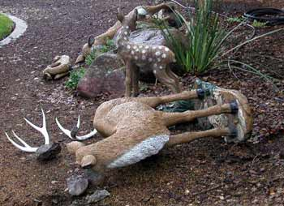

Slide 9
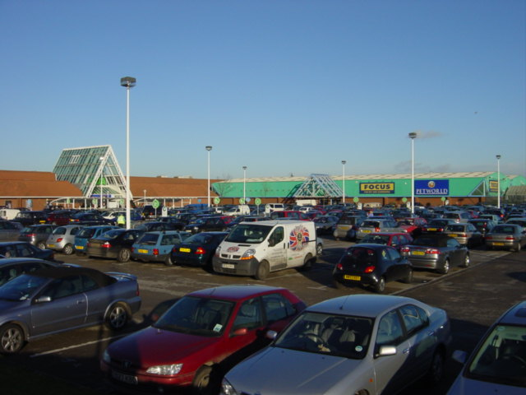
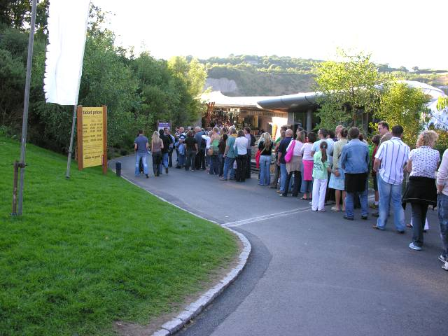


Slide 10
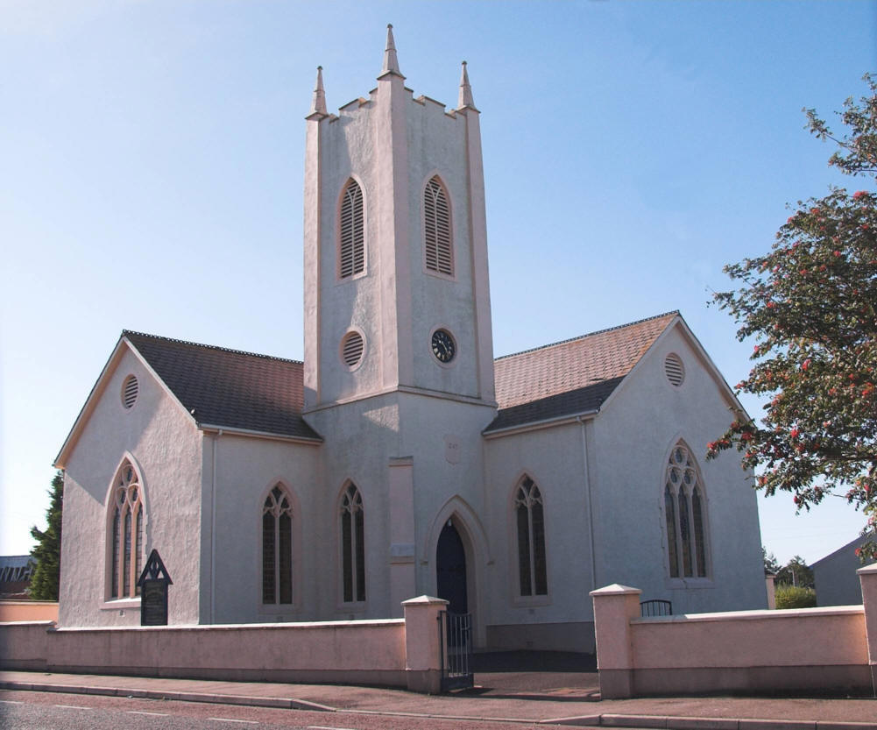
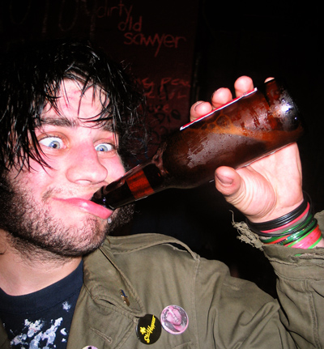
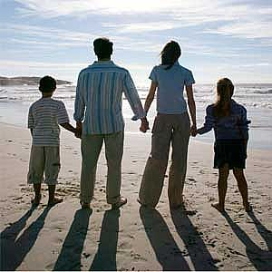
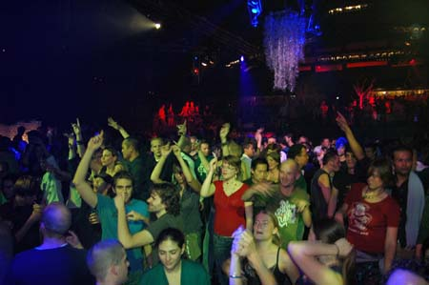

Slide 11
What benefits are there?

Slide 12
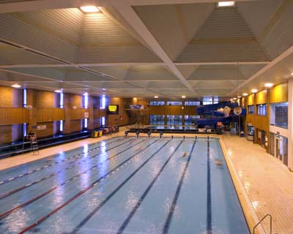
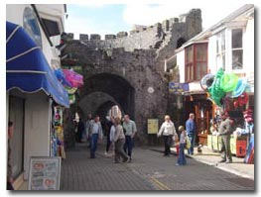
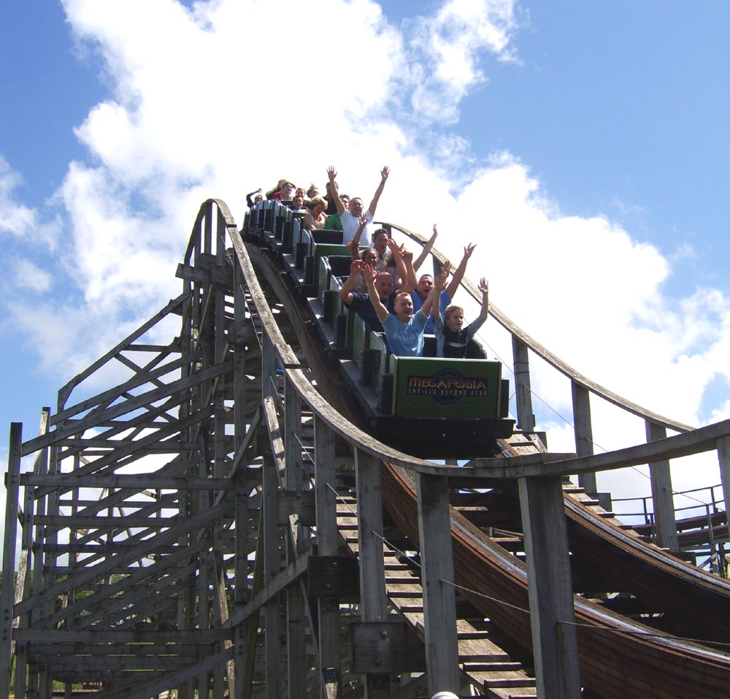
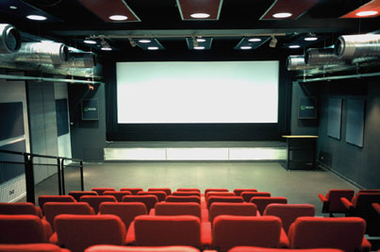

Slide 13
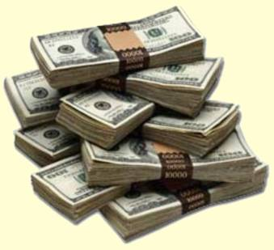

Slide 14
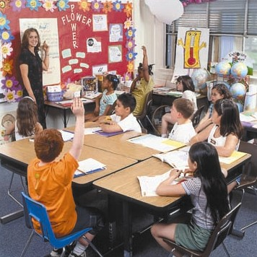


Slide 15


Slide 16


Slide 17
Complete the table below with some of the benefits and problems (negatives) of tourism. Pick three from each category to write in.
Tourism
Benefits | Problems

