Slide 1
Fashion and Globalisation
Today We are learning to:
Develop an understanding of the lives of the people who make our clothes
We will do this by:
Investigating the working conditions in a Mexican factory.

Slide 2
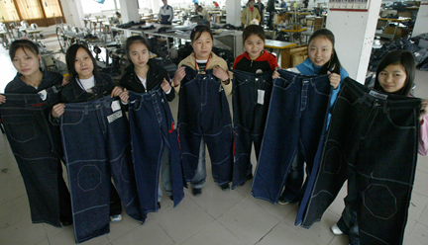
News Feature: The Big Issue Oct 2003
Are those jeans worth the hurt and pain that these workers face? Levelled writing assessment
advert
cartoon

Slide 3
Sweatshop shame in focus – Tarrant factory in Mexico
Use the information to complete your fact file
Information about Oscar:
Information about Florescel:
Socio-economic problems:
Environmental problems:

Slide 4
Create a charity (including name, logo and poster)
Produce a charity campaign to raise awareness of the problems that people face to produce cheap clothes for shops like Primark and Tesco.

