Slide 1
Weather and Climate

Slide 2
Aim: To know the equipment we can use to measure the weather?

Slide 3
Weather is...
the day to day condition of the air around us over a short period of time.

Slide 4
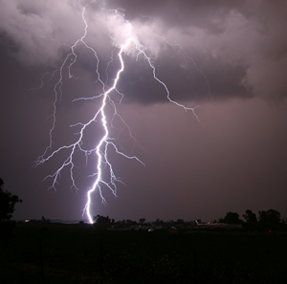
Basic Definitions
Weather: The current state of the atmosphere in regards to temperature, cloud cover, wind speed and direction, precipitation, humidity, etc.
Climate: The average (general/normal) weather conditions that a region or country experiences. Climate is averaged over a number of years.

Slide 5
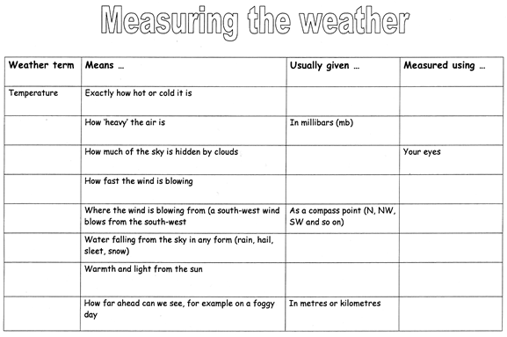
Use your table to record the following information.

Slide 6
Temperature
Temperature means how hot or cold it is
It is usually measured with a thermometer in degrees centigrade(ºC)

Slide 7
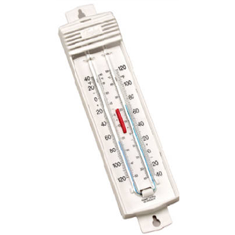
Max./Min. Thermometer
A maximum and minimum thermometer records the maximum temperature of the day and the minimum temperature of the day (diurnal range).
A maximum/minimum thermometer contains a mixture of mercury and alcohol.
The mercury sits in the u-bend of the thermometer.
The bulb at the top of the tube reading the minimum temperature contains alcohol and the bulb at the top of the tube reading the maximum temperature contains a vacuum.
At any given time both thermometers should record the same temperature. However, during the day they would have recorded the maximum and minimum temperature - a steel marker should indicate these temperatures.

Slide 8
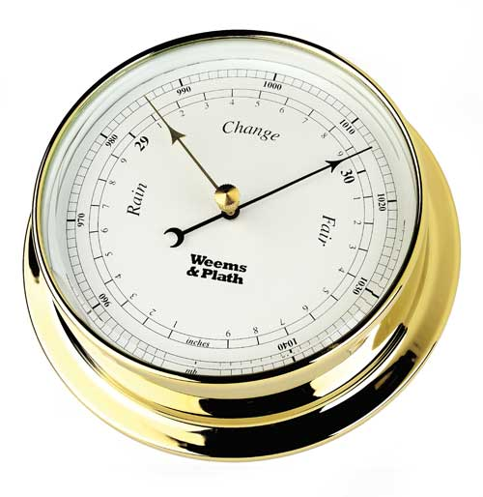
Barometer
Barometers are used to measure air pressure.
Air pressure is normally measured in millibars.
Barometers are normally kept inside stevenson screens to keep them safe.
A barometer has a movable needle (pointer). The pointer can be moved to the current reading so that you can then make a comparison with the reading from the following day.

Slide 9
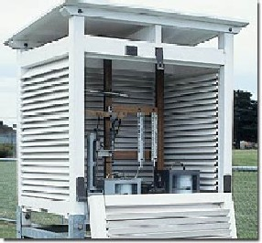
Stevenson Screen
A Stevenson screen is basically a white wooden box.
The box is designed to contain some weather equipment like thermometers and barometers.
The Stevenson screen is white to reflect sunlight and has slats to allow air to circulate easily.
The Stevenson should be placed above the ground and away from the buildings.
The idea is for the weather instruments to take accurate readings of the air, rather than direct sunlight or heat from the ground or from buildings.

Slide 10
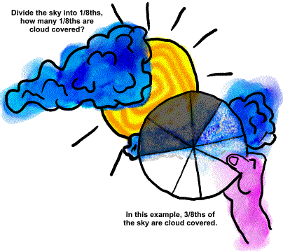
Cloud Cover
Cloud Cover tells us how much of the sky is covered by clouds.
It is measured by estimating the amount of cloud cover in eighths.
oktas is the measurement of cloud cover.

Slide 11
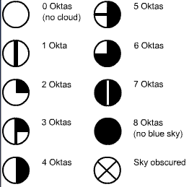
Cloud Cover

Slide 12
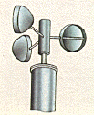
Wind Speed
Wind speed is how fast the wind is blowing.
An anemometer measures wind speed in mph.
The most common type looks like a toy windmill. Three cups are fixed to a central shaft and the stronger the wind blows the faster they spin around. The wind speed is shown on a dial, just like a car's speedometer

Slide 13
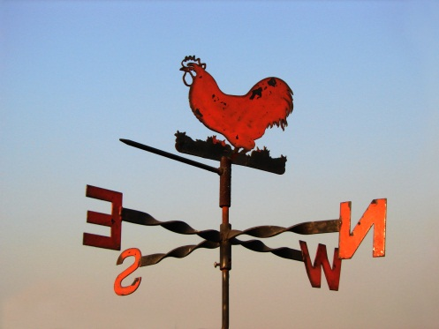
Wind Vane
Wind vanes are used to check the direction of the wind.
Compass points are used to give wind direction.
Wind is measured in the direction that the wind is coming from.
Wind vanes are often placed on top of buildings so that they are fully exposed to the wind.
When using a wind vane you need to use a compass to make sure that it is properly aligned.

Slide 14
Rainfall/Precipitation
Precipitation is water falling from the sky.
Rain gauge: measures the amount of rainfall in mm. Not only does a rain gauge measure rainfall, but also all other forms of precipitation.

Slide 15
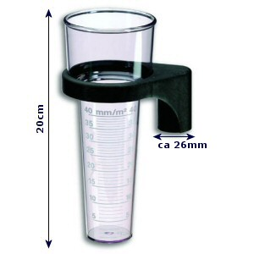
Rain Gauge
Rain gauges are used to measure rainfall.
Rainfall is normally measured in millimetres.
Rain gauges should be placed on grass, because if they are placed on concrete, extra water can splash in.
Rain gauges should also be checked regularly to avoid evaporation.

Slide 16
Sunshine
Sunshine is light and warmth from the sun.
A Campbell Stokes Recorder measures sunshine.
This type of recorder is made up of a glass ball which concentrates sunshine on to a thick piece of card. The sunshine then burns a mark on the card which shows the number of hours of sunshine in the day.

Slide 17
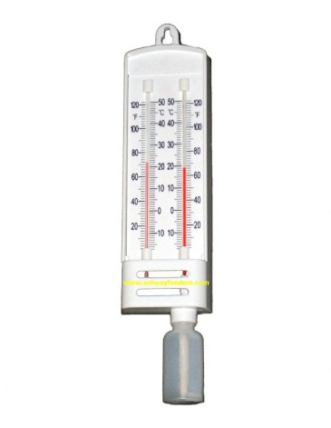
Wet/Dry Bulb Thermometer
A hygrometer measures the humidity of the air. Humidity is the amount of moisture (water vapour) in the air.
A hygrometer has two thermometers, a dry one and a wet.
Humidity is measured by using a table that looks at the difference between the wet bulb and the dry bulb.
A hygrometer can also be used to find dew point.
There is a difference between the dry and wet bulb thermometers because of latent heat created during the process of evaporation.

Slide 18
Visibility
Visibility is how far ahead we can see.
It is measured using a tape measure or trundle wheel, in metres or kilometres.

Slide 19
