Slide 1
Water World
To know where water is found and what it comprises of.
To be able to label and explain the hydrological cycle.
To understand the links between the hydrosphere, lithosphere and biosphere.

Slide 2
What is the definition of water?
A colourless, tasteless, transparent, odourless liquid that forms the seas, rivers and rain.

Slide 3
Where is water found?

Slide 4
Task
You need to draw 3 bar graphs showing the compounds of water – similar to the one we have just been looking at.
Bar 1 | Bar 2 (of fresh water) | Bar 3 (of surface water)
Fresh Water – 3% | Ice – 79% | Lakes – 52%
Salt Water – 97% | Underground – 20% | Soil – 38%
 | Surface 1% | Atmosphere – 8%
 |  | Rivers – 1%

Slide 5
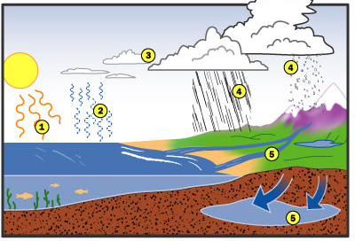
The Water Cycle

Slide 6
TASK
Each of you has half of a more difficult diagram showing the
hydrological cycle. Sit back
to back with a partner (DO
NOT LET THEM SEE YOUR
DIAGRAM). Try and explain
your diagram to them –
they must draw it and label
it from your explanation on
their whiteboards.
Swap and try to draw your other half.

Slide 7
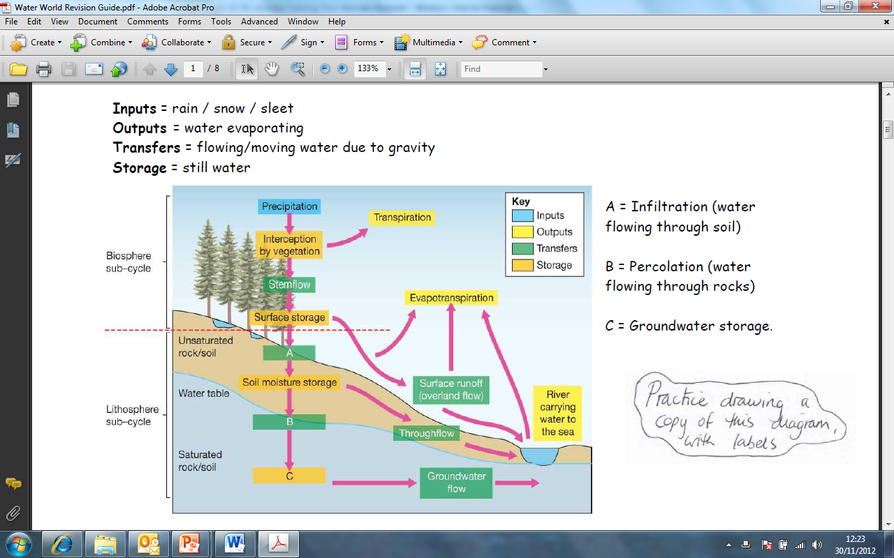
The Water Cycle

Slide 8
TASK
Condensation
When water changes from a liquid to vapour.
Evaporation
When cooling vapour turns into a liquid.
Surface runoff
Water that falls on the earth’s surface (rain, snow).
Precipitation
Movement of water over the land (river).
Groundwater
Plants giving off water vapour from their leaves.
Transpiration
Water that has sunk through the ground to the rocks below.
Match up the definitions with the statements – write them neatly into your book
Draw the water cycle diagram and add the labels above
Peer mark

Slide 9
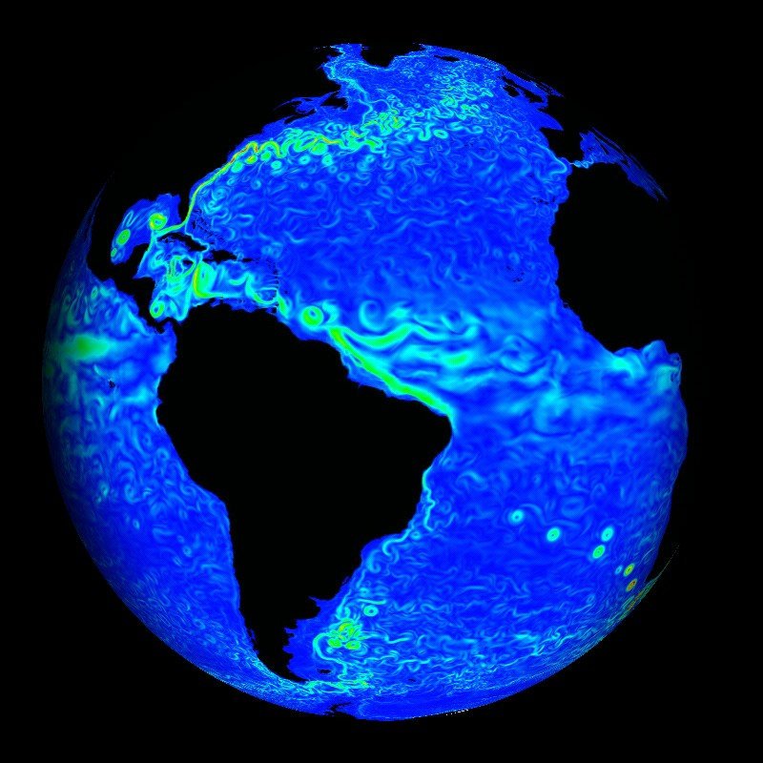
Hydrosphere relationships
The Earth’s biosphere captures and stores water. Vegetation leaves store water until the water evaporates – therefore it is a regulated flow. As a result forests are an excellent flood defence as it intercepts water which might get to the river too quickly in a flash flood.
The lithosphere also acts as a water store. Soils and rocks hold water for a period of time – this is dependant on how permeable the surface is.

Slide 10
TASK
Add the links between the hydrosphere, atmosphere, biosphere and lithosphere by matching them to the correct part of the diagram.
Exam practice – Bullet point the answers to these questions.
Describe the fastest route that rain falling over land can take to reach the ocean. (4)
Explain why tree planting slows water movement through the hydrological cycle. (4)

Slide 11
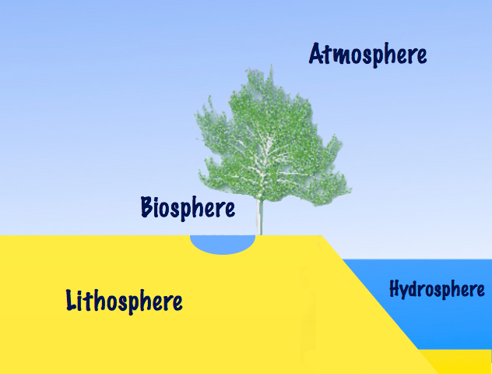

Slide 12
Ten days of rain is stored in the clouds above the each.
Precipitation falls onto unvegetated ground
Evaporation off water surfaces
Rain and snow falls off leaves
Plant root uptake
Water is caught and held on leaves when it rains
Water evaporates off leaves
Water drops off leaves to reach ground
Water flows off land
Rivers, streams, lakes and oceans
Water evaporates off ground surface
Water is stored underground in aquifers and on land as ice

Slide 13
Ten days of rain is stored in the clouds above the each.
Precipitation falls onto unvegetated ground
Evaporation off water surfaces
Rain and snow falls off leaves
Plant root uptake
Water is caught and held on leaves when it rains
Water evaporates off leaves
Water flows off land
Water drops off leaves to reach ground
Rivers, streams, lakes and oceans
Water evaporates off ground surface
Water is stored underground in aquifers and on land as ice

