Slide 1
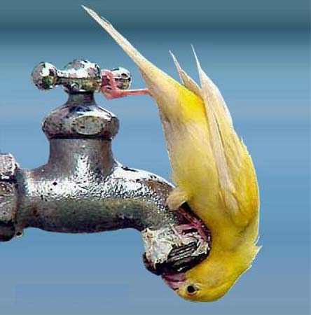
Living with water shortages
To know why water availability and quality is declining
To be able to explain the difference between water scarcity and water stress
To understand how changes in water supplies can impact on people and ecosystems.

Slide 2
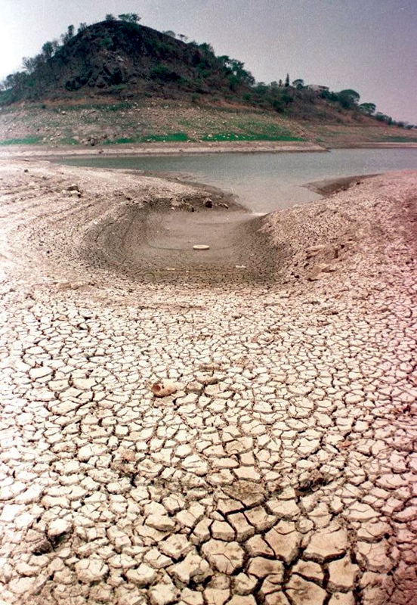
Water availability and quality…
The world is currently facing a freshwater crisis. Demand is soaring as population increases, and supplies are becoming increasingly unpredictable. Many economists predict that in the future we may experience water wars, especially in the Middle East.
TASK
Make notes on demands and pressure in the Sonoran Desert.
http://www.bbc.co.uk/learningzone/clips/the-sonoran-desert-over-extraction-of-water/3099.html

Slide 3
Water availability and quality…
The increasing use of water for agriculture is having a major impact on the amount of water remaining for other uses. A rapidly rising global population and constant economic development, especially in countries such as China and India, means that industrial and domestic demand has also grown. More water is needed for manufacturing industries, and rising living standards means people use more water at home for showers, washing machines and so on.

Slide 4
TASK - Continuum
Most damaging
Draw an arrow in your book like the one opposite – read the information on water decline. Highlight the keywords then place them on the continuum depending on which one you think is the most damaging.
A*-B: 2 paragraphs explaining your choices.
B-D: 1 paragraph explaining your choices.
Least damaging

Slide 5
Energy: Consumption has increased with population growth and industrial development. Developing countries have vast, untapped HEP resources. But storing water in reservoirs increases the amount of water lost through evaporation and the risks of water related disease.
Tourism: There has been a massive increase in tourism in developing countries. But tourism developments (including hotels and golf courses) take a huge share of a region’s water resources.
Climate Change: Global warming and climate change affect rainfall, evaporation and water availability. Places already suffering from water shortages are likely to experience lower rainfall. The dry areas of developing countries will be hardest hit.
Population Growth: World population grew from 2.5 to 6.2 billion between 1950 and 2000. Water supplies per person decreased by one third from 1970-1990. Seven billion people are likely to have insufficient water by 2050.
Agricultural Demand: Rising population increases the demand for food and the water needed for farming. The area of irrigated land doubled in the twentieth century. Future water shortages could threaten food supplies in many developing countries.
Urbanisation: By 2050 nearly 60% of the world’s population will live in urban areas. The water supply and sanitation infrastructure won’t be able to cope. This will put pressure on governments, especially in LEDCs.
Industrial Development: The growth of manufacturing industry depends on water supplies. Industries such as steel and paper are major water users. They also use rivers and seas to get rid of waste.

Slide 6
Energy: Consumption has increased with population growth and industrial development. Developing countries have vast, untapped HEP resources. But storing water in reservoirs increases the amount of water lost through evaporation and the risks of water related disease.
Tourism: There has been a massive increase in tourism in developing countries. But tourism developments (including hotels and golf courses) take a huge share of a region’s water resources.
Climate Change: Global warming and climate change affect rainfall, evaporation and water availability. Places already suffering from water shortages are likely to experience lower rainfall. The dry areas of developing countries will be hardest hit.
Population Growth: World population grew from 2.5 to 6.2 billion between 1950 and 2000. Water supplies per person decreased by one third from 1970-1990. Seven billion people are likely to have insufficient water by 2050.
Agricultural Demand: Rising population increases the demand for food and the water needed for farming. The area of irrigated land doubled in the twentieth century. Future water shortages could threaten food supplies in many developing countries.
Urbanisation: By 2050 nearly 60% of the world’s population will live in urban areas. The water supply and sanitation infrastructure won’t be able to cope. This will put pressure on governments, especially in LEDCs.
Industrial Development: The growth of manufacturing industry depends on water supplies. Industries such as steel and paper are major water users. They also use rivers and seas to get rid of waste.

Slide 7
Water Scarcity & Stress
Water Stress
Many rivers, lakes and groundwater supplies are drying up from overuse. Water stress takes the form of shortages of water supplies, especially for irrigation.
Water Scarcity
A lack of water due to two reasons…
Economic Scarcity
When people simply cannot afford water, even if it readily available.
Physical Scarcity
Shortage occur when demand exceeds supply.

Slide 8
TASK
Placed around the room are information sheets about the impacts of water stress and scarcity. Annotate your world map with the key information and detail – these will be useful case studies for your exam.
Extension – complete Questions 1-3 Page 63.

Slide 9
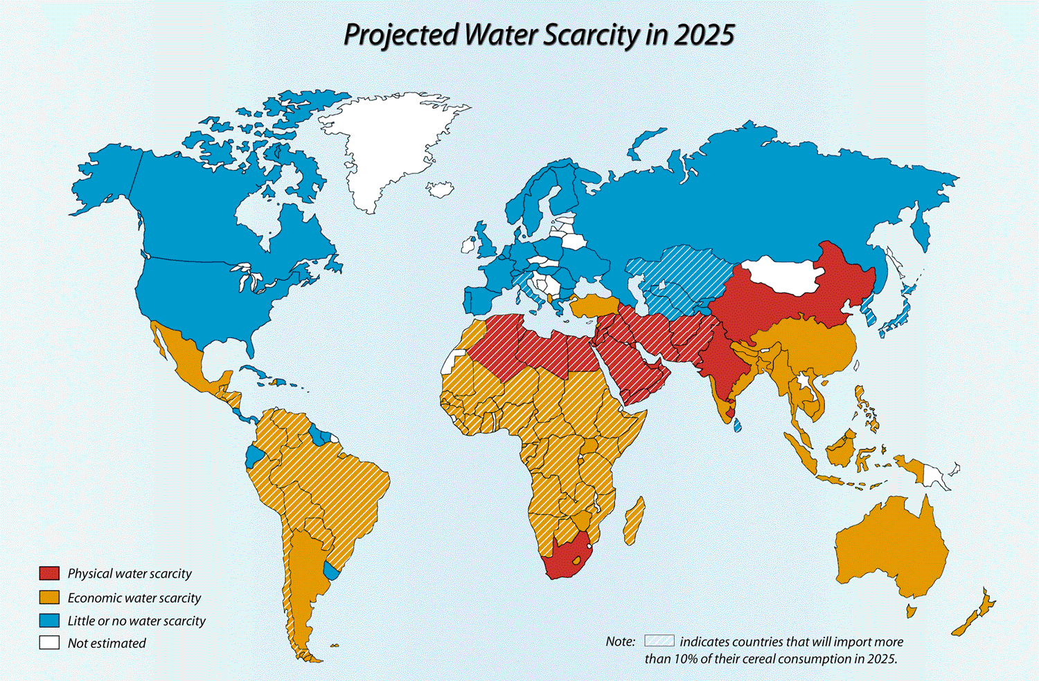
Colour in your map with this information

