Slide 1
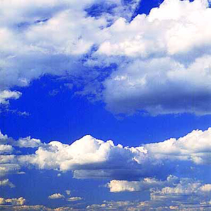
Types of Clouds

Slide 2
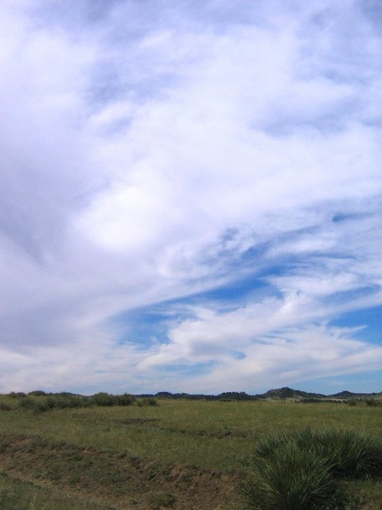
How is rain made?
The sun has been warming the ground all morning.
The ground warms the air and the temperature rises
The warm air rises.
As the warm air rises, it cools and the water vapour (tiny droplets of water) in the air condenses to form clouds.
The water droplets join together with other water droplets and get heavy. They fall as rain.

Slide 3
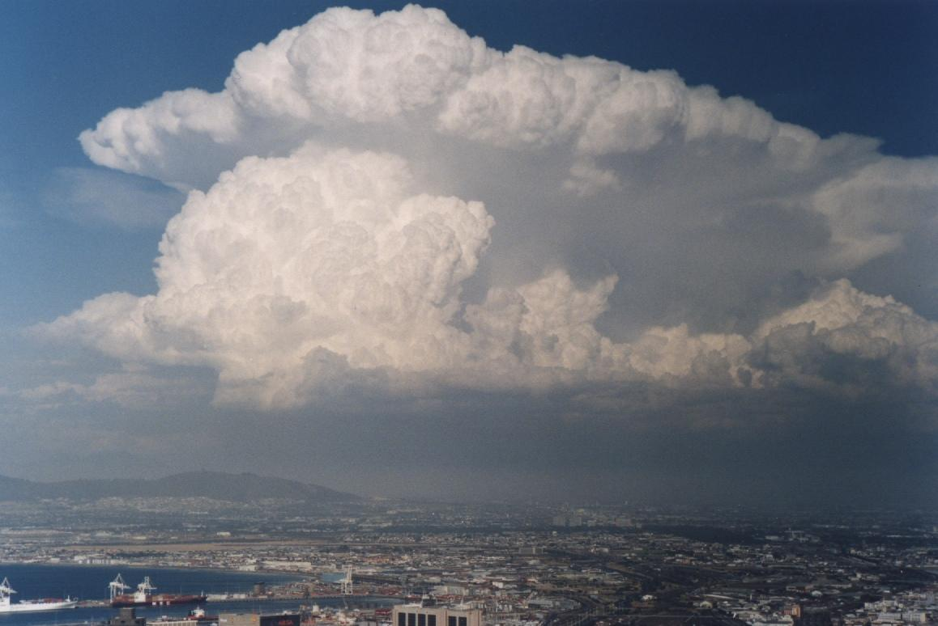
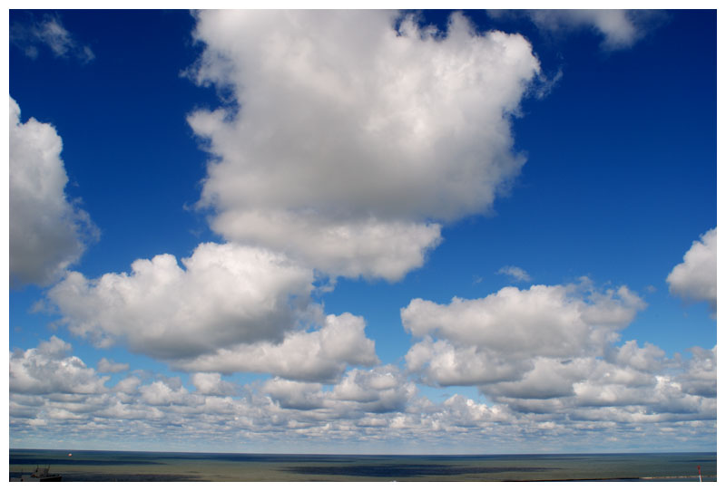
Types of clouds
Cumulus clouds
Cumulus clouds are
big and fluffy.
They form low in the
sky.They bring short,
heavy showers of rain.

Slide 4
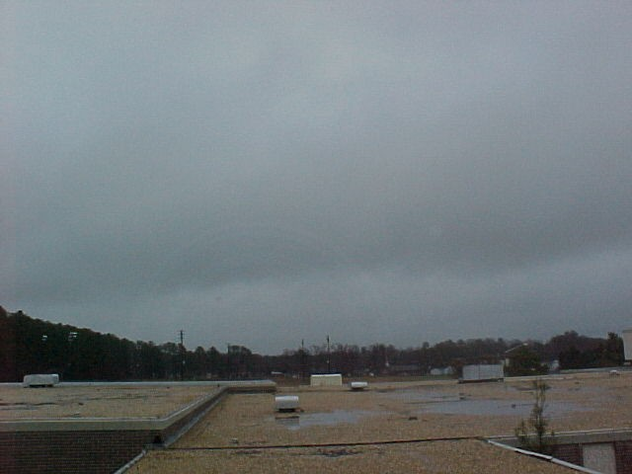
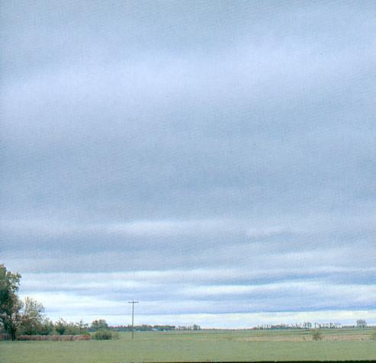
Stratus clouds
Stratus clouds are big blankets of dull cloud.
They hang low in the sky and cover the whole
sky.They give a light drizzle but not heavy
showers.

Slide 5
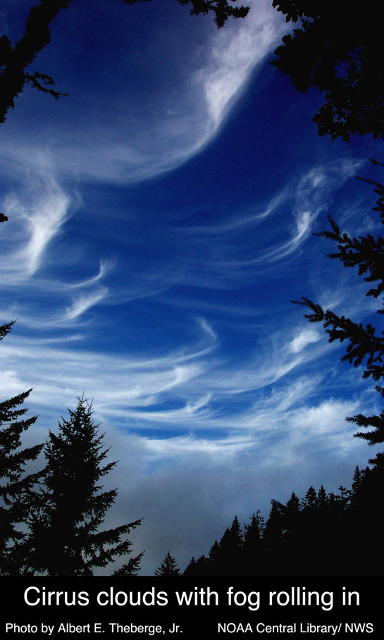
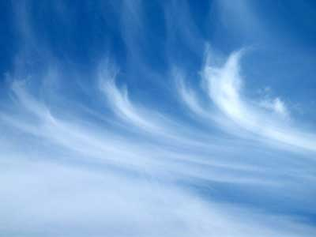
Cirrus Clouds
Cirrus clouds are thin
And wispy and are very
high up.(More than 6km
up). It is freezing up
there so they are made
of ice crystals. They
can mean that bad
weather is on the way.

Slide 6
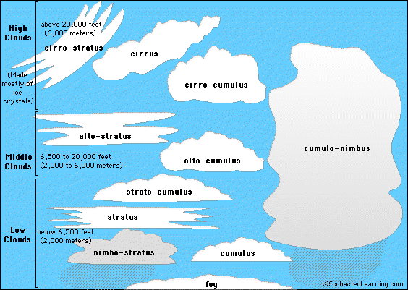

Slide 7
Clouds
Clouds are a collection of water droplets or ice crystals.
The warmer the air temperature, the more water vapour (gas) that the air can hold.
However, when the air starts to cool, water vapour starts to condense as long as it has condensation nuclei to condense around.

Slide 8
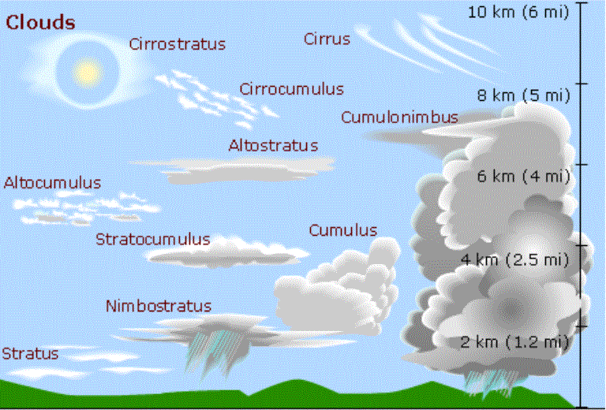
Clouds

Slide 9
Describe 2 features of a cumulus cloud. (2 marks) One feature is ………… A second feature is that……………
Exam practise

Slide 10
Cumulus
Fairly low clouds with bottom between 600m and 1200m
Look like lumps of cotton wool
Can produce light rain
Individual clouds have a short life cycle

Slide 11
Describe 2 features of a cumulonimbus cloud. (2 marks)
Exam practise

Slide 12
Cumulonimbus
Large clouds up to 10km high and across.
They resemble giant cauliflower.
Produce rain, thunder and lightening
Usually found in spring and summer

Slide 13
Describe 2 features of a Stratus cloud. (2 marks)
Exam practise

Slide 14
Stratus
Low level – below 2000m and sometimes reaching ground.
Usually grey and colour and move fast.
Can produce light rain and snow.

Slide 15
Describe 2 features of a cirrus cloud. (2 marks)
Exam practise

Slide 16
Cirrus
Found high in the atmosphere – usually over 5,500 metres
Common throughout the world
Thin and wispy in appearance
Move fairly quickly

