Slide 1
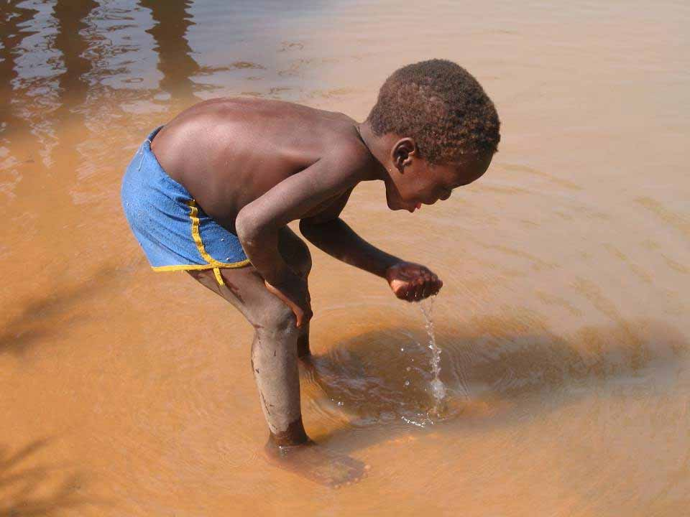
Sustainable water supplies for developing countries
To Know the advantages and disadvantages of water usage in the Colorado River
To be able to explain how water was used sustainably at the Olympics.
To Understand how water can be used more sustainably on a small scale

Slide 2
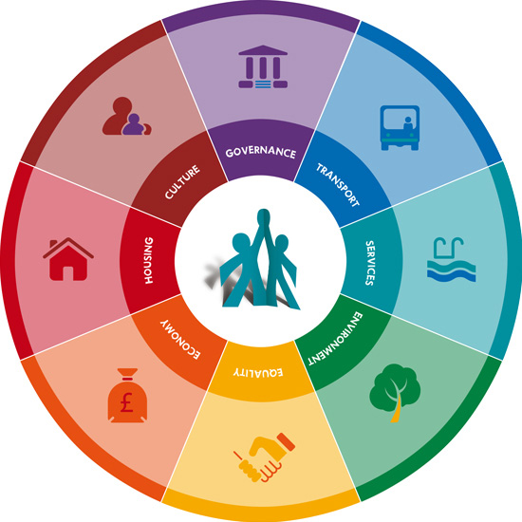
Colorado River
Using the textbook you should complete an Egan’s Wheel Case Study about water usage in the Colorado River. You may not be able to find something for every section but think very carefully.

Slide 3
Sydney Olympics
Developed to host the Olympic Games in 2000.
640 hectare park – commercial, residential, recreational, leisure and public uses.
Designed to make use of the facilities and infrastructure left behind after the Olympics.

Slide 4
The Water Reclamation and Management Scheme
Water management & reclamation
A water reclamation plant was set up to remove water from sewage at a rate of up to 3 million litres per day.
A brickpit – a water reservoir holding up to 300 million litres.
A water treatment plant to filter and disinfect water from the water reclamation plant and storage reservoirs at a rate of up to 7.5 million litres per day.
A separate, dedicated supply system to pipe water from the treatment plant through Sydney Olympic Park and Newington.
Newington – a new suburb which originally housed athletes.

Slide 5
The scheme aimed to reduce pressure on the demand for drinking water supply in the Sydney area by providing recycled water for other uses.

Slide 8
Small Scale Projects
NGOs such as Water Aid often develop small scale sustainable solutions to local problems in developing countries. Local communities are involved in projects to develop safe and reliable water supplies.
Local people are trained to take responsibility for the development and management of the scheme. The aim is that when the NGO finishes its work then people can continue with the project and replicate them elsewhere.
http://www.youtube.com/watch?v=ebOkY4XeZqM

Slide 9
