Slide 1
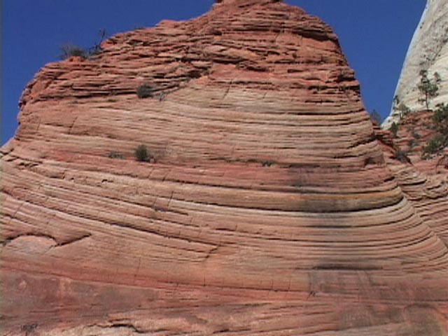
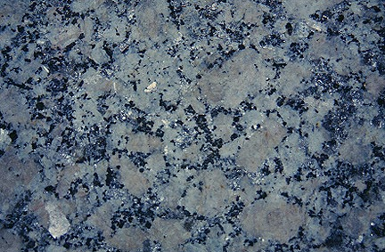
As You Come In!
There are three types of rocks.
What are they? What makes them different from each other?

Slide 2
Revising Rocks
To consolidate everything that we now know about rocks and rock formation!

Slide 3
Sedimentary, metamorphic, or igneous??
Sedimentary = Left of the room
Metamorphic = Centre of the room
Igneous = Right of the room

Slide 4
Sedimentary, metamorphic, or igneous??
Granite
Igneous

Slide 5
Sedimentary, metamorphic, or igneous??
Limestone
Sedimentary

Slide 6
Sedimentary, metamorphic, or igneous??
Porous
Sedimentary

Slide 7
Sedimentary, metamorphic, or igneous??
Pumice
Igneous

Slide 8
Sedimentary, metamorphic, or igneous??
Marble
Metamorphic

Slide 9
Sedimentary, metamorphic, or igneous??
Chalk
Sedimentary

Slide 10
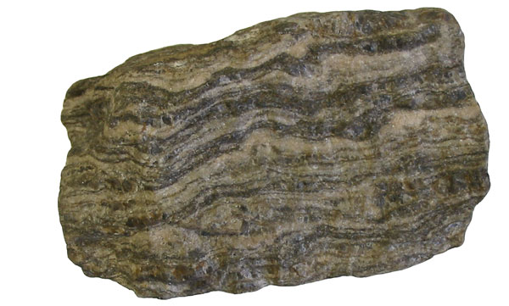
Sedimentary, metamorphic, or igneous??
Gneiss
Metamorphic

Slide 11
Sedimentary, metamorphic, or igneous??
Slate
Metamorphic

Slide 12
Sedimentary, metamorphic, or igneous??
Sandstone
Sedimentary

Slide 13
Sedimentary, metamorphic, or igneous??
Crystals with no pattern
Igneous

Slide 14
True or False?
Use the miniature whiteboards to answer the questions as we go along.
If you don’t know then guess!

Slide 15
True or False?
True!
Igneous rocks are formed when magma or lava cools and solidifies?

Slide 16
True or False?
True!
Pressure causes minerals to come out of solution and cement sediments together ?

Slide 17
True or False?
True!
Metamorphic rock is formed when high temp and pressure changes a rock’s structure?

Slide 18
True or False?
False!
You can find fossils of dead animals or plants in igneous rock?

Slide 19
True or False?
True!
The rock cycle describes the continuous process of rock breakdown and formation?

Slide 20
True or False?
False!
Basalt and granite are good examples of sedimentary rocks?

Slide 21
True or False?
True!
Metamorphic slate used on roofs is formed from sedimentary shale?

Slide 22
True or False?
True!
Sedimentary limestone is formed from the bones and shells of dead animals?

Slide 23
True or False?
True!
At the end of a river, close to the sea, rocks are smoother and smaller because of erosion?

Slide 24
True or False?
False!
Slow cooling magma or lava forms igneous rock with small crystals?

