Slide 1
Language for learning:

Slide 2
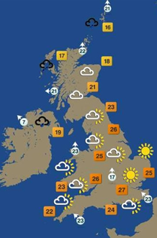
Weather Maps
Weather maps can display a whole variety of data. The map below is fairly simple and simply shows:
• Temperature
• Wind speed
• Wind direction
• Likely weather e.g sun, rain cloud
Other weather maps can be more detailed and show information like:
• Air pressure (using isolines to show areas of the same pressure (millibars))
• Cloud cover (oktas)
• Humidity (%)

Slide 3
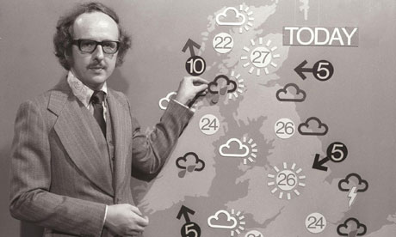
BBC One Christmas Day weather with Michael Fish - 1984 - YouTube
dragdropmap/europeweathermap
dragdropmap/ukweathermap
Aim: to present the weather predictions for the day using the information from your homework

Slide 4
GROUP 1 | GROUP 2 | GROUP 3 | GROUP 4 | GROUP 5 | GROUP 6
WERE A NUMBER OF PLACES/REGIONS MENTIONED? GOOD/SATISFACTORY/ UNSATISFACTORY | WERE A NUMBER OF PLACES/REGIONS MENTIONED GOOD/SATISFACTORY/ UNSATISFACTORY | WERE A NUMBER OF PLACES/REGIONS MENTIONED GOOD/SATISFACTORY/ UNSATISFACTORY | WERE A NUMBER OF PLACES/REGIONS MENTIONED GOOD/SATISFACTORY/ UNSATISFACTORY | WERE A NUMBER OF PLACES/REGIONS MENTIONED GOOD/SATISFACTORY/ UNSATISFACTORY | WERE A NUMBER OF PLACES/REGIONS MENTIONED GOOD/SATISFACTORY/ UNSATISFACTORY
All members took part in presentation? YES/NO | All members took part in presentation? YES/NO | All members took part in presentation? YES/NO | All members took part in presentation? YES/NO | All members took part in presentation? YES/NO | All members took part in presentation? YES/NO
WERE THERE ENOUGH GEOGRPHICAL WORDS? YES/NO/ALMOST | WERE THERE ENOUGH GEOGRPHICAL WORDS? YES/NO/ALMOST | WERE THERE ENOUGH GEOGRPHICAL WORDS? YES/NO/ALMOST | WERE THERE ENOUGH GEOGRPHICAL WORDS? YES/NO/ALMOST | WERE THERE ENOUGH GEOGRPHICAL WORDS? YES/NO/ALMOST | WERE THERE ENOUGH GEOGRPHICAL WORDS? YES/NO/ALMOST
WAS THE FORECAST EASY TO UNDERSTAND? Y/N | WAS THE FORECAST EASY TO UNDERSTAND? Y/N | WAS THE FORECAST EASY TO UNDERSTAND? Y/N | WAS THE FORECAST EASY TO UNDERSTAND? Y/N | WAS THE FORECAST EASY TO UNDERSTAND? Y/N | WAS THE FORECAST EASY TO UNDERSTAND? Y/N
WAS THE FORECAST GEOGRAPHICALLY ACCURATE? Y/N | WAS THE FORECAST GEOGRAPHICALLY ACCURATE? Y/N | WAS THE FORECAST GEOGRAPHICALLY ACCURATE? Y/N | WAS THE FORECAST GEOGRAPHICALLY ACCURATE? Y/N | WAS THE FORECAST GEOGRAPHICALLY ACCURATE? Y/N | WAS THE FORECAST GEOGRAPHICALLY ACCURATE? Y/N
MARK /10 | MARK /10 | MARK /10 | MARK /10 | MARK /10 | MARK /10
Star pupil? Why? | Star pupil? Why? | Star pupil? Why? | Star pupil? Why? | Star pupil? Why? | Star pupil? Why?

