Slide 1
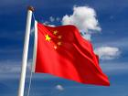
Investigating Hydro Electric Power
LO: To understand some of the benefits of Hydro Electric Power.
To assess the impact of the Three Gorges Dam on both people and the environment.

Slide 2
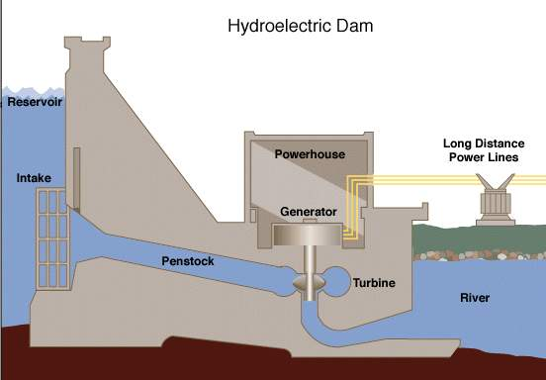
Starter: Take the quiz to find out how Hydro Electric Power works.
http://www.darvill.clara.net/altenerg/hydroquiz.htm

Slide 3
Three Gorges Dam Watch the clips carefully and complete the casestudy sheet.
http://clipbank/espresso/clipbank/servlet/link?macro=setresource&template=vid&databaseType=cms&resourceID=909
http://clipbank/espresso/clipbank/servlet/link?macro=setresource&template=vid&databaseType=cms&resourceID=907
http://clipbank/espresso/clipbank/servlet/link?macro=setresource&template=vid&databaseType=cms&resourceID=910
http://clipbank/espresso/clipbank/servlet/link?macro=setresource&template=vid&databaseType=cms&resourceID=911
http://clipbank/espresso/clipbank/servlet/link?macro=setresource&template=vid&databaseType=cms&resourceID=914

Slide 4
http://clipbank/espresso/clipbank/servlet/link?macro=setresource&template=vid&databaseType=cms&resourceID=912
http://clipbank/espresso/clipbank/servlet/link?macro=setresource&template=vid&databaseType=cms&resourceID=913
http://clipbank/espresso/clipbank/servlet/link?macro=setresource&template=vid&databaseType=cms&resourceID=915

Slide 5
Plenary: Inside – Out….
How does Hydro electric power generate electricity?
What is the capital of China?
In which continent is China located?
Which countries have a border with China?
What is ‘hello’ in Chinese?
On what river is the Three Gorges Dam?
Why did the Chinese build the Three Gorges Dam?
What was the impact on the natural environment?
What benefits does the Three Gorges Dam provide for the Chinese economy?
What impact has the Three Gorges Dam has on the people?
Three Gorges Dam – Success or Failure?

