Slide 1
Global Warming
Lesson one
Knowledge objectives –
To know and understand what is meant by the term global warming
To know and understand what the causes and effects are of global warming
To consider the different opinions people hold about an issue.

Slide 2
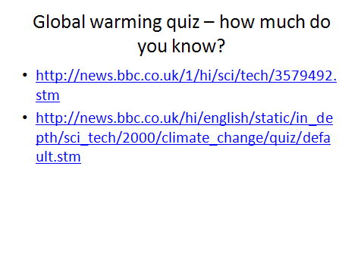

Slide 3
What is global warming?
Global warming is an increase in the global temperature. This is as a result of the greenhouse effect.

Slide 4
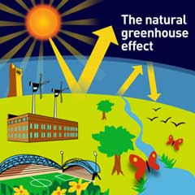
0n Earth, the atmospheric gases allow sunshine to pass through but absorb heat that is radiated (bounced) back from the warmed surface of the Earth

Slide 5
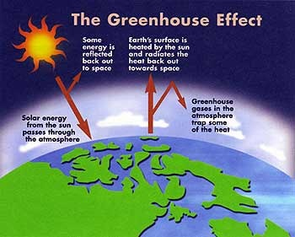

Slide 6
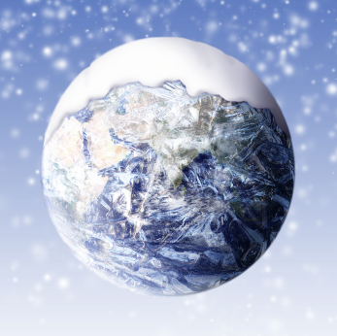
Without greenhouse gases,
heat would escape back into space and Earth’s average temperature would be about 16ºC colder...

Slide 7
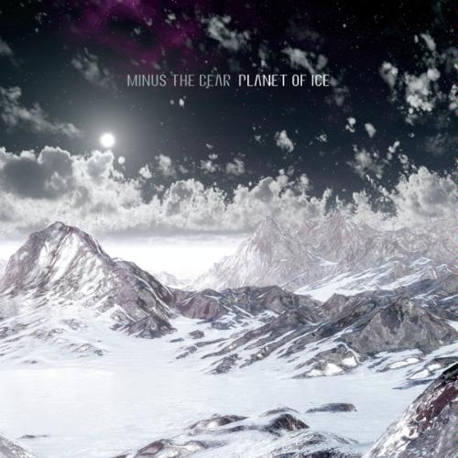
...and the Earth would not be warm enough for humans to live.

Slide 8
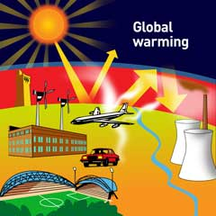
Greenhouse Effect
So what’s the problem?
The increasing amounts of greenhouse gasses released
into the atmosphere due to human activities such as
burning fossil fuels and cutting down forests is trapping
more heat so making the planet warmer than it should
be. This results in Global Warming.
kirklees.gov.uk

Slide 9
Missing words: temperature, fossil fuels, escape, sun, trap, carbon dioxide, freeze, atmosphere
The _________ around the Earth acts like a natural greenhouse. It contains gases particularly ______ _________(C0₂) – that allow the rays from the ____ to pass through and to warm up the Earth’s surface. However, these gases also _____ some of the heat that the Earth gives off so that it is unable to ________. Without it the Earth would either boil or _______. As we burn _________ _______ the amount of carbon dioxide and other gases in the atmosphere increases. More heat is trapped and the ___________ goes up.

Slide 10
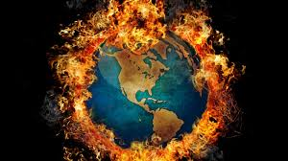
Some people think that Global warming is a myth
Conspiracy theory.
In some ways climate change is nothing new as the atmosphere changes all the time.
The Earth’s atmosphere has evolved over millions of years. So those that were skeptical of climate change being a problem perhaps are only denying it as being human induced.

Slide 11
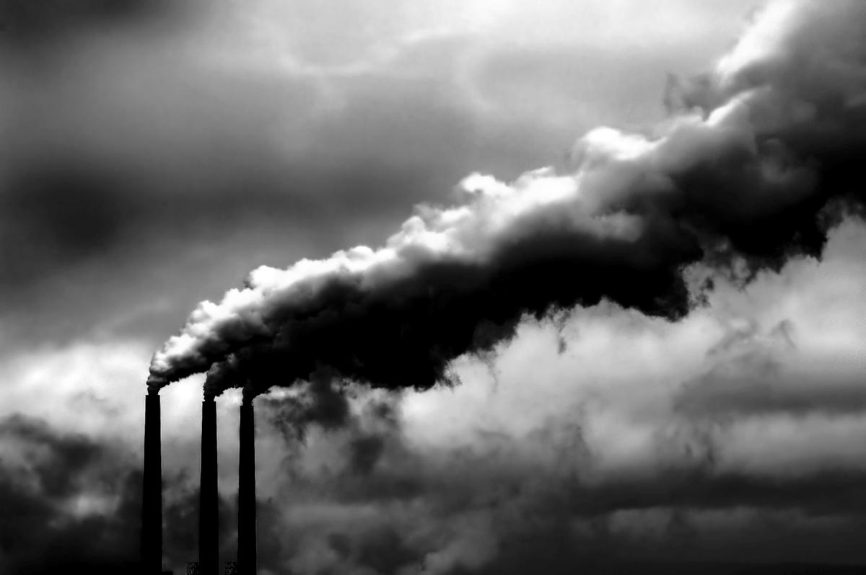
For the first two billion years of the Earth’s life the atmosphere was mostly Carbon dioxide.

Slide 12
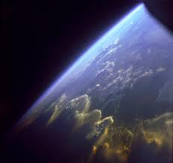
over the next two billion years green plants evolved removing the carbon and producing oxygen.
As the plants died, the carbon that was locked within them was buried under ground – creating our fossil fuels.
In the last billion years the build-up of oxygen created the ozone layer that blocked the harmful rays from the sun and allowed complex organisms like us to develop.

Slide 13
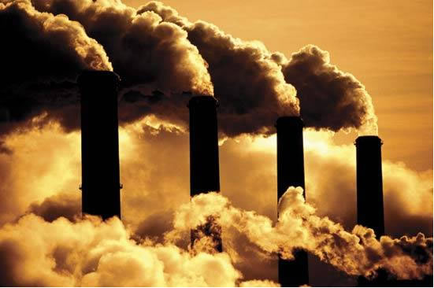
Today there should be virtually no carbon dioxide in our atmosphere, however, with deforestation and the burning of fossil fuels the locked-up carbon is released and the levels of it in our atmosphere are rising.
Watch the first part of hot planet on you tube which proves climate change is real

Slide 14
Global Warming
Lesson Two
Knowledge objectives –
To know and understand what is meant by the term global warming
To know and understand what the causes and effects are of global warming
To consider the different opinions people hold about an issue.

Slide 15
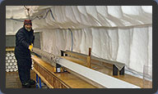
Climate in the past
(As shown on the BBC documentary)
By drilling a hollow tube up to 3,000 metres into the Antarctic ice, scientists can pull out samples of ice known as ice cores that have been buried for thousands of years.
Each layer of an ice core represents a particular point in time. The layers contain pockets of ancient air sealed in tiny bubbles that show different concentrations of gases. By studying the archive of gases in the trapped air, scientists can get a very good idea of what the air quality and climate was like up to 740,000 years ago. They may even find clues about future changes that could affect us all.

Slide 16
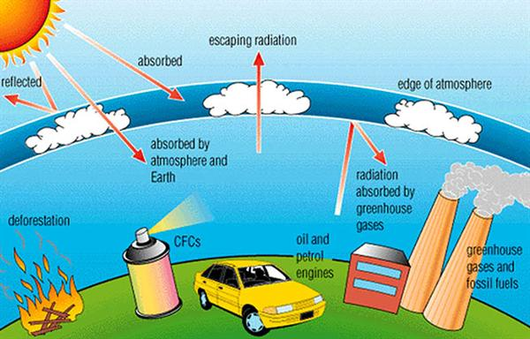
Man has increased the amount of Greenhouse gases going into the atmosphere.
Man-made Climate Change

Slide 17
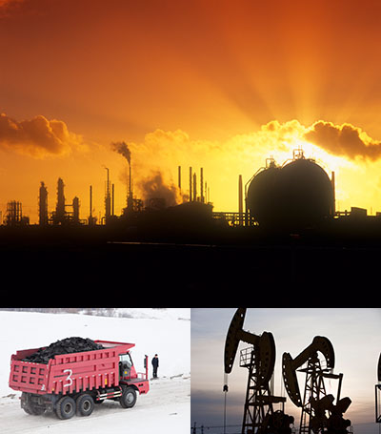
Man-made Sources of
Carbon Dioxide
Burning of solid waste, wood, and fossil fuels (oil, natural gas, and coal).

Slide 18
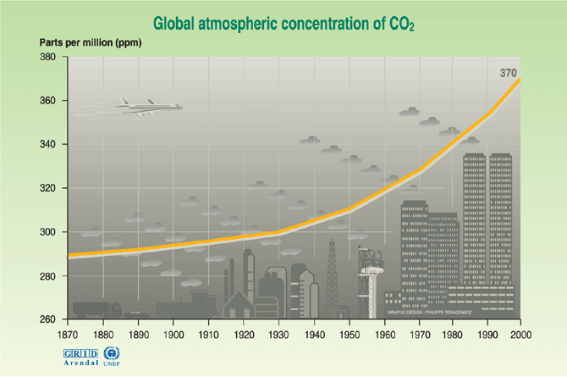
Carbon dioxide concentrations have been on the rise since the industrial revolution

Slide 19
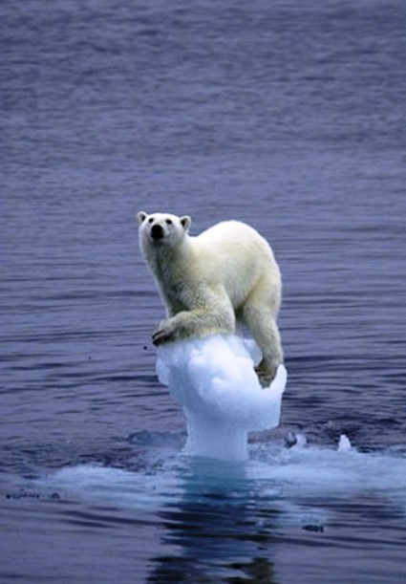
If the greenhouse effect becomes stronger, it could make the Earth warmer than usual.
Can polar bears survive the next 100 years

Slide 20
Potential solutions to Global Warming
Watch the rest of hot planet on you tube
List the ways of combating climate change and global warming they suggest.
Rank your ideas in order of most effective to least effective.
Explain you choice for the top three.

Slide 21
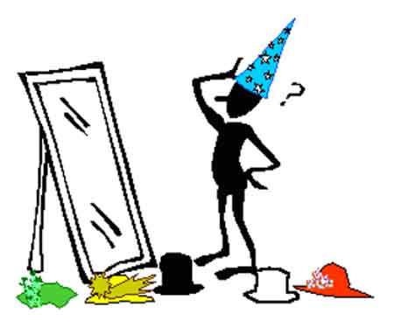
Thinking hats Activity

Slide 22
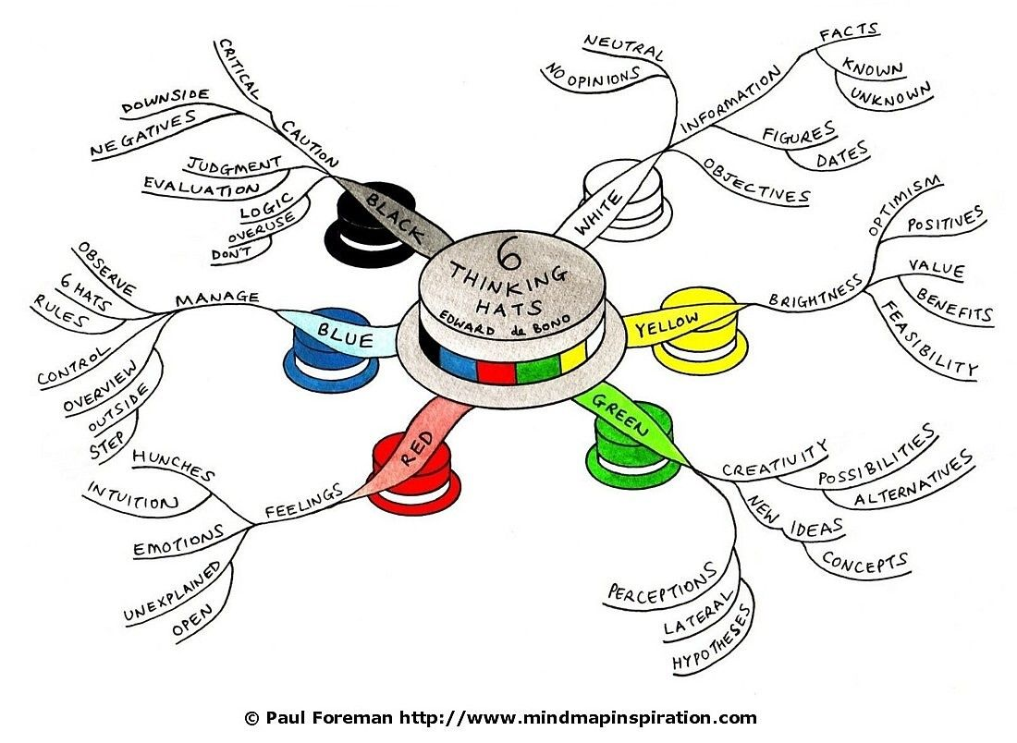
LO2) Understand the problems of Battery Hens

Slide 23
Thinking Hats
Answer the following question in your hat:
“Global warming – myth or reality? Will it cause our world to change forever?“
E.g. RED… you are likely to include emotional the feelings behind the people and animals effected by global warming.
GREEN…. You are likely to think of any alternative solutions to global warming.
You have 10 minutes to fill in your sheet.

Slide 25
Steps to Success
Understand your thinking hat- know what you are looking for.
Write up your answer to the question:
“Global warming – myth or reality? Will it cause our world to change forever?“
You have 10 minutes

Slide 26
Causes, Impacts…..Action.
Mini Research Project/homework:
Find out about the Kyoto Treaty and World Summit agreements since then.
Where? What? Why? When? Who?
Was it successful? Why do countries disagree on what to do?

Slide 27
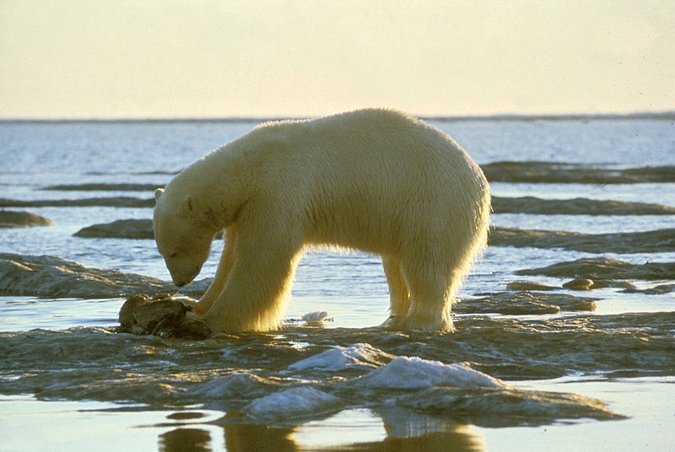
So, what can you do?
Practice your 3 Rs- Reduce, Reuse, and Recycle!
Reduce the amount of machines you use like tvs, computers, and cars (all
of these use fossil fuels)
Reuse and recycle which helps the earth because these actions lessens the demand for new things. It stops trees from being cut down to
make paper, cardboard, and building materials.
Reusing and recycling things stops items from going into garbage dumps. This is good because garbage dumps emit gases that create climate change. As the waste decomposes it releases methane which is 20 times stronger than carbon dioxide.

Slide 28
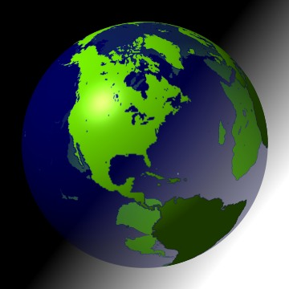
Causes, Impacts, Action
You could add a map of the world and label the most affected places. Canada/Arctic border ice sheets.
In groups design an information leaflet to highlight the causes, impacts and action being taken due to global warming.

