Slide 1
The Akosombo Dam Deal or No Deal
1
5
You are President John Agyekum Kufuor of Ghana. The USA have offered a deal to pay for a dam to be built in your country.
8 boxes will be opened during the course of the game. As each box is opened, you need to decide whether to say deal or no deal!
2
6
3
7
4
8

Slide 2
Ready?...
1
5
2
6
3
7
4
8

Slide 3
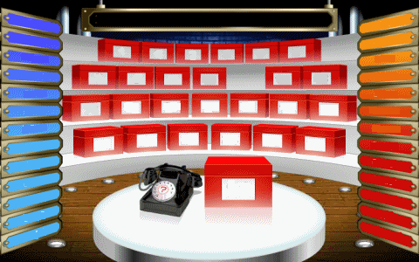
Box 1: The USA will pay for your new dam.

Slide 4
The USA will pay for your new dam.
1
5
2
6
3
7
4
8

Slide 5
Box 2: You will get a reliable supply of cheap electricity and clean water for drinking and growing crops.

Slide 6
The USA will pay for your new dam.
1
5
Reliable supply of cheap electricity and clean water.
2
6
3
7
4
8

Slide 7
Box 3: Thousands of people will be displaced.

Slide 8
The USA will pay for your new dam.
1
5
Reliable supply of cheap electricity and clean water.
2
6
Thousands of people will be displaced.
3
7
4
8

Slide 9
Box 4: The American company Valco make aluminium using Bauxite. They will set up a factory at the side of your dam. Your country sells Bauxite!

Slide 10
The USA will pay for your new dam.
1
5
Reliable supply of cheap electricity and clean water.
2
6
Thousands of people will be displaced.
3
7
Valco will make Aluminium beside your dam.
4
8

Slide 11
Box 5: You will be able to fish in the new lake that is made.

Slide 12
The USA will pay for your new dam.
You will get a new lake to fish in.
1
5
Reliable supply of cheap electricity and clean water.
2
6
Thousands of people will be displaced.
3
7
Valco will make Aluminium beside your dam.
4
8

Slide 13
Box 6: Valco will buy their Bauxite from Jamaica because it’s cheaper than yours!

Slide 14
The USA will pay for your new dam.
You will get a new lake to fish in.
1
5
Reliable supply of cheap electricity and clean water.
Valco will buy their Bauxite from Jamaica not from you.
2
6
Thousands of people will be displaced.
3
7
Valco will make Aluminium beside your dam.
4
8

Slide 15
Box 7: Valco will use so much electricity that there will be none left for your people.

Slide 16
The USA will pay for your new dam.
You will get a new lake to fish in.
1
5
Reliable supply of cheap electricity and clean water.
Valco will buy their Bauxite from Jamaica not from you.
2
6
Valco will use all of the electricity so there is none left for your people.
Thousands of people will be displaced.
3
7
Valco will make Aluminium beside your dam.
4
8

Slide 17
Box 8: The water levels are so low that there is not enough in the lake to irrigate the fields or provide clean drinking water.

Slide 18
The USA will pay for your new dam.
You will get a new lake to fish in.
1
5
Reliable supply of cheap electricity and clean water.
Valco will buy their Bauxite from Jamaica not from you.
2
6
Valco will use all of the electricity so there is none left for your people.
Thousands of people will be displaced.
3
7
Valco will make Aluminium beside your dam.
Water levels in the lake are low so there is not enough water.
4
8

Slide 19
Should Ghana have done the deal? (give reasons)
Write your answer in your exercise book.
EXTENSION: If it was such a bad deal, why did Ghana agree to it?

