Slide 1
Summary
Can you summarise the key topic areas we have learnt about for this unit: Going Global?
Learning Links
Without looking?

Slide 2
Key question / Learning outcomes
EQ7: Global challenges for the future
Pros and cons of globalisation
LEARNING OUTCOME…
Evaluate the positive and negative changes created by globalisation
Explore the moral and social consequences of globalisation
Notes:
2

Slide 3
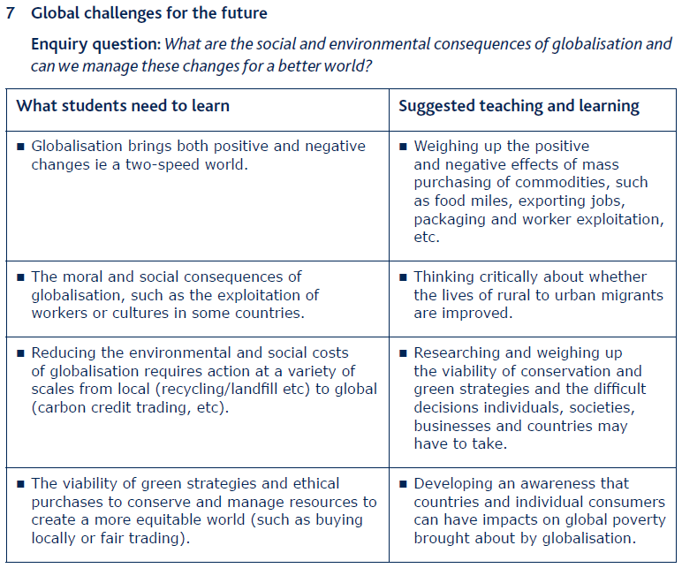

Slide 4
Activity
CONSEQUENCES OF GLOBALISATION
During this lesson we will summarise some of the key processes and consequences of globalisation
On A3 paper you need to map out and annotate these processes and consequences
It is important that you do this in a clear and organised manner because you will have a further task linked to these notes

Slide 5
Globalisation is primarily an economic process, however these inevitably have a series of social and environmental knock-on effects (called externalities)
Key themes;
The globalised world in increasingly urban, on the move and connected
Global shift
TNCs
Creation of NICs
Local + global environmental consequences
Individuals + Government spending
E.g. National policy
Food miles
Multiplier effect / cumulative causation
Bhopal disaster when TNC Union Carbide India Limited pesticide manufacturing plant leaked a mixture of deadly gases killing approx 18,000
Working conditions, pay + rights
Remittances sent home
Rural-urban migration
Risk of capital flight
Rapid urbanisation + it’s consequences
Grapes from Chile (heavily packaged) and prawns from Indonesia – both over 12,000km in refrigerated units
Coffee produced in Africa is sent to India for roasting, then the UK for sale
New information

Slide 6
Globalisation is primarily an economic process, however these inevitably have a series of social and environmental knock-on effects (called externalities)
Key themes;
The globalised world in increasingly urban, on the move and connected
Global shift
Creation of NICs
Local + global environmental consequences
Individuals + Government spending
E.g. National policy
Food miles
Multiplier effect / cumulative causation
Working conditions, pay + rights
Remittances sent home
Rural-urban migration
Risk of capital flight
Rapid urbanisation + it’s consequences
Deindustrialisation in some MEDCs
Shift of economic activities
Post-industrial
*
Two-speed world
Aka the haves + have not's
Spiral of deprivation
Highly educated + paid
Ecological footprint
Climate change
Malthus vs. Boserup
Mass consumption
New information
Notes:
2-speed world – India case study notes from p159-160 in Edexcel AS Geography, Philip Allan by Sue Warns et al.

Slide 7
Key
themes
Globalisation is primarily an economic process, however these inevitably have a series of social and environmental knock-on effects (called externalities)
The globalised world in increasingly urban, on the move and connected
Influential e.g. environmentally - McDonalds
Cultural + linguistic implications
Powerful, economic powerhouses
Homogeneous + westernised
Trans/multi national therefore encouraging diversity?
TNCs
Global shift
Creation of NICs
Local + global environmental consequences
Individuals + Government spending
E.g. National policy
Food miles
Multiplier effect / cumulative causation
Working conditions, pay + rights
Remittances sent home
Rural-urban migration
Deindustrialisation in some MEDCs
Risk of capital flight
Rapid urbanisation + it’s consequences
Shift of economic activities
Post industrial
Two-speed world
Aka the haves + have not's
Spiral of deprivation
Highly educated + paid
Ecological footprint
Climate change
Malthus vs. Boserup
Mass consumption
New information
Notes:
Environmentally – McDonald’s CS e.g. is that at one time were large consumers of illegal soya fuelling deforestation. Greenpeace involvement highlighted issue, McDonalds responded and now buys rainforest alliance coffee.

Slide 8
Activity
CLASSIFYING CONSEQUENCES
Using colours classify and highlight these key points
This will help you to organise and evaluate the consequences of globalisation, which we will apply to an exam question

Slide 9
Reflection
Reflection

Slide 10
